Slide 1
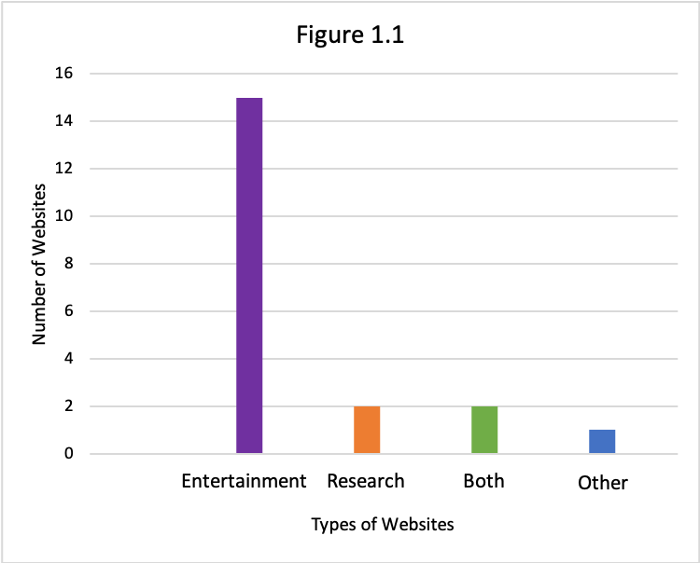
LGBTQ+ Representation in the Media:
The Importance of Blogging in Forming Identity
By: Kathleen Smith
Home Page
More Media!
Methods:
During the course of my research, I investigated 20 different websites that had to do with queer representation within the media, which I define as anything pertaining to entertainment, such as books, TV shows, movies, music, podcasts, etc. In the course of this research, I also conducted an audience analysis, in which I evaluated who the target audience was and what need this site was meeting. I looked mainly for blogging websites, but I also sought out informative/resource based websites. I broke down each site by how successful it appeared, what number listing it was and on what page of Google, and performed my audience analysis, as stated previously. I also consulted various peer-reviewed articles for facts and statistics about LGBTQ+ representation within the media.
Purpose:
In order to counter problematic and un-diverse characterizations of queer individuals within the media, my goal is to create a website that both educates about the need for better representation and to provide entertainment resources for the queer community that show strong LGBTQ+ individuals at the forefront.
About This Site
Research/Why Representation is important
Books
Music
LGBTQ Youtube Channels
TV/Movies
Conclusion:
Based on my research, there is still a need within the media to provide relatable and believable queer characters. The media serves as an important resource for queer individuals, as they can use it as a tool to both cope with trauma and develop his/her/their own identities. While many websites keep educational resources and entertainment resources separate, it would ultimately be more beneficial to the queer community to have both informational and entertainment resources on hand, in the same site. In this way they do not have to dig for resources that can help them fight back against oppression, either by means accepting who they are as a person or by pointing out representation/diversity issues within the media to others.
Reviews/Summaries of film with LGBTQ+
themes
Featured LGBTQ+ Artist music
Podcasts
Reviews/Summaries of Books that represent LGBTQ+ themes
Analysis:
It appears that LGBTQ+ blogs and websites on entertainment topics are fairly popular, and in some cases, appear very successful. There are some websites that provide information on the issue of LGBTQ+ representation within the media, but they do not tend to be included with recommendations for those who are looking to read/view material that contains said representation. It seemed that most of these sites targeted queer viewers themselves but didn’t provide any research to help them contextualize why media identity and representation is important. This is a large oversight, as representation helps queer viewers/readers to understand and come to terms with their own identity. It would therefore be helpful for them to know why this representation is important so that they can articulate this knowledge: both to themselves and to others who are important to them.
Overall, it seemed unpopular among the blogs I looked through to only focus on one topic within the media. Those blogs that only focused on books or movies alone seemed obscure and difficult to find. Combining multiple forms of media should combat this issue. I have planned a detailed website analysis in Figure 1.2 to the left, which shows how I will break down each tab of my website by type of media for ease of use.
Information on me/Why I started blog
Top Favorites List
Radio Channels
Movie Soundracks with Featured artists will link
Playlists
Links to books that are made into films/show
Figure 1.2 above shows the website analysis for my site, which is categorized by media type.
Traditional Research:
My research via articles and journals shows that although there is an increase in queer representation in the media, that representation isn’t always positive. According to an article by Erin Waggoner, the media today tends to box the LGBTQ+ community into tropes that are harmful, such as by killing off the gay and, especially, the lesbian characters, or by portraying bisexual women as people who are only “experimenting,” and therefore not really queer (1878). The recurring killing of gay characters actually re-sparked a backlash on social media called “Bury Your Gays” according to Waggoner on pages 1877-1878, after the television show “The 100” killed off the beloved warrior lesbian character, Lexa (Figure 1.3, middle). This is damaging to this populace, as LGBTQ+ viewers become connected and attached to these characters but are never allowed to see them grow. This can be translated to real lives to impress upon queer viewers/readers that they simply do not matter.
Another article by Shelley Craig, et. all, explores the idea that positive media portrayals help LGBTQ+ youth who are struggling to come to terms with their identities by giving them a role model who has also dealt with discrimination. This creates a diverse form of community in which queer youth feel that they can explore and develop their sense of self (Craig 267). Shelley Craig, et. all, also notes that it has been proven that LGBTQ+ youth are much more likely to self-harm and commit suicide than non-queer youth, which is likely due to the increased discrimination, bullying, and harassment (Craig 255). Queer youth, in many cases, do not have a better understanding of how to deal with their pain than through these negative coping strategies. Positive media influences give LGBTQ+ individuals characters that they can relate to, but more importantly, characters that survive and heal from their own traumas, which sometimes spark from and around their identities. The knowledge that others suffer through similar issues and can still attain their own happiness in their lives gives LGBTQ+ youth something to hold on to. This stands for adults as well, as they withstand their own struggles over their identities. Representation can provide hope and solace to individuals across the board, and is so important in letting people know that it is okay to be who they are and that they are valid.
Website Research:
Only a few websites I looked at were centered on education and information. In Figure 1.1, an overwhelming 15 out of 20 websites, which is 75% of the researched sites, specifically focused only on entertainment. Only 2 of the websites sought to both educate and entertain, therefore reaching out not only to the queer community, but also friends, family, or anyone else looking to understand or learn more about this issue. In most cases with the entertainment websites, media was mainly understood to be almost everything besides books. Media included music, TV, movies, and even radio and YouTube channels. When searching for websites that reviewed books as well as more technological forms of media, I had to specifically search for “lgbtq book blogs” or “lgbtq ya book blogs.” Only one website included books in with movies and television programs. Although the topic of media can extend into literature, it seems that many publications veer away from this avenue, even though there is a void in LGBTQ+ representation within books as well as television. This ignores an entire audience of queer people who prefer reading to watching TV. My audience analysis showed that both the audiences for entertainment based sites and research based sites were interested in the same thing: representation and why it is important. Entertainment sites sought to affirm the identities of viewers/readers and so did research websites, with the main difference being that the research based websites aim was more to defend the importance of representation than to provide access to it.
Figure 1.1 shows that a majority of the researched sites focused mainly on providing entertainment resources. Only two of the sites combined both educational resources and entertainment suggestions.
Figure 1.3, lesbian and bisexual female character that have been killed off in the media. From top to bottom, Willow and Tara from ”Buffy the Vampire Slayer,” Lexa from the “100” and Shaw and Root from “Person of Interest.”
References:
Craig, Shelley L., et al. “Media: A Catalyst for Resilience in Lesbian, Gay, Bisexual, Transgender, and Queer Youth.” Journal of LGBT Youth, vol. 12, no. 3, Jan. 2015, pp. 254–275. EBSCOhost,
search.ebscohost.com/login.aspx?direct=true&db=eric&AN=EJ1067819&site=eds-live.
Fleenor, S.E. SYFY Wire, SYFY, Mar. 2019, www.syfy.com/syfywire/the-5-queerest-episodes-of-buffy-the-vampire-slayer.
Cezkie. Pinterest, Mar. 2019, www.pinterest.com/pin/276338127116157138/?d=t&mt=login.
Cameron, Cate. Variety, Variety, Mar. 2019, variety.com/2016/tv/news/the-100-lexa-dies-alycia-debnam-carey-boycott-fear-the-walking-dead-1201735453/.
Waggoner, Erin B. “Bury Your Gays and Social Media Fan Response: Television, LGBTQ Representation, and Communitarian Ethics.” Journal of Homosexuality, vol. 65, no. 13, Dec. 2018, pp. 1877–1891. EBSCOhost,
doi:10.1080/00918369.2017.1391015.

