Slide 1

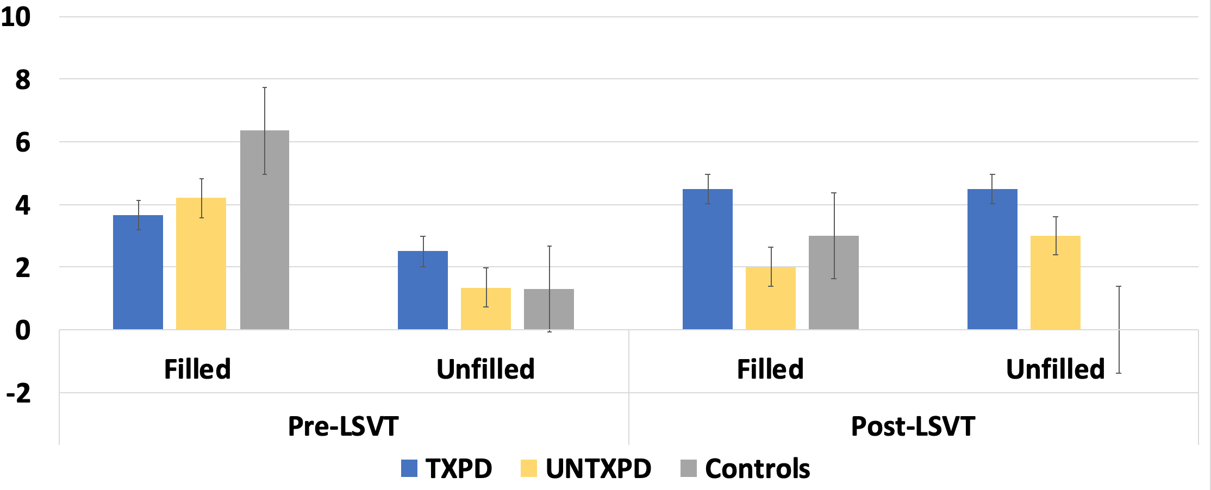
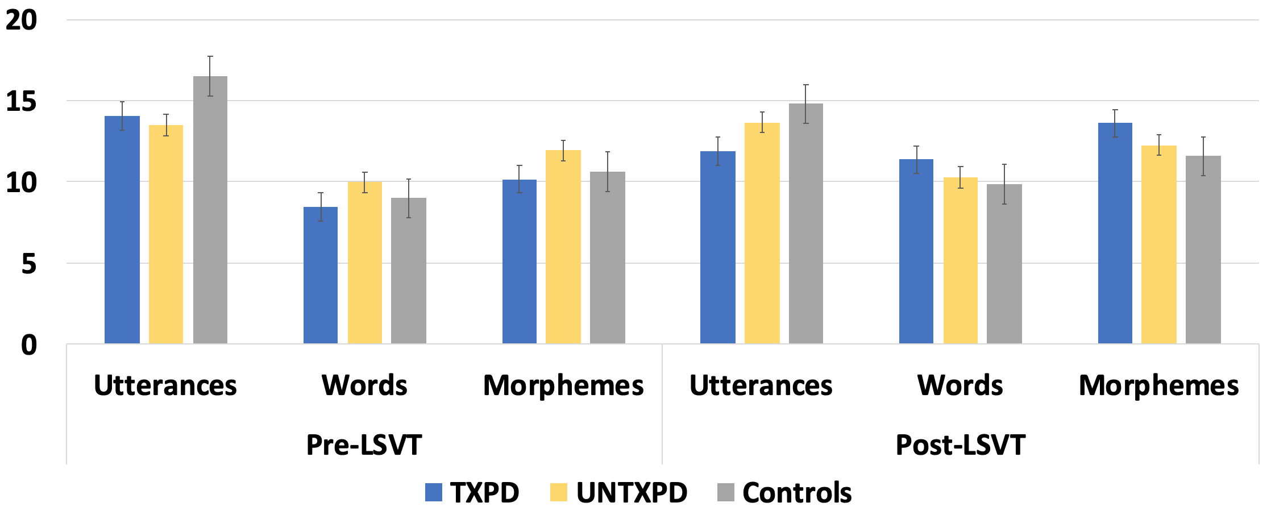
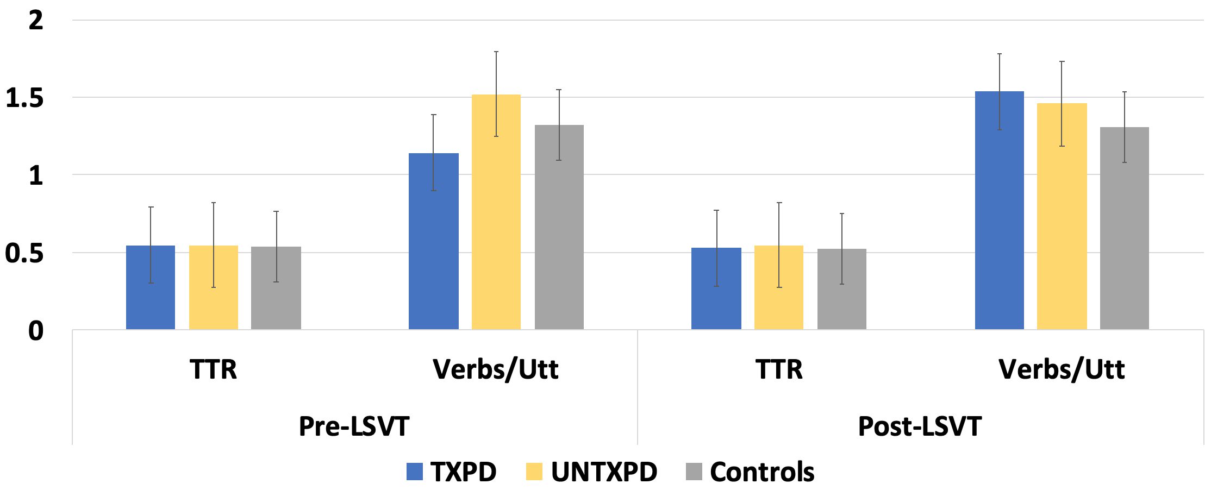
Language Performance in Parkinson’s Disease
Cognition Brain and Language Team
Shannon L. Bryant
Advisor: Amy E. Ramage
Communication Sciences and Disorders
Background
Methods
Treatment Effects
Participants
Parkinson’s Disease (PD) is a dyskinetic neurodegenerative disease associated with dopaminergic deficiency in the basal ganglia. Speech in PD is characterized by a lack of control over voluntary movements, bowing of the vocal folds resulting in breathy vocal quality, and reduced loudness. In addition, there are higher-level cognitive deficits.
The Lee Silverman Voice Treatment (LSVT) LOUD is an efficacious and effective voice treatment developed to improve and maintain vocal loudness in PD [1].
It is not known whether improvements in voice control with LSVT may transfer to other communication behaviors, or specifically if it contributes to language production.
 | TXPD (n=20) | UNTXPD (n=20) | Controls (n=20)
Age | 67.05 ± 8 | 64.55 ± 9 | 64.15 ± 8
Gender | 16 M: 4 F | 13 M: 7 F | 13 M: 7 F
Hoehn & Yahr | 2.13 ± 0 | 2.02 ± 1 | N/A
Beck Depression Inventory | 9.75 ± 6 | 7.3 ± 5 | 2.85 ± 3
Mini-Mental State Exam | 28.7 ± 1 | 29.0 ± 1 | 29.3 ± 1
Years Since Diagnosis | 4.99 ± 7 | 4.73 ± 4 | N/A
Figure 4. Significant group-by-time interactions indicate significant treatment effects for production of mean length of utterance words (F_{2,57} = 6.3, p = .003), mean length of utterance morphemes (F_{2,57} = 6.6, p = .003) and verbs/
utterance (F_{2,57} = 5.6, p = .006) in the TXPD group.
These treatment effects indicate that successful improvement of voice production, through LSVT, also effects a significant increase in words, morphemes and verbs per utterance in connected language during picture description.
Table 1. The groups do not significantly differ for any of the demographic or symptom inventories, indicating a well-controlled study.
Specific Aims
Data Analysis
To identify differences in language performance in PD versus Healthy Controls.
  Hypothesis 1a. The groups will not differ in language performance at baseline.
2. To determine whether LSVT treated PD (TXPD) participants produce more efficient and complex language than untreated PD (UNTXPD).
  Hypothesis 2a. TXPD will exhibit fewer pauses within utterances, longer mean length of utterance (MLU), more variance in the types of words produced, and more verbs than UNTXPD.
For Specific Aim I, two multivariate general linear model with the MOR output as the dependent variables and group as the independent variable, was performed for baseline and for post-LSVT data.
For Specific Aim II, a repeated-measures general linear model was utilized to identify changes within-subject changes in MOR output from pre- to post-treatment between groups.
Group Differences
Methods
*
Figure 1. Pauses: The HC group produced significantly more filled pauses than the PD groups pre-LSVT, but the TXPD group produced more of both types at post-LSVT.
Conclusion
PD and healthy control (HC) participants were recruited for an LSVT randomized-controlled trial [2] from outpatient clinics, support groups, and physicians.
Characterization of the sample included:
Hoehn and Yahr scale: a clinical rating scale that defines broad categories of motor function in PD [4].
Beck Depression Inventory (BDI): a self-report rating inventory that measures characteristic attitudes and symptoms of depression [5].
Mini-Mental Status Examination (MMSE): a measure of cognitive function in the aging population [6].
Language samples were picture descriptions (Cookie Theft, [4]) for which participants described, in as much detail as possible, a pictured scene for one-minute.
Each participant performed the picture description task twice, (1) prior to and after LSVT in the PDTX group, or (2) at a 4-week interval for the UNTXPD and HC groups.
Audio-recordings of the language samples were transcribed using Computerized Language Analysis (CLAN) transcription software, and analyzed for morpho-syntax using MOR [3] as follows:
  # Pauses: pauses (“the boy …”), filled pauses (“the boy um)
  MLU: utterances, words and morphemes
  Types of words: type-token ratio (TTR)
  Verbs: verbs/utterance, %verbs
*
*
There was significant improvement in TXPD for production of words, morphemes and verbs per utterance from baseline to post-treatment. This finding, combined with existing literature, suggests verb production may be a potential treatment target in PD.
Verb production deficits in PD are thought to occur because the motor system is involved in the representation of physical action concepts for language production [8]. While specific limb movements map somatotopically onto frontal motor regions, the basal ganglia (particularly the substantia nigra and subthalamic nuclei [9]) are involved in the sensorimotor inputs involved in associating motor movement with action verbs [8].
Because LSVT is designed to recalibrate certain sensory processes [2], affecting the sensorimotor mapping of actions and the motor system underlying them, our finding of LSVT-related increases in verbs/utterance, MLU morphemes, and MLU words may be a reflection of that recalibration. That is, strengthening of the semantic representations of physical actions may improve access to verbs, as well as the clauses and other morphemes inherent in their use.
Figure 2. Mean Length of Utterance: The groups did not differ for mean utterance length, words or morphemes, but HC had a longer MLU post-LSVT.
*
*
Figure 3. Type Token Ratio and Verbs/Utterance: The groups did not differ for variety of words classes produced, but the UNTXPD produced more verbs/utterance than the TXPD at pre-LSVT.
References
[1] Fox, C., Ebersbach, G., Ramig, L., & Sapir, S. (2012). LSVT LOUD and LSVT BIG: Behavioral Treatment Programs for Speech and Body Movement in Parkinson Disease. Parkinson’s Disease, 2012, 391946.
[2] Ramig, L., Halpern, A., Spielman, J., Fox, C., & Freeman, K. (2018). Speech treatment in
Parkinson’s disease: Randomized controlled trial (RCT). Movement Disorders, 0(0).
[3] MacWhinney, B. (2000). The CHILDES Project: Tools for analyzing talk (3rd ed.). Mahwah, NJ: Lawrence Erlbaum Associates.
[4] Goodglass, H., & Kaplan, E. (1983). Boston Diagnostic Aphasia Examination (BDAE). Psychological Assessment Resources.
[5] Bhidayasiri, R., & Tarsy, D. (2012). Parkinson’s Disease: Hoehn and Yahr Scale. In R. Bhidayasiri & D. Tarsy (Eds.), Movement Disorders: A Video Atlas: A Video Atlas (pp. 4–5).
[6] Beck Depression Inventory (BDI). (n.d.). Retrieved April 17, 2019, from https://www.apa.org website:
[7] Monroe, T., & Carter, M. (2012). Using the Folstein Mini Mental State Exam (MMSE) to explore methodological issues in cognitive aging research. European Journal of Ageing, 9(3), 265–274. [
8] Roberts, A., Nguyen, P., Orange, J. B., Jog, M., Nisbet, K. A., & McRae, K. (2017). Differential impairments of upper and lower limb movements influence action verb processing in Parkinson disease. Cortex, 97, 49–59.
[9] Tomasino, B., Marin, D., Eleopra, R., Rinaldo, S., Cristian, L., Marco, M., … Fabbro, F. (2014). To move or not to move: subthalamic deep brain stimulation effects on implicit motor simulation. Brain Research, 1574, 14–25.

