Slide 1


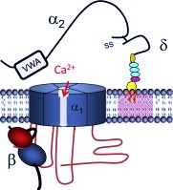
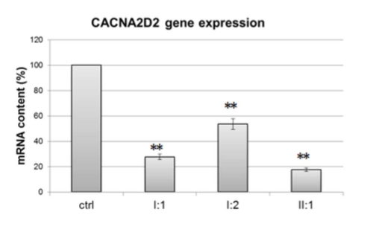
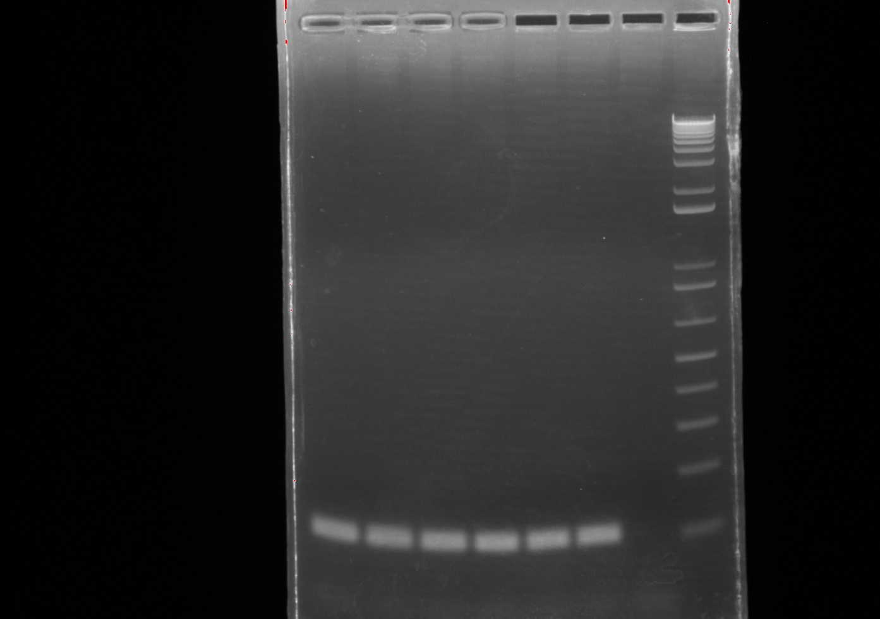
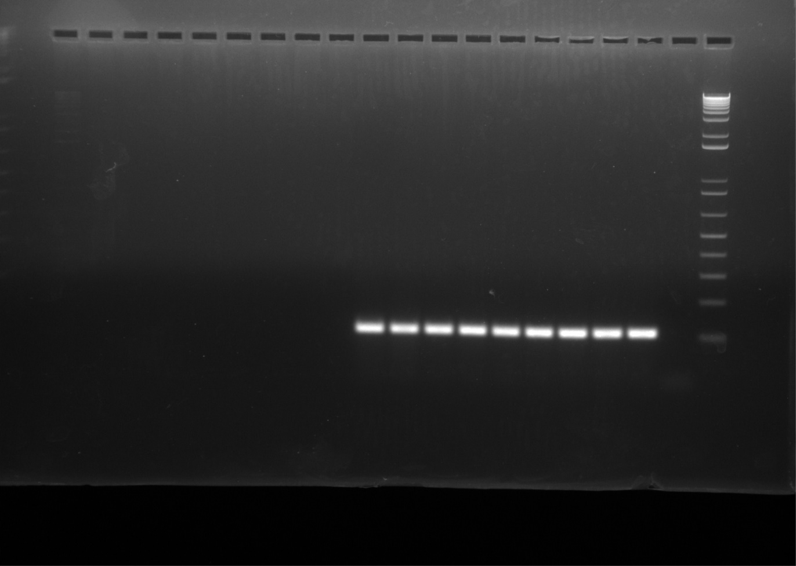
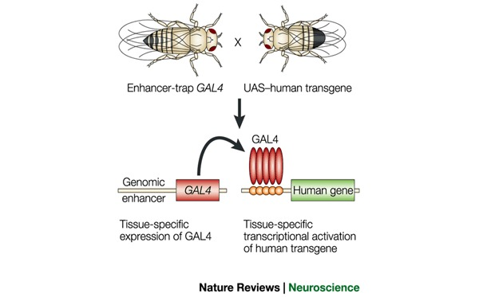
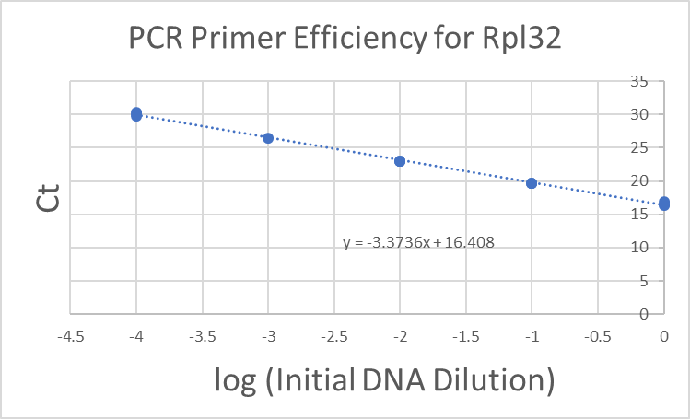
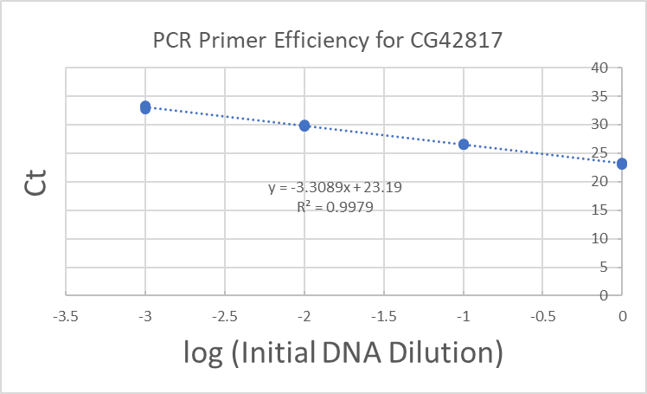
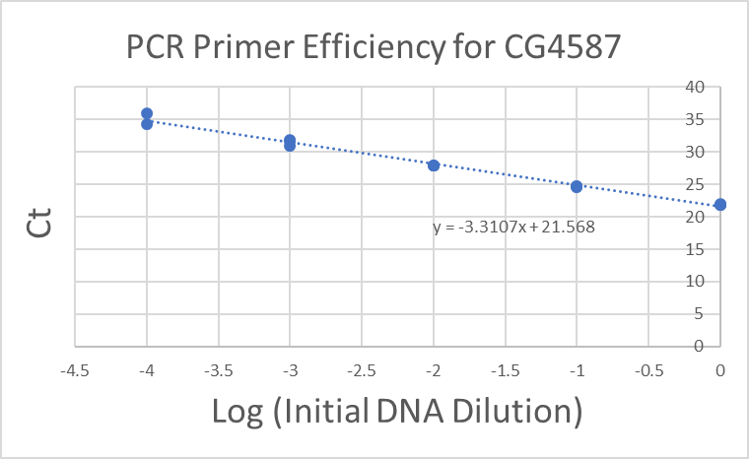
Neuronal-Specific Knockdown of the CG4587 & CG42817 α2δ-proteins in
Drosophila melanogaster
Juan Gomez-Rivadeneira, Julian Brown & Arturo Andrade, PhD
Department of Biological Sciences, University of New Hampshire
Why Do We Care About
α2δ-Proteins?
Methods for Genetic Crosses
Results Continued
Figure 1
CG42817-RNAi UAS /CG42817-RNAi UAS
CG42817-RNAi-UAS/ Elav-Gal4
CG4587-RNAi UAS/ SB₁
CG4587-RNAi-UAS/ Elav-Gal4
CG42817-RNAi -UAS/Canton-S
Elav-Gal4 / Canton-S
CG4587-RNAi-UAS /Canton-S
Elav-Gal4 /Canton-S
Fig. 4A: Normalized expression percentage of the gene CG42817. After normalizing to the expression of CG42817xCanton-S flies, CG42817xElav flies display a 64.2% reduction of CG42817 gene expression.
α2δ-Proteins
Extracellular proteins that regulate the activity of the α1 voltage-gated calcium channel (VGCC) subunit.
Elav-Gal4/ ElavGal4
Encoded by CACNA2D genes in mammals.
Four α2δ-protein isomers have been identified in mammals (α2δ-(1-4)).
Fig. 1: Mating scheme for the knockdown of the CG42817 and CG4587 proteins in all neurons using the neuronal marker, Elav. Genetic controls are produced by mating Gal4 and UAS flies with a wildtype fly (Canton-S).
Schematic of a VGCC with subunits (Dolphin et. al 2013)
Results
Significance of α2δ-Proteins
Increased signaling from α2δ-1 drives cell death following neuropathic injury in mammals (Lau et al., 2013).
The anticonvulsant medications Lyrica and Gabapentin bind to α2δ-Proteins to treat symptoms of epilepsy and neuropathic pain (WebMD©, 2018).
A
1 2 3 4 5 6 7 8
B
1 2 3 4 5 6 7 8 9 10 11
Fig. 4B: Normalized expression percentage of the gene CG4587. After normalizing to the expression of CG4587xCanton-S flies, CG4587xElav flies display 44.2% reduction of CG4587 gene expression.
Reduced CACNA2D2 gene expression is linked with epileptic encephalopathies (Puppucci et al., 2008)
Drosophila melanogaster
Has three genetically conserved α2δ proteins: Straightjacket, CG42817 and CG4587. The latter two genes are thought to be homologues to the α2δ-1 and α2δ-2 protein in humans.
Fig. 2: Gel-electrophoresis of cDNA synthesized from RNA extracted from 30 fly heads using primers for the constitutively expressed gene, Rpl32.
2A (left to right): CG4587xCanton-S (1&4), ElavxCanton-S (2&5), CG4587xElav (3&6), (-) Control (7), DNA Hyperladder (8).
2B (left to right): ElavxCanton-S (1,4,7), CG42817xCanton-S (2,5,8), CG42817xElav (3,6,9), (-) Control (10), DNA Hyperladder (11).
Acknowledgements
Schematic of the Drosophila GAL4/UAS system (Asakawa & Kawakami, 2008)
Funded by the UNH McNair program and the Hamal Center for Undergraduate Research.
Thank you to Dr. Karla Kaun and her lab at Brown University for training me to conduct research with Drosophila melanogaster.
Special thanks to Julian Brown for his assistance throughout this project.
Gal4/UAS System
The yeast activator protein GAL4 and the upstream activating sequence (UAS) is used to target gene expression in D. melanogaster.
RNA Interference (RNAi) will be used to target CG42817 and CG4587 at UAS sites to knockdown genetic expression.
A
Fig 3A-C: Real-Time PCR standard curve for Rpl32, CG42817, and CG4587 primer pairs.
A) % Efficiency, Rpl32 = 98.0%
B) % Efficiency, CG42817 = 100.5%
C) % Efficiency CG4587 = 109.8%
[%Efficiency= (10^{-1/Slope} - 1) * 100]
References
Objectives
Asakawa, K., & Kawakami, K. (2008). Targeted gene expression by the Gal4-UAS system in zebrafish. Development, Growth & Differentiation,50(6), 391-399.
Dickman, D. K., Kurshan, P. T., & Schwarz, T. L. (2008). Mutations in a Drosophila α2δ Voltage-Gated Calcium Channel Subunit Reveal a Crucial Synaptic Function. Journal of Neuroscience, 28(1), 31-38 Dolphin, A. C. (2013). The α2δ subunits of voltage-gated calcium channels. Biochimica Et Biophysica Acta (BBA) - Biomembranes,1828(7), 1541-1549. .
Geisler, S., Schöpf, C. L., & Obermair, G. J. (2015). Emerging evidence for specific neuronal functions of auxiliary calcium channel α2δ subunits. General Physiology and Biophysics,34(02), 105-118. (Geisler, Schöpf & Obermair 2015)
Lau, L. A., Noubary, F., Wang, D., & Dulla, C. G. (2017). α2δ-1 Signaling Drives Cell Death, Synaptogenesis, Circuit Reorganization, and Gabapentin-Mediated Neuroprotection in a Model of Insult-Induced Cortical Malformation. Eneuro,4(5).
Pippucci, T., Parmeggiani, A., Palombo, F., Maresca, A., Angius, A., Crisponi, L., . . . Carelli, V. (2013). A Novel Null Homozygous Mutation Confirms CACNΑ2D2 as a Gene Mutated in Epileptic Encephalopathy. PLoS ONE, 8(12).
Scharfman, H. E. (2007) The neurobiology of epilepsy. Current Neurology and Neuroscience Reports, 7(4); 348-354.
Snutch, T. P., Peloquin, J., Mathews, E., & McRory, J. E. (2013). Molecular Properties of Voltage-Gated Calcium Channels. Voltage-Gated Calcium Channels Molecular Biology Intelligence Unit, 61-94.
  Knock-down expression of the CG42817 and CG4587 genes all neuronal populations of D. melanogaster using the GAL4/UAS tool.
  Dissect 30 D. melanogaster heads per sample to extract RNA.
  Synthesize complementary DNA (cDNA) from extracted RNA via reverse transcription.
  Quantify the expression of CG42817 and CG4587 with the quantitative polymerase chain reaction (qPCR) using gene-specific primers to assess whether CG42817 and CG4587 are being effectively knocked down.
  Calculate Knockdown-% from qPCR data using ΔΔC_{T} method.
B
C

