Slide 1



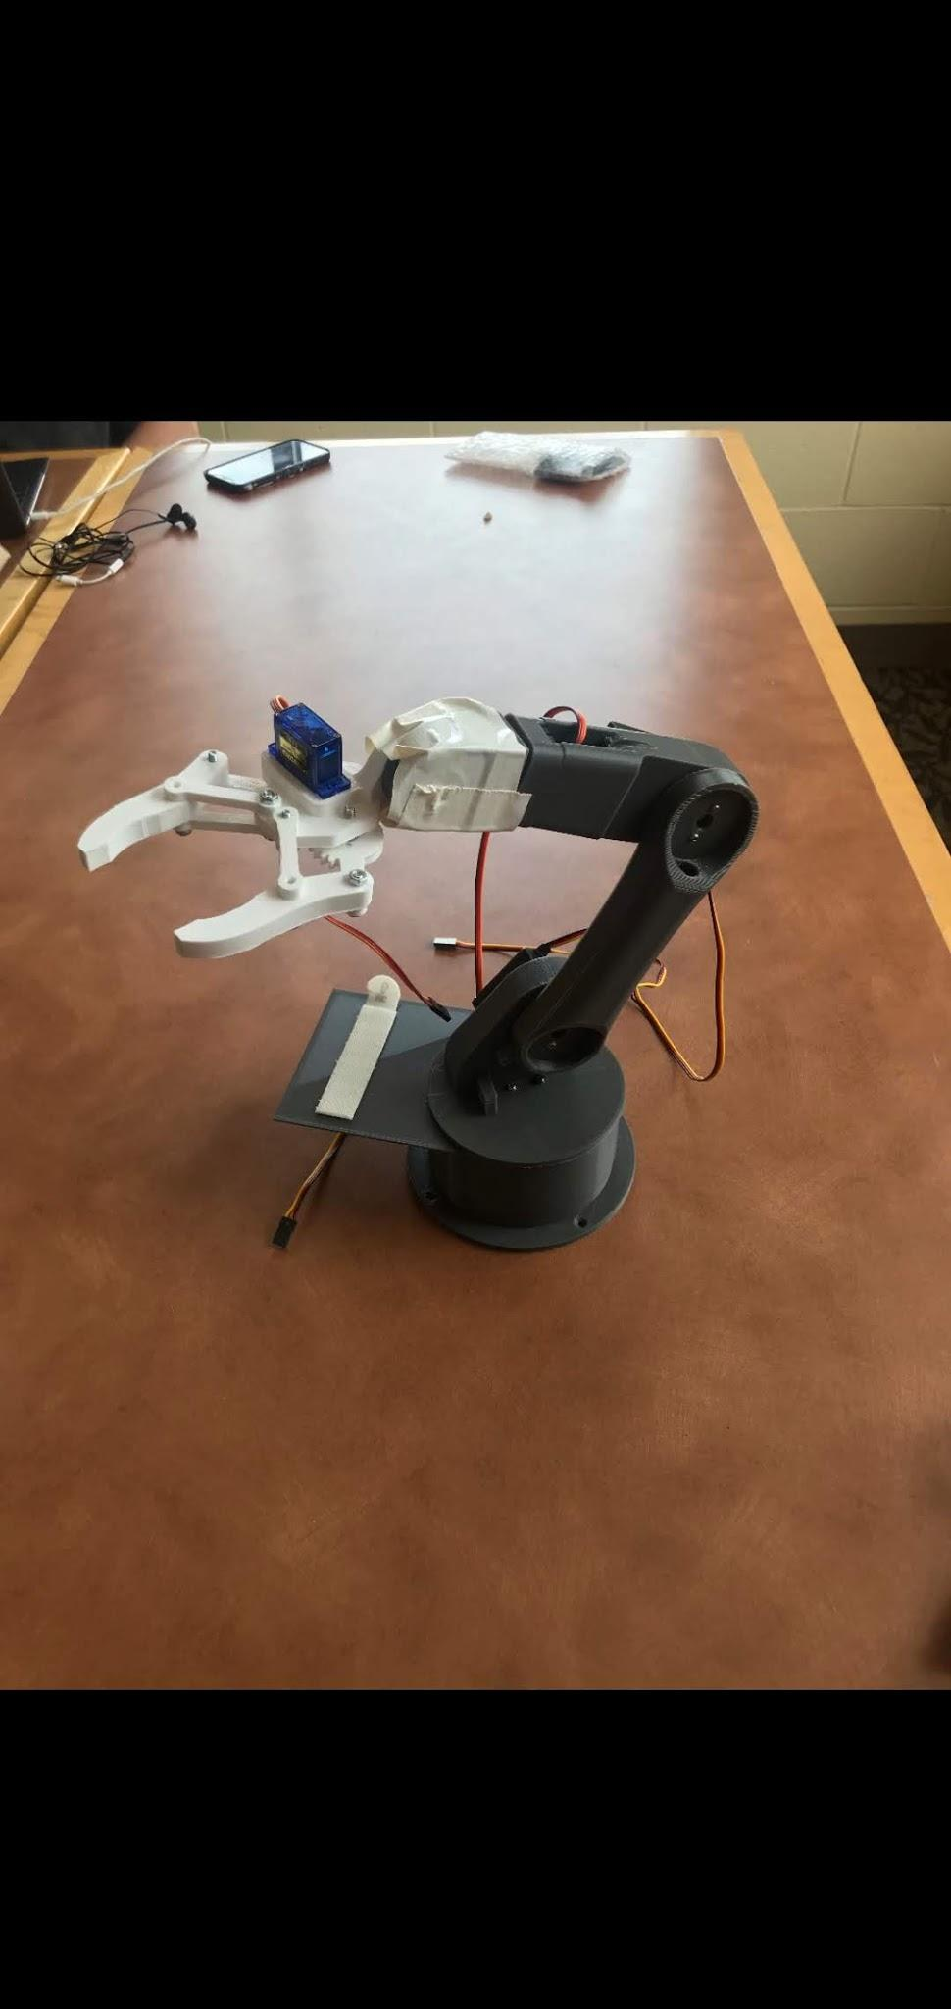
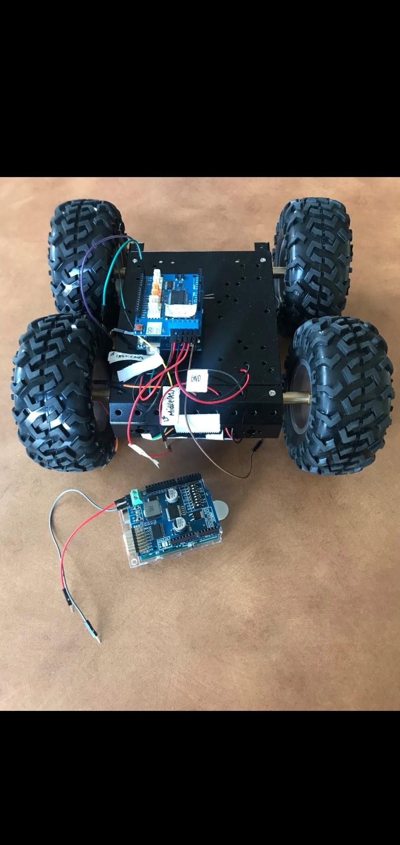
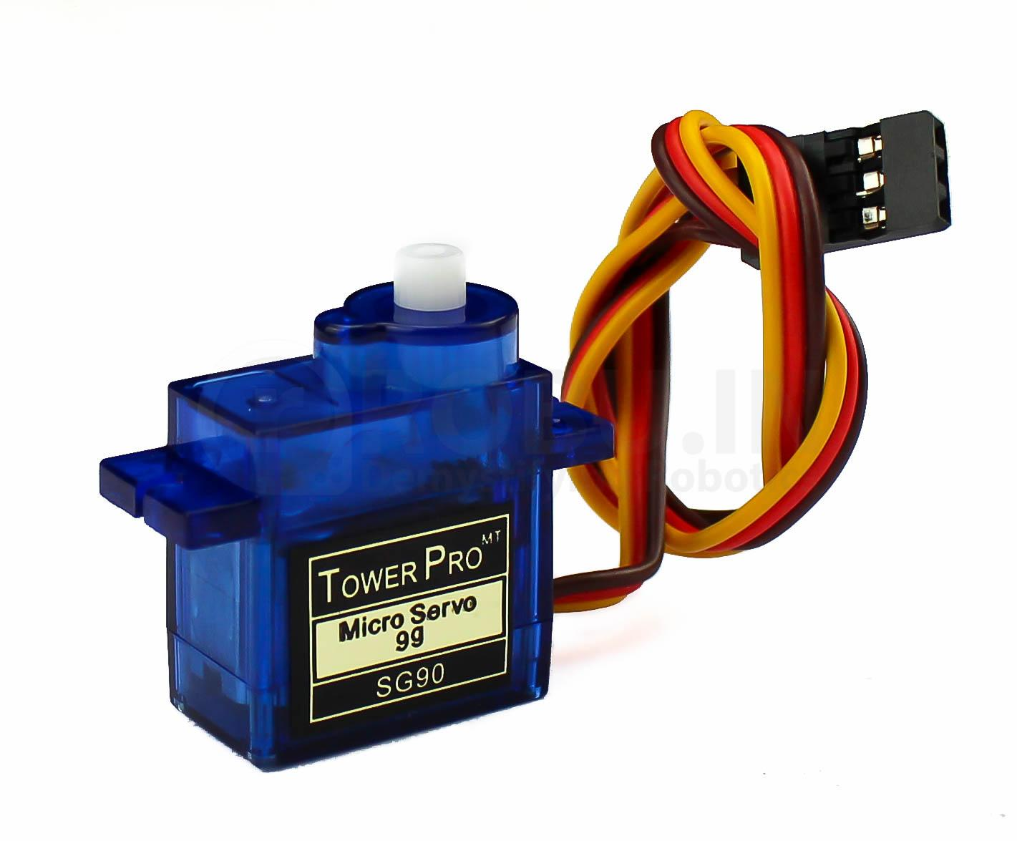
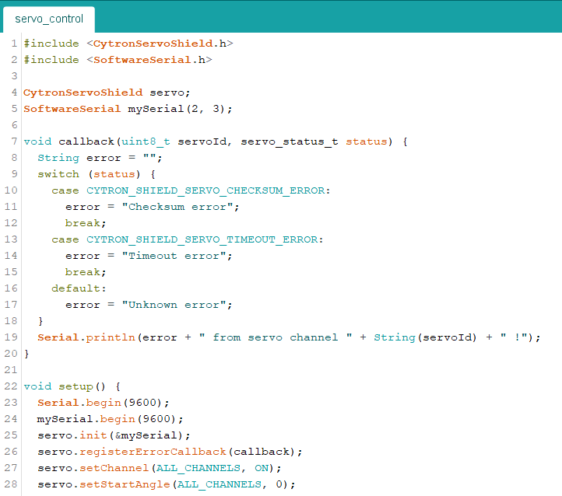
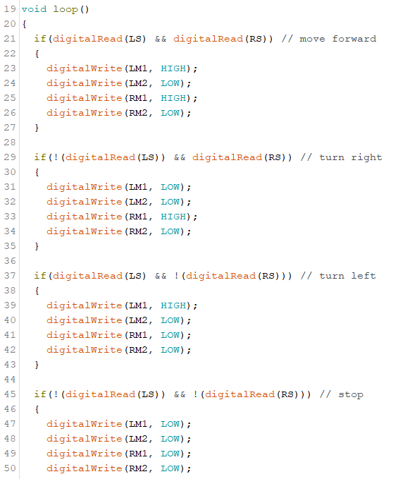
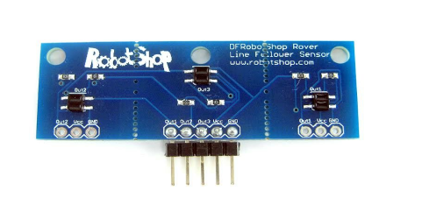
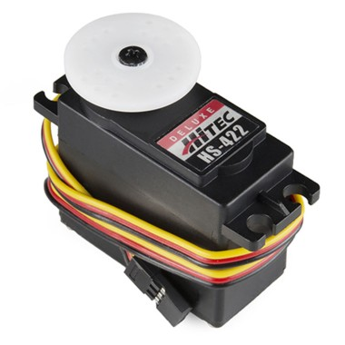
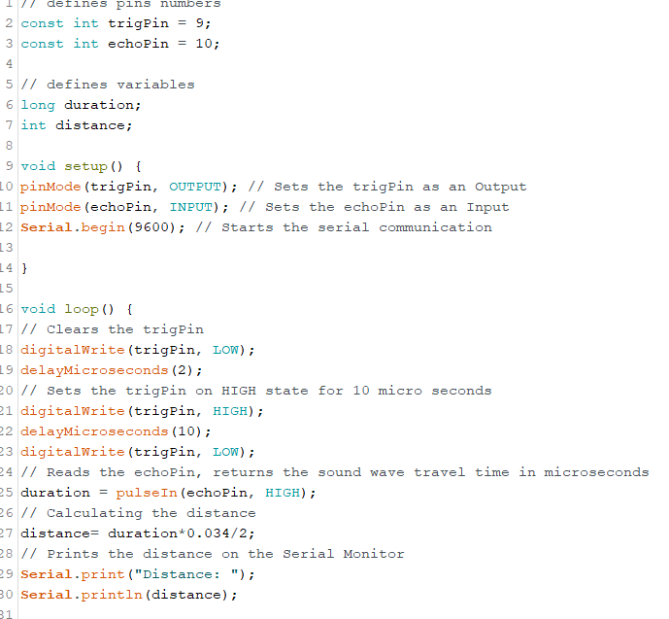
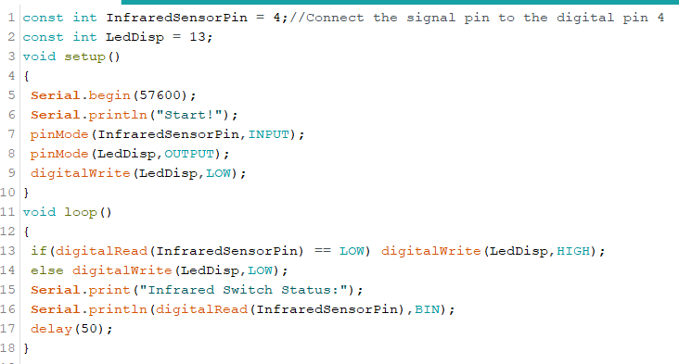
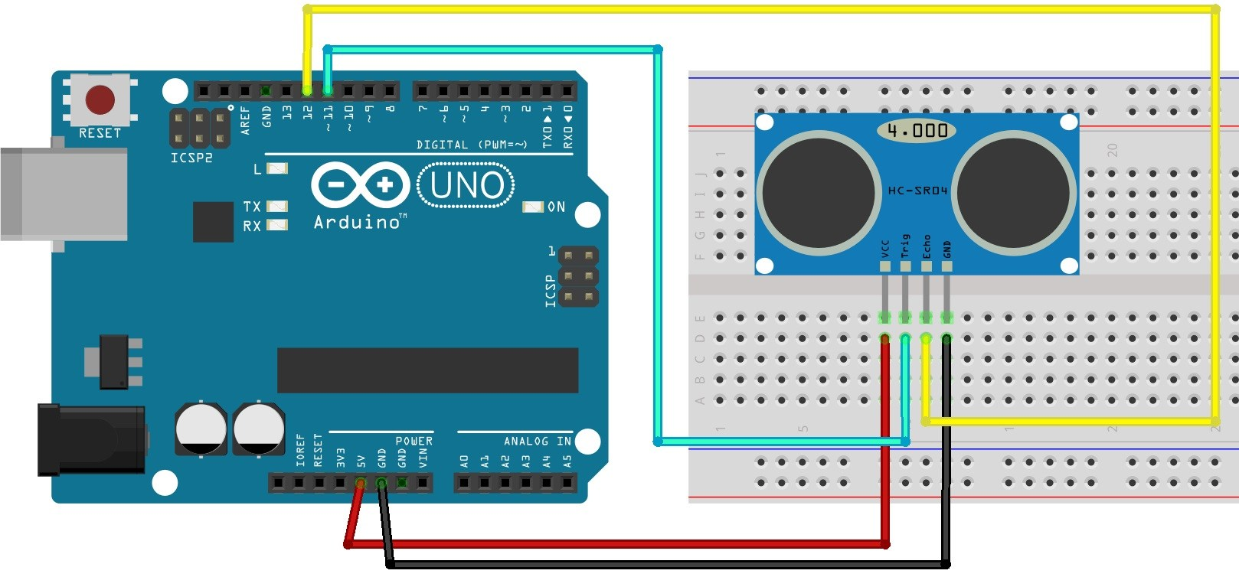
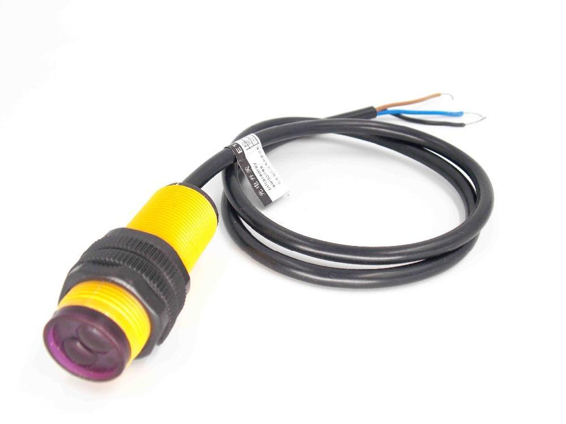
Applying Manufacturing Concepts to an Arduino Robot
Samantha Brady, Kathryn Goldner, Emily Skowfoe, Abbigail Young
Advisor: Oscany Rodriguez-DeJesus
College of Engineering and Physical Sciences, University of New Hampshire, Durham, NH 03824
Abstract
Action Shots
Conclusion
Purpose is to introduce a device that could be incorporated into an advanced manufacturing setting to:
  Eliminate safety hazards by taking the place of employees who operate in dangerous environments
  Save time by completing tedious jobs
  Increase efficiency and quality of product after being programmed to perform with precision and accuracy
  Have the robot to work alongside employees
  Have a simple design that allows for sizing up or down
The 3D Printed Arm
The Rover
Robots are a more efficient way to allow the manufacturing process to take place
Different sensors could easily be added for different manufacturing situations depending on what is needed
Arduino robots are prototypes that can lead to more advanced processes in manufacturing
Arduino robots are a cost effective way to make manufacturing work safer
After code is developed, the robots can be assembled fast, allowing high production
The arm after printing and assembly
The base of the robot before the addition of the arm
Code
Further Research
Components
A larger rover could accommodate for a better arm base, and therefore, something more sturdy
How this robot could interact with other robots
Addition of more sensors that may be beneficial to the manufacturing process, such as temperature or motion
Addition of a mapping and identifying camera sensor so the robot knows what object it is picking up
More time spent on the code would make the project more efficient
A moving base called a rover that consists of:
  a metal frame
  four wheels
  four DC motors
A robotic arm that is 3D printed in based on a SolidWorks model
A line-following sensor to navigate an assigned path
An infrared sensor to detect people
An ultrasonic sensor to detect objects
A battery pack, arduino, and compatible shield
Servo Code
Line-Following Code
Above: Beginning of Marc Tausanovitch’s servo code.
Top left: https://robu.in/product/towerpro-sg90-9gm-1-2kg-180-degree-rotation-servo-motor-good-quality/,
Bottom left: https://www.robotshop.com/en/hitec-hs-422-servo-motor.html
Right: Example of code needed for line-following sensor.
Left: https://www.robotshop.com/media/files/pdf2/linefollowerdatasheet.pdf
Acknowledgements
Ultrasonic Code
Infrared Code
We would like to thank Rowan Boyer and Marc Tausanovitch for help with coding, Joe Camobreco for his help with soldering, and our mentor, Oscany Rodriguez-DeJesus, for her guidance on coding, ordering parts, and assembling. Also, we extend our thanks to Ali Davarpanah for overseeing the project and the Olson Center for funding the construction.
Coding Process
Decide what we want the robot to accomplish as this helps us lay out the flowchart for the code
Understand the internal coding functions and structure of Arduino
Research coding expressions for the sensors and understand how the sensors function
Include servo and sensor libraries in code
Understand the errors in the code and correct them
References
Benson, C. “Complete Guide for Ultrasonic Sensor HC-SR04 with Arduino.” Random Nerd Tutorials, 17 Sept. 2018, randomnerdtutorials.com/complete-guide-for-ultrasonic-sensor-hc-sr04/.
Calderone, Len. “Robots in Manufacturing Applications.” ManufacturingTomorrow, Manufacturing Tomorrow, 2 Aug. 2016, 07:55 AM, www.manufacturingtomorrow.com/article/2016/07/robots-in-manufacturing-applications/8333
Dejan. “DIY Arduino Robot Arm with Smartphone Control.” HowToMechatronics, 17 Dec. 2018, howtomechatronics.com/tutorials/arduino/diy-arduino-robot-arm-with-smartphone-control/..
“How to Build an HC-SR04 Distance Sensor Circuit.” How to Build an HC-SR04 Distance Sensor Circuit, 2016, learningaboutelectronics.com/Articles/HC-SR04-ultrasonic-distance-sensor-circuit.php.
“Line Follower Sensor.” DF Robot Shop Rover, 2015, www.robotshop.com/media/files/pdf2/linefollowerdatasheet.pdf.
☺, SolidWorks Tutorial, director. SolidWorks Tutorial # 310: Robotic Arm (Layout Design, Mate Controller). YouTube, YouTube, 24 Nov. 2017, www.youtube.com/watch?v=pVY0Wt4LXUs.
Top: Example of beginning of code for the ultrasonic sensor.
Bottom: https://randomnerdtutorials.com/complete-guide-for-ultrasonic-sensor-hc-sr04/
Top: Example of the beginning of infrared sensor code.
Bottom: https://robu.in/product/adjustable-infrared-sensor-switch/
Notes:
Font size and logo

