Slide 1

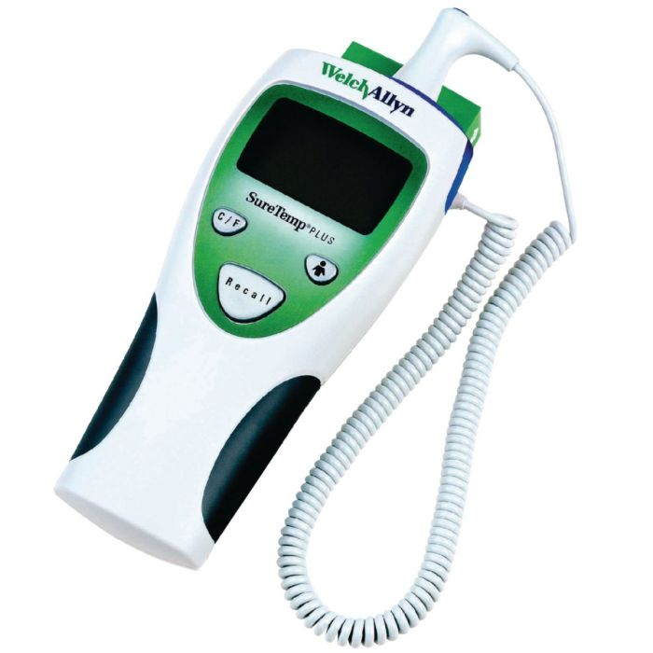
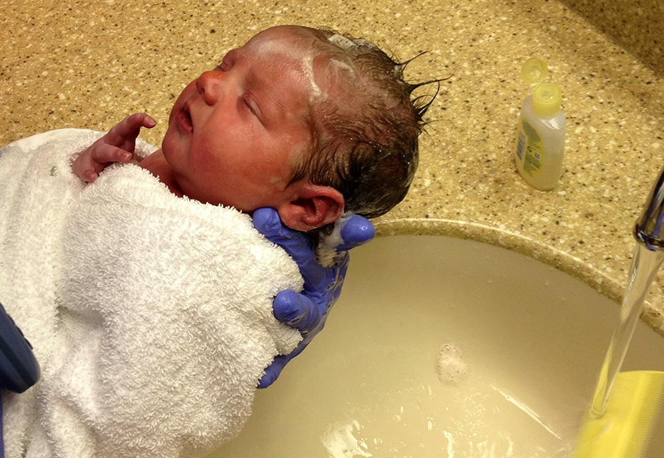
Delaying the First Bath and it’s Effects on Normothermia and Breastfeeding
Emily Pelletier, UNH Nursing Student
University of New Hampshire Nursing Department
Goal
Clinical Question
Clinical Implications
The goal of this evidence-based research project was to review literature regarding the timing of a newborns first bath to determine the effect on thermoregulation and breastfeeding of a healthy, term newborn.
In healthy, term infants (P), does delaying the first bath to at least twelve hours of life (I) increase the rate normothermia and exclusive breastfeeding (O) compared to infants who receive a bath prior to twelve hours of life (C)?
To delay the newborn bath to 12 hours of life or greater in the healthy, term (>37 0/7 weeks gestation) newborn
To minimize the prevalence of hypothermia in healthy, term newborns
To increase the hospital’s rate of exclusive breastfeeding
Background
Newborns are at a high risk for hypothermia compared to adults and children due to their large body surface area, thin skin, and lack of physiological thermoregulation abilities (Mullany, 2010).
Mullany (2010) states that the “first 10-20 minutes after birth it is not uncommon for a baby to lose 2-4°C” and can be increased further with a lack of thermoregulation practices like skin-to-skin contact, swaddling, and placing away from drafts.
When newborns are hypothermic they can develop cold stress, which causes the demand for glucose and oxygen to increase. When this happens, it “can then lead to hypoglycemia and hypoxemia” (Brogan & Rapkin, 2017).
If a newborns temperature drops by only 1°F from the desired 97.7°F (36.5°C), then the newborns demand for oxygen can increase by 10% (Warmth and Temperature Regulation).
“Newborn hypothermia remains one of the most important contributors to neonatal mortality and morbidity” (Mullany, 2010).
Breastfeeding has multiple benefits to the infant as well as the mother. Studies have shown that breastfeeding can protect against gastrointestinal, respiratory, and ear infections. It can also reduce the risk of childhood obesity and type 2 diabetes. (Bellù & Condò, 2017)
Problem
The global prevalence of newborn hypothermia is “up to 85% in hospitals and up to 92% at home” (Horn et al., 2014). Newborn hypothermia can cause hypoglycemia, respiratory distress, sepsis, metabolic acidosis, and death (Andrews, et. al., 2018). These issues be prevented by delaying the first newborn bath to at least 12 hours after birth.
Research Implications
To determine the optimal time for a newborns first bath
To better understand the relationship between delayed bathing, exclusive breastfeeding rates, and thermoregulation
Expected Outcomes
Practice Recommendations
Increase staff and patient’s awareness of the detrimental effects of newborn hypothermia
Increase knowledge about importance of delayed bathing
Reduce the number of baths given prior to 12 hours of life
Reduce the incidence of newborn hypothermia
Cause the rate of exclusive breastfeeding to rise
WHO Newborn Hypothermia Classifications
Mild | 36.0°C – 36 .5°C
Moderate | 32.0°C – 35.9°C
Severe | <32.0°C
Recommendations include:
Delay first bath for healthy, term (>37 0/7 weeks gestation) newborns to greater than 12 hours
Promote breastfeeding and skin-to-skin contact before first bath occurs.
Promote thermoregulation practices before and after the bath. These include: skin-to-skin contact, swaddling, wearing a hat, warm blankets, warm room temperature, and placing newborn away from drafts.
Take temperature of newborn 15 minutes before bath, delay bath until temperature reaches 98.5°F.
Take temperature 30 minutes after bath to determine regulation of temperature post-bath.
Evidence
The World Health Organization (2013) recommends that “bathing should be delayed until 24 hours after birth. If this is not possible due to cultural reasons, bathing should be delayed for at least six hours.”
In a study performed at Dartmouth-Hitchcock hospital in Lebanon, NH baths were delayed from 2-3 hours after birth to at least 12 hours. This intervention decreased the rate of hypothermia from 9.4% to 7.1%. (Andrews et al., 2018)
A study performed by Brogan and Rapkin (2017) found that “newborns who had delayed immersion baths were significantly more likely to be normothermic.”
“Patting the baby dry but not washing and leaving the amniotic fluid on the hands increases the baby’s ability to make the neural connections for breastfeeding” (Smith & Shell, 2017).
A study found that newborns bathed at an average of 13.5 hours of life were 39% more likely to exclusively breastfeed than newborns bathed at 2.5 hours of life (Preer, Pisegna, Cook, Henri, & Philipp, 2013).

