Slide 1


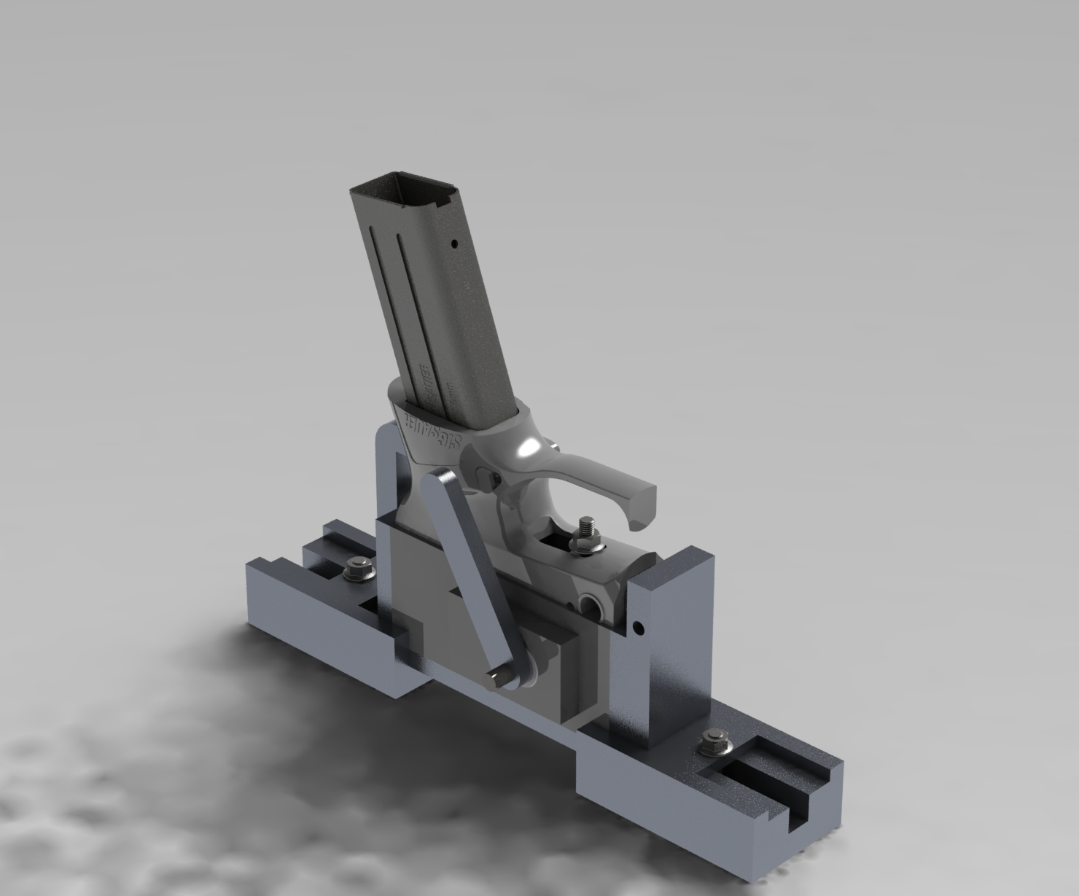
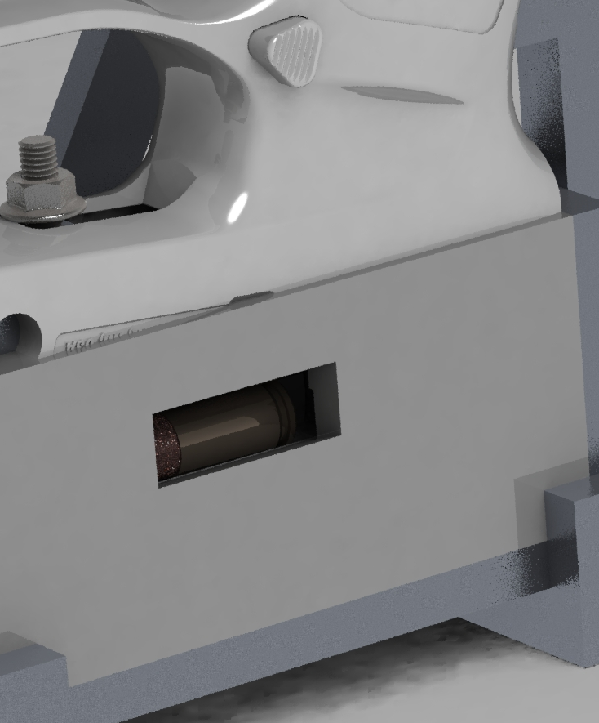

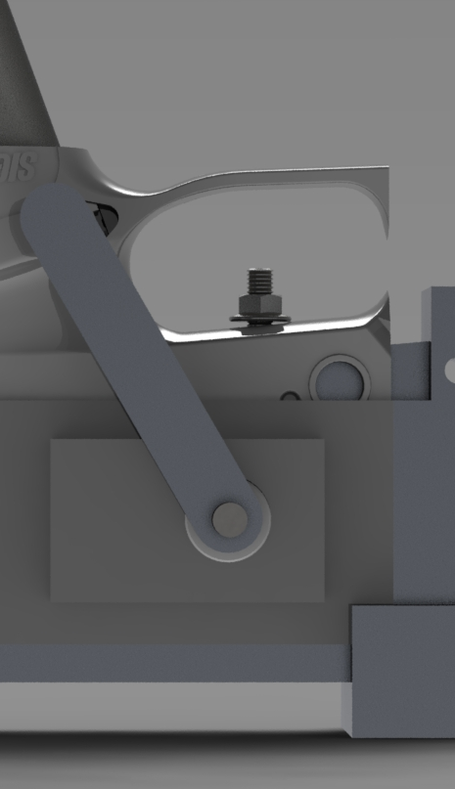
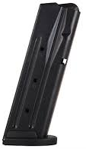
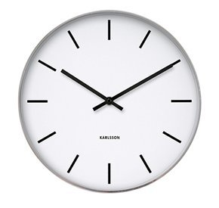

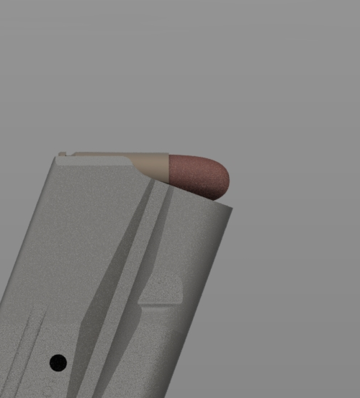
Automated Pistol Magazine Speed Loader (Patent Pending)
Department of Mechanical Engineering
Member(s): Alex Kittler | Faculty Advisor: Ivaylo Nedyalkov | Company Advisor: Scott Shinkle
What is the Speed Loader?
The automated pistol magazine speed loader is a conceptual, compact and revolutionary design to change the way we traditionally load rounds into a pistol magazine. Using patent pending technology, this device has the potential to reinvent the tedious task that is loading ammunition.
Magazine
Lock
Area of Improvement | Pros | Cons
Replace gimbal mounts with ball and socket joints | Decreases risk of binding and jamming within the system | Marginally increases cost
Motorize and create a controller feedback system | Less human input, will have logic to know when magazine is full | More complex system, additional costs
Incorporate hopper feeding system | Automatic bullet orientation, increases efficiency | Added cost, more design required
Empty Pistol Magazine
Inspiration:
While working at Sig Sauer over the past several months, it was very evident that testing ran into efficiency issues. There would be large amounts of time where testing would cease because more rounds needed to be loaded into magazines. Since no industrial grade loader was currently present on the market, I tasked it upon myself to make a solution come to fruition.
Crank Arm
Feed Bay
Loading Dynamics:
Implementation:
~during large scale industrial endurance testing
Detachable Locking System
Testing Plan:
Load round(s) into speed loader
Test for failure
Provide data relating the rate of failure to the rate of successful loaded rounds**
Increased volume of loaded magazines
Decreased loading time
Increased cost savings
Acknowledgements:
Funding: Sig Sauer Inc., University of New Hampshire
Company Advising: Scott Shinkle, Adrian Thomele, Dan Hochberg
University Advising: Ivaylo Nedyalkov, Scott Campbell
**It is expected that the two main causes of failure will be through jamming and binding of the system.

