Slide 1

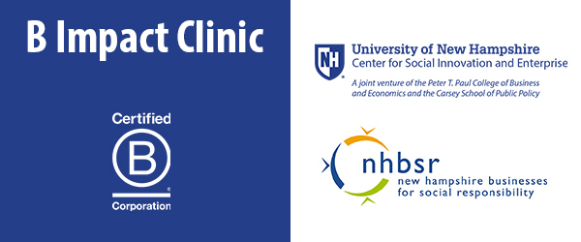
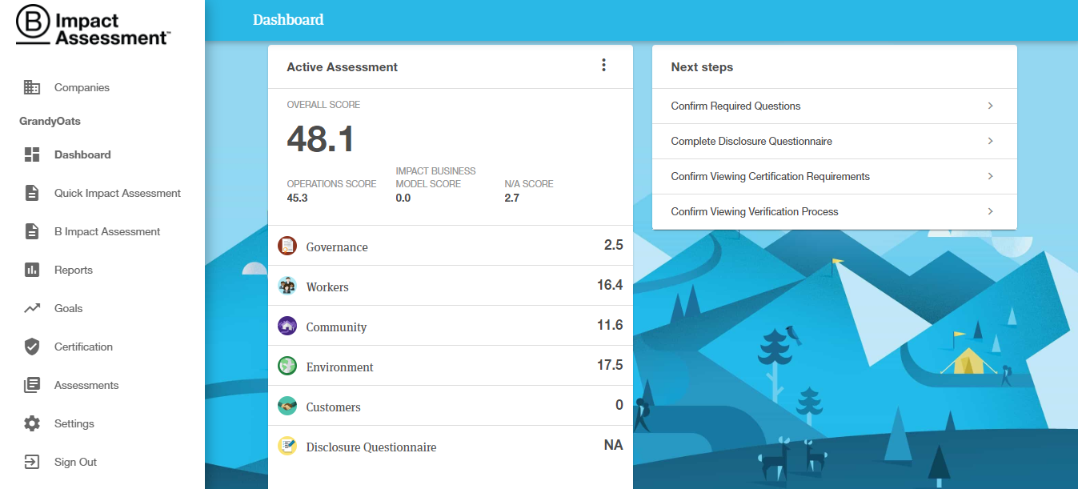
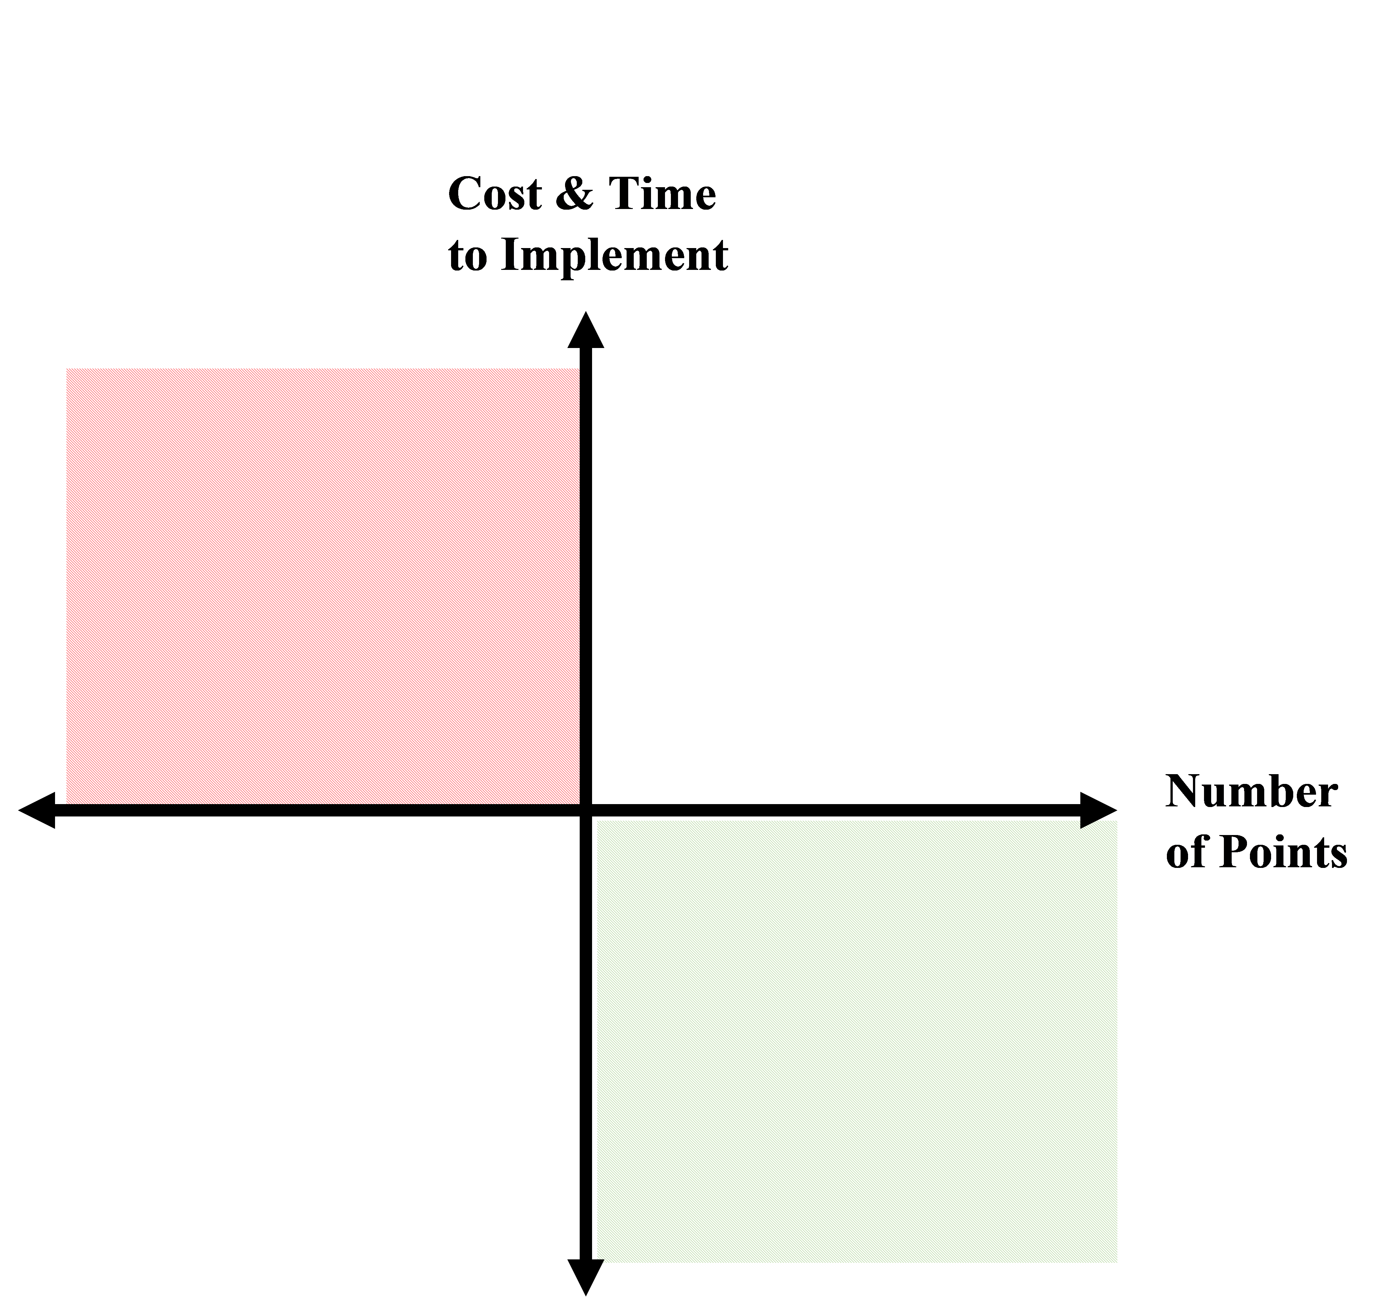
Business for Good: B Corporations and Sustainable Business
Caitlin Burnett, Cassidy Yates & Jake Beanland
Faculty Advisors: Vanessa Levesque & Fiona Wilson
Sustainability Dual Major Capstone Project
Introduction
Results
Discussion
  The world we live in today faces a multitude of sustainability challenges, including issues of environmental resource depletion and social inequality. While business may be the root of many sustainability challenges, it can also act as a force for good, helping to address and solve these issues.
  This is the mission of B Lab, a non-profit organization that awards the B Corporation certification, acknowledging businesses excelling in social, environmental, and economic sustainability. To become certified, a business must score a minimum of 80 points on the assessment.
  A recent clinic at University of New Hampshire brought together students and clients to help businesses move toward B Corp certification. Our research focused on a small food production company in New England.
  Conversations with client revealed a perceived company culture of sustainability
  Scores on the assessment did not reflect these beliefs
  Lack of formalized policies
  Small businesses have fewer employees and smaller management teams
  Closely-knit relationships may lead to belief that values are shared and understood through company culture, not necessitating formalized documents.
  Small businesses may lack depth and personnel to implement formal policies impacting legal structure.
Next Steps
Research Objectives
  What sustainable practices are already taking place within the Company and how can they be measured?
  In what areas can improvements be made?
  Are there limitations of the assessment, especially as used by a very small company?
  Compiling the recommendations we developed through our analysis
    organized by level of difficulty to implement
    company can utilize to make internal changes and gain points on the assessment
  2) Creating visual aid for company
    how to navigate and utilize the B Impact Assessment website
    use of Improvement Report
Methods
  Weekly client conversations
  B Impact Assessment responses organized by category and appropriate company contact
  Cost and efficiency analysis to develop recommendations for improvement
References
  B Impact Assessment. (n.d.). Retrieved April 17, 2019, from https://app.bimpactassessment.net/company/156856/dashboard
  Ang, James S. 1991. “Small Business Uniqueness and the Theory of Financial Management” In Journal of Small Business Finance, ISSN 1057-2287, JAI Press, Greenwich, CT, Vol. 1, Iss. 1, Pp. 1-4.
  Honeyman, Ryan. 2014. The B Corp Handbook. San Francisco: Berrett-Koehler Publishers, Inc..

