Slide 1

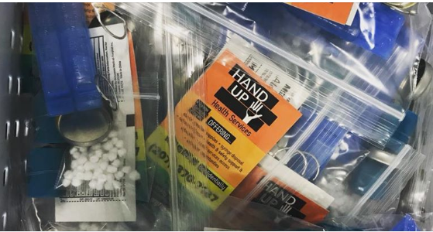

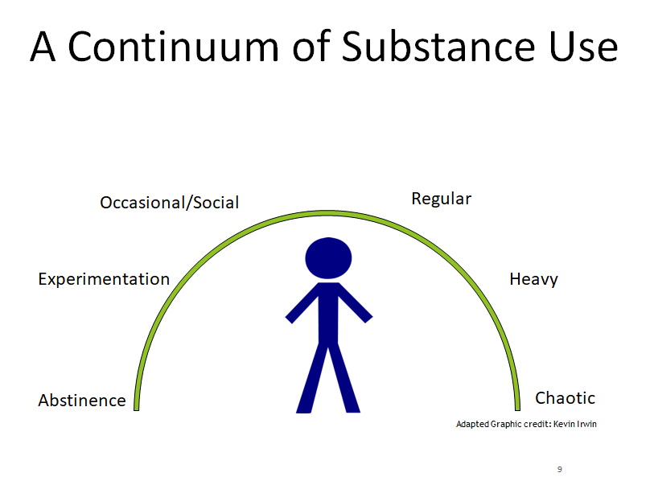
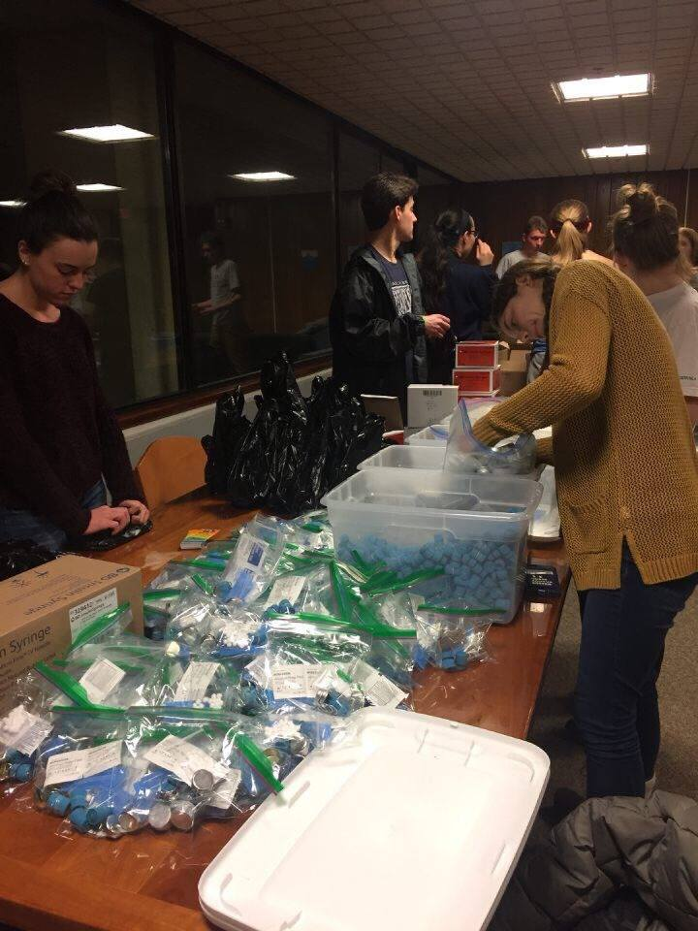
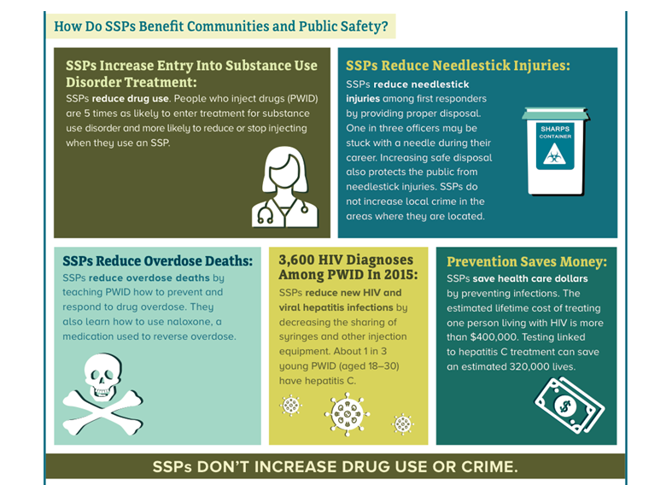
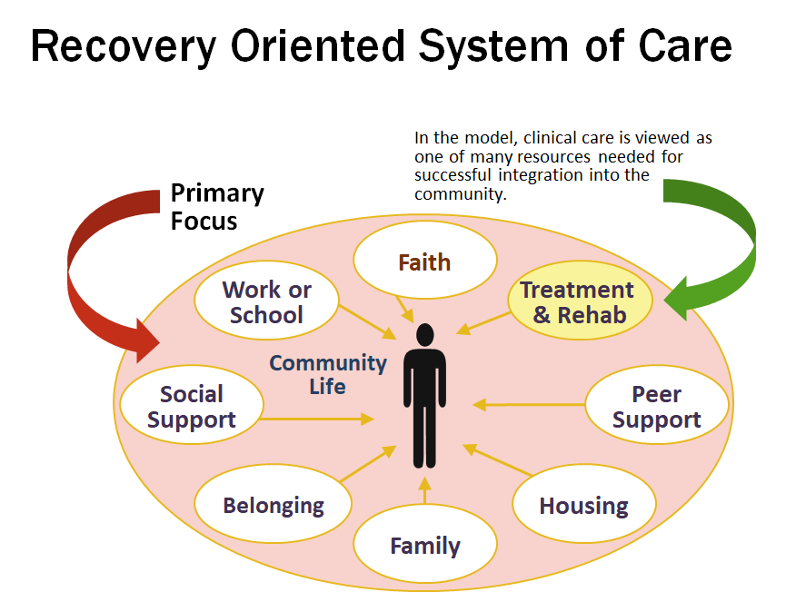
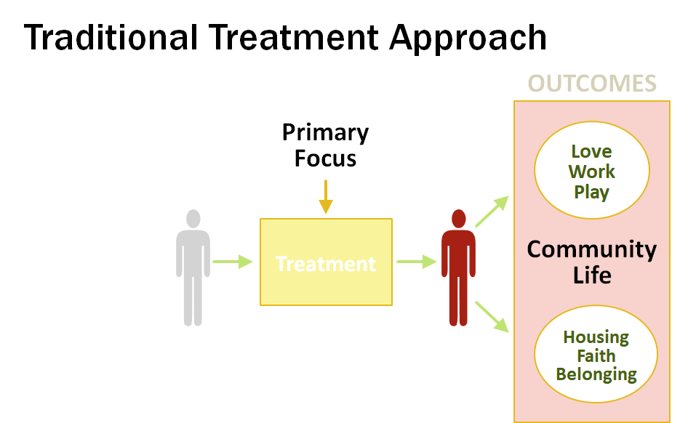
HAND UP HEALTH SERVICES
Adriana Radosavljevic, Biochemistry and Faith Farnham, Nursing
Kerry Nolte, Medical Coordinator, Hand Up Health Services
What is HAND UP Health Services? ²
Harm Reduction Is… ²
  HAND UP is a Syringe Service Program (SSP) founded by Dean Lemire, Kerry Nolte, Joe Hannon, Ryan Fowler, and Kevin Irwin in June 2017.
  HAND UP comprises a diverse group of volunteers including nurses, people in recovery, and social workers delivering free, community-based services that reduce the personal and social harms associated with drug use.
  HAND-UP supports people to make any positive change in their lives and to reduce the risk of drug overdose, HIV/ Hepatitis C and other viral and bacterial infection, and other harms associated with the drug use and misuse. We reach people through direct outreach and by referral from health care and other service providers and peers in the community. Our services are confidential; we do not collect or share identifying information about anyone we serve.
  A range of public health policies designed to lessen the negative social and/or physical consequences associated with various human behaviors, both legal and illegal.
  A set of practical strategies and ideas aimed at reducing negative consequences associated with drug use.
  A movement for social justice built on a belief in, and respect for, the rights of people who use drugs.
Safe Injection Practices ²
Use sterile injecting supplies
Take care of your veins
Take your time
Carry Naloxone
Don’t use alone
Avoid reusing or sharing
Get an extra sterile syringe for splitting drugs
If you must reuse, mark what equipment is yours
If you have to share, clean with bleach and sterile water
The Aims of Harm Reduction Are…²
  To improve the health and well-being of individuals, their partners, families, associates, and communities.
  To highlight and address the roles of discrimination due to poverty, racism, classism, sexism, social isolation, trauma, and other inequalities in drug-related harm and the roles of dignity, respect, and empowerment in reducing harm.
  Prevent disease and infection including HIV, Hepatitis C, endocarditis, cellulitis, and abscesses.
UNH Student Involvement of Hamel Scholars
Evidence and Support for SSPs ¹
Recovery Oriented System of Care versus Traditional Treatment Approach
References
[1] CDC. (2018, December 13). Syringe Services Program Info Sheet. Retrieved from https://www.cdc.gov/hiv/risk/ssps.html
[2] HAND UP Health Services. (n.d.). Retrieved from http://nhhrc.org/resources/handup/
Notes:
CDC SPP evidence- APA
Switch sfe injection practices and SSP graphic
Need names and disciplines
What is hand up-nhhrc citation (text edits)

