Slide 1



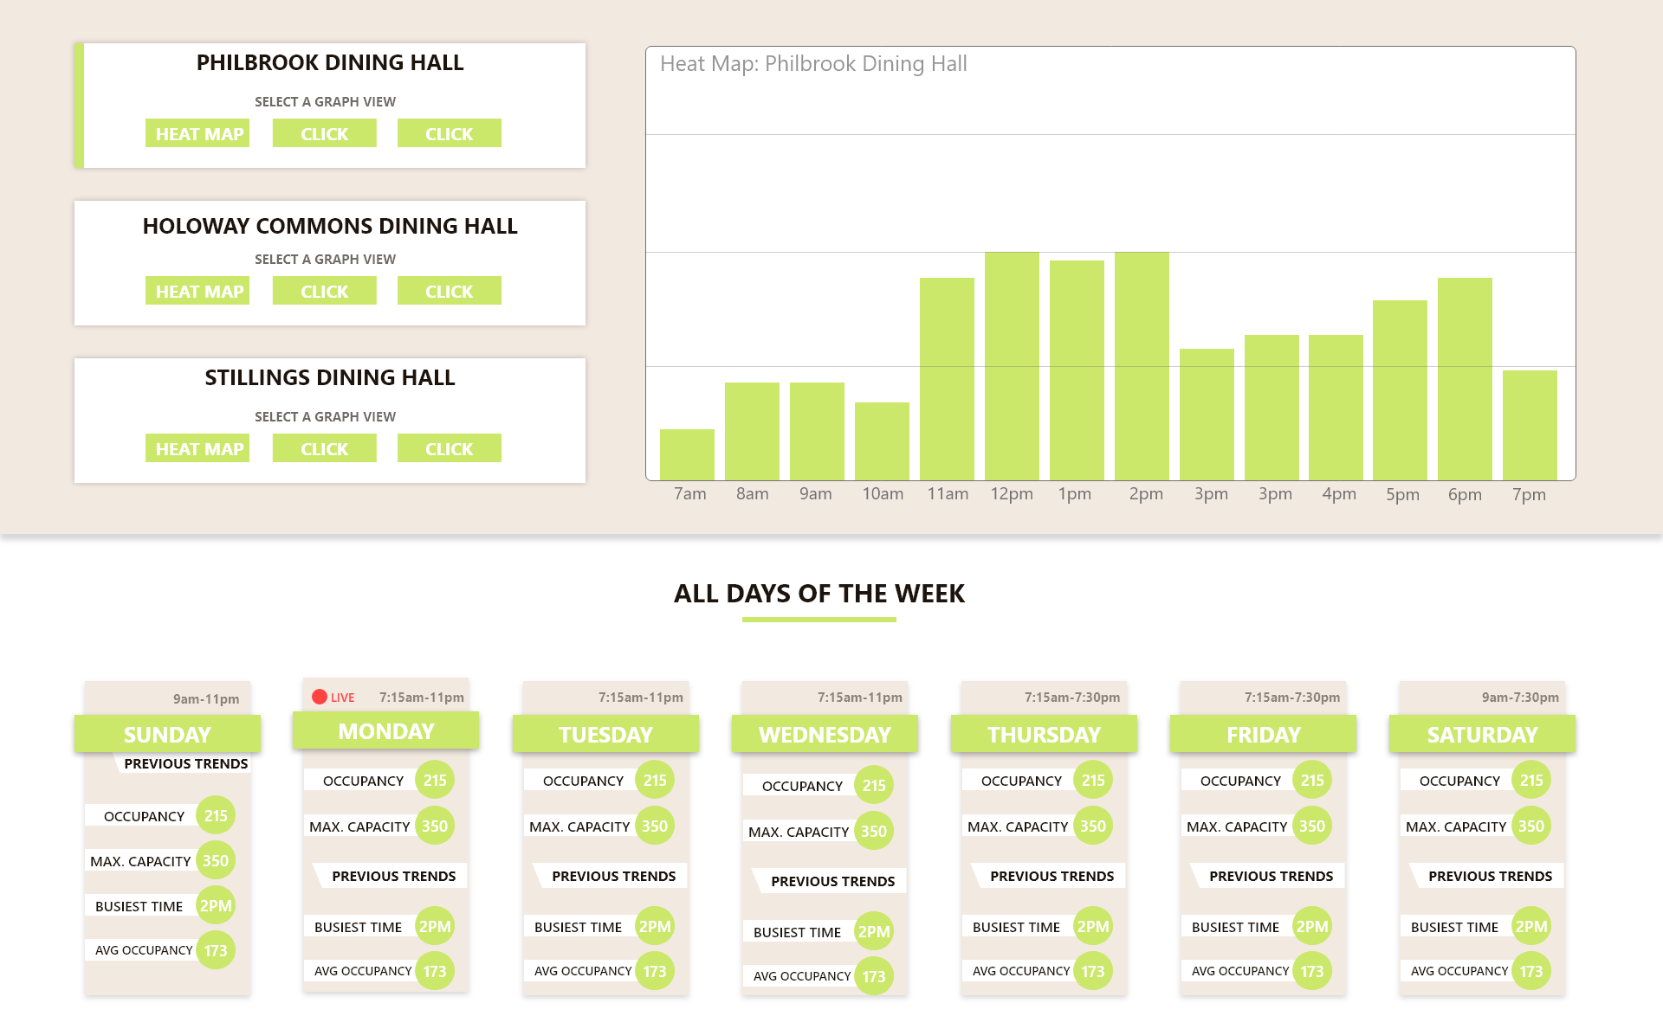
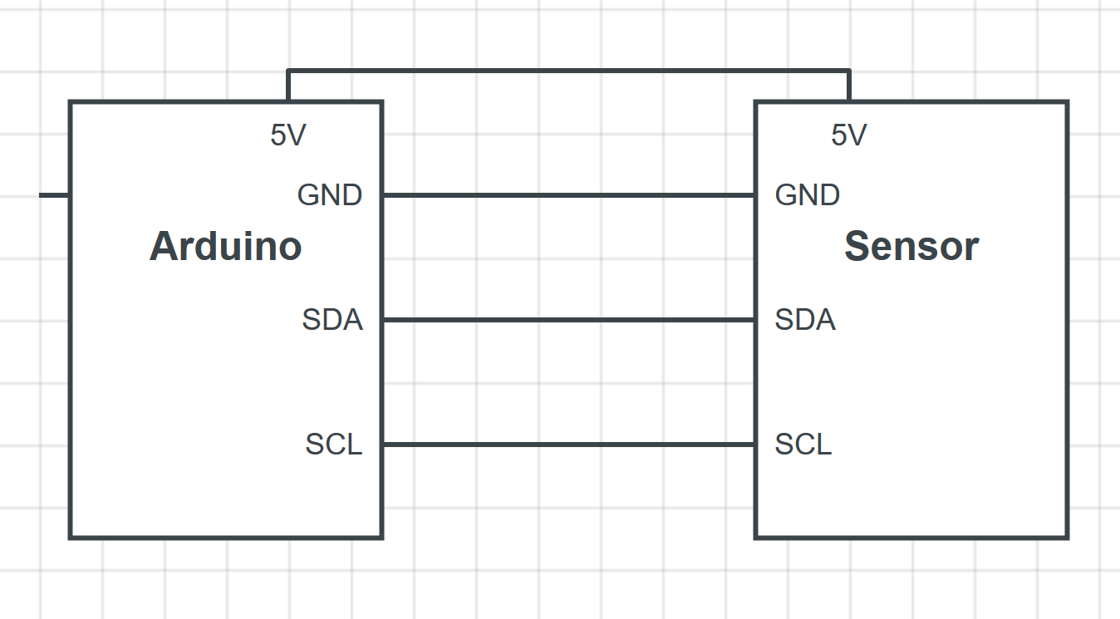
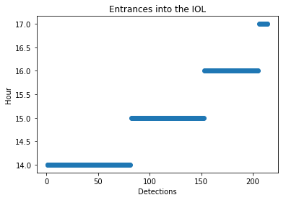

Super Sensors
Background
Public locations tend to routinely fill up at certain points during the day
A lack of available data on occupancy in public spaces makes it difficult to avoid the busiest times
Patrons of public spaces are left to guesswork in order to steer clear of long lines
Goals
Construct a device capable of tracking people as they enter and exit from certain locations
Organize the data and present it in an easy to read manner
Create a web app from which the data will be easily accessible
Methods
An Adafruit thermal sensor connected to an Arduino will collect raw data
REST API will be used to retrieve the data from the sensor
Team Members: Jon Snow, Jacob Easterling, Dan Kirichok, Conor Harrington

