Slide 1




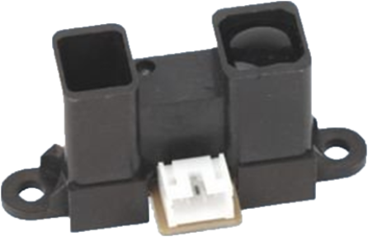
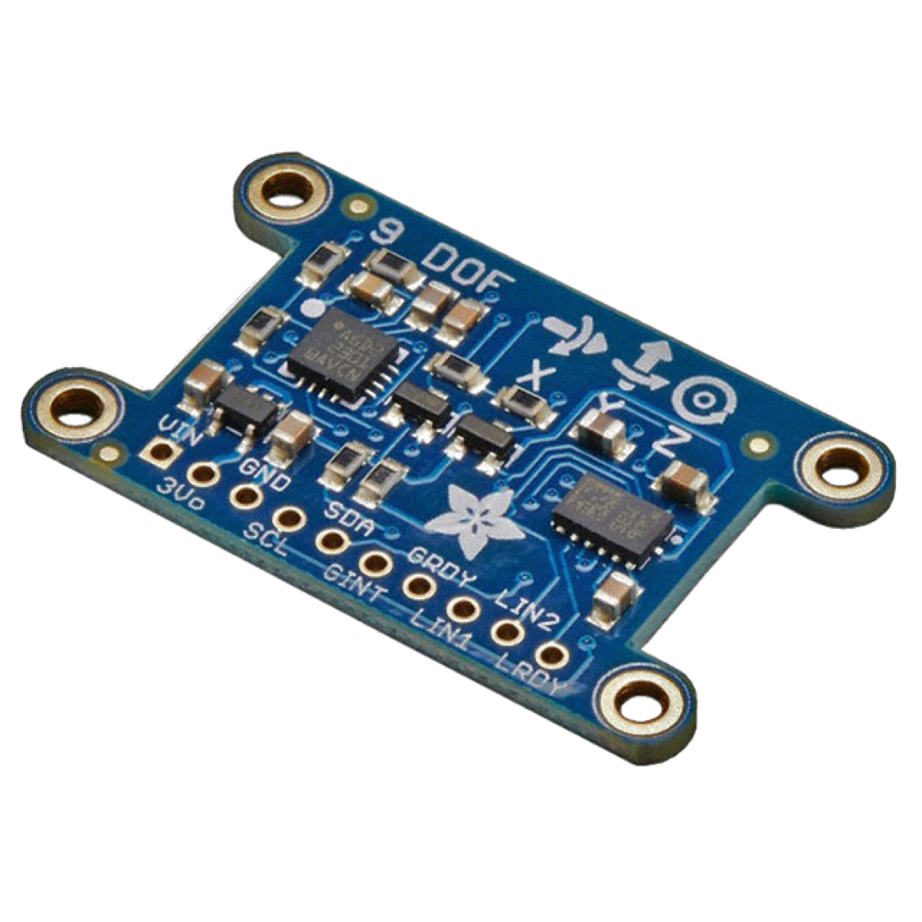
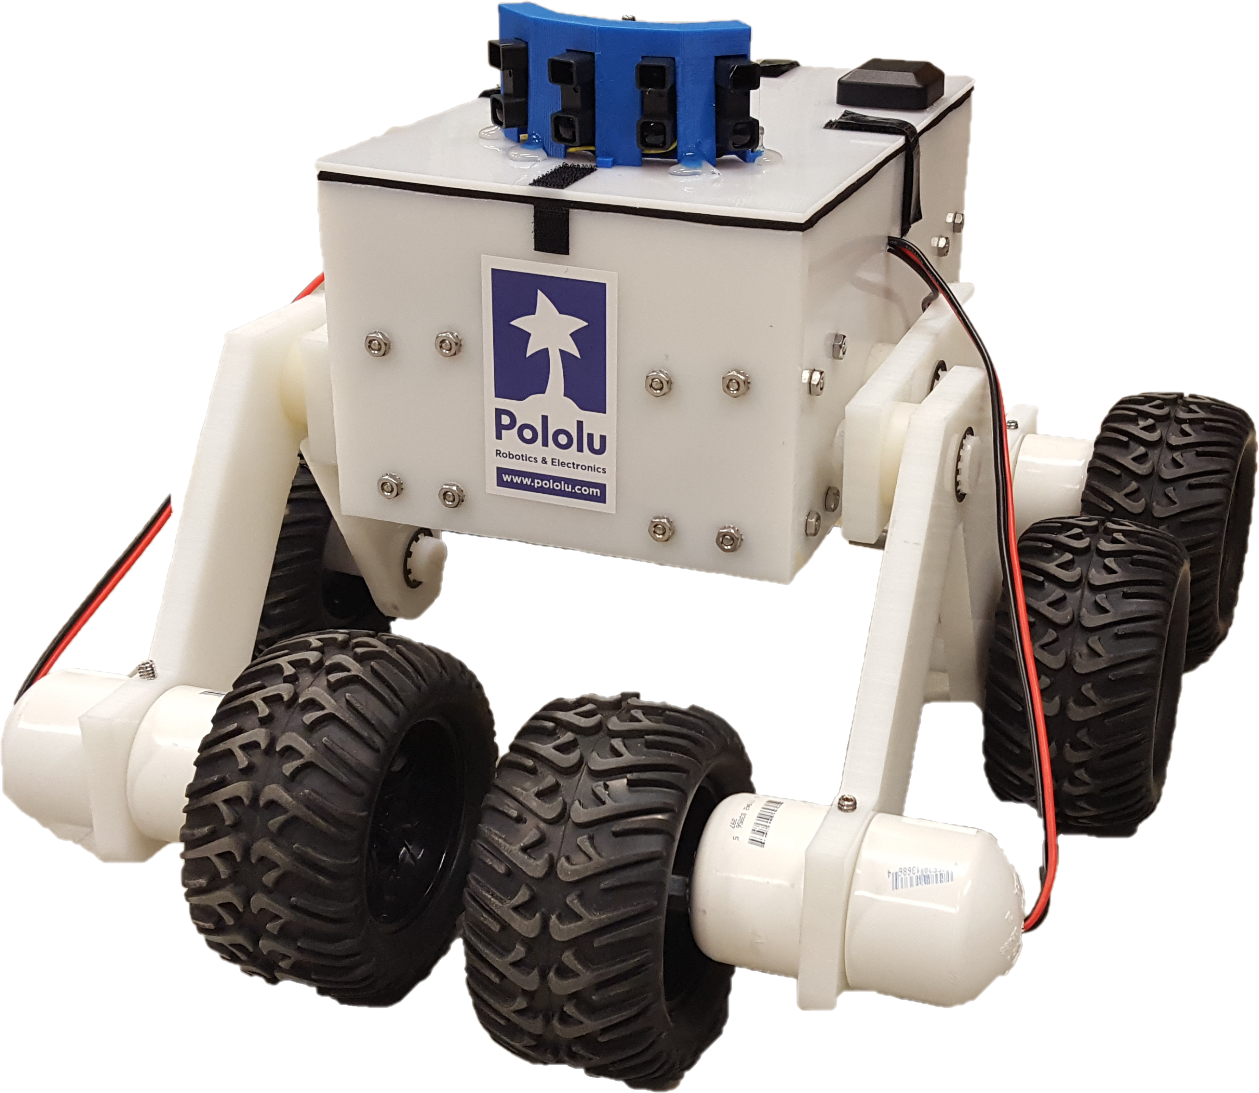

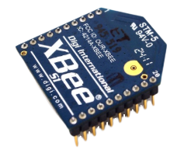
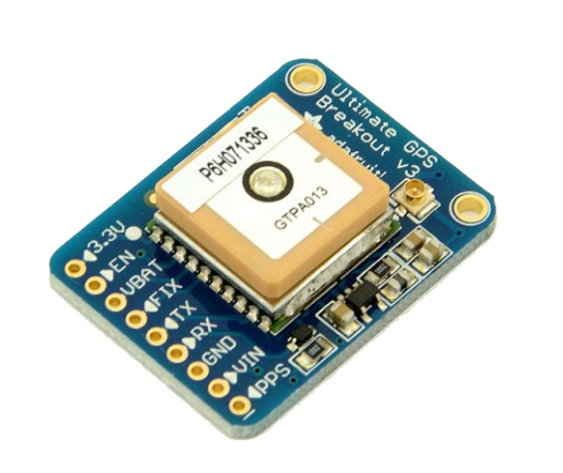
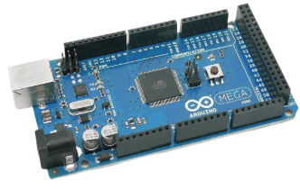
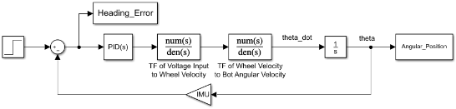
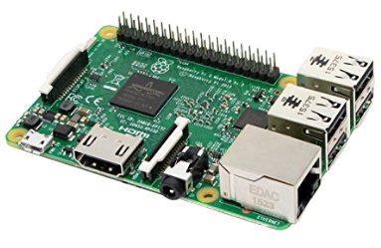
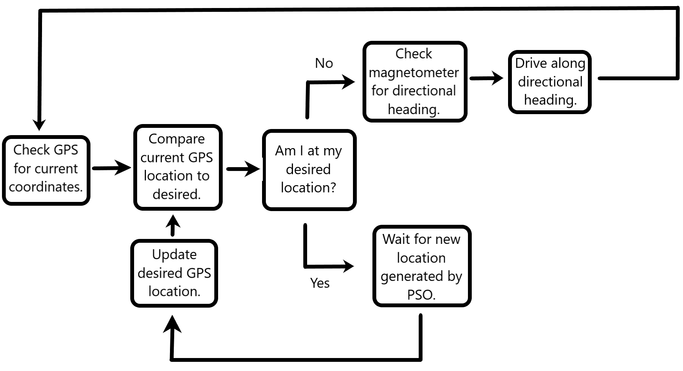
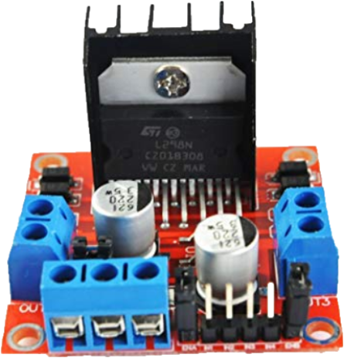
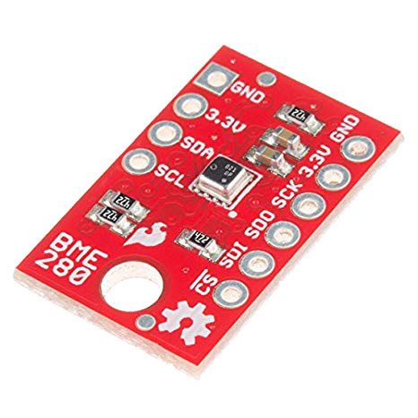
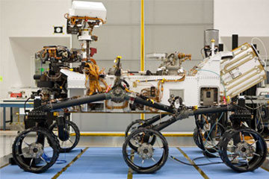

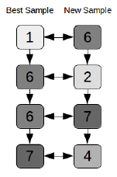
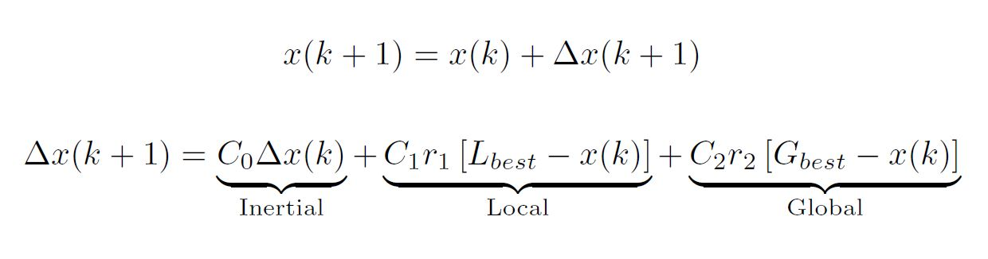
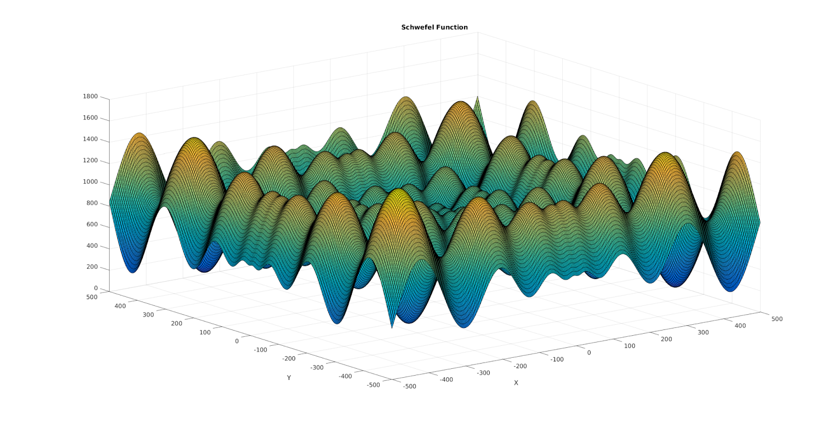
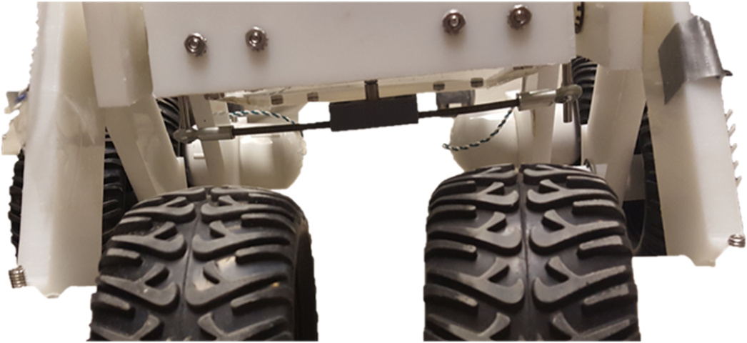
Team Members : Brian Brophy, Alex Cerce, Shaun Kerr, Tristan Lee, Brian Mitchell, Alexander Nees, Timothy Russell, Tuller Schricker, Jacob Shaker, Kevin Shea,
Benjamin Stadnicki
Advisors: Professor May-Win Thein,
Greg Hatfield, Alex Cook
Sensors and Electronics
Motor Control
Control direction and speed of motors in order to reach desired location obtained from PSO
Heading and Position Control
  IMU obtains current heading using the magnetometer
  GPS obtains current position
  Distance is determined using the following equation:
Where: 𝛽 = latitude (in radians) and 𝛾 = longitude (in radians)
  Based on our GPS module, this equation produces results that are accurate to within 2 meters
Both Heading and Position control implement a PID control system:
IR Distance Sensors
Detects obstacles, the 4 sensors provide 110º field of view
Inertial Measurement Unit (IMU)
Combination accelerometer, magnetometer, and gyroscope
Accurately determines roll, pitch and yaw of robot with 9 degrees of freedom
XBee Wireless Transceiver
2.4 GHz transmitter/receiver used to wirelessly communicate data throughout the swarm, allowing each bot to individually send and receive data
Adafruit Ultimate Global Positioning System (GPS)
Uses up to 22 satellites to determine location.
Location is used to help tell bots where they are and to help them determine how to get to their next location
Arduino Mega Microcontroller
Analog and digital input/output pins read sensor data and perform various tasks
Sends sensor data to Raspberry Pi via serial communication for processing
Raspberry Pi 3B Microprocessor
Main microcontroller for the Swarm
Uses sensor data and the PSO algorithm to select search points and plan path to destination
L298N Motor Controller
Uses pulse width modulation from Arduino to power motors. Acts as DC/DC converter.
Each controller powers one side of the robot
Atmospheric Sensor Breakout - BME280
Obtains temperature, humidity, and pressure readings in order to obtain the altitude of the bot
The altitude readings are then used for the PSO
Particle Swarm Optimization
Obtains temperature, humidity, and pressure readings in order to obtain the altitude of the bot
The altitude readings are then used for the PSO
Robust optimization algorithm
Used for unknown, nonlinear, multidimensional fitness functions
Scalable, Efficient, Decentralized, and independent of a priori
Based on Swarm Theory (bees, school of fish, etc.)
Operates in discrete time (steps)
Requires: Knowing location, sensor readings, inter-bot communication.
Where: k = time step; x = vector position of a particle; C’s = the weight for the respective term;
r = random vector on interval (0,1), L = Local (individual particle) best vector location;
G = Global (whole swarm) best vector location.
Rocker Bogie Suspension
This year’s chassis was inspired by NASA’s Rocker Bogie suspension system, which can be found on Mars rovers such as Opportunity and Curiosity.
Uses a differential bar to relate motion between the rockers instead of differential gears.
This system offers chassis stability, the ability to climb steep terrain, and ease of manufacturing.
Eliminates the need for conventional springs and damper suspension systems.
Reduces noise in sensors that is generated by the DC motors by moving them outside of the chassis.
Reduces the cost from nearly $1,000 per robot to roughly $450 per robot.
Acknowledgements for their assistance in this project: Jonathan Ells, Ryan Bergman, and the ET NavSwarm Organization

