Slide 1

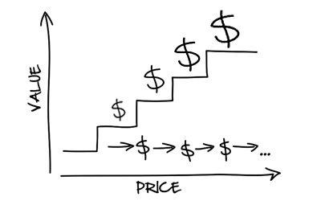
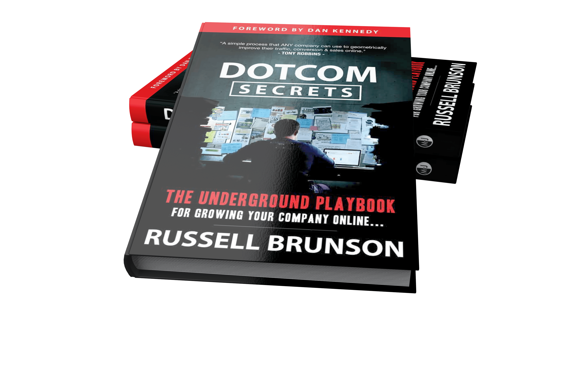



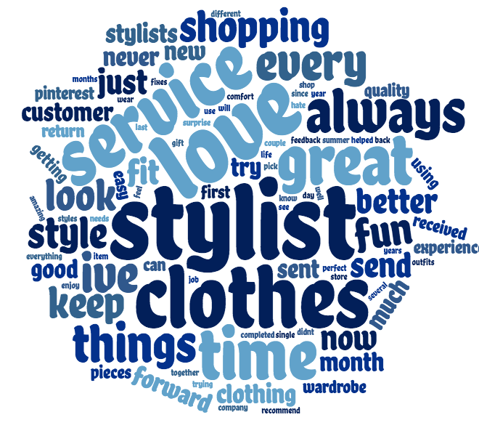
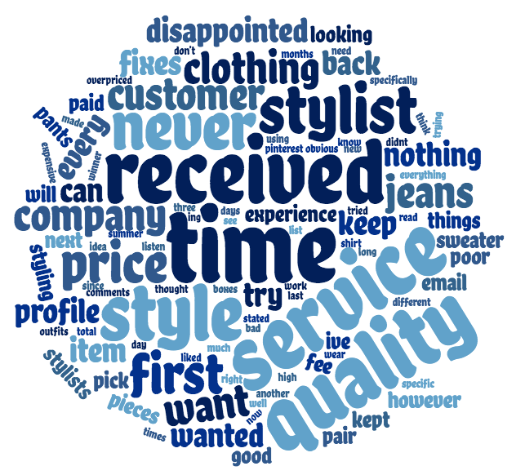
Ascending and Descending the Value Ladder of a Subscription Service
Spencer Pope
Paul College of Business and Economics, University of New Hampshire, Durham, NH 03824
Faculty Advisor: Inchan Kim
Literature Review of Internet Marketing
Research Questions
What is Internet marketing?
The process of driving traffic to your business
Using the traffic you own to create more business for yourself
Creating email strings, facebook ads, and sales funnels
What is ascending a value ladder?
3 Ways to Grow your Business are to increase:
  Value of your Product/Service
  Number of Clients you sell to
  Frequency of Client Return
What makes clients ascend the value ladder of a business?
What factors into clients terminating their agreements?
What can we learn from StitchFix about the future of internet marketing?
Methods
Topic Analysis
Positive:
Negative:
Consistent
“service”
”every”
“shopping”
“always”
“time”
Alternative
“getting”
”keep”
“shopping”
“company”
“clothes”
“better”
“service”
“will”
“together”
”wear”
Mislead
“disappointed”
”item”
“try”
“expensive”
“pieces”
“three”
“fee”
“clothes”
“service”
”pants”
Poor Quality
“send”
”quality”
“received”
“clothing”
“back”
Research Process
Web Scrape Client Review Data
Topic Analysis
Thesis Proposal
Data Cleaning
Results
Learnings
297 reviews scraped from the internet
Cleaned data using R studio cloud
5x5 and 10x10 topic analyses ran using two different R packages
Further analysis done using topic mapping to the raw data
Word clouds created with all topic analysis results
Positive reviews highlighted convenience
Negative reviews indicated distrust
Stitch Fix – An online personal styling service that combines the talents of stylists and data scientists to provide outfits shipped right to your door at your choice of frequency.
Client trust can be lost very easily
  Quality not as expected
  Price/style not aligned with profile
  Customer service short comings
Stitch Fix should be marketing the convenience factor
  For those who hate shopping
  Or don’t have time
  Keep it black and white
Future studies should experiment with sales funnels based around honesty and convenience
Internet Marketing Tactics:
Email strings
Pop-up ads
Value Ladder:
Style profile
Price range/Order frequency
72% Positive
28% Negative
Brunson, R. (2015). Dotcom secrets: The underground playbook for growing your company online New York: Morgan James Publishing.

Slide 2

This poster template provided courtesy of
UNH ESRC Poster Printing Services
Trust us to make your poster look GREAT!
Website: http://posters.unh.edu
Poster Guide: http://goo.gl/1E7TJY
DELETE THIS SLIDE BEFORE PRINTING

