Slide 1

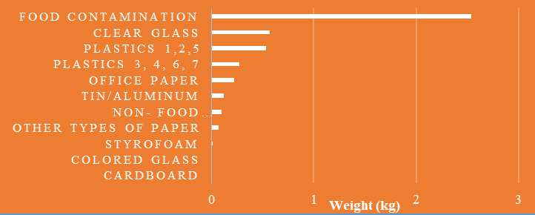
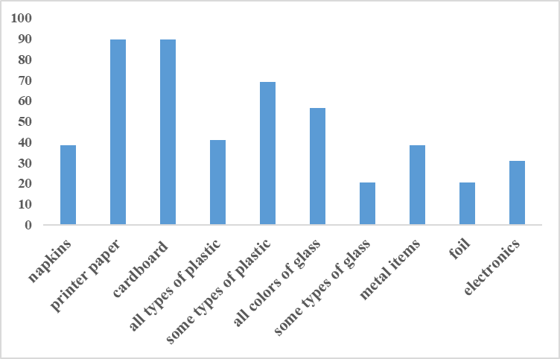
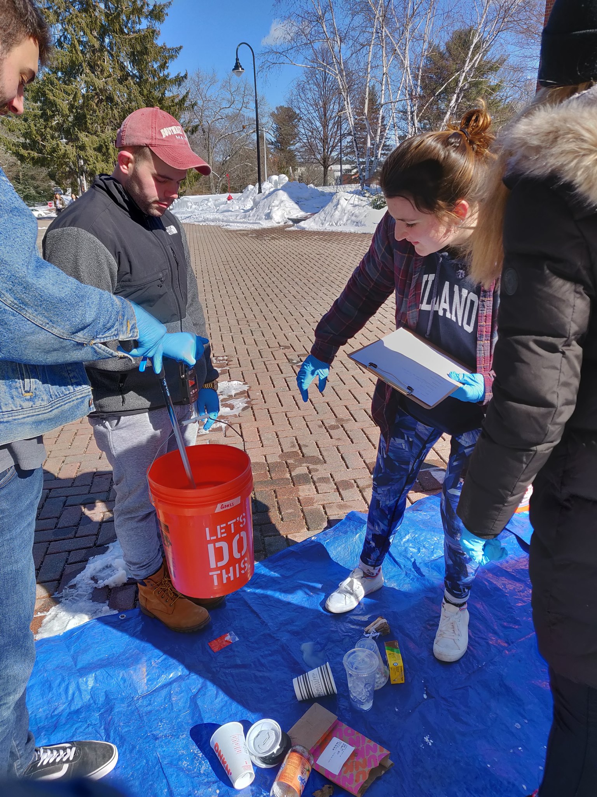
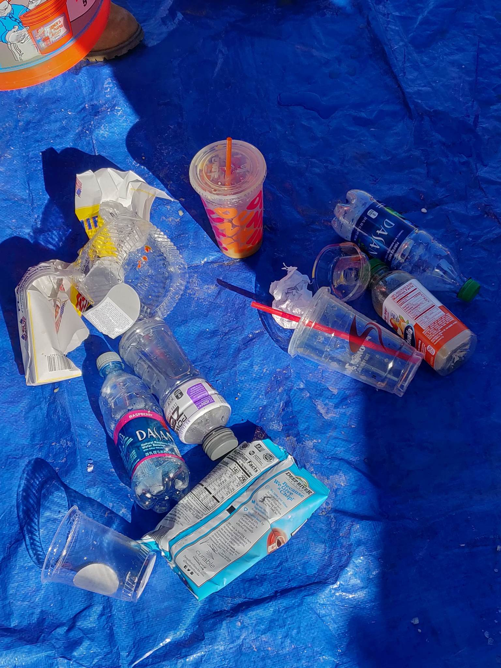
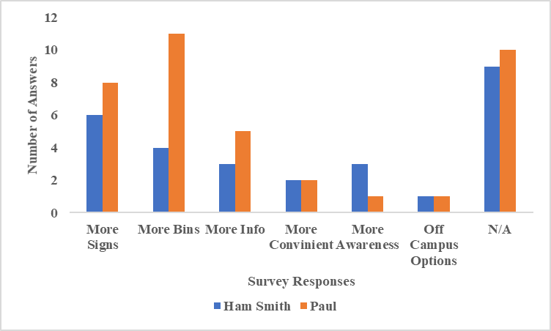

UNH’s Recycling Crisis:
An Assessment of Recycling Knowledge in Relation to Behaviors
Emily Bean, Jodi Bezanson, Timothy Readdean, Casey Shea, Daniel Sheldon
Advisors: Jennifer Andrews and Colleen Flaherty
Sustainability Dual Major Project Spring 2019
Introduction
Results
Results
Waste has a negative impact on both the natural and social environments. When it is not recycled it is sent to a landfill or incinerated; both methods contribute to air, groundwater, and soil pollution. Recycling is one well-known way to divert materials from the landfill. One large issue within the recycling system is contamination, which occurs when non-recyclable materials or food waste are placed in recycling bins. If any percentage of recycling is contaminated, the bin is deemed non-recyclable and is managed as waste. Contamination can undermine successful recycling habits. ¹
57.6% of all recycling collected was contaminated with food waste
80.7% of people surveyed learned about recycling through information posted around campus
When asked if “any food contamination would make an item unrecyclable”, 55.9% of people correctly answered “true”, and 44.1% incorrectly said “false”
Discussion
Figure 1. Composition of waste by category. Weight measured in kilograms. Compilation of data from both Hamilton Smith and Paul college
The most prevalent material extracted from each bin was food contaminated waste
There is a collective ambiguity as to what can be recycled – especially when it comes to food and liquid contamination
There is no single source or place wherein students and faculty feel they can receive information about recycling
The public believes the most effective way of communicating about recycling is through the use of signs around campus
Research Questions
What is the general base of knowledge on recycling between students, faculty and staff?
What are the most prevalent types of contaminated waste are in recycling at UNH and how much of the total recycling mass does this account for?
Does knowledge on recycling affect the amount of contaminated waste in our recycling on campus?
Methods
Next Steps
Figure 2. Percent of people surveyed who answered each type of waste material for the question “Which of the following can be recycled?”, combining the data from both buildings.
With the data collected, it is clear that UNH students, faculty, and staff need to be further educated on how to properly recycle in order to create less contamination within recycling². Some methods might include formal training, consistent bins, and more understandable signage. Once UNH is adequately trained on recycling methods, the movement towards zero waste and a sustainable future can continue.
Two recycling waste audits were performed in academic buildings Paul College and Hamilton Smith Hall
Sorted waste into 11 categories, and the weight of each category was recorded in kilograms
Performed intercept surveys, in both buildings, composing of 7 questions
References
Sameerow. “Recycling Bin Contamination.” Planet Blue, University of Michigan , 12 Jan. 2014, sustainability.umich.edu/environ211/recycling-bin-contamination.
Andrews, Ashley, Mary Gregoire, Heather Rasmussen, Gretchen Witowich, Comparison of recycling outcomes in three types of recycling collection units,Waste Management, Volume 33, Issue 3, 2013, Pages 530-535.
Figure 3. Survey responses for the question “What suggestions do you have to improve recycling at UNH?”, compared between the two buildings surveyed on campus.

