Slide 1

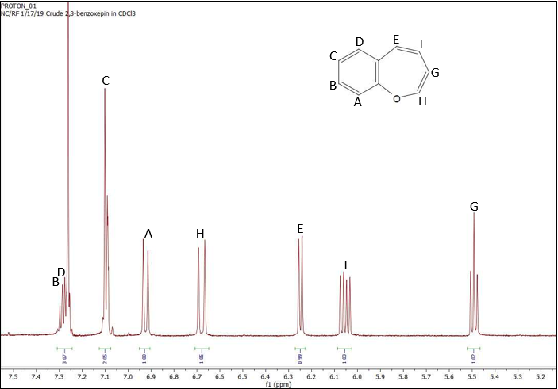
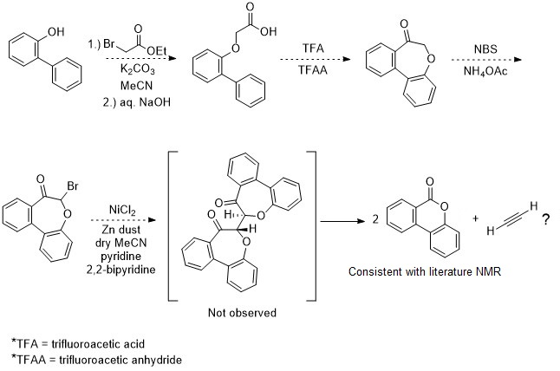
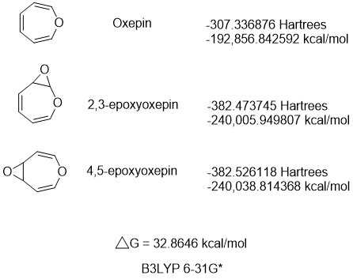
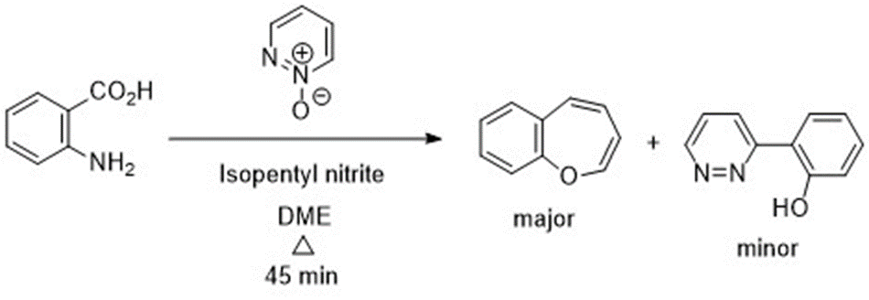
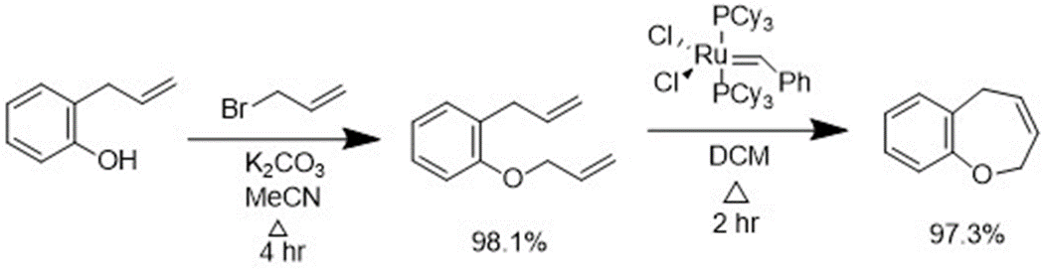
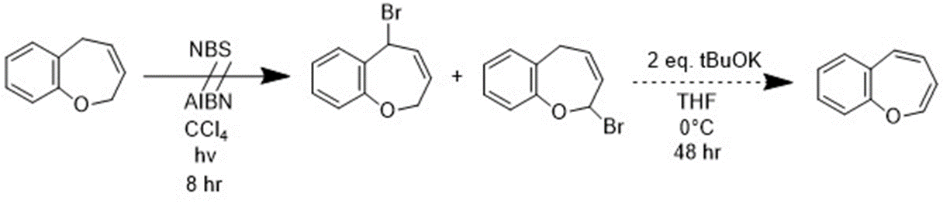
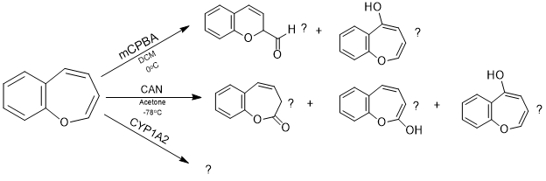
Synthesis of Model Oxepin Substrate 2,3-Benzoxepin for Benzene Metabolic Mechanistic Studies with m-Chloroperbenzoic Acid, Cerium (IV) Ammonium Nitrate, and Cytochrome P450
Noah A. Cote^{2a}, Ryan W. Fitzgerald¹, Tristan J. Hart-Bonville^{2b}, Arthur Greenberg^{3*}
nac1009@wildcats.unh.edu, Department of Chemistry, University of New Hampshire, Durham, NH
Benzene is a known carcinogen and dangerous chemical used in industry. Modeling the mechanistic pathways of the cancer-causing metabolites in the liver is an important step to both prevent future illnesses as well as assist those currently ill. The Greenberg group at UNH focuses on synthesizing model substrates of benzene oxide’s valence tautomer, oxepin, to aid in elucidating ring-opening metabolic pathways.
This project focuses on the synthesis of the second model substrate 2,3-benzoxepin. Compared to other model substrates, 2,3-benzoxepin could potentially exemplify competition for epoxidation of the ring when performing enzymatic as well as potential competitive consecutive one-electron oxidation.
Scheme 1. Metabolic routes of benzene in vivo.^{1,2,3}
Introduction:
To perform the separation of products and final characterization of both the CAN as well as mCBPA reactions. Further purification is necessary as tautomers appear to be present. The analysis of the enzymatic assays needs to be completed to finalize the comparative study. Continue to synthesize a dibenzo dimer derivative for the 4,5-benzoxepin project.
The original multistep synthesis of 2,3-benzoxepin was abandoned for a direct route using an n-oxide. Reactions with mCPBA and cerium (IV) ammonium nitrate have been completed and are currently in the characterization process. Enzymatic assays have also been completed but have yet to be analyzed.
Results and Discussion:
Future Work:
Figure 1. ¹H NMR (400MHz, CDCl₃) of 2,3-benzoxepin.
Figure 2. Computational studies of competitive epoxidation
of oxepin using B3LYP/6-31G*.
Conclusions:
Acknowledgements:
The Elsawa group must be gratefully acknowledged for the use of lab space and equipment when performing the enzymatic studies. My mentor Ryan, other undergraduate research assistant Tristan, and the rest of the chemistry department are acknowledged for their constant support within and outside of this synthesis.
Experimental Work:
References:
Vogel, E., Gunther, H., Angew. Chem. Int. Ed. 1967, 6, 385-476
Davies, S. G., Whitham, G. H., J. Chem. Soc. Perkin Trans. I, 1977, 1346-1347
Morgan, J., Greenberg, A., J. Org. Chem. 2010, 75, 4761-4768
Greenberg, A., et. al., Structural Chemistry, 1998, 9(3), 223-236
Nauduri, D., Greenberg, A., Tetrahedron Letters, 2004, 45, 4789-4793
Paquette, L. A., Barrett, J. H., Org. Synth. 1969, 49, 62.
Rabideau, Peter W., Burkholder, E., J. Org Chem. 1978, 43, 4283-4288
Scheme 2: Original multistep synthesis of 2,3-benzoxepin.
Scheme 3: Direct route to 2,3-benzoxepin with further reactions with CAN, mCPBA, and CYP1A2.

