Slide 1

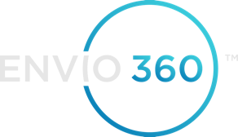
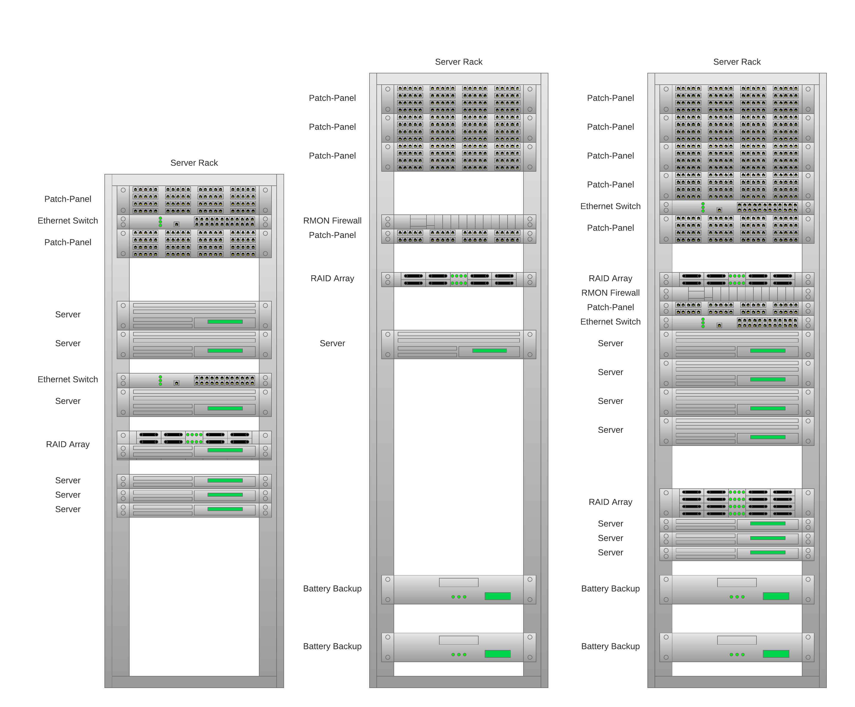
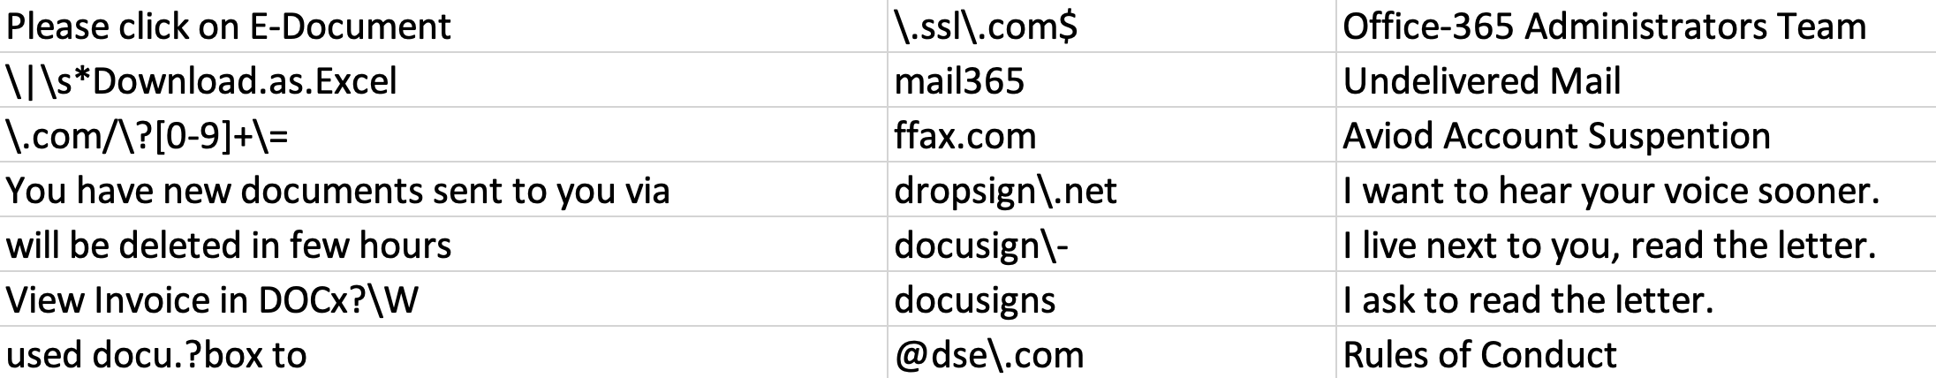
Profit Tools IT Infrastructure Improvement
Benjamin Ward Sponsor: Tyler Bedgood
Help Desk
Server Rack Configuration
ngDesk
Free and open source (minimal budget)
Clean interface and simple to use
Enables employees to submit requests by email
Allows IT staff to prioritize and complete requests
Can generate reports about key metrics on ticket resolution and types of requests
Ability to utilize APIs for more advanced and customized features in the future
Provided documentation for IT staff and employees on how to use the software
ngDesk offers online support
Consolidation
Made sure each and every server was actually needed
Documented the old configuration
Using Lucidchart I created a diagram of the original two racks in the server room
Created a new diagram that was a consolidated version of the two racks
Profit Tools is going to moving to an office space in Dover from their current office in Lee, so no consolidation has been done yet
They will be using the new diagram once they are in the new office space to setup all of the equipment in one server rack
Security – Spam Filtering
Spam Filters
Setup through Administrator account on Outlook
Researched the best filters and how to set them up
Used regular expressions (regex) to filter out by specific words, phrases, etc.
Also filtered out by specific email domains and subject lines
Provided documentation on best practices regarding spam emails

