Slide 1
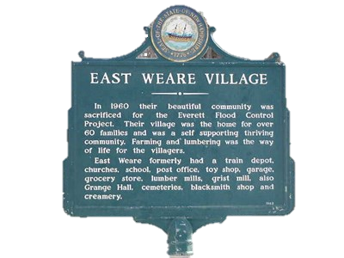

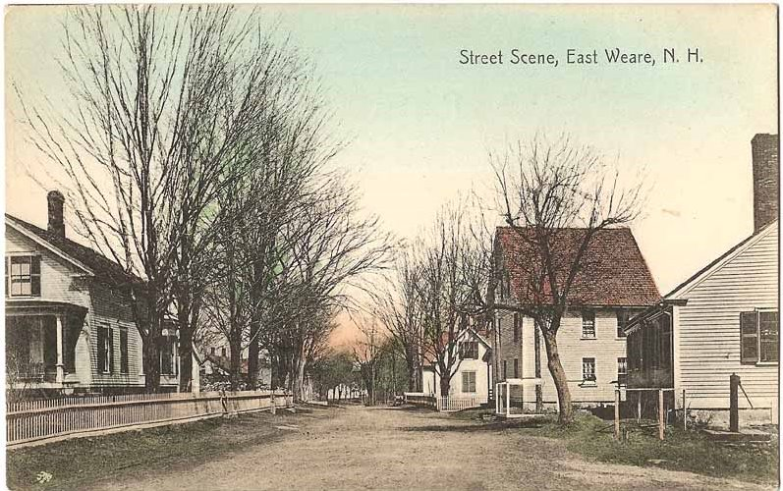
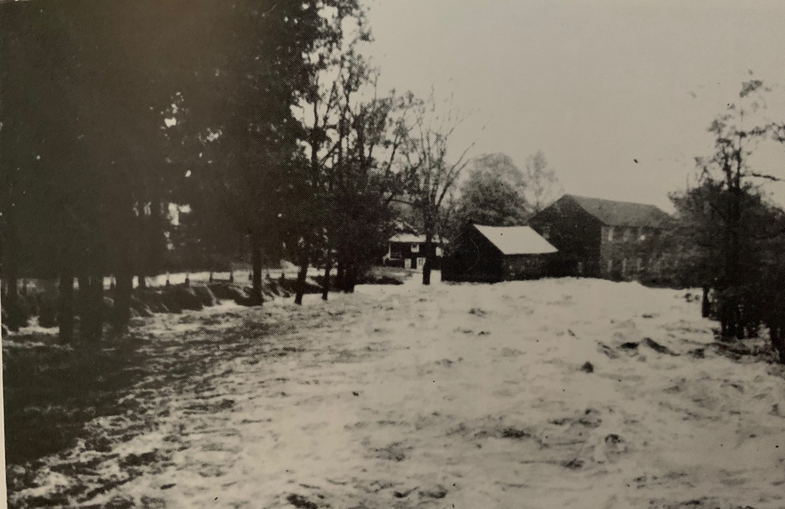
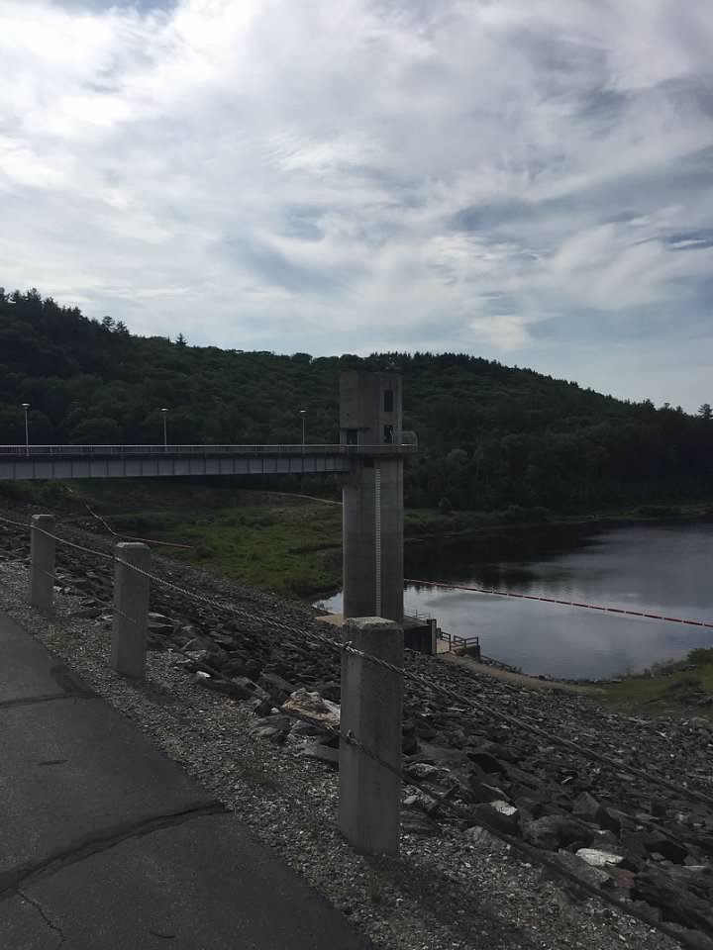
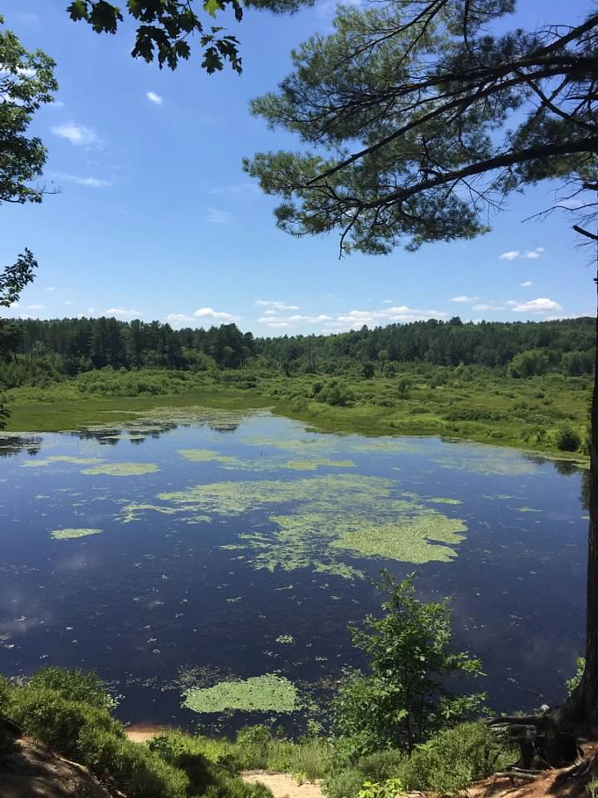
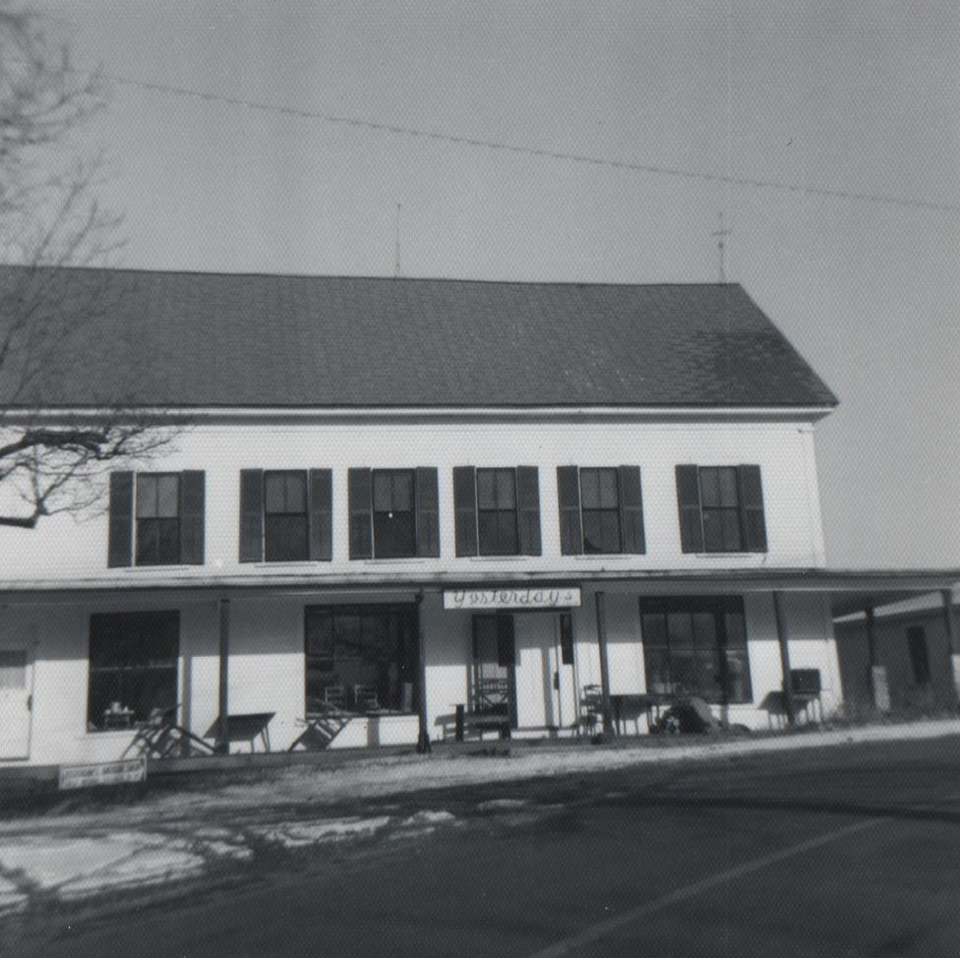
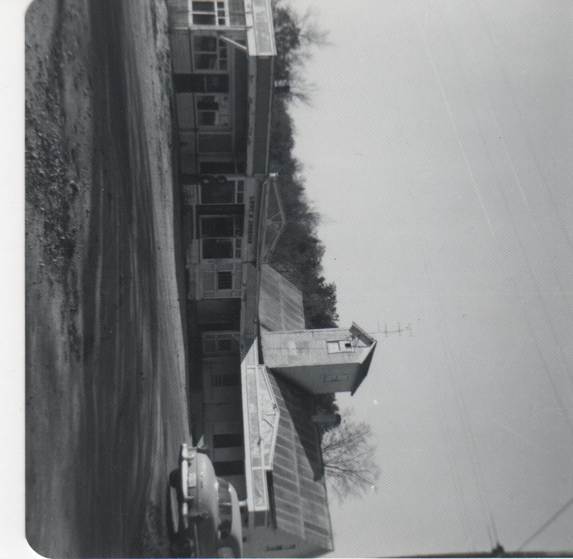
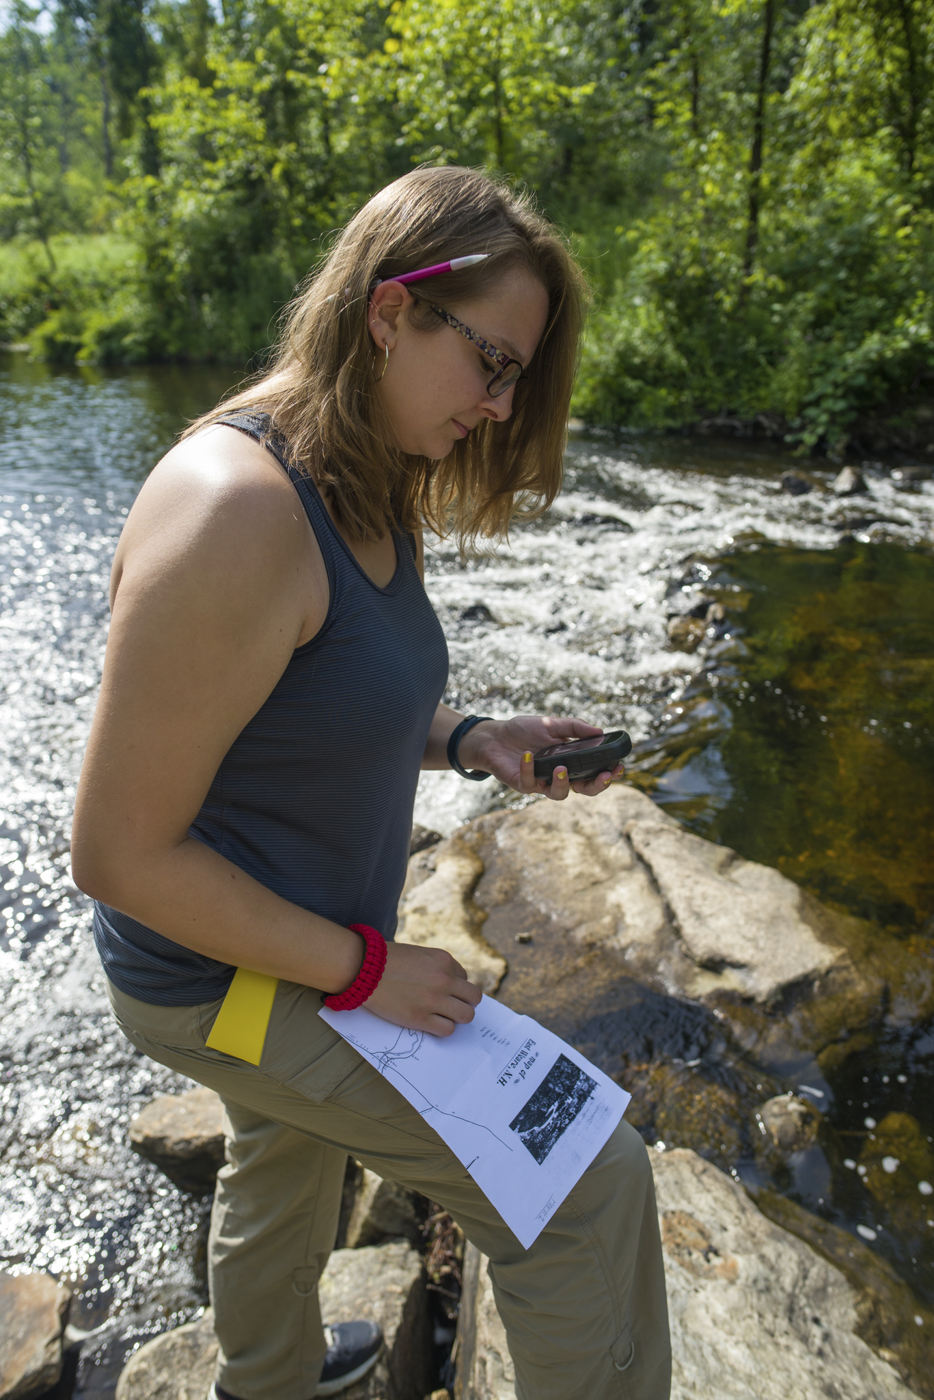
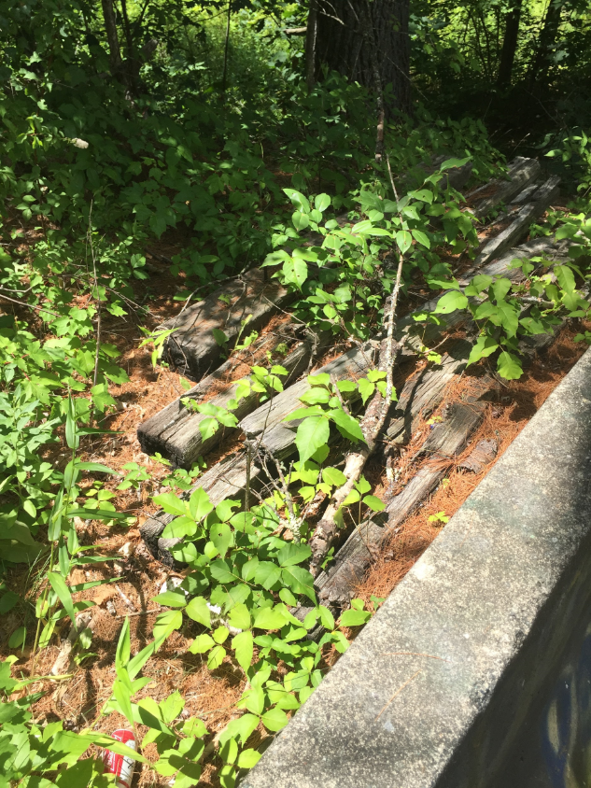
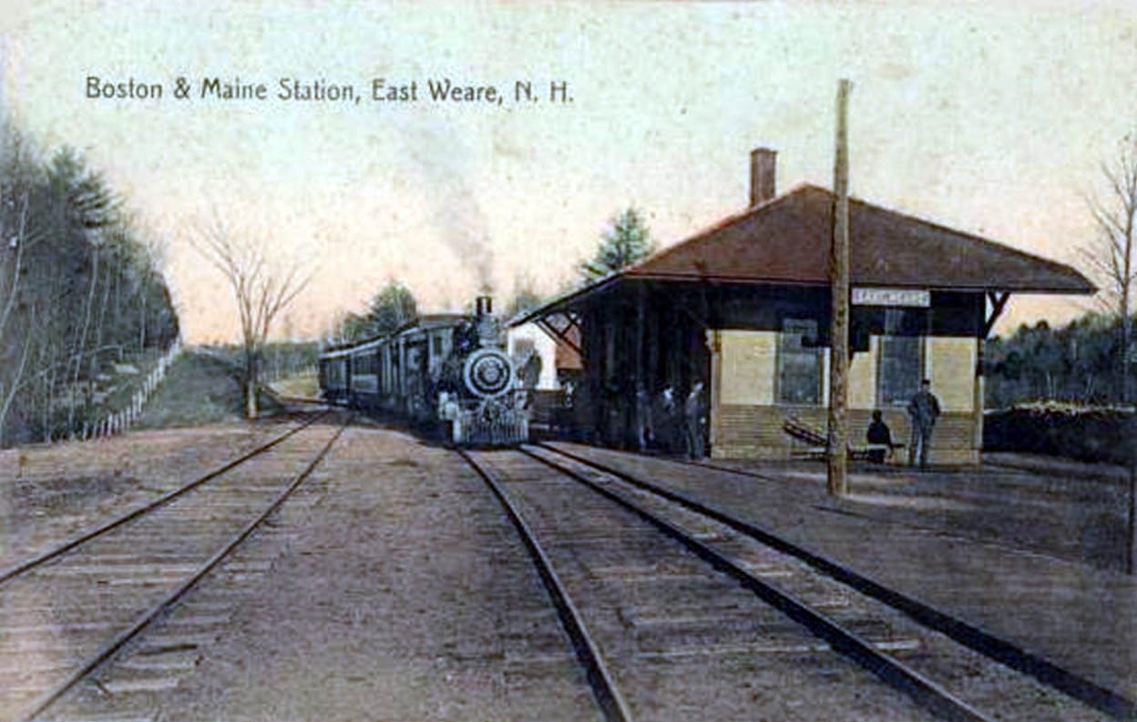
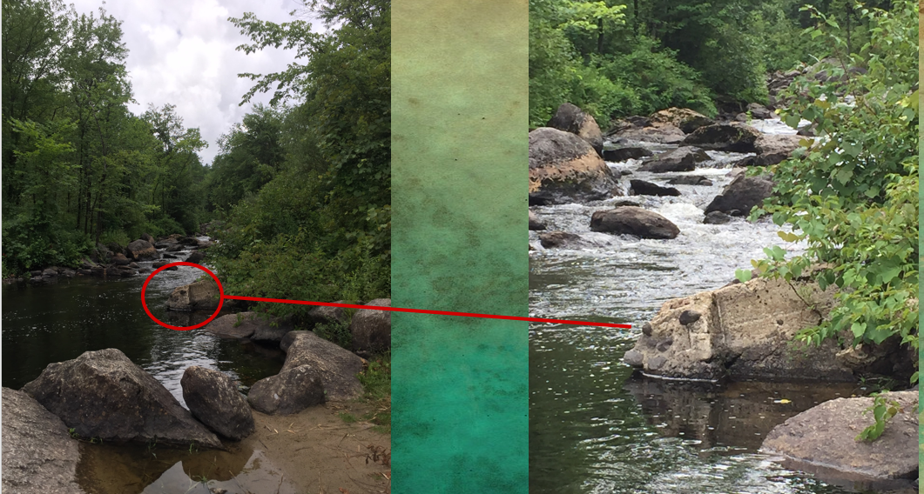
Preserving a Lost Village:
Ground Truthing Residual Foundations from the Great Flood of 1938
East Weare, New Hampshire
What was East Weare Village?
Riley V. Boss
Department of Anthropology, University of New Hampshire
Dr. Meghan Howey, Faculty Mentor
Department of Anthropology, University of New Hampshire
Everett-Hopkinton Dam Project
East Weare Village was flourishing with businesses, housed roughly 60 families, and attracted outsiders to wander the shops and meet friendly people. It was also the section of Weare that suffered the worst and the longest damages after the flood of 1938 (Dearborn 1959: 152).
East Weare Village lies around the Piscataquog river that runs through the town of Weare into Goffstown. There were approximately 97 buildings at the time of the 1938 hurricane; consisting of homes, lumbering industries, a toy shop, a train depot, churches, a post office, blacksmith shops, a school house, creameries, a pub, and mills (Brown 2008).
The flood dispirited the residents to put in efforts to restore their community. In the next two years after the devastation, the federal government brought in a number of saw mills to chop up the lumber and assist Weare residents in the town clean up (Dearborn 1959: 151). Around the mid-1950s, there had since been reoccurring flood across the land of East Weare (The Weare Junior Historical Society 1972: 14).
Although East Weare had never fully recovered from the flood, there were many families who refused to move, while others had no choice but to relocate. The Hopkinton-Everett dam was approved by congress in 1957 the New Hampshire State Legislatures established a commission to take on the project and begin clearing roads, moving remaining residents, and officially restrict any more building on the land (US Army Corps of Engineers). The Hopkinton-Everett dam was completed in 1962 and the area that once had been East Weare Village became a flood zone owned by the federal government.
The Great Flood of 1938
During the 1938 flood, buildings were washed away with the waters (Dearborn 1959: 152). Transportation in and out of the town of Weare was practically impossible. Only one road that led into the neighboring town of Goffstown was untouched. The rest of the roads in the entire town were washed away or blocked by debris (The Weare Junior Historical Society 1972: 12).
According to one Weare elder I spoke to, there were a number of mills and houses in Weare that were burnt to the ground because the fire trucks had to drive 50 minutes around the boarder of Weare in order to get to the call. Electricity was out for nine days.
Residents of Goffstown, Dunbarton, and Henniker offered to temporarily house anyone that had their homes demolished by the waters according to another Weare elder I spoke to.
Old postcard of East Weare Village (Brown, 2008)
Flood waters rising by the Toy Shop right before the building was swept, 1938 (Weare Historical Society)
Left: Hopkinton-Everett Dam present day (Boss, 2018)
Right: Swamp in the center of East Weare Village presently (Boss, 2018)
Left photo: Alfred H. Marshall’s Store, E. Weare (Eaton, C. 1950s) Right Photo: Unknown (Ray Eaton)
Finding East Weare Village
Methods
Cultural Heritage
Acknowledgements
With the help of Light Detection and Ranging (LiDAR) maps provided by NH GRANIT, and a clearinghouse of Geographical Information System (GIS) services, the goal of this research was to ground-truth remaining features throughout East Weare Village.
By examining LiDAR maps, most artificial structures could be uncovered without the trouble of dense forests and vegetation growth. This allowed for ground-truthing to be done; a technique where a survey and search is performed to locate a feature or landmark inferred on a record and its exact coordinates. Ground-truthing also informs whether a feature or landmark is significant.
Vegetation growth played a huge role in finding where buildings once stood as well.
Utilized vegetation growth at approximate locations of each building
Ground-truthed first, then referenced LiDAR maps borrowed from UNH GRANIT
Collected coordinates of area and uploaded them into ArcGIS
Created Story Map Journal
Pinned and narrated each building found
Interviewed Elders of Weare
Transcribed interviews and added their commentary to build the story
Interested in exploring the Story Map Journal?
Ask the Weare Library or the Weare Historical Society for a link!
Cultural heritage is a characteristic unique to all communities, varying between different countries, states, and even town to town. It takes the form of physical relics or memories, both which can be passed down through generations. Every story shared and item inherited allows for the vestige of that culture to survive through time. Contemporary forces of each generation, such as looting, tourism, and climate change, put distinct cultural heritages at the risk of being lost (Barthel-Bouchier 2013).
When I was just beginning this research, I asked some of the Weare elders what they would like to see as results if my research were to ever be launched as a project. The majority of them said, in one way or another, that they would like to see East Weare Village brought back to life. For them, they were just teens and kids when their homes were destroyed by the hurricane of 1938. Some were driven out of the village immediately after their homes were destroyed, and the rest were relocated by the U.S Army Corps of Engineers in the 1950s when the proposal to build the Hopkinton-Everett dam was approved.
This is what archaeology and anthropology are all about. We preserve stories, cultures, and essentially the lives that once lived in a time we cannot witness for ourselves. We can share and pass on these stories, connecting people to their roots or educating them on what once was so important to their town, neighbors, friends, and so on.
I humbly thank the Hamel Center for Undergraduate Research for awarding me a Summer Undergraduate Research Fellowship, and the donors of the Rebecca Lang Scholarship.
I’d also like to thank Dr. Meghan Howey and Dr. Marieka Brower-Burg for helping bring this archaeological adventure to life.
Thank you to my fellow Wearites; Betty Straw, Ray Eaton, Don Gage Sr., Kevin Martell, Allen Ilsley, the Weare Public Library, and the Weare Historical Society.
My final and biggest thank you is to my grandfather Charles L. Osborne… Without his help, I would have never noticed the old tree that sparked a lightbulb to focus on vegetation growth.
Old postcard of East Weare Train Station (Brown, 2008)
Left: Riley Boss comparing coordinates with Weare Historical Map (Gasowski, 2018)
. Right: Old railroad ties from the Boston-Maine Railroad (Boss, 2018)
References
Barthel-Bouchier, Diane. 2013. Cultural Heritage and the Challenge of Sustainability. New York, NY: Routledge.
Brown, Janice. 2008. “New Hampshire Missing Places: East Weare Village.” Cow Hampshire. July 8, 2008.
Dearborn, Helen E. 1959. Town History of Weare, New Hampshire from 1888. Concord, NH: Evans Printing Company.
Howey, Meghan C.L, Franklin B. Sullivan, Jason Tallant, Robert Vande Kopple, Michael W. Palace. 2016. Detecting Precontact Anthropogenic Microtopographic Features in a Forested Landscape with Lidar: A Case Study from the Upper Great Lakes Region, AD 1000-1600. PLoS ONE 11(9). https://doi.org/10.1371/journal.pone.0162062.
The Weare Junior Historical Society. 1972. The Flood and Hurricane of 1938 Weare, New Hampshire. Weare, NH: Acisme Service Corporation. US Army Corps of Engineers. 2016. “Hopkinton-Everett Lakes Flood Risk Management Project.” US Army Corps of Engineers. April 7, 2016.
Residual foundation presumably from the Toy Shop in the river (Boss, 2018)

