Slide 1
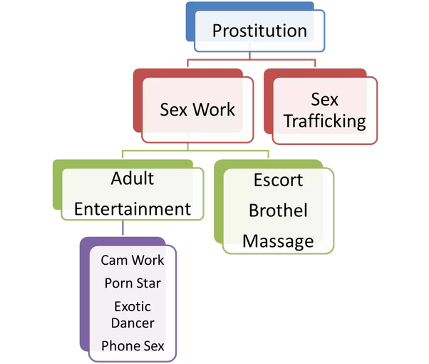
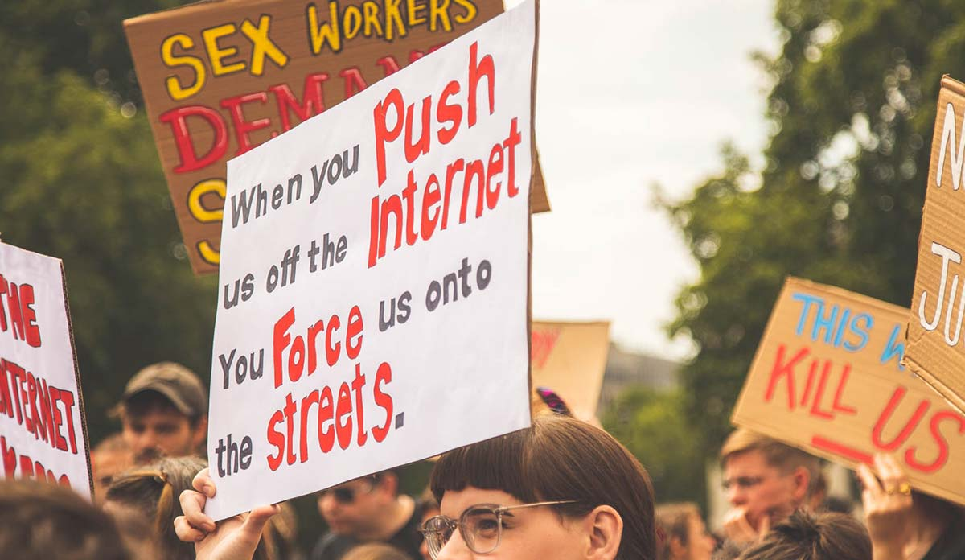
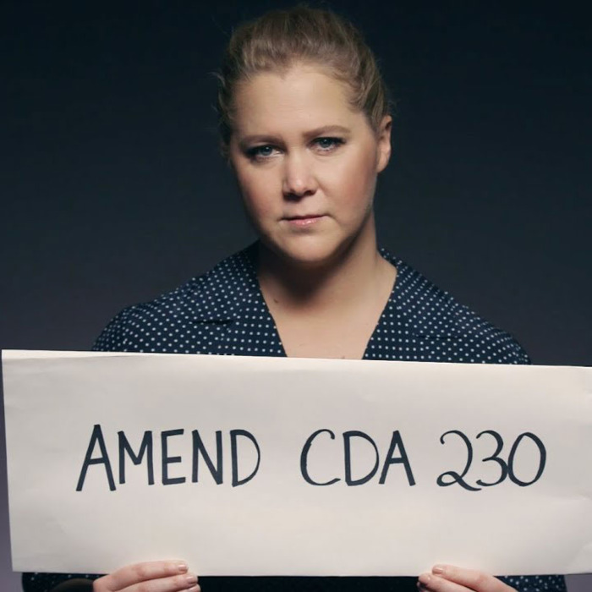
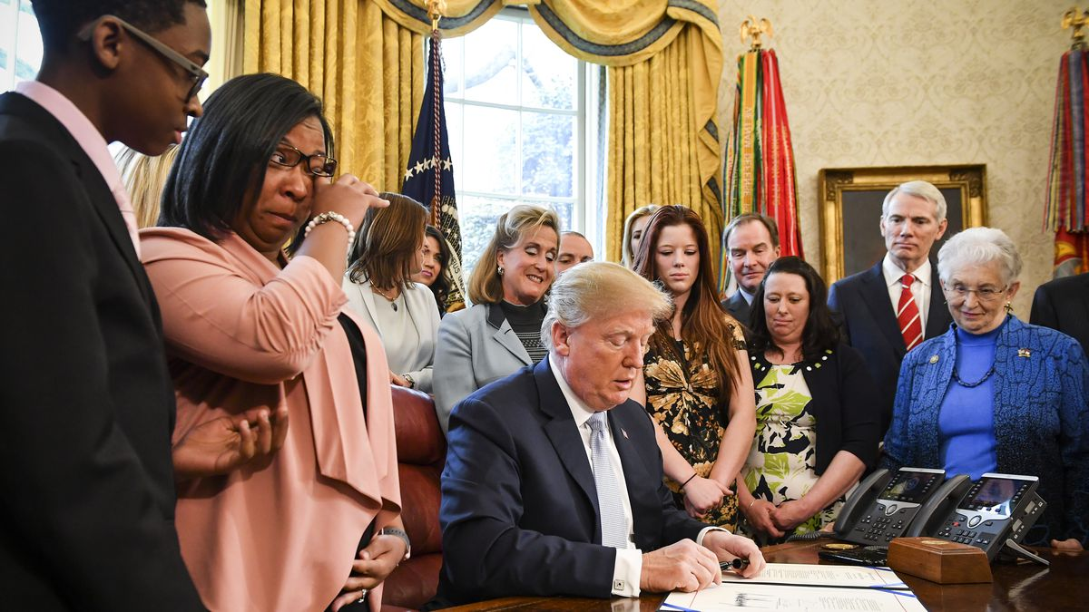

Intent and Impact of Fight Online Sex Trafficking Legislation Act (FOSTA) and Stop Enabling Sex Traffickers Act (SESTA).
Kyana Burgess, Department of Anthropology
Background/Objective
Defining Prostitution
In an attempt to hold internet platforms accountable for any advertising involved with sex trafficking, FOSTA-SESTA was signed into law on March 21st, 2018. These acts intended to protect victims of sex trafficking and provide them means to prosecute cases against online platforms. The objective of this study is to evaluate the actual impact of FOSTA-SESTA on sex workers and victims of sex trafficking.
“Human trafficking remains shockingly prevalent in this day and age. Sex trafficking, which includes prostitution, pornography production, bride servitude, and the commercial sexual abuse of children, is one of the most lucrative and disturbing sectors of the illegal human trafficking trade. We cannot allow this to continue in the United States.
For this reason, I supported the Stop Enabling Sex Trafficking Act, a bipartisan measure that was recently signed into law. The law amends the Communications Decency Act to specifically target human trafficking activity and holds websites accountable if they knowingly facilitate sexual exploitation by third parties and would allow victims of sex trafficking to seek justice. This law is narrowly tailored to specifically target cases of sex trafficking and preserves the Communications Decency Act’s “Good Samaritan” provision that protects websites that proactively block and screen offensive content.” - Senator Jeanne Shaheen, D-NH
The key difference between sex work and sex trafficking is consensual action between both parties in the act of exchanging money for
sexual services.
FOSTA-SESTA: An Overview of the Bill
Protesters of the FOSTA SESTA bill at a gathering
(Fig.1)
(Sec. 2) Updates the Communications Decency Act of 1934 Section 230 to remove legal protection of website providers and users that unlawfully promote and advertise of unlawful sex acts with sex trafficking victims.
(Sec. 3) The bill amends the federal criminal code to impose penalties on a person promoting or facilitating the prostitution of another person.
(Sec. 4) Amends the Communications Decency Act of 1934 Section 230 to remove limits on federal-civil claims, and federal/state criminal charges for conduct that constitutes sex trafficking/prostitution.
(Sec. 5) Amends the federal criminal code to clarify the crime of sex trafficking to be knowingly assisting, supporting, or facilitating a sex trafficking violation.
(Sec. 6) A state may file a federal civil action to enforce federal sex trafficking violations.
(Sec. 7) States that this bill does not limit federal or state civil actions or criminal prosecutions that are not preempted by Section 230 of the Communications Decency Act of 1934.
(Sec. 8) Requires the Government Accountability Office must report to Congress on information related to damages and mandatory restitution for aggravated offenses under this bill.
Impact of FOSTA-SESTA on Sex Workers
The bill which is aimed to stop sex trafficking on the internet, has shut down
pages (Backpage, Craigslist’s personal Ads), used by many sex workers to promote
their business, connect with other workers, and provide safety warnings.
Craigslist's ERC (Erotic Services Page) had connected sex workers and aided
them in screening clients with an overall lowered female homicide rates 10.17%
(Cunningham, February 2019).
The Internet provides workers independence, reducing the risk of violence from pimps and or other forms of control.
“I have seen people who already thought sex work was inherently harmful become more emboldened in these beliefs after FOSTA passed. It was a bipartisan bill, and all those politicians wanted to feel good about themselves, and so did CNN and it's readers. It was celebrated as a great step for women's rights. meanwhile I'm trying to keep my income afloat because I can't advertise, and I'm literally doing riskier work in order to make the same.”
–Elle Stanger, Sexual Educator, interviewed for this project
A star-studded Public Service Announcement ad fighting for changes in Section 230 of the Communications Decency Act.
(Fig.2)
Impact of FOSTA-SESTA on Sex Trafficking Victims
Limited internet access can cause sex trafficking victims to be forced into more dangerous situations such as street work, or subjected to more violence from their traffickers.
Without internet platforms, law enforcement lost a tool in identifying sex trafficking rings, potentially sinking trafficking victims underground where they cannot be located and rescued as easily.
Reports on statistical errors related to human trafficking occur often and with imprecision. Congresswoman and sponsor Ann Wagner referenced a FBI report United States carried a $9.5 billion dollar annual revenue in human trafficking. During investigation, it was found that the FBI and that the estimate was a global statistic, not specific to the United States (Glenn Kessler, June 2, 2015)
“I also have many, many friends and clients, and allies, that engage voluntarily in sex work. So if I’m going to contrast a Ph.D. student who is escorting out of her home twice a week to make ends meet, with somebody who at 16, is being brutally raped and forced to stay out on the street all night, it’s really demeaning and horrific to both of them to say “you’re experiencing the same thing,” or, “we can put you under the same rubric of trafficking.” It’s incredibly belittling to both of their experiences of what they’re doing. And it removes agency from both of them, really, by denying their own experience of what they’re going through.”
-Study Excerpt from Crystal A. Jackson
Intent of the Bill
President Trump signing FOSTA-SESTA into action.
(Fig.3)
FOSTA-SESTA’s intends to reduce sex trafficking through internet platforms.
Bill amended laws related to sex trafficking of children, clarifying that “participating in a venture” also equates to “knowingly assisting, supporting, or facilitating” acts of sex trafficking that violates the Federal Criminal Code.
Alters Section 230 of the Communications Decency Act, adding a clause which inhibits the act from impairing or limiting civil suits or criminal cases relating to Federal sex-trafficking crimes.
Federal and State Prosecutors gain power to pursue websites that facilitate trafficking through hosting ads, as well as allowing victims to file lawsuits.
Conclusion
“This legislation is critical to ensuring justice for survivors of sex trafficking and holding bad actors like Backpage.com, whose business model rested on knowingly facilitating online sex trafficking, accountable and liable for such heinous crimes. The first responsibility of any government is to keep the public safe, and I will continue monitoring the implementation of this legislation to ensure that it puts the well-being and
safety of children and other survivors of sex trafficking first.”
– Senator Maggie Hassan, D-NH
The legislation heralded as being a great step towards decreasing sex trafficking has been lauded with inaccurate claims and statistics. This misrepresentation of statistics by bill sponsors weakens the effectiveness of the laws put forward. The lack of due diligence in investigating the issue of sex trafficking before passing legislation has resulted in a more dangerous situation for sex workers and sex trafficking victims while pimps and traffickers gain more control. These bills also strip law enforcement and rights advocates of a very useful tool to identify sex trafficking rings and help victims.
The symbol of sex worker rights: red umbrellas in use during protests.
(Fig.4)
References available upon request. Thanks to Elle Stanger and stated Senators and Representatives for their time and insight.

