Slide 1

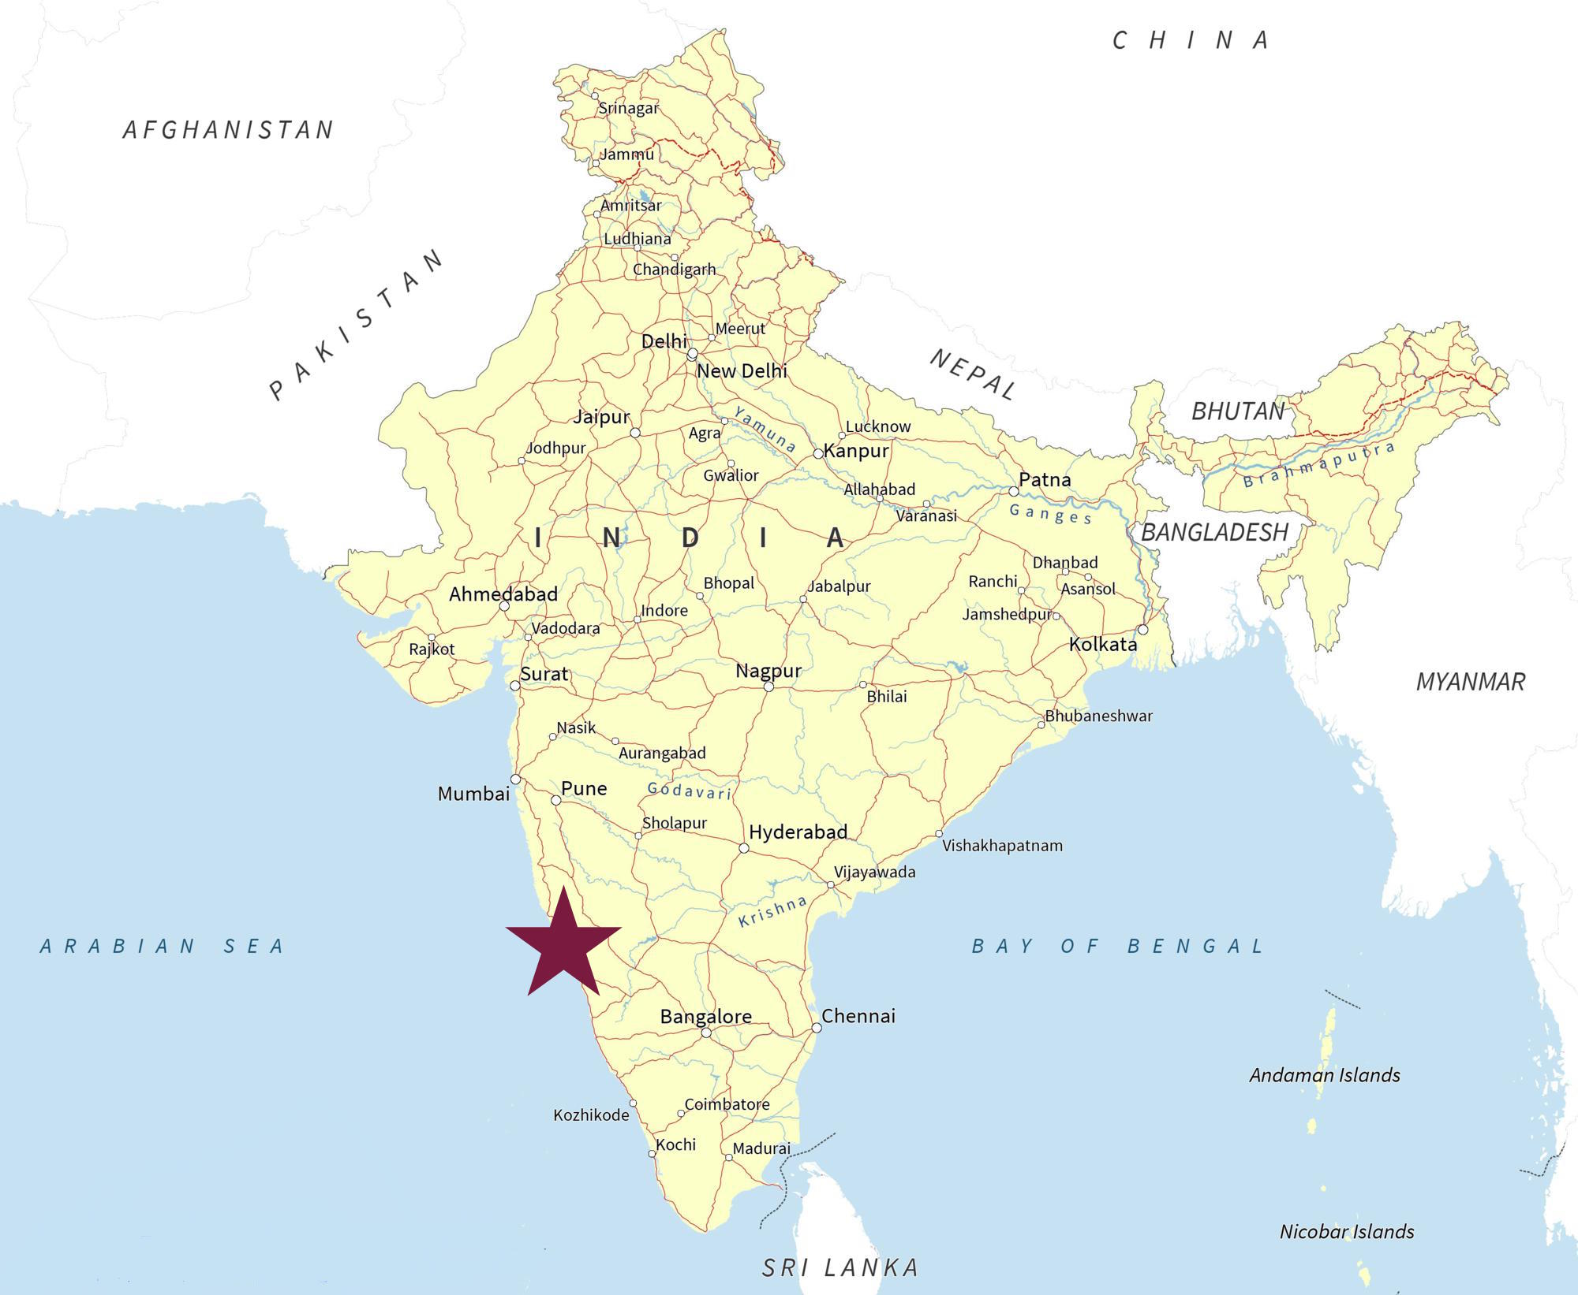
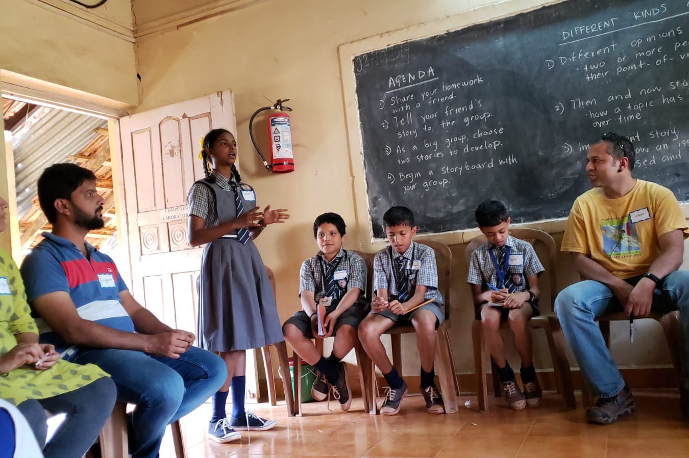
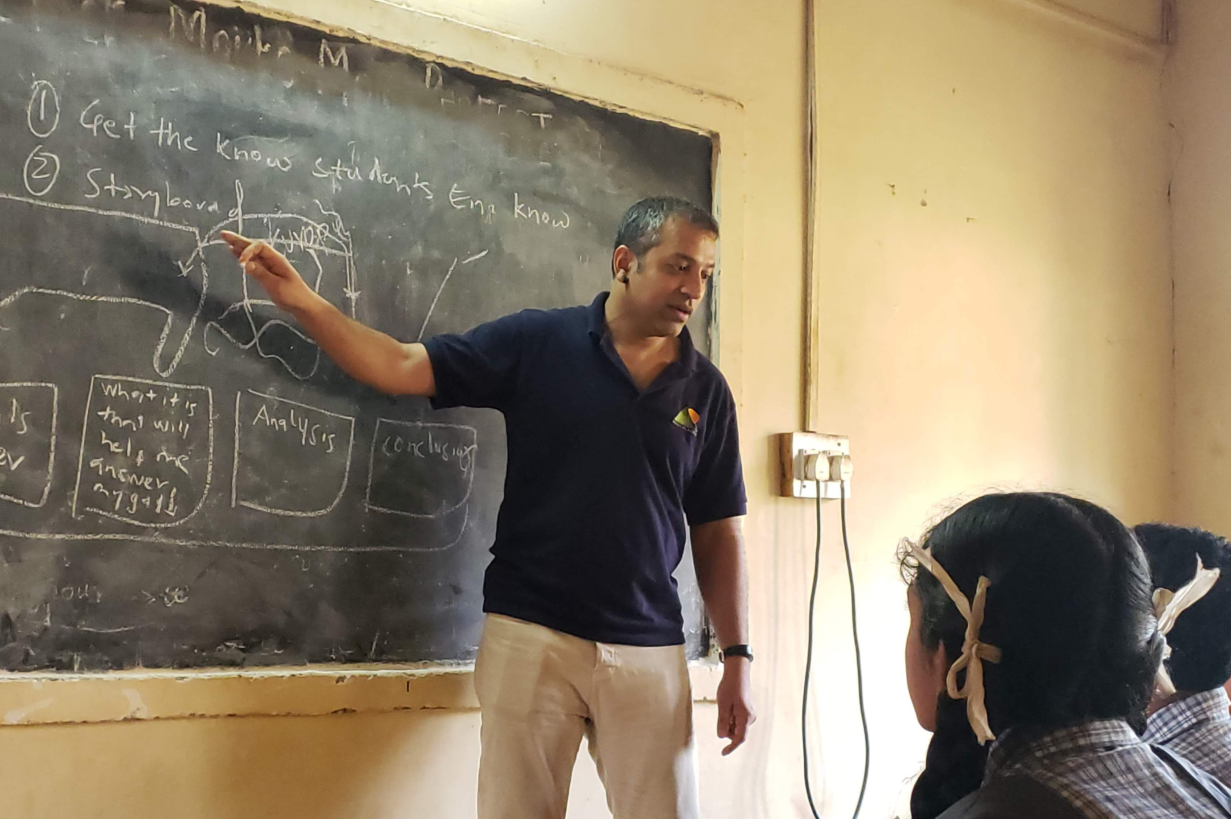
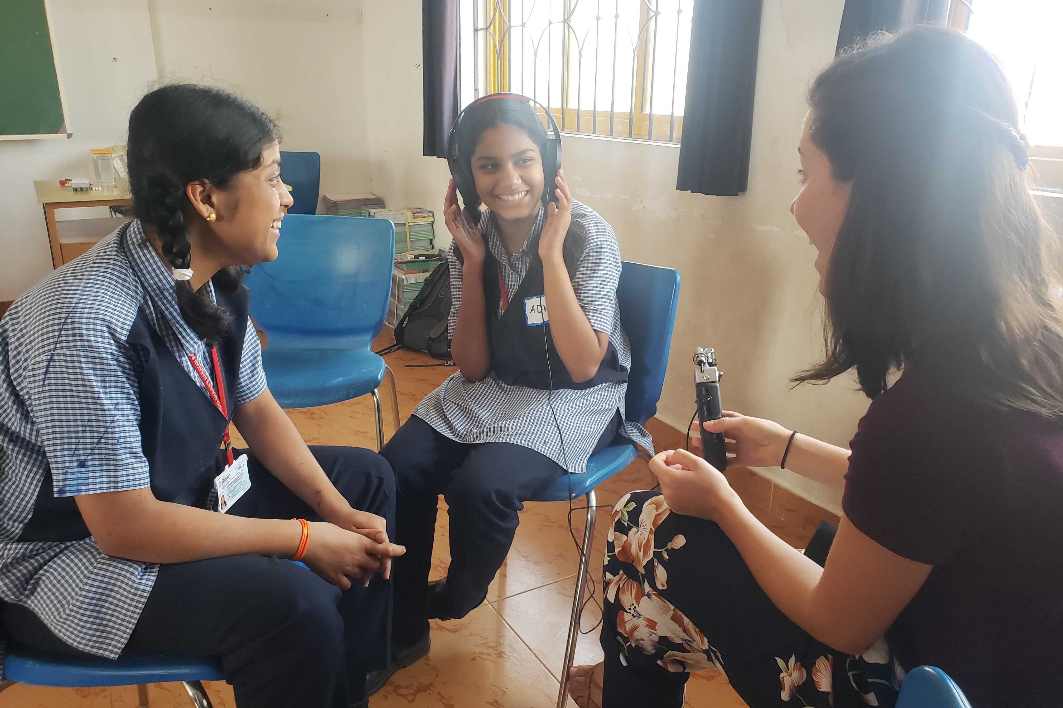
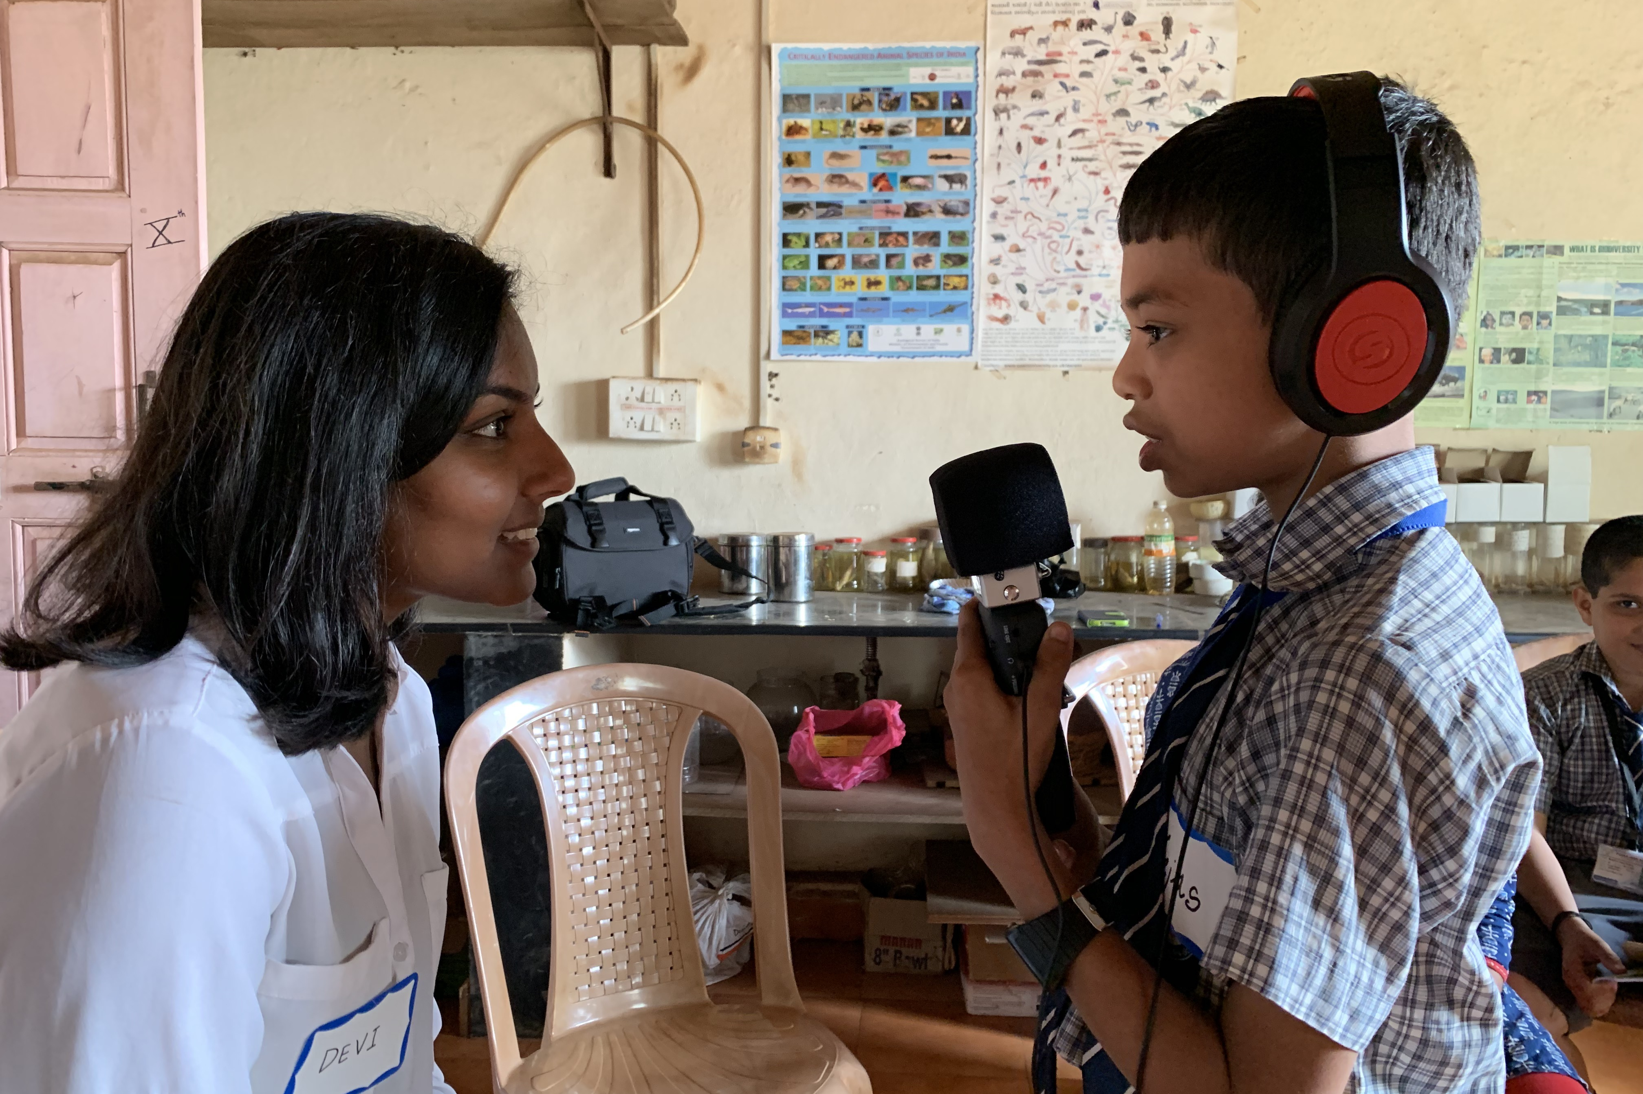
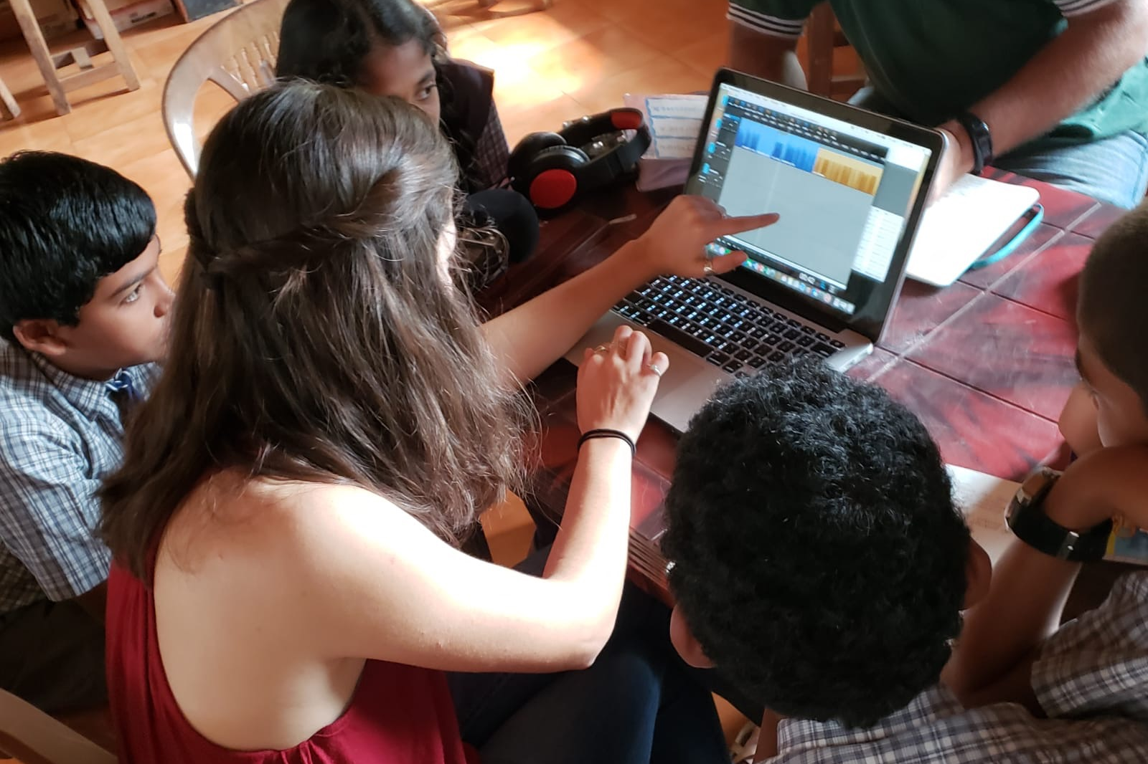
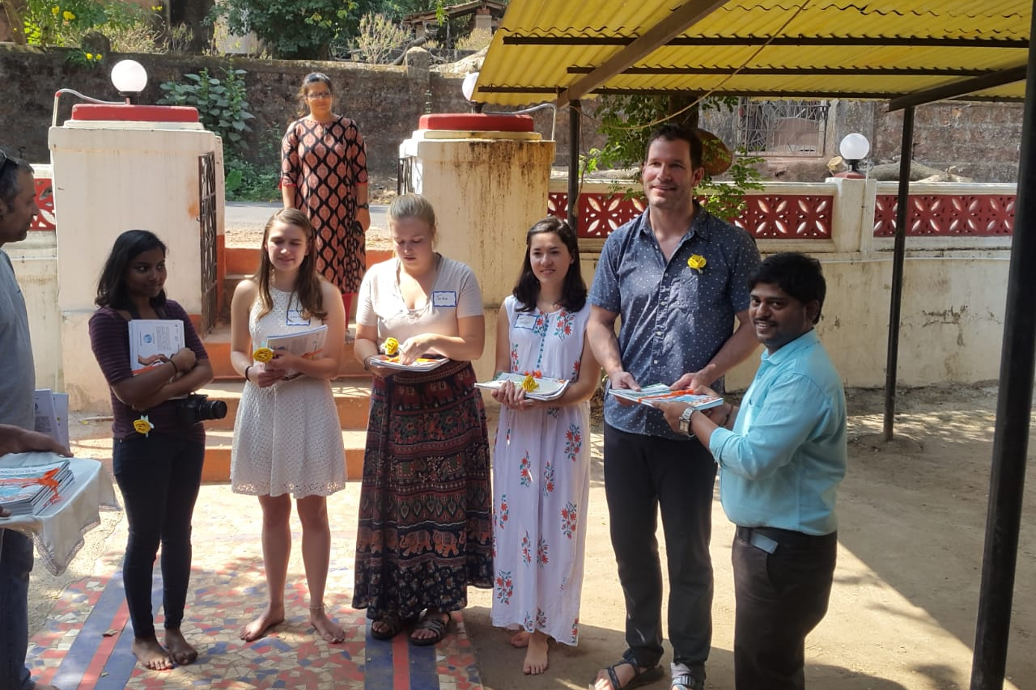
Improving Undergraduate Environmental Science Education
Through International Work, Service Learning, and Multidisciplinary Research
Taylor R. Lindsay, Department of Natural Resources, The University of New Hampshire
Introduction
Case Study: Podcasting for the environment, a student-initiated service project in India
Benefits for Undergraduates
Because humans are unequivocally responsible for most environmental issues, and will ultimately be responsible for solving or mitigating them, it is important for scientists to understand the cultural aspects of their research. Research in the field of environmental science should be accompanied by community collaboration, cultural understanding, and locally relevant dissemination techniques, which are rarely taught at the undergraduate level. This study reimagines “broader impacts” to involve undergraduates in science training that leverages multiple human ways of knowing throughout the scientific process.
Summary
Weaving Strands of Knowledge is a group of students, professors, and community organizations focused on using international, community-centered storytelling to highlight local environmental stories, complimenting narratives and evidence of formal scientific inquiry. In January 2019, we traveled to Goa, India to conduct a service project. The project was initiated by UNH undergraduate students with help from university faculty and local community members. This group previously worked together on a similar project in Bhutan and Vermont. The partnership-based, reciprocal project was a unique form of international service that also included collaborative undergraduate research. We worked with school children from one urban and one rural school. We used podcasting as a tool for communicating about environmental issues.
Formal discussion of power structures and equity, which are key to the process
Experience with social science research
Experience developing models of community collaboration
Leadership development
Contribution to UNH service initiatives
Exposure to cultural diversity
Areas for Improvement
Project Goals
Leave students and teachers with tools to continue telling environmental stories and learning about their communities through storytelling
Deepen student curiosity for environmental issues and community involvement
Create equitable collaboration between all partners and build trust
Integrate local environmental issues with community ways of knowing, reflecting on the possible educational effects of such a project
Formal reflection of service projects
Pre-travel research or education on local issues and effective teaching
Longer programs to build stronger relationships
Better dissemination techniques in international and domestic communities
Collaboration between departments within universities
‘Broader Impacts’ Experiences
Service Learning
Flexibility gives access to students who often do not have opportunities for community-engaged academic learning
A budding branch of citizen science
Projects can be designed to have reciprocal benefits for all involved
Provides experience with a ‘bigger purpose’ of science: improving life
Multidisciplinary Research
Enhances students’ repertoires and prepares them to imbed novel ideas and methods into future research
Social science research trains science students on how to propose and implement ‘broader impacts’
Exposure to social sciences improves understanding of education, improving students’ abilities to communicate and teach
International Work
De-westernizes traditional science
When local knowledge is valued, science understanding is improved and broadened
Collaboration improves the impact of science by addressing the needs and desires of multiple communities
Equitable science balances power and builds trust
Methodology
1. Introductions & Brainstorming
2. Storyboarding
Conclusion
Once students chose a topic for their podcasts, we discussed types of stories and developed storyboards, or outlines, for their podcasts. In this step, the students decided whom to interview in their communities for evidence and wrote introductions and interview questions.
Undergraduate environmental education is rigorous in many ways, yet most programs omit formal broader impact training. The National Science Foundation, amongst others, places great emphasis on ‘broader impacts’, defined as “the potential [of the research] to benefit society and contribute to the achievement of specific, desired societal outcomes.” This study presents a case study of one way that undergraduates can gain sophisticated understanding of broader impacts in science. By training environmental scientists early in their careers, they are better equipped to conduct effective multidisciplinary research and involve under-represented communities as partners, thereby improving the impact of the sciences on society.
3. Equipment Training
4. Interviews
The interviews were an important part of the project, as they diversified the perspectives presented in the podcasts. Students selected members of their communities, such as local leaders, teachers, and family members. The students began by asking pre-determined questions, but eventually developed the skills to ask new questions on the spot.
Acknowledgements
5. Narrating & Editing
6. Sharing & Reflecting
I am grateful to the UNH Emeriti Council Student International Service Initiative Grant for funding the project. Thank you to my advisor Andrew Coppens for his guidance and support throughout this project, and to all the members of Weaving Strands of Knowledge: Caitlin Burnett, Jordan Garrett, Sameer Honwad, Sara Clarke-Vivier, Shakuntala Devi Gopal, Madhura Niphadkar, and all our other collaborators.
We designed an event to bring the two school communities together to share stories and reflect. On our last day of the program, the students and teachers met, listened to all the podcasts, and viewed a photo slideshow of each others’ work. After the end of the project, the researchers went through a set of exit interviews to reflect on the program.
References
1. Mathieu, R., Pfund, C., & Gillian-Daniel, D. (2009). Leveraging the NSF broader impacts criterion for change in STEM education. Change: The Magazine of Higher Learning, 41, 50-55.
2. Roberts, M.R. (2009). Realizing societal benefit from academic research: Analysis of the National Science Foundation’s broader impacts criterion. Social Empistemology, 23, 199-219.
3. Stapleton, S.R. (2015). Environmental identity development through social interactions, action, and recognition. Journal of Environmental Education, 46, 94-113.
4. The National Academies of Sciences, Engineering, & Medicine. (2018). Learning Through Citizen Science: Enhancing Opportunities by Design. Wash, DC: The National Academies Press.
5. Vakil, S., Royston, M.M., Nasir, N.S., & Kirshner, B. (2016). Rethinking race and power in design-based research: Reflections from the field. Cognition and Instruction, 34, 194-209.
Notes:
Multidisciplinary research enhances student repertoire and prepares them to imbed novel ideas into future research
Design-based research in the social sciences can improve methodology and scope of environmental science research
Social science research trains students how to propose and implement ‘broader impacts’
Service is a beneficial form of experimental learning for environmental students
Informal projects can be designed to have reciprocal benefits for all involved
Service learning is a budding branch of citizen science
Student-led initiatives build leadership and enhance student understanding
Service projects expose science students to opportunities that may otherwise be unattainable, especially low-income & marginalized students
Exposes students to diversity, promoting collaboration
Traditional science is westernized, so exposure to other cultures can broaden students’ ideas of science and the environment
Using local knowledge can improve scientific research, especially in the environmental sciences
Sharing ideas through collaboration introduces new questions and methods
Collaboration improves the impact of science by addressing the needs and desires of the community
Diverse teams have members with different skills
Dissecting power structures builds trust by addressing the effects of race, gender, status, and class on the project, training students to implement these concepts in the future
Community equity builds trust and enhances collaboration

