Slide 1
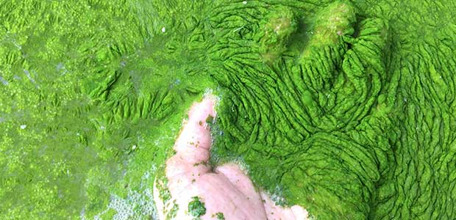
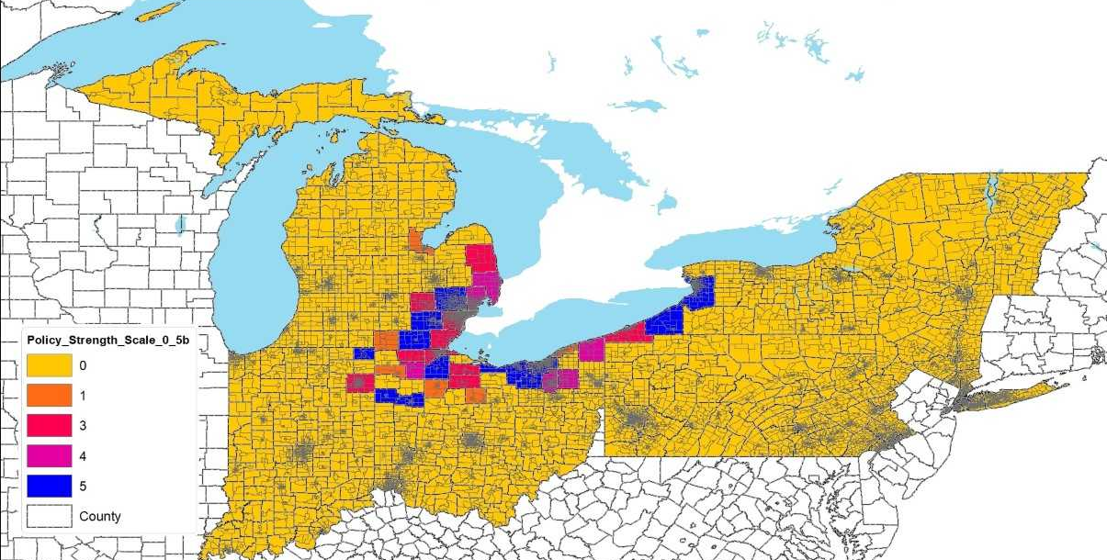
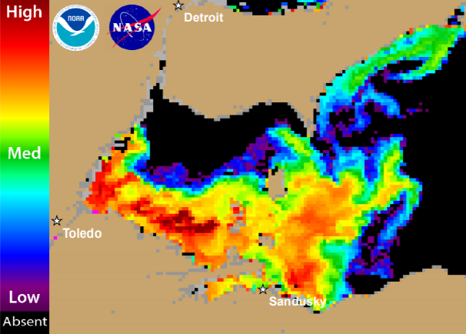
Assessing Correlates of Farmer Behavior to Prevent Harmful Algal Blooms (HABs): A Multi-Level Analysis
Alyssa Greig, Semra Aytur, PhD, MPH, Mary Doidge, PhD, Elizabeth Doran, PhD, Mark Axelrod, PhD, DG Webster, PhD, Emily Jenkins, Robyn Wilson, Ph.D, Jiyoung Li, PhD, and Kevin Carlin, MPH
University of New Hampshire, Ohio State University, University of Vermont, Michigan State University, Dartmouth College
Background
Results
Results Continued
The Centers for Disease Control and Prevention (CDC) One Health initiative is an interdisciplinary approach to human health. It recognizes that human health is in connection with the health of animals and the environment.
In 2014, a Harmful Algal Bloom (HAB) in Lake Erie made the tap water in Toledo, OH unsafe to drink. Cyanobacteria that cause the HABs release cyanotoxins that can cause mild symptoms like headaches and gastroenteritis, however they can also act as potent neurotoxins. It has been indicated that excess nutrients (nitrogen, phosphorus, carbon) from fertilizers may act to “overfeed” the cyanobacteria, leading them to proliferate and produce large amounts of toxins.
Effect | β | Standard Error | Pr > |t|
Gender | -0.2170 | 0.2360 | 0.3584
Total farm acres | 5.937E-6 | 0.000026 | 0.8165
Total farm income | -0.022295 | 0.02080 | 0.2706
Years farming | 0.000776 | 0.002106 | 0.7126
Population | 3.465E-8 | 0.000025 | <.0001
Bloom severity | 5.56E-7 | 0.000033 | <.0001
BMP Confidence | 0.004631 | 0.001524 | 0.0026
Statistically significant correlates at the county level included higher algal bloom severity (based on the WHO cyanotoxin index) (p<0.0001) and higher population (<0.0001). At the individual level, farmers’ perceived level of confidence in using best management practices (such as applying fertilizer only at the right time) was statistically significant (p=0.0026). Farmers’ age, gender, number of years farming, total acres farmed, total farm income, and education were not statistically significant.
Objectives
Determine Lake Erie area farmers’ levels of concern towards HABs
Identify what factors lead to a higher level of concern
Encourage Best Management Practices (BMPs) in farmers to avoid nutrient pollution
Conclusion
Findings suggest that higher resource areas where ecosystem services are valued may provide supportive contexts for BMP adoption. Farmers with higher levels of environmental concern and confidence reported more BMPs, reflecting opportunities to educate farmers about the public health co-benefits associated with agricultural practices, particularly in counties with greater income inequality. Educating farmers about the public health co-benefits associated with best management practices to prevent HABs may be a promising strategy
Methods
References
Data was collected from a survey of farmers in the Maumee Watershed (n=602), and a BMP index was derived by summing the number of BMPs reported by each farmer. County-level indicators reflecting the public health context were gathered from the County Health Rankings dataset. Multi-level log-Poisson models with random intercepts for county were used to assess associations between the number of BMPs adopted, farmer-level attributes, and county-level factors.
1. Centers for Disease Control and Prevention (CDC). (2019). One Health. Retrieved from https://www.cdc.gov/onehealth/index.html
2. Centers for Disease Control and Prevention (CDC). (2019). Harmful Algal Bloom (HAB) –Associated Illness. Retrieved from https://www.cdc.gov/habs/index.html
3. Stumpf, R. (2015). Use of Satellite Data to Monitor and Evaluate Cyanobacteria Blooms in Lake Erie and Other Lakes. Retrieved from: https://acwi.gov/monitoring/conference/2016/2_wednesday_may4/H1/Stumpf_2016_NMC_Tampa_secure.pdf
4. Wilson, R. (2017). Best Management Practices and the Efficacy Gap. BMPs for Reducing P Losses from Cropland: State of Science Conference Tiffin, OH ~ March 10, 2017. Retrieved from: https://ncwqr.files.wordpress.com/2017/06/wilson-2017.pdf
5. University of California, Los Angeles. Regression models with Count Data (2018). Retrieved from: https://stats.idre.ucla.edu/stata/seminars/regression-models-with-count-data/
6. Agresti, A. (2001) Categorical Data Analysis (2nd ed). New York: Wiley.
7. Long, S. J. (1997) Regression Models for Categorical and Limited Dependent Variables. Thousand Oaks, CA: SAGE Publications, Inc.
8. D'Anglada, L. (2015). Editorial on the Special Issue “Harmful Algal Blooms (HABs) and Public Health: Progress and Current Challenges”. Toxins 2015, 7, 4437-4441; doi:10.3390/toxins7114437
Acknowledgements
This study was funded by the NSF National Socioenvironmental Synthesis Center (SESYNC) and the UNH Hamel Center for Undergraduate Research Center REAP program.

