Slide 1

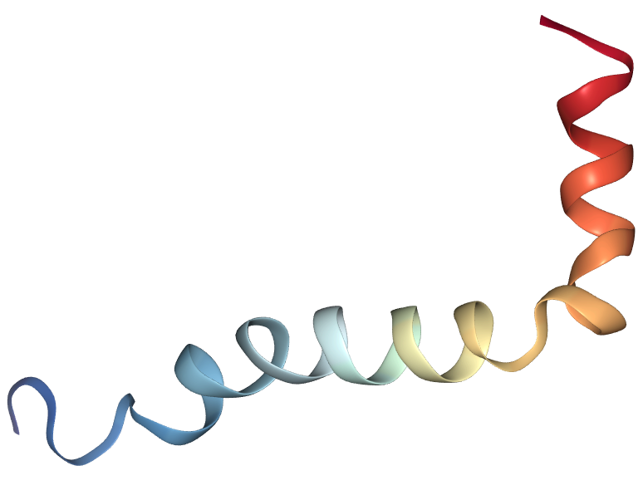
Chiral Enhancement of Carbon Dots Synthesized from Amino
Acids and Their Applications in Amyloid-beta 42 Fibrillation
Hannah Coco, Christine A. Caputo
Department of Chemistry, University of New Hampshire
Introduction
Results
Discussion
Alzheimer’s disease is the most common cause of dementia worldwide.¹ It’s thought that Alzheimer’s disease is caused by fibrillation of amyloid-beta 42 (Aβ42) and phosphorylated tau proteins in the brain.² The accumulation of Aβ fibrils leads to formation of plaques and ultimately neuronal death.²
The issue of Aβ fibrillation and accumulation in the brain may be addressed with the assistance of carbon dots (C-dots). C-dots are nanoparticles consisting of a graphitic core and a diverse range of surface functional groups.⁵ It was previously shown that C-dots synthesized from L-lysine inhibited the fibrillation of Aβ42 while the D- enantiomer did not effect fibrillation.⁵ C-dots are non-toxic and can penetrate the blood-brain barrier, making them attractive for biological applications and particularly treatment of Alzheimer’s disease. C-dots are also fluorescent in the visible region, making them useful for bioimaging. Our goal is to synthesize a C-dot (either as-prepared or surface functionalized) that demonstrates selective chiral interaction with Aβ42. Fluorescence spectroscopy will be used to observe this interaction.
Initial IR spectra indicate that we have successfully synthesized an amino acid surface functionalized C-dot. Fluorescence spectroscopy indicates that there is fluorescence quenching when Aβ42 is incubated with L-lysine functionalized citric acid C-dots at an excitation of 400 nm and 420 nm when compared to samples mixed with equal volume potassium phosphate buffer solution. There is no indication of quenching at excitation wavelengths below 400 nm. This suggests that Aβ42 is associating with the functionalized C-dot, but the specifics of this interaction are unknown. There is no change in fluorescence intensity when Aβ42 is incubated with nonfunctionalized C-dots synthesized from enantiopure aspartic acid or lysine. Lifetime fluorescence spectroscopy shows no difference in fluorescence lifetime between the L-lysine functionalized C-dots and the L-lysine functionalized C-dots incubated with Aβ42. Polarimetry and circular dichroism were attempted but due to the optical density of the C-dot solution the results could not be verified.
Figure 1. Fibrils of Aβ42.³
Figure 2. Helical solution structure of Aβ42.⁴
Figure 2. IR spectra of citric acid C-dots and L-lysine functionalized citric acid C-dots
439 nm
462 nm
456 nm
460 nm
Future Work
A functionalized citric acid C-dot with the D- enantiomer of lysine on the surface still needs to be synthesized and fluorescence spectroscopy should be conducted with the C-dot incubated with Aβ42. Circular dichroism should be conducted with the C-dots synthesized from amino acids and of the functionalized citric acid C-dot to determine that chirality was maintained in the starting material and to what extent the lysine functional group induces chirality in the achiral C-dot.
Experimental Work
Figure 3. Fluorescence spectroscopy of L-lysine functionalized citric acid C-dots with Aβ42 compared with L-lysine functionalized citric acid C-dots with equal volume of phosphate buffer solution.
Figure 4. Fluorescence spectroscopy of L-Lys C-dots incubated with Aβ42 and L-Lys C-dots mixed with equal volume phosphate buffer.
Acknowledgments
I would like the thank Dr. Caputo and the entire Caputo Group for their help and support. Special thanks to Dr. Varga and Yoonbin Joh for their assistance with this project.
Scheme 1. Synthesis of C-dots from enantiopure lysine and aspartic acid
References
Scheme 2. Synthesis of C-dots from citric acid
(1) Alzheimer's and Dementia 2015, 11 (3), 332–384.
(2) Lahiri, D. K.; Farlow, M. F.; Greig, N. H.; Sambamurti, K. Drug Development Research 2002, 56 (3), 267–281.
(3) Xiao, Y. et al. A β ( 1 – 42 ) fibril structure illuminates self-recognition and replication of amyloid in Alzheimer ’ s disease. 22, (2015).
(4) Picone, D. Solution structure of the Alzheimer amyloid beta-peptide ( 1-42 ) in an apolar microenvironment . Similarity with a virus fusion domain . 269, (2002).
(5)Yang, ST.; Wang, X.; Wang, H. Carbon Dots as Nontoxic and High-Performance Fluorescence Imaging Agents. J. Phys. Chem. C. Nanomater Interfaces. 2009,113(42):18110-18114.
(6) Malishev, R.; Arad, E.; Bhunia, S. K.; Shaham-Niv, S.; Kolusheva, S.; Gazit, E.; Jelinek, R. Chem.Commun. 2018, 54 (56), 7762–7765
.
Figure 5. Fluorescence lifetime spectroscopy of L-lysine functionalized C-dots incubated with Aβ42.
Figure 6. Fluorescence lifetime spectroscopy of L-lysine functionalized C-dots
Scheme 3. Synthesis of L-lysine surface functionalized C-dots

Slide 2

This poster template provided courtesy of
UNH ESRC Poster Printing Services
Trust us to make your poster look GREAT!
Website: http://posters.unh.edu
Poster Guide: http://goo.gl/1E7TJY
DELETE THIS SLIDE BEFORE PRINTING

