Slide 1

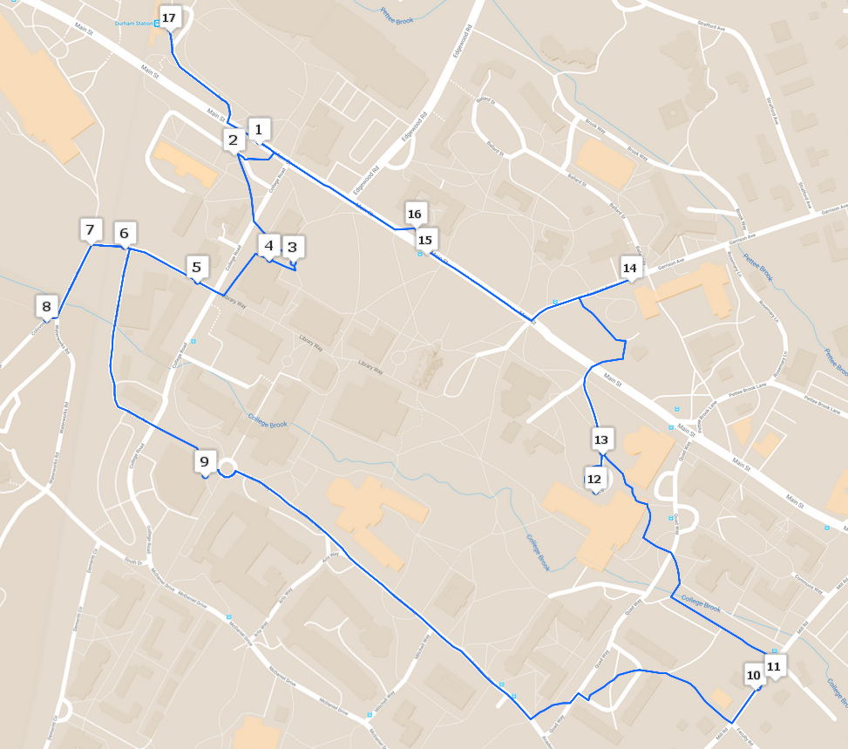
A Tour Showcasing Campus Sustainability
Timothy Putnam, Cameron Perkins, Dean Herrick, Sumner Bright
Faculty Advisors: Vanessa Levesque, Cameron Wake
Introduction
Results
The University of New Hampshire (UNH) has embraced sustainability as a guiding framework for its operations and education
Sustainability facets at the UNH have yet to be effectively displayed
Tours have been found as an engaging way to inform and familiarize stakeholders about the importance of sustainability initiatives
Introducing a sustainability tour at the UNH would set our campus apart from other Universities in the region, nationwide, and could provide many opportunities for future success
Stop Name | Environmental | Social | Economic | Research | Operations | Education | Outreach | Priority
Nesmith / Sustainability Institute | X | X | X | X | X | X | X | 1
Co-Generation Plant | X |  | X |  | X |  | X | 1
UNH Dining | X | X | X |  | X | X | X | 1
Waysmeet Center |  | X | X |  |  | X | X | 2
Bike Lanes and Bike Racks | X | X |  |  |  |  |  | 3
Figure 1: Sample of Prioritization Checklist
Stop 5: Cogen Plant
Located on the east side of campus next to the recently renovated Wildcat Stadium, the UNH Combined Heat and Power facility (COGEN Plant), went online in 2006. Originally this facility was the coal powered heating plant built in 1927 for the university. Upon completion of the renovations the plant was able to use some of the heat created in electricity production to heat campus buildings, in turn reducing emissions. It is estimated that the COGEN plant reduced greenhouse gas emissions 21% from 2005.
Research Questions
What stops should be on a sustainability tour at UNH?
What is the best platform to deliver the tour?
What are the informative and interesting stories at
each stop?
Stop 15: EcoCat/ Wildcat Transit
The University of New Hampshire operates the largest public transportation system in the state. This transit system is open to the public for a small fee, while it is free to UNH students. Along with stops all over campus to get students to and from classes quickly, there is also service to the surrounding towns of Newmarket, Dover, and Portsmouth. Many sustainability focused improvements have and are being made in the Wildcat Transit fleet. In order to decrease emissions, the Wildcat Transit bus fleet runs mainly on Compressed Natural Gas (CNG). CNG is a much cleaner fuel source than traditional gasoline or diesel, by producing less GHG emissions and a smaller amount of particulate matter than diesel.
Methods
Comprised a master list of potential tour stops
Prioritized stops into three groupings based off the aspects below
  Promotes environmental, economic, and social well being
  Included research, education, related to operations and community outreach
  If the university was actively promoting
Conducted interviews to gain information about stops
Constructed tour using Google MyMaps
Figure 2: Map of Campus Tour
Discussion
Many opportunities exist for future iterations of the tour:
  Integration with university apps and website
  Audio alternatives
  Ability to schedule a guided tour online
Stop descriptions will need to be up-to-date and new stops added as new sustainability facets arise
Guided, walking tour will benefit from added stops as more efficient walking routes can be created
17 stops were identified on main campus through the prioritization system
Some stops were too far off main campus to be in walking distance, or lacked a single location (student clubs, certain research projects)
Distant or non-location-specific stops can be incorporated into a digital version of the tour
References:
Trahan, Ellen, et al. “Campus Sustainability Tours: Exploring an Uncharted Tool.” International Journal of Sustainability in Higher Education, vol. 18, no. 6,

