Slide 1


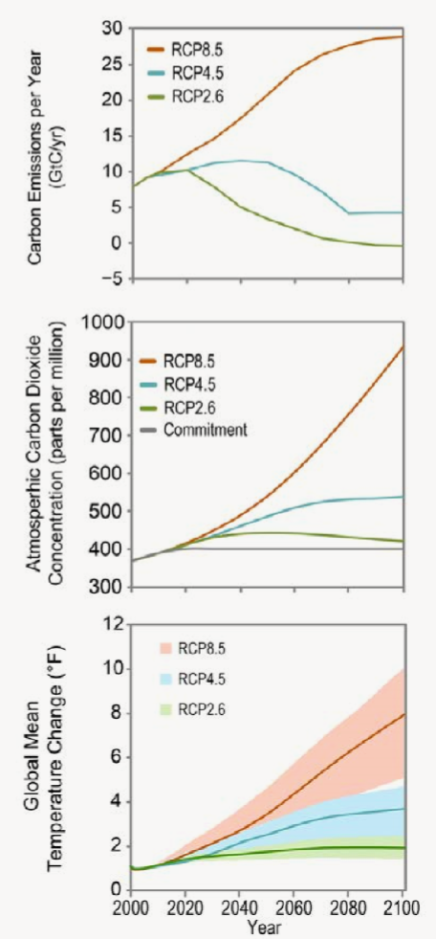
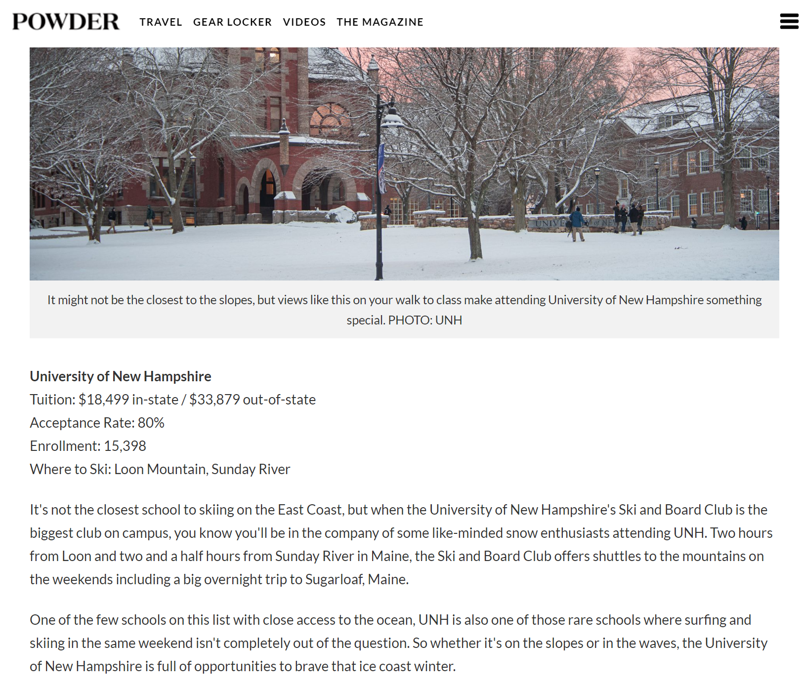
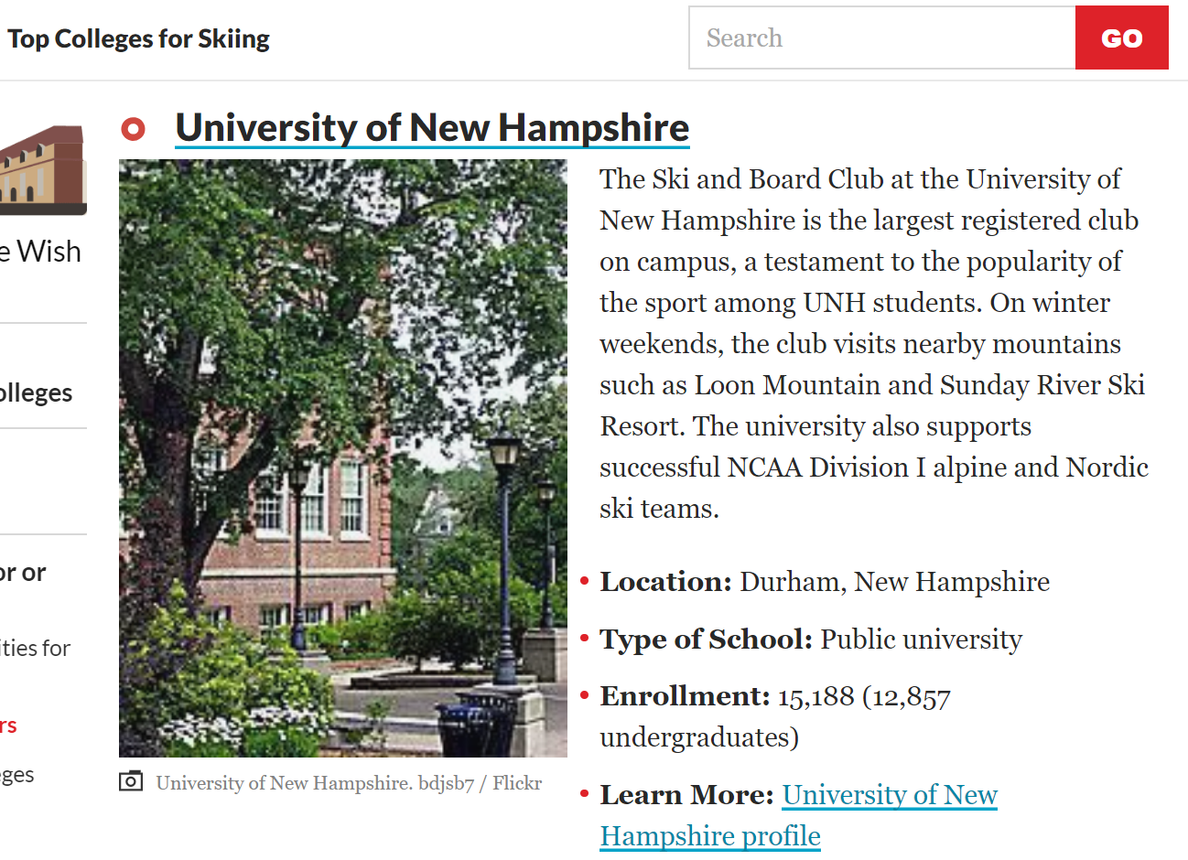


Creating Community Through Experiential Exposure
Olivia Audino ‘19 President: UNH Ski and Board Club
Recreation Management & Policy – Program and Event Management
Mission
Trends
Relevant Skills
Our purpose is to expand the skiing and riding experience to the UNH Community. We do this by providing transportation to and from mountains across New England to create a culture of passionate skiers and riders. We promote and engage our participants into the world of skiing through on and off campus events, to promote connections, awareness and motivation.
Climate Impacts:
Warmer, wetter winters with temperature increases of 5.5°C (9.0 °F) by the end of the century (high emissions scenario resulting in total seasonal snowfall to decrease 10-30% (Figure 1. USGCRP, 2017).
The number of snow days is projected to be reduced by 25% percent in northeastern regions under a high emissions carbon output scenario (Demaria et al., 2016; Ning and Bradley, 2015).
During years of high snow totals, increased participation added $692.0 million in value nation-wide and added 11,800 jobs compared to avg. participation
Figure 1. Representative Concentration Pathways (RCP) scenarios used in climate models to project future scenarios – used from Fourth National Climate Assessment Climate Science Special Report (USGCRP, 2017)
Logistical planning with a participant-focused approach and application of learned skills from RMP
Cultivating a driven community both within UNH and beyond through brand engagement, student participation and volunteering and hands-on managerial positions on the club’s Executive Board
Risk Management Policies & Protocols structured through NCAA Regulations
Leadership and organizational structure skills forming independent management techniques through a 100% student-run club
Experience through exposure including through marketing, budgeting skills, risk exposure and crisis scenarios on and off mountain
Community Impact
Q
Future Objectives
Designing and implementing programming surrounding New Hampshire skiing initiatives
Creating more accessible opportunities to become involved in Climate action programs such as Protect Our Winters (POW)
  We implement awareness through tracking our GHG emissions in our transportation fleet
Hosting collaborative campus discussions with organizations such as Nature Groupie, Granite Backcountry Alliance for backcountry volunteer opportunities and Mount Washington Avalanche Center for avalanche awareness
Largest club on UNH’s Campus with over 418 registered members
Providing skiing and riding opportunities for all ability levels, ages, backgrounds
Weekend and overnight trips every weekend throughout first and second semester to Loon, Sunday River and Sugarloaf with over 60-100 students per weekend
Regional events collaborating with brands and organizations such as Redbull, The Faction Collective, UNH Recreation Society, etc.
Resilience and Mitigation
Ski resorts addressing climate change through green initiatives including tracking GHG emissions (NSAA Climate Challenge)
Community engagement to create cohesive awareness of industry trends including adoption of renewable energy within resort operating sytems
Four-Season Model including summer and fall operations
References:
Burakowski, E.A., 2008. Trends in wintertime climate in the northeastern United States: 1965-2005. Journal of Geophysical Research Atmospheres, 113, D20114
Demaria, E.M., J.K. Roundy, S. Wi, and R.N. Palmer. 2016. The Effects of Climate Change on Seasonal Snowpack and the Hydrology of the Northeastern and Upper Midwest United States. J. Climate, 29, 6527– 6541
USGCRP, 2017: Climate Science Special Report: Fourth National Climate Assessment, Volume I [Wuebbles, D.J., D.W. Fahey, K.A. Hibbard, D.J. Dokken, B.C. Stewart, and T.K. Maycock (eds.)]. U.S. Global Change Research Program, Washington, DC, USA, 470 pp.,
Hagenstad, M.,Burakowski, E., Hill, R., 2018. The economic contributions of winter sports in a changing climate, Protect Our Winters, 2-68
Wobus, Cameron, Eric E. Small, Heather Hosterman, David Mills, Justin Stein, Matthew Rissing, Russell Jones, Michael Duckworth, Ronald Hall, Michael Kolian, Jared Creason, Jeremy Martinich, 2017. Projected climate change impacts on skiing and snowmobiling: A case study of the United States. Global Environmental Change, 45: 1-14.
Notes:
Social Pic:

