Slide 1
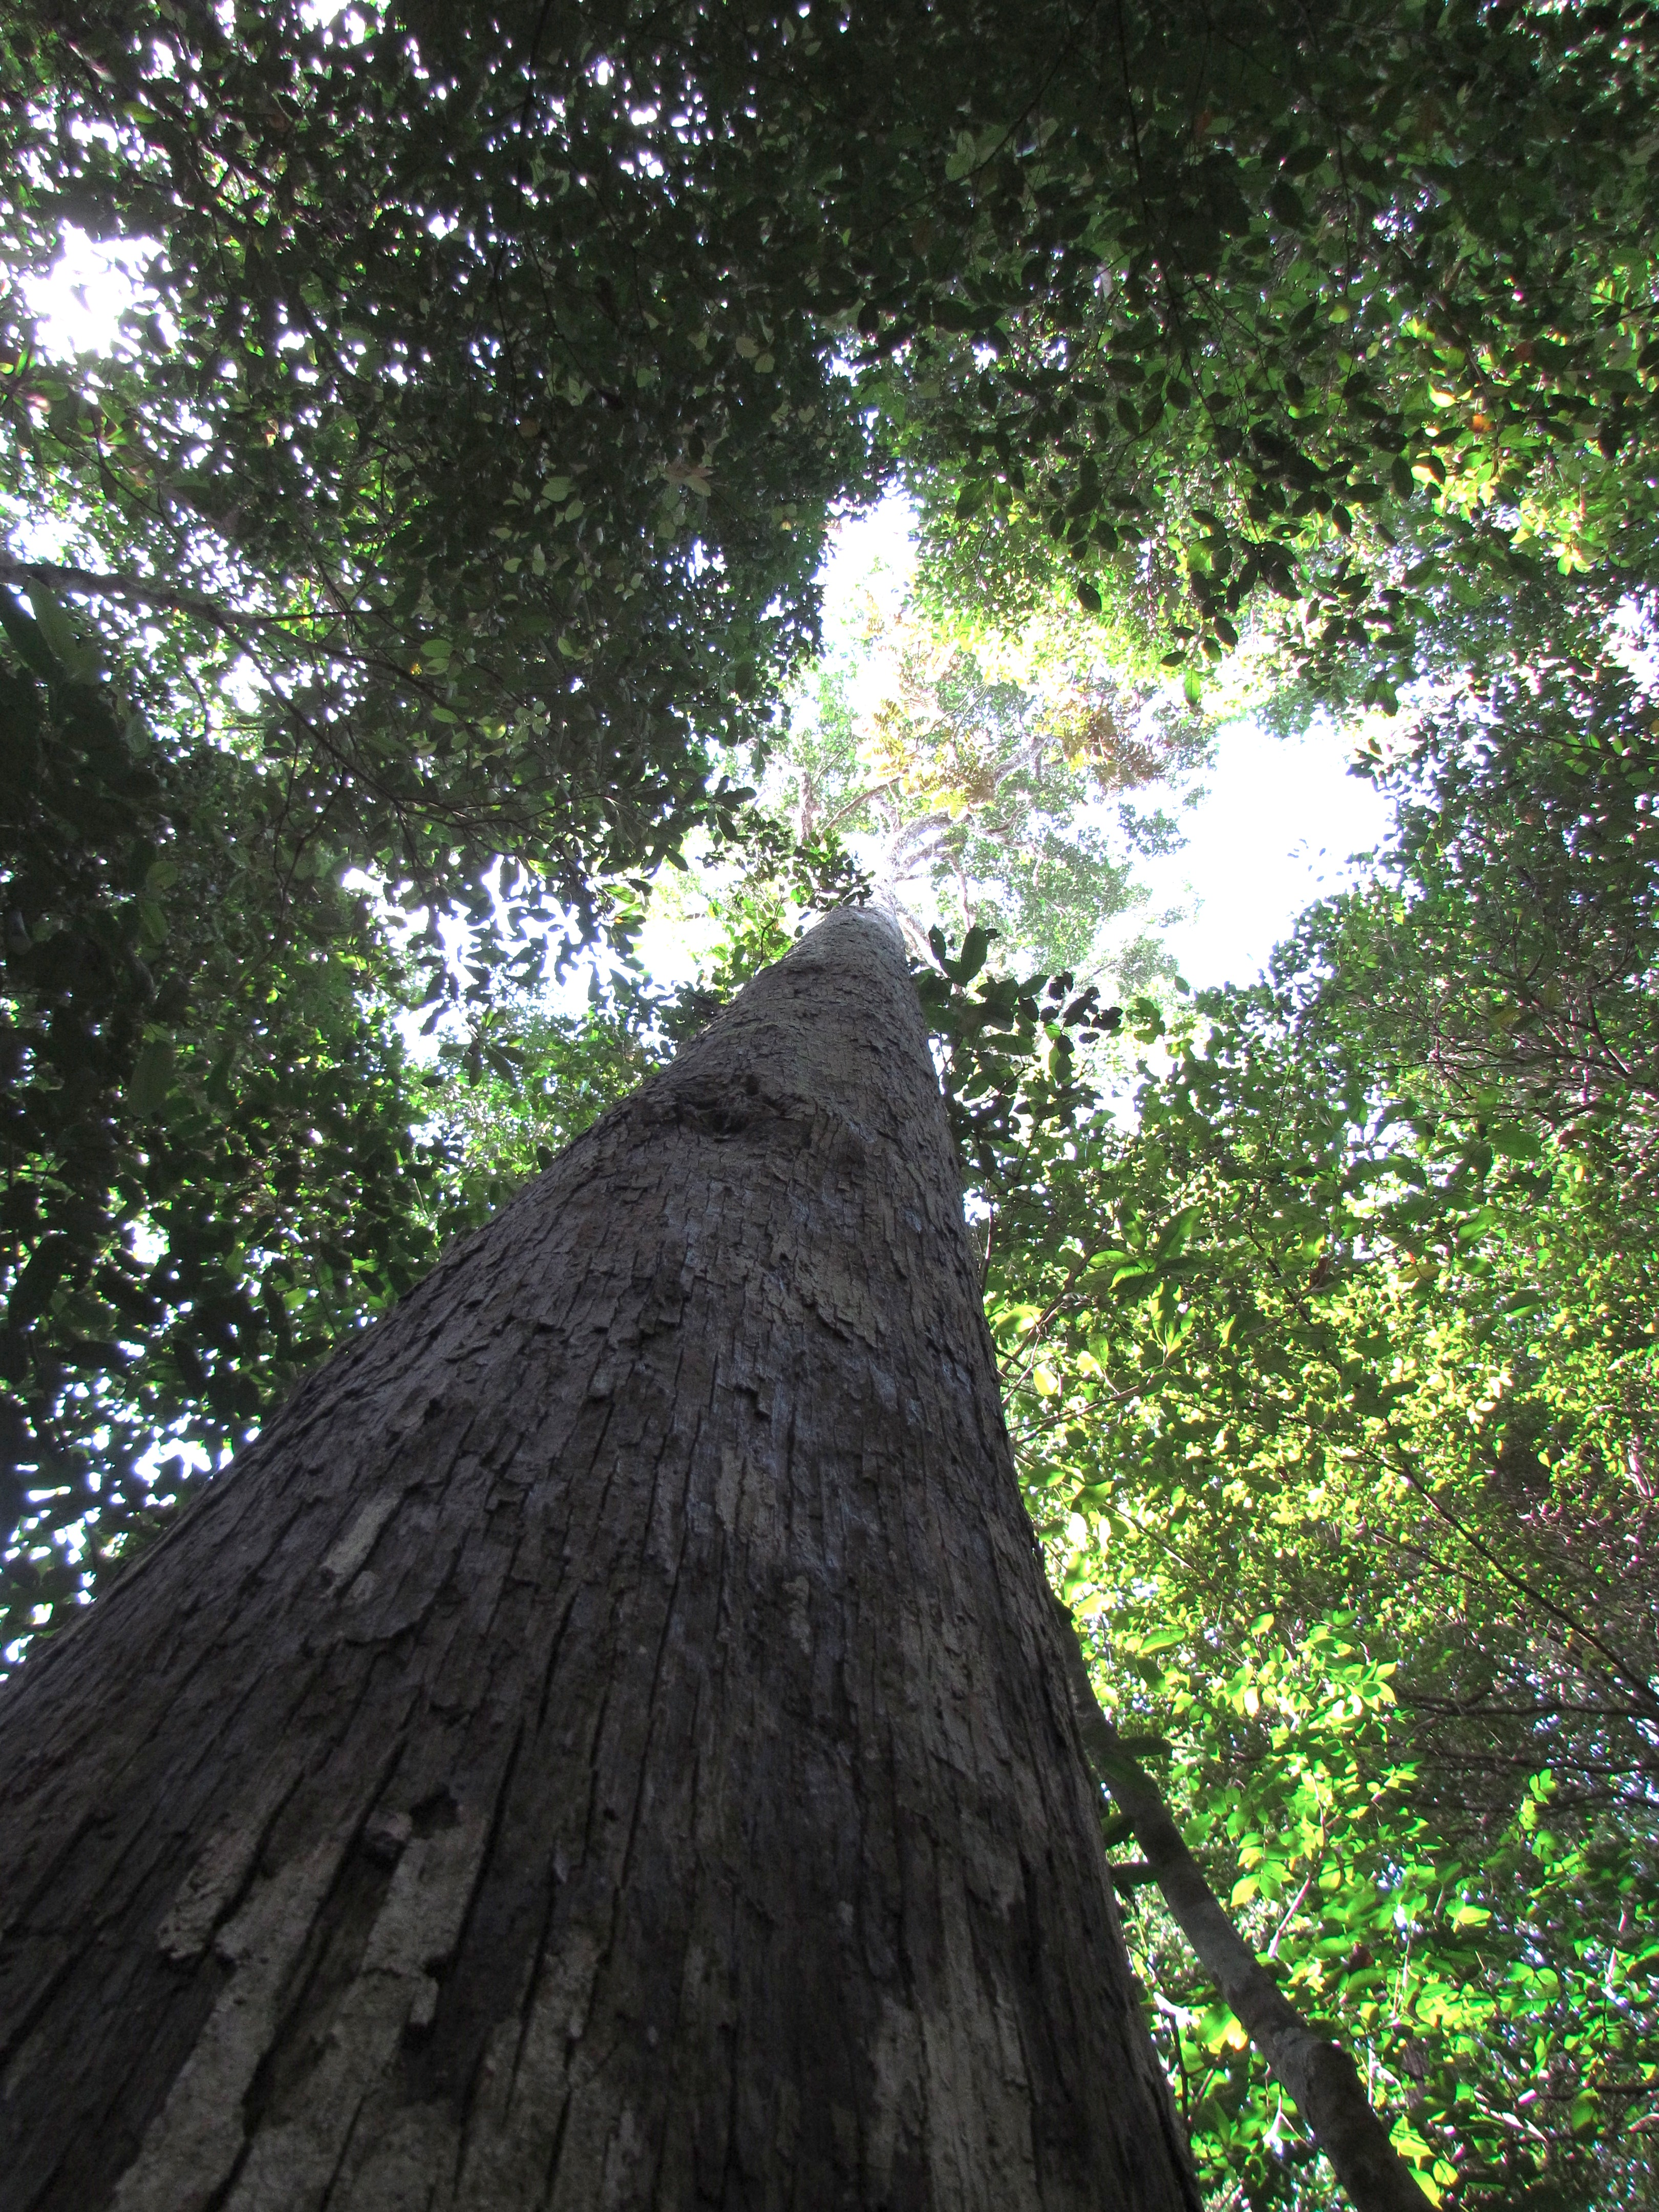
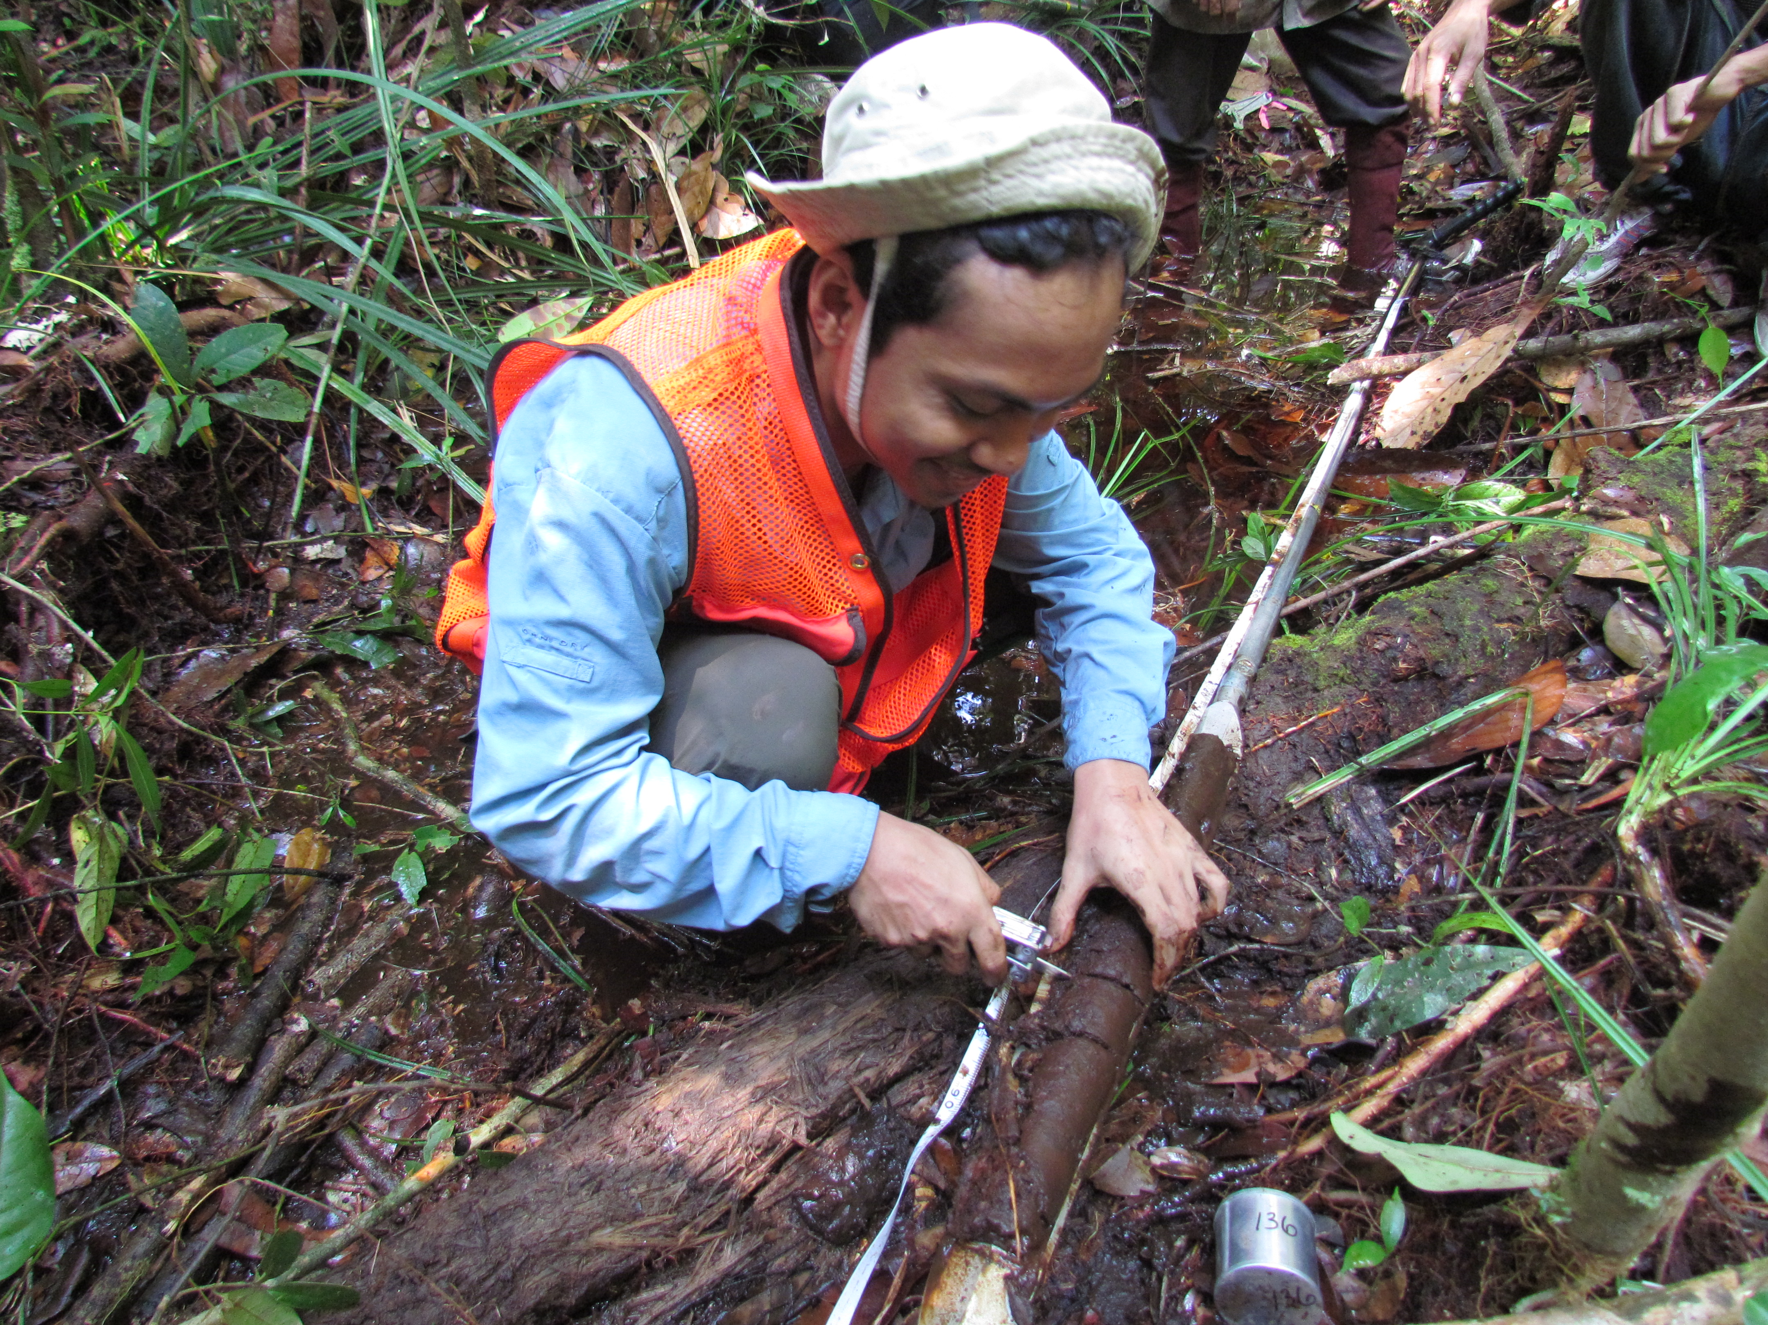
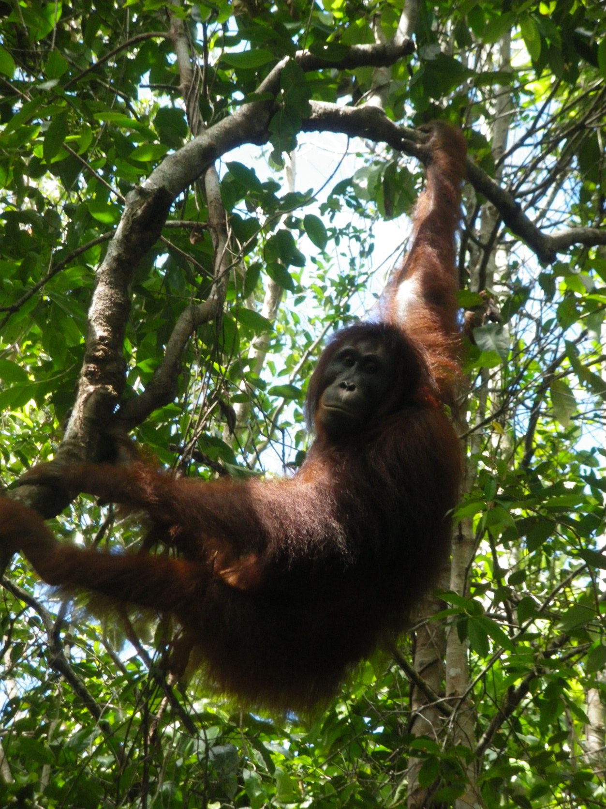
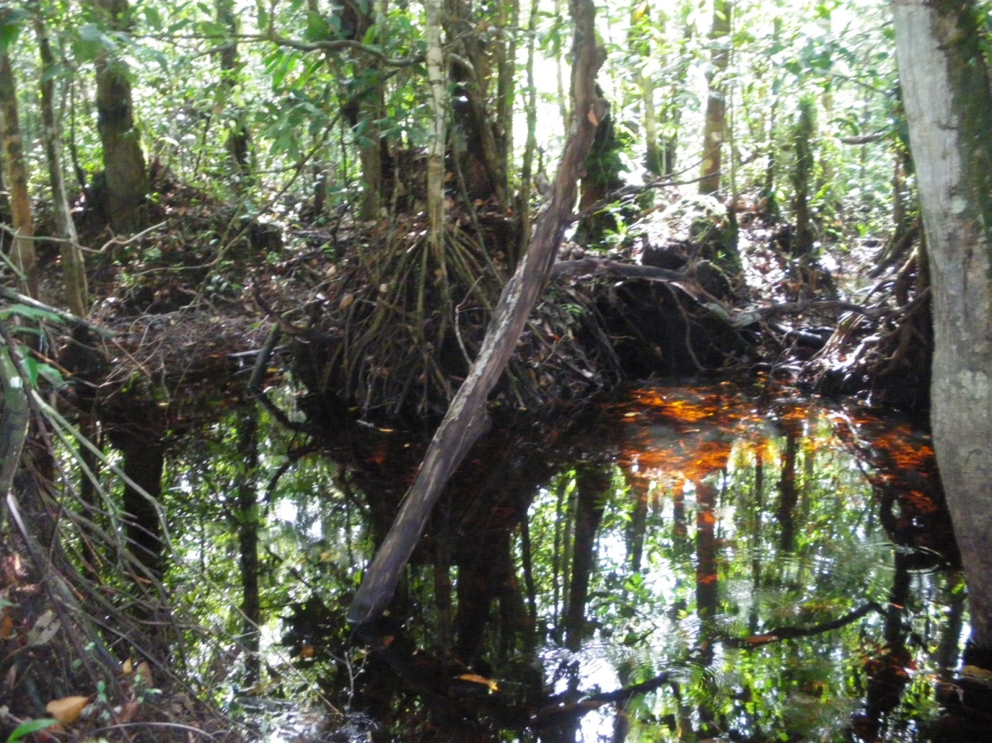
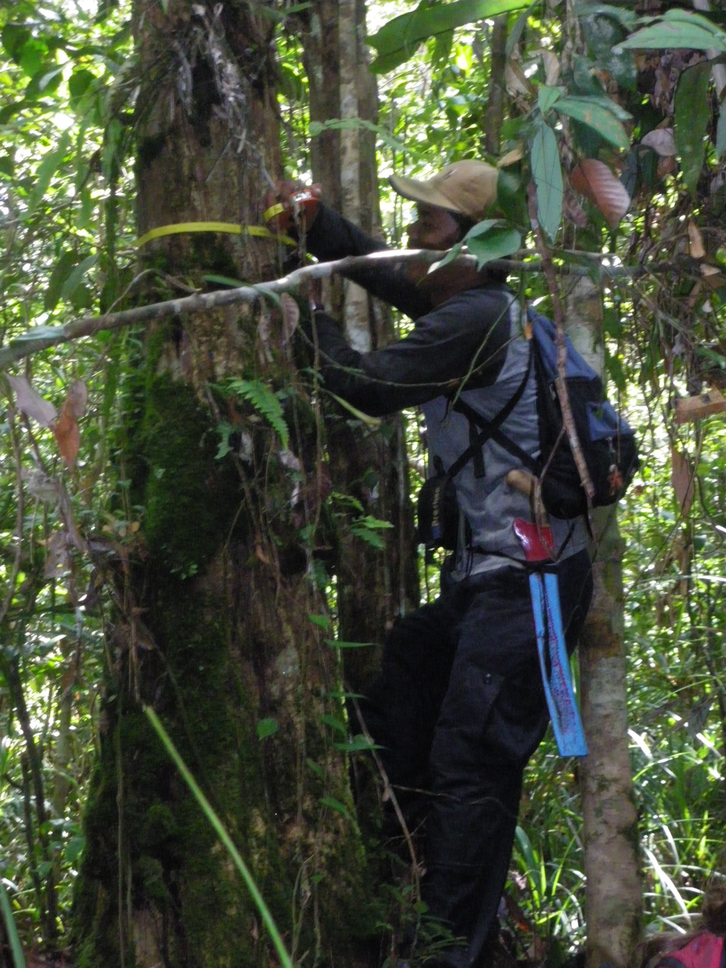
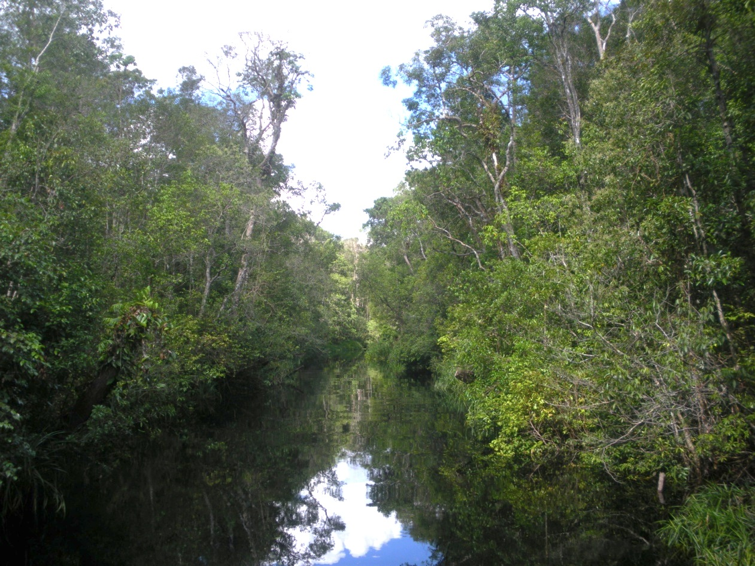
The Modeling of Long Term Carbon Accumulation in Tropical Peat Swamp Forest Ecosystem
Sofyan Kurnianto
Advisor: Prof. Steve Frolking
Introduction
Tropical peatlands cover an area approximately 441,000 km² (10-16% of global peatland area).
Indonesian peatlands occupy about 50% of the tropical peatland area. They are under intense deforestation pressure (Figure 1).
Vegetation of tropical peatlands: Lowland moist tropical forest or called by peat swamp forest.
Peat swamp forests have both high productivity and and total carbon stocks (Figure 2).
GPP = 30.4
Re = 28.4
Rh = 6.9
Living AG = 196
R_{a}=21.5
CH₄
LF = 7.4
T = 7.6
R_{l}=15.4
Rr = 6.1
Peat – C = 675
Living BG (roots) = 33
Rmor = 1.5
NPP = GPP – Ra
= 8.9 Mg C ha⁻¹ year⁻¹
NEP = GPP – Re
  = 2 Mg C ha⁻¹ year⁻¹
NECB = 1 Mg C ha⁻¹ year⁻¹
DOC; POC = 1.0
Stocks, Mg C ha⁻¹
Figure 1. The distribution of peatland in Indonesia (Hooijer et al., 2010)
Flows, Mg C ha⁻¹ year⁻¹
Holocene Peat Model (HPM)
Annual time step; 1000 – 10,000 year simulations
Coupling of carbon and water balance
12 plant functional types: mosses, sedges, other vascular
PFT litter input is a function of peat depth and water table depth
Calculating total peat height and C content, bulk density, peat water content, and water table
Evaluated in Canadian peatlands
Frolking et al. (2011)
Hergoualc’h et al., 2011; Murdiyarso et al., 2010; Malhi et al., 1999
Figure 2. The diagram of carbon cycle in tropical peat swamp forest
Objectives:
Modifying HPM to be applicable to tropical peat swamp forest
  New PFTs? Understanding the role of trees in peatland development
  Pattern of humification in the peat column
Developing a Holocene tropical climate reconstruction or scenario to drive the model.
Estimating the dynamical changes of peat thickness and peat carbon density over long periods, and making projections for the 21st century.
Estimating carbon cycle variables (NPP, NECB)
References
Frolking, S., Roulet, N.T., Tuittila, E., Bubier, J.L., Quillet, a., Talbot, J., Richard, P.J.H., 2010. A new model of Holocene peatland net primary production, decomposition, water balance, and peat accumulation. Earth System Dynamics 1, 1-21.
Hergoualc’h, K., Verchot, L.V., 2011. Stocks and fluxes of carbon associated with land use change in Southeast Asian tropical peatlands: A review. Global Biogeochemical Cycles 25.
Malhi, Y., Baldocchi, D.D., Jarvis, P.G., 1999. The carbon balance of tropical, temperate and boreal forests. Plant, Cell and Environment 22, 715-740.
Murdiyarso, D., Donato, D., Kauffman, J.B., Kurnianto, S., Stidham, M., Kanninen, M., 2009. Carbon storage in mangrove and peatland ecosystems: A preliminary account from plots in Indonesia. Africa.
www.cifor.cgiar.org
www.ForestsClimateChange.org

