Slide 1
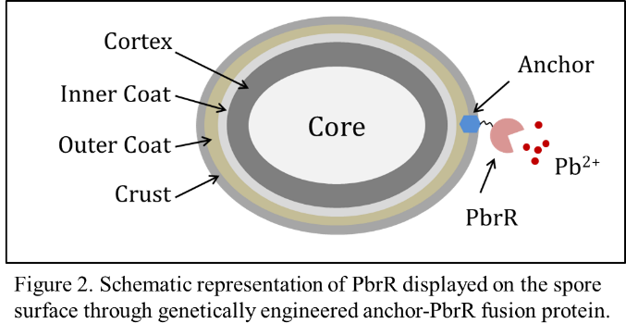
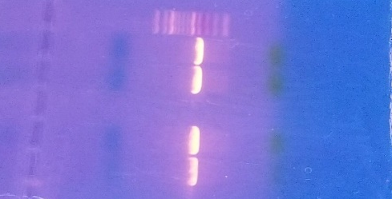
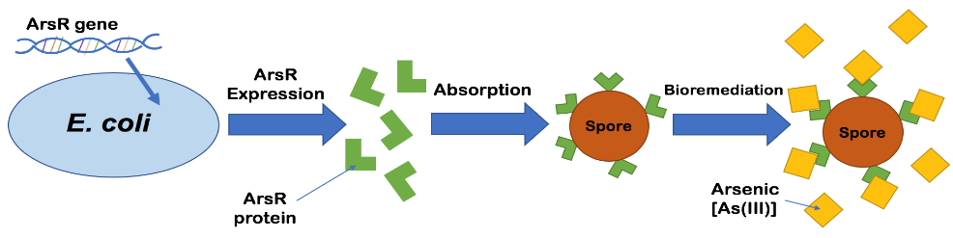
Heavy Metal Bioremediation
Justin Hardcastle and Joseph Tumidajski
Faculty Advisor: Dr. Kang Wu
Department of Chemical Engineering
University of New Hampshire
Introduction
Heavy metal contamination is a problem that affects populations and individuals worldwide. Current methods of lead and arsenic removal are energy costly, inefficient, and produce toxic sludge. Bioremediation provides an alternate method by using the natural abilities of biological systems or materials to capture pollutants. In this study, two proteins, PbrR2 from Cupriavidus metallidurans CH34, and ArsR from Escherichia coli, which bind specifically to lead and arsenic ions respectively, are displayed on the surface of spores of Bacillus subtilis for heavy metal recovery. Our group has displayed various proteins on the dormant spore surface and they show enhanced robustness and remain functional for months at room temperature, making the system ideal for bioremediation. In the long run, we aim to develop a low-cost, robust spore based system for heavy metal remediation and recovery.
Results
Currently, we have constructed a plasmid for the expression of PbrR2 in E. coli. Purification of PbrR2 was not successful using the Ni-NTA column. We are working on the purification of these two DNA-binding proteins using HiTrap Heparin affinity column.
Figure 1: PCR amplified PbrR2 inserts on agarose gel to check size before enzyme digestion and insertion into vector, pET28a. The bottom two wells are PbrR2 with a his tag attached to the C-terminal, and the other two are PbrR2 with the his tag on the N-terminal. The ladder used is a 100 bp ladder. The correct sizes as shown are between 400 and 500 bp.
Methods
1. To produce and purify the heavy metal binding proteins: We have constructed plasmids for the expression of PbrR and ArsR in E. coli. The two proteins are tagged with 6xHis and will be purified using Ni-NTA affinity column. The resulted proteins will be used as a control to compare the function of soluble proteins and proteins displayed on the spore surface.
2. To display the proteins on the spore surface: Two methods are being explored to display the two proteins on the spore surface. The first method is to genetically fuse the protein to be displayed with a native spore surface protein, such as CotC. The formed chimeric protein is produced in the mother cell during the late sporulation phase and then assembled to the surface of the spore with the native protein as the anchor on the spore surface. The second is to produce and purify the proteins from the cells produced in Step 1, and then adsorb them onto the spore surface. The quantity of the protein on the spore surface will be characterized using ELISA and dot blotting.
3. To characterize the protein function and efficiency: To determine the efficiencies of the heavy metal ion removal of the designed systems, we will mix the spores with a solution of heavy metal ions and then measure the difference before and after using Atomic Absorption Spectroscopy. The binding efficiency will be compared to soluble proteins.
What Next…
Purification and quantification of PbrR2 using HiTrap Heparin column.
Construction of the plasmid for the production of ArsR.
Purification and quantification of ArsR using either Ni-NTA column or Heparin column.
Adsorption of PbrR and ArsR on the spore surface.
Construction of plasmids for CotC-PbrR2 and CotC-ArsR and transform B. subtilis to display the fused proteins on the spore surface.
Characterization of heavy metal binding efficiency of spores displaying PrbR2 and ArsR.

