Slide 1

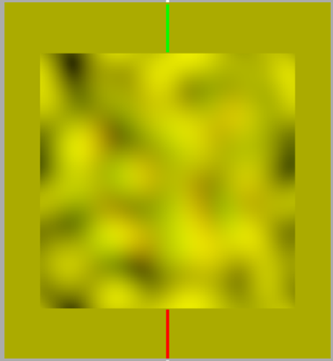
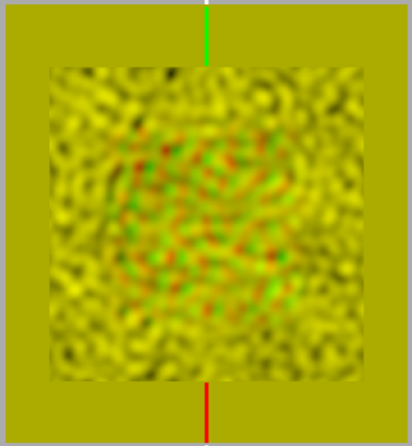
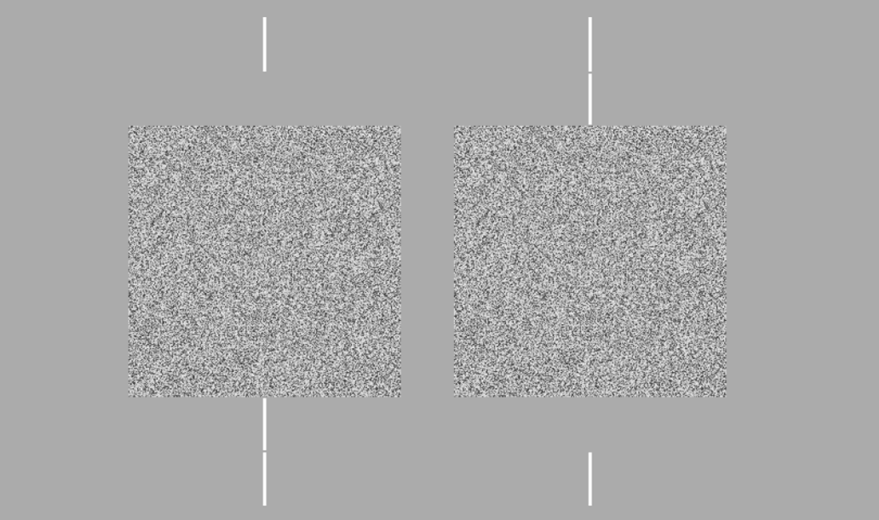
Spatial Frequency Effects on Stereo Acuity
Kailee Brachman-Pappas, Sofia Lombardo, Andrew J. Kitt, and Wm Wren Stine
Psychology Department, University of New Hampshire, Durham, NH
Introduction
Previous studies indicate that spatial frequency affects stereo acuity. A study conducted by Schor and Wood in 1983 used psychometric functions to measure the effects of spatial frequency on stereo acuity using differences of Gaussians as stimuli. This experiment measures the effects of spatial frequency on stereo acuity through signal detection theory using filtered random dot stereograms as stimuli. We also introduced stereo masks that were spatially filtered. Our results demonstrated that masks can influence stereo acuity, though differentially across subjects.
Results
1
2
Definitions
Random dot stereogram: Pair of images composed of an array of random dots in which part of one is shifted relative to the other, resulting in the perception of depth in that area when the images are presented to the two eyes.
Spatial Frequency: How far apart repeating patterns appear to be, expressed in terms of cycles per degree of visual angle.
Stereo Acuity: Minimum disparity that a person can identify under a given set of conditions – how much brightness changes across space.
Stereopsis: Depth perception that arises from a disparity between the images presented to the two eyes.
3
4
Methods
Random dot stereograms of five different crossed disparities were used to test each subjects’ stereo acuity across a range of spatial frequencies. We then presented the same targets with spatial frequency masks.
Images created on Matlab were presented on an Apple Macintosh desktop computer through a Maxwellian view system. A two-alternative forced choice method was utilized, with choices of depth vs no depth.
Discussion
Schor and Wood found that acuity was constant with spatial frequencies from about 2.4 c/deg to about 19.2 c/deg. A filtered random-dot mask should reduce stereo acuity. Our results show a large effect for a high sptial frequency mask for one subject and a large effect of both masks on a low spatial frequency target for the other subject.
Example Anaglyphs
References
Dichoptic stimulus
for global stereopsis
Schor, C. M., & Wood, I. "Disparity Range for Local Stereopsis as a Function of Luminance Spatial Frequency.” Vision Research 23.12 (1983): 1649-654
Notes:
E15JCY15- Psychology Department
-Stereoacuity: how good you are at stereopsis
-local stereopsis: DOG
-global stereopsis: RDS
-spatial frequency: light across spatial dimension, graphing amount of light across space
-creates black and white bars
-Maxwellian view system: controls amount of light entering the pupil and also aligns the subject (using bite bar)
-Method of constant stimuli: all possible permutations are presented randomly and data is statistically analyzed after
-Define crossed and uncrossed disparity

