Slide 1

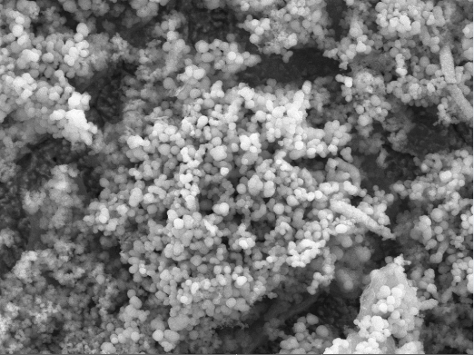
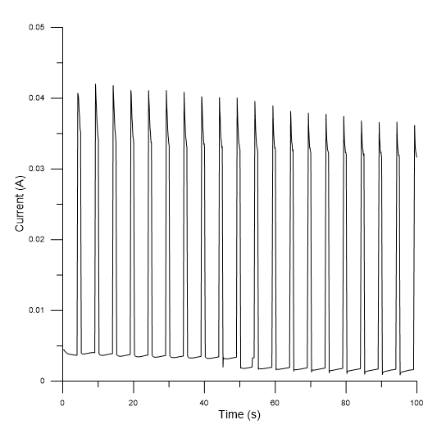
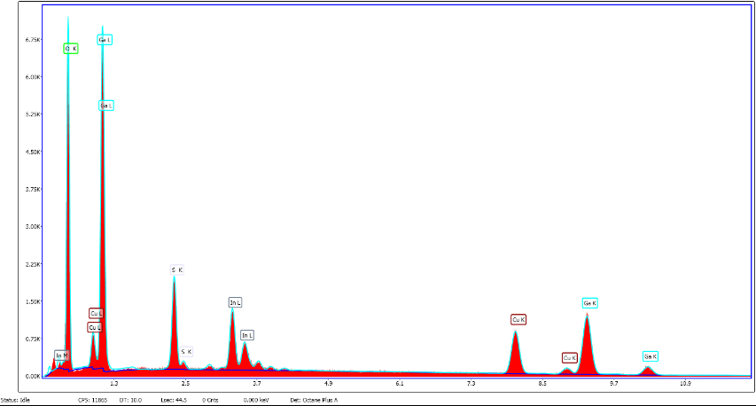
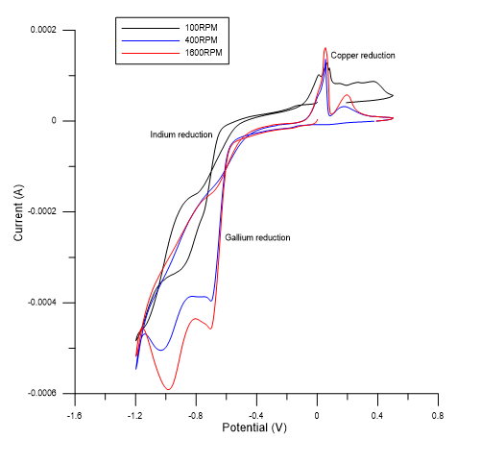
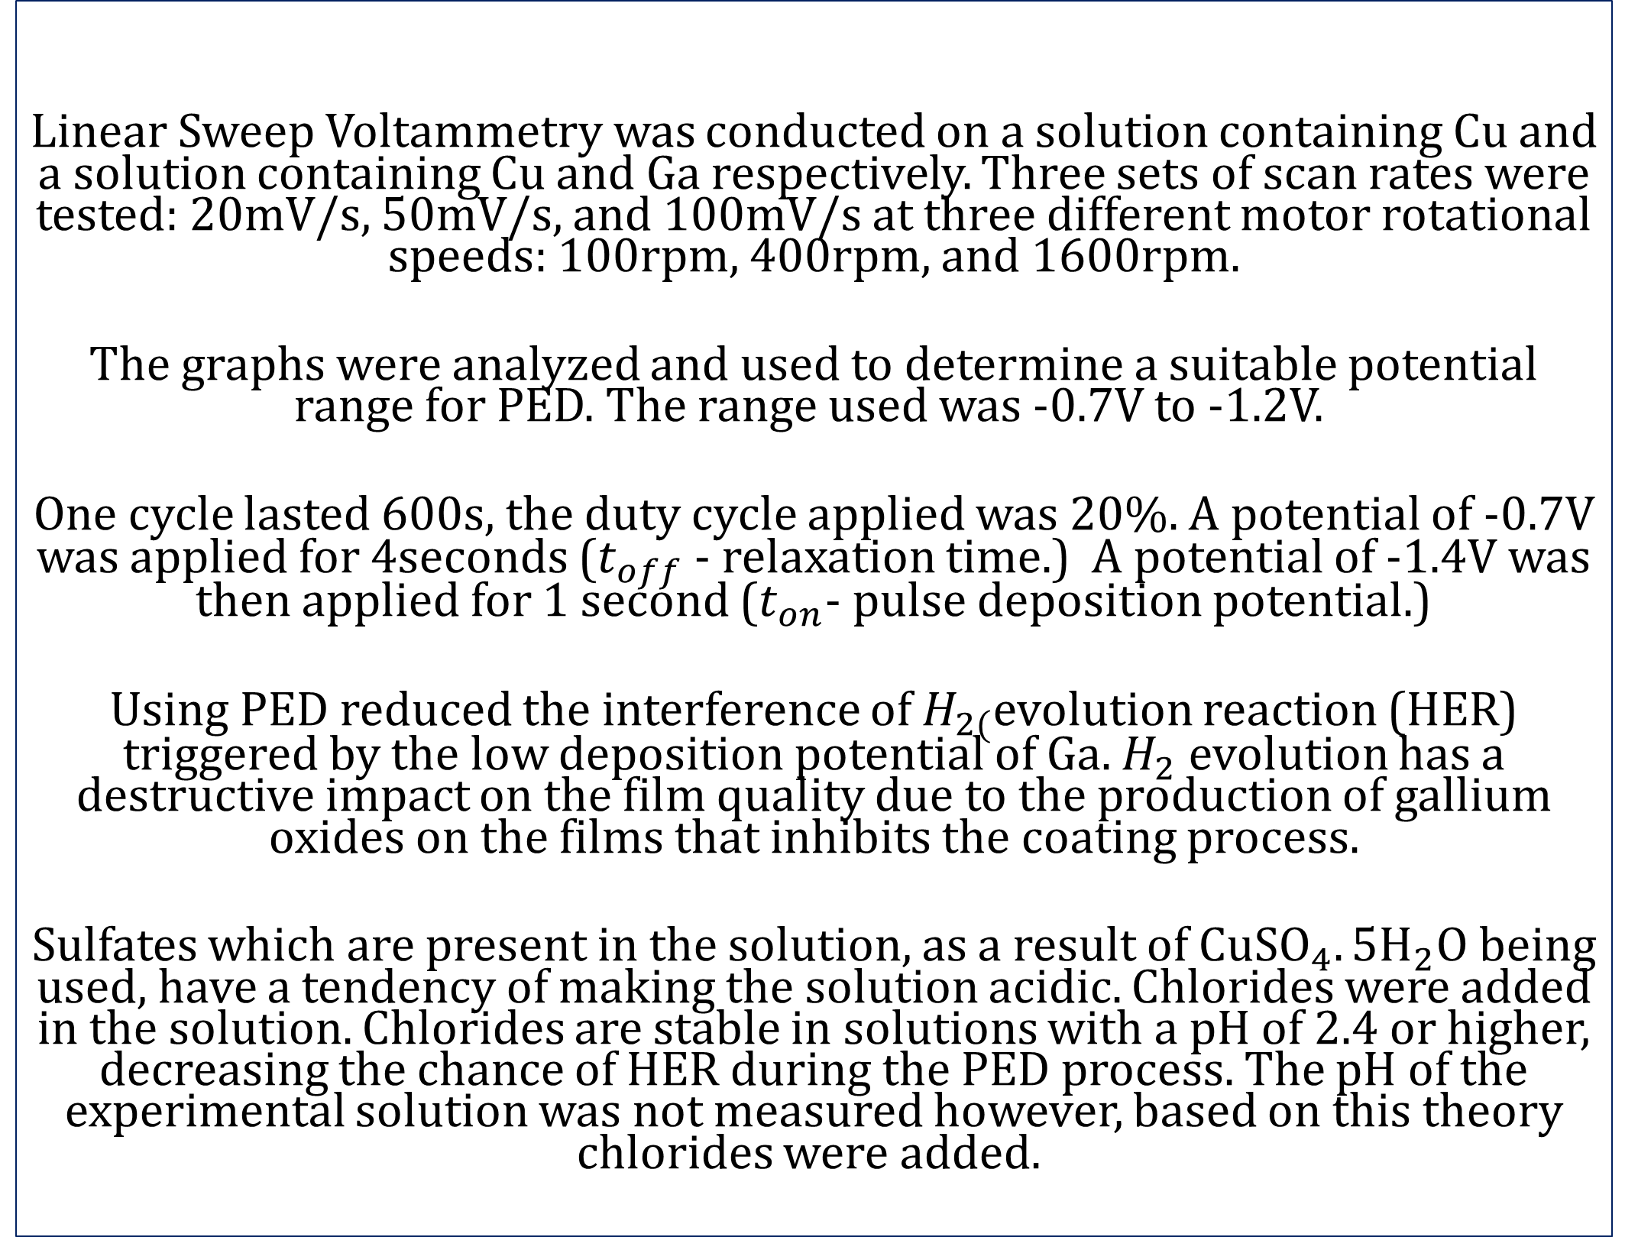
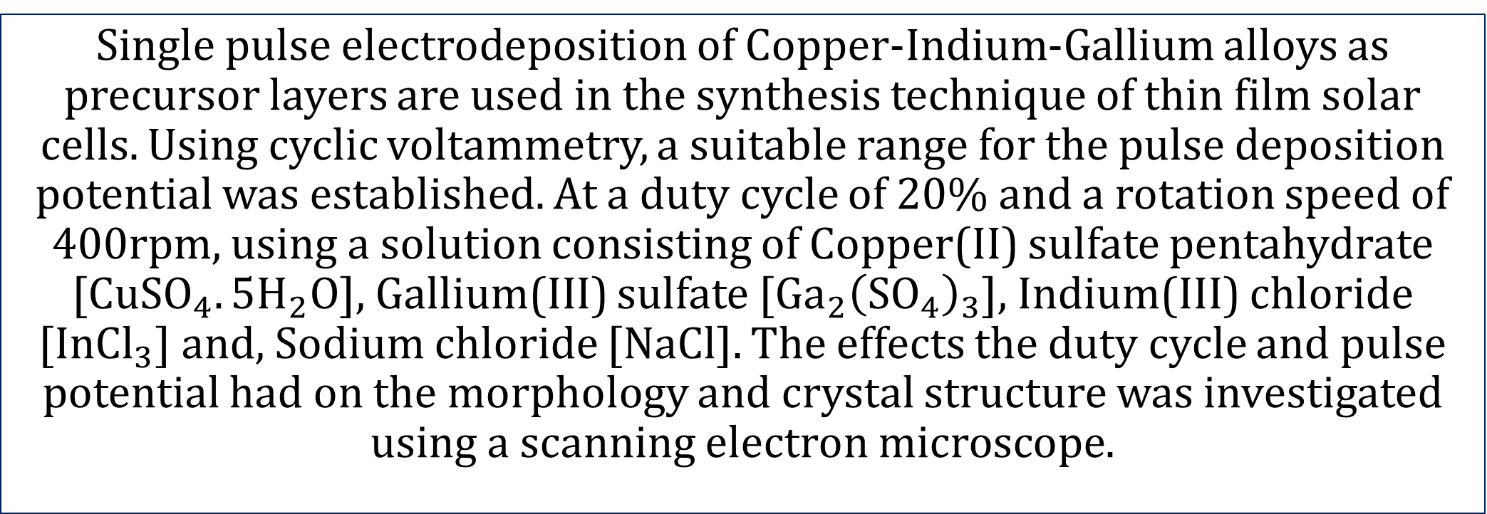
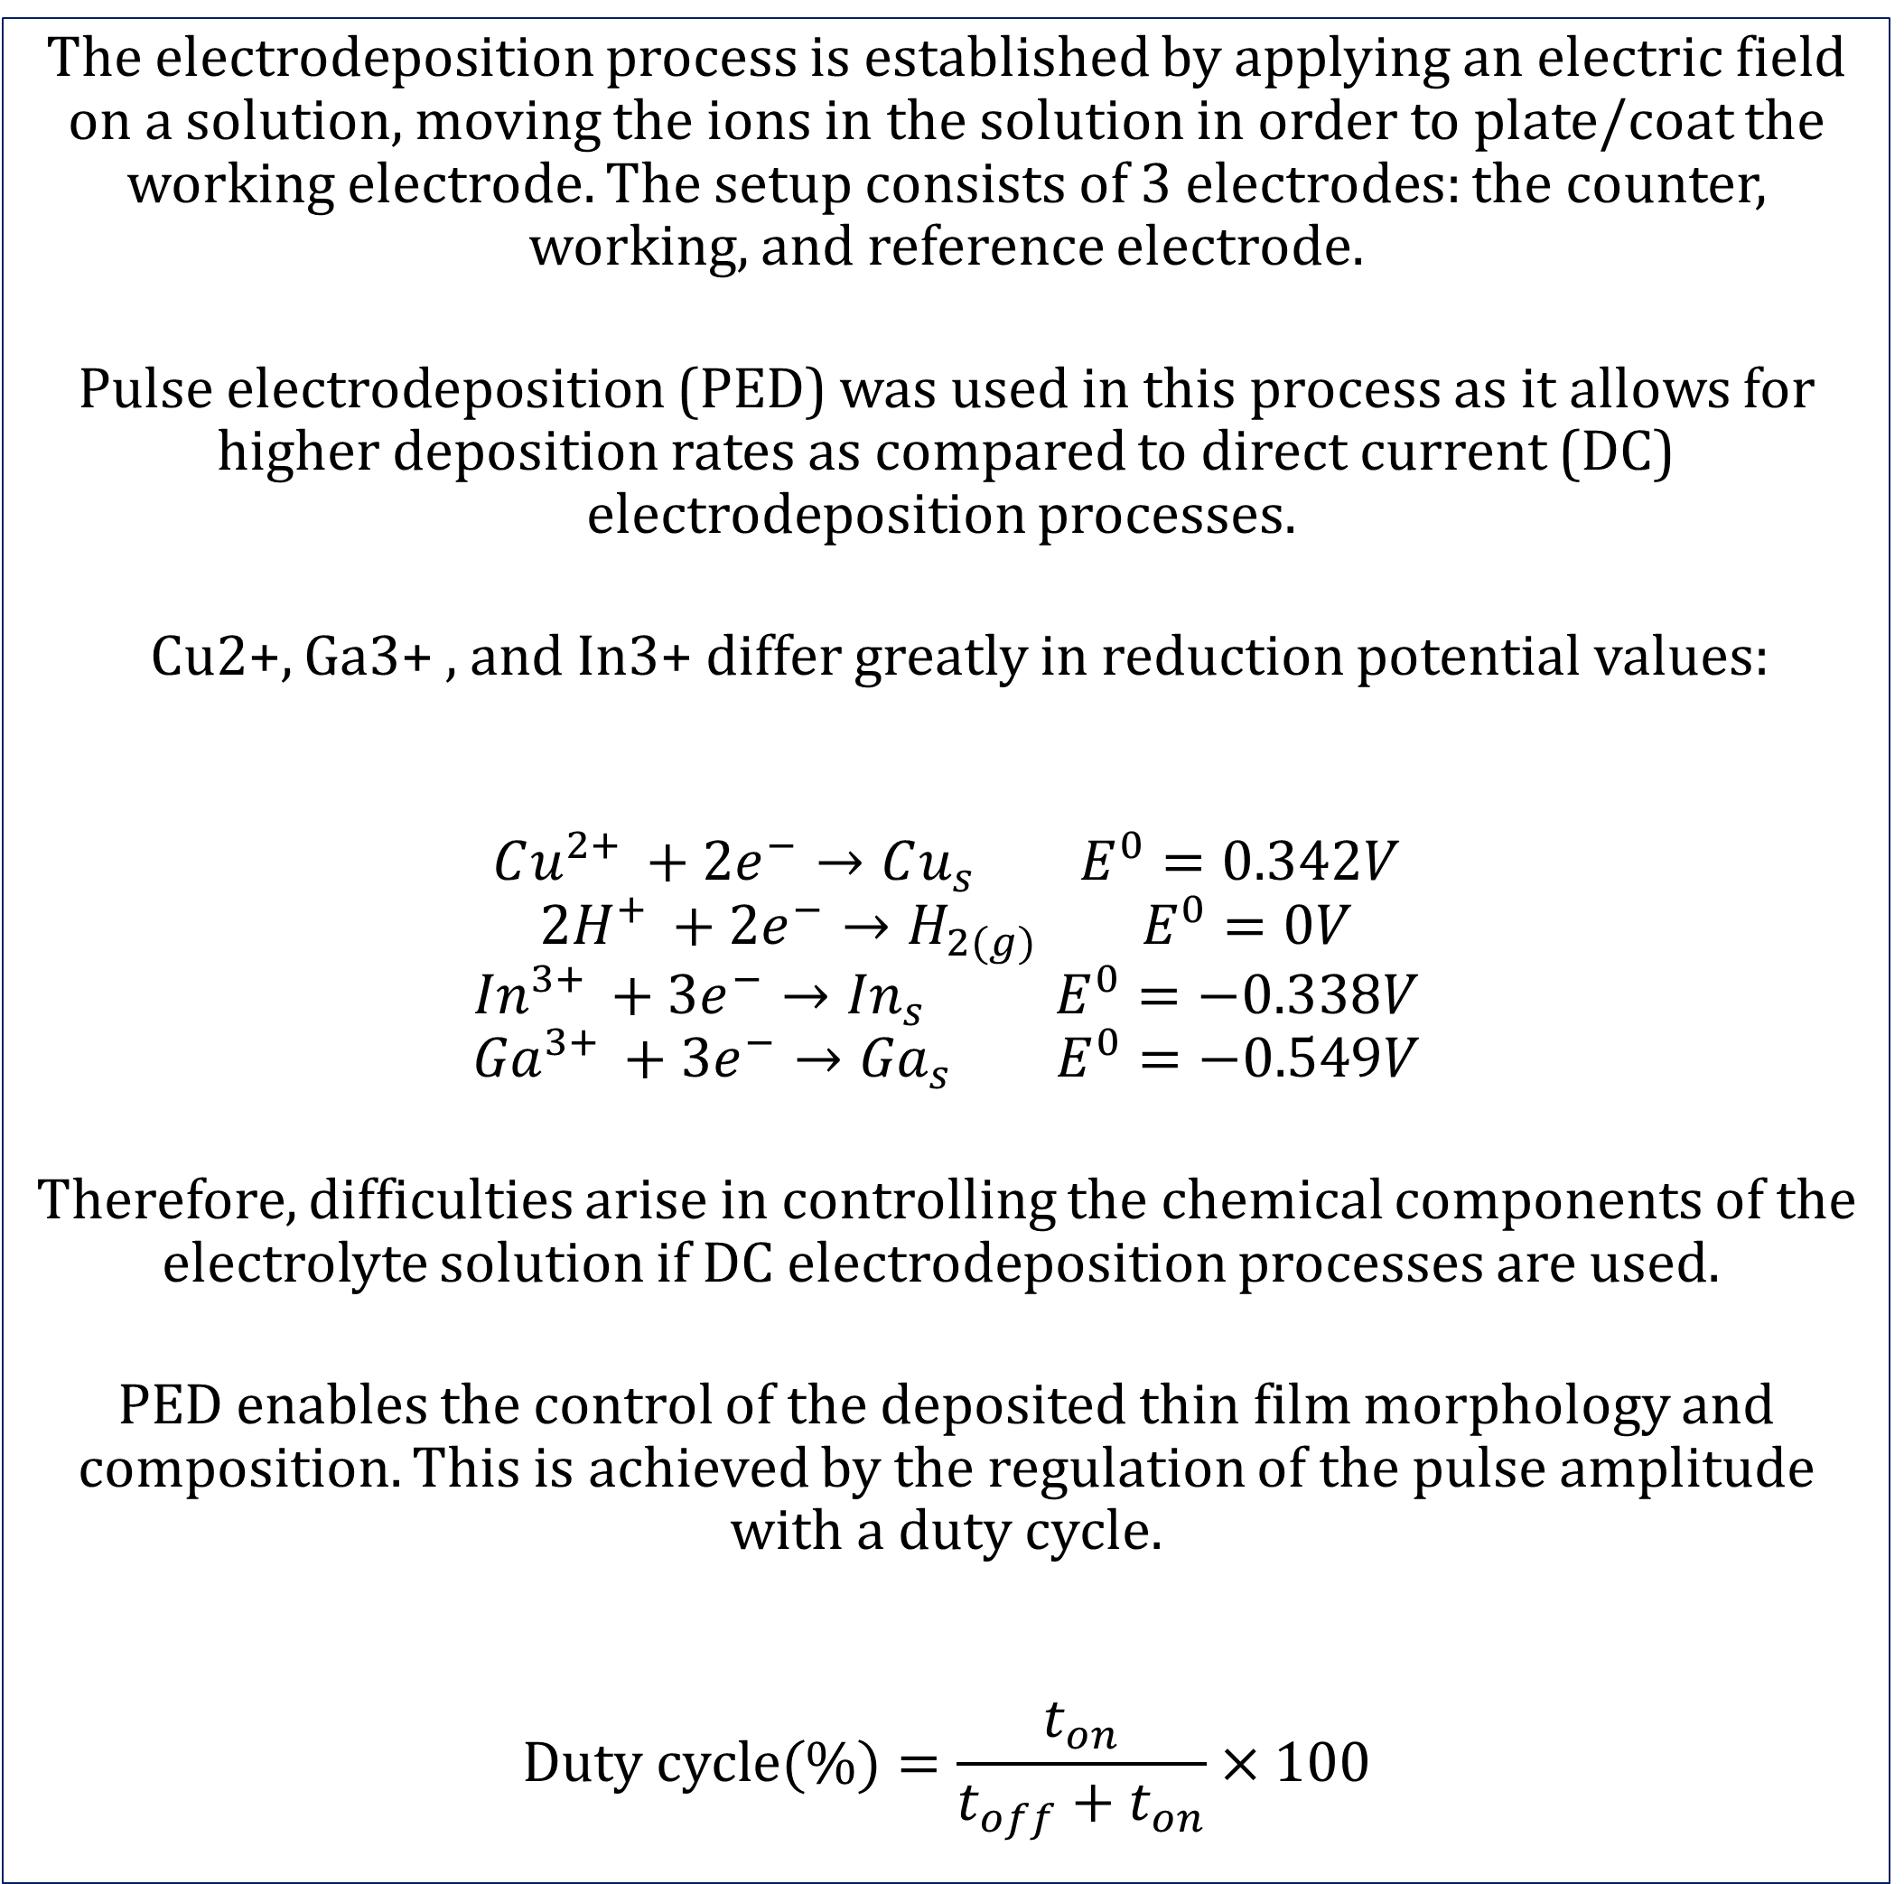
Pulse Electrodeposition of Copper-Indium-Gallium alloys as precursor layers for thin film solar cells
Valerie Mores
Department of Chemical Engineering, University of New Hampshire
Abstract
SEM scans at a magnification of 5000x
Single pulse electrodeposition of Copper-Indium-Gallium alloys as precursor layers are used in the synthesis technique of thin film solar cells. Using cyclic voltammetry, a suitable range for the pulse deposition potential was established. At a duty cycle of 20% and a rotation speed of 400rpm, using a solution consisting of Copper(II) sulfate pentahydrate [$CuSO_{4}.5H_{2}O$], Gallium(III) sulfate [$Ga_{2}{\left({SO}_{4}\right)}_{3}$], Indium(III) chloride [$InCl_{3}$] and, Sodium chloride [NaCl]. The effects the duty cycle and pulse potential had on the morphology and crystal structure was investigated using a scanning electron microscope.
Introduction
The electrodeposition process is established by applying an electric field on a solution, moving the ions in the solution in order to plate/coat the working electrode. The setup consists of 3 electrodes: the counter, working, and reference electrode.
Pulse electrodeposition (PED) was used in this process as it allows for higher deposition rates as compared to direct current (DC) electrodeposition processes.
Cu2+, Ga3+ , and In3+ differ greatly in reduction potential values:
$$Cu^{2+ }+2e^{−}→Cu_{s} E^{0}=0.342V$$
$${2H}^{+ }+2e^{−}→H_{2(g)} E^{0}=0V$$
$${In}^{3+ }+3e^{−}→{In}_{s} E^{0}=−0.338V$$
$${Ga}^{3+ }+3e^{−}→{Ga}_{s} E^{0}=−0.549V$$
Therefore, difficulties arise in controlling the chemical components of the electrolyte solution if DC electrodeposition processes are used.
PED enables the control of the deposited thin film morphology and composition. This is achieved by the regulation of the pulse amplitude with a duty cycle.
$$Duty cycle(\%)=\frac{t_{on}}{t_{off}+t_{on}}×100$$
Image #1 The deposited sample at a pulse potential range of (-0.4V to -1.4V)
Image # 2 The deposited sample at a pulse potential range of (-0.7V to -1.2V)
Image #3 The deposited sample at a pulse potential range of (-0.7V to -1.0V)
Mole percent vs. pulsed potential ranges
A section of the PED data
Results
From the EDS spectrum it is clear that In, Ga, and Cu were deposited on the film.
From the SEM images at a magnification of 5000x and a pulse potential range of (-0.4V to -1.4V,) the deposited material had areas where curling patterns are observed as a result of tensile stress.
At a magnification of 10000x for the same sample the dendritic structures of the deposit are clearly observed.
A section of the thick deposited material containing no curling structures was further analyzed and mapping of In, Ga, and Cu was done.
In and Ga were evenly deposited around the sample area, however Cu appeared to be more prevalent in the darker regions of the deposit where In and Ga were sparsely deposited.
An increase in RPM lead to in an increase in deposition current.
Pulsing at higher magnitudes increased the morphological instability leading to growth of dendrites
Lowering the driving force resulted in increasingly smooth and compact deposited structures. However, less Indium and Gallium is deposited. The deposits had better adherence to the plate with a decrease in grain structure therefore, this process is mass transfer limited.
Figure. 1. Mole percent of In, Ga and, Cu at 3 pulse potential magnitudes
Figure.2 . Current as a function of time
Methods
EDS spectrum
Linear Sweep Voltammetry
Linear Sweep Voltammetry was conducted on a solution containing Cu and a solution containing Cu and Ga respectively. Three sets of scan rates were tested: 20mV/s, 50mV/s, and 100mV/s at three different motor rotational speeds: 100rpm, 400rpm, and 1600rpm.
The graphs were analyzed and used to determine a suitable potential range for PED. The range used was -0.7V to -1.2V.
One cycle lasted 600s, the duty cycle applied was 20%. A potential of -0.7V was applied for 4seconds ($t_{off}$ - relaxation time.) A potential of -1.4V was then applied for 1 second ($t_{on}$- pulse deposition potential.)
Using PED reduced the interference of $H_{2(}$evolution reaction (HER) triggered by the low deposition potential of Ga. $H_{2}$ evolution has a destructive impact on the film quality due to the production of gallium oxides on the films that inhibits the coating process.
Sulfates which are present in the solution, as a result of $CuSO_{4}.5H_{2}O$ being used, have a tendency of making the solution acidic. Chlorides were added in the solution. Chlorides are stable in solutions with a pH of 2.4 or higher, decreasing the chance of HER during the PED process. The pH of the experimental solution was not measured however, based on this theory chlorides were added.
LSV at a scan rate of 50mV/s with varying RPM’s
Acknowledgements
UNH Hamel Center for Undergraduate Research for providing funding.
Dr. Barkey and the Chemical Engineering department for guidance and assistance.
UNH University Instrumentation Center for the SEM and EDS analysis.
References
Cao, Z., Yang, S., Wang, M., Huang, X., Li, H., Yi, J., & Zhong, J. (2016). Electrodeposition of Cu–Ga precursor layer for CuGaS2 solar energy thin film from alcohol solution. Ionics, 23(4), 1027-1033. doi:10.1007/s11581-016-1888-6
Cao, Z., Yang, S., Wang, M., Huang, X., Li, H., Yi, J., & Zhong, J. (2016). Electrodeposition of Cu–Ga precursor layer for CuGaS2 solar energy thin film from alcohol solution. Ionics, 23(4), 1027-1033. doi:10.1007/s11581-016-1888-6
Figure.3 . EDS spectrum of the thick deposited sample are at a magnification of 10000x
Figure.4 . Linear sweep voltammetry of In, Ga. And Cu in solution with copper as the reference electrode.

