Slide 1

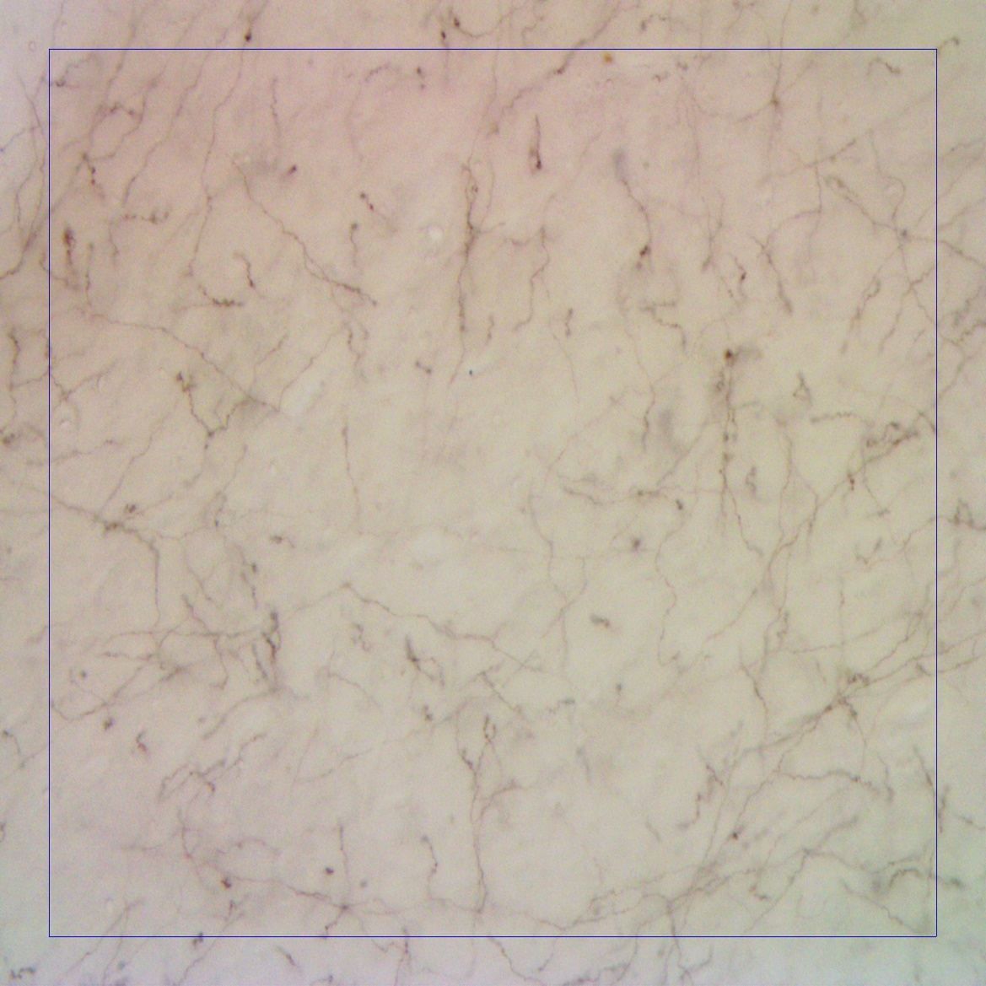
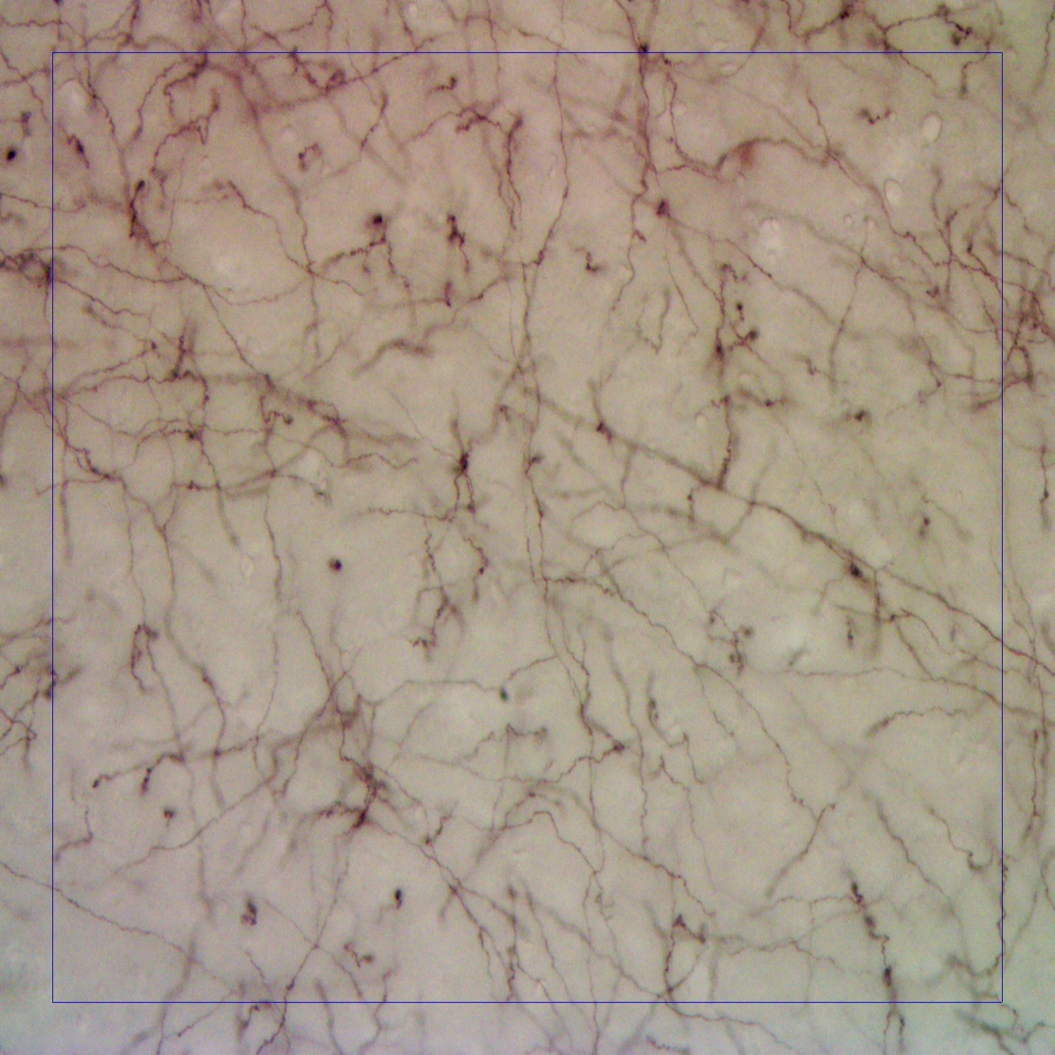
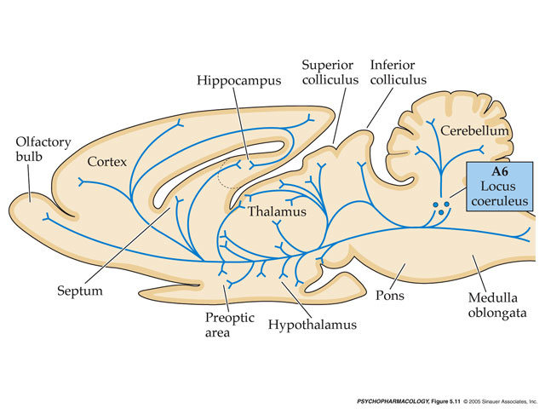
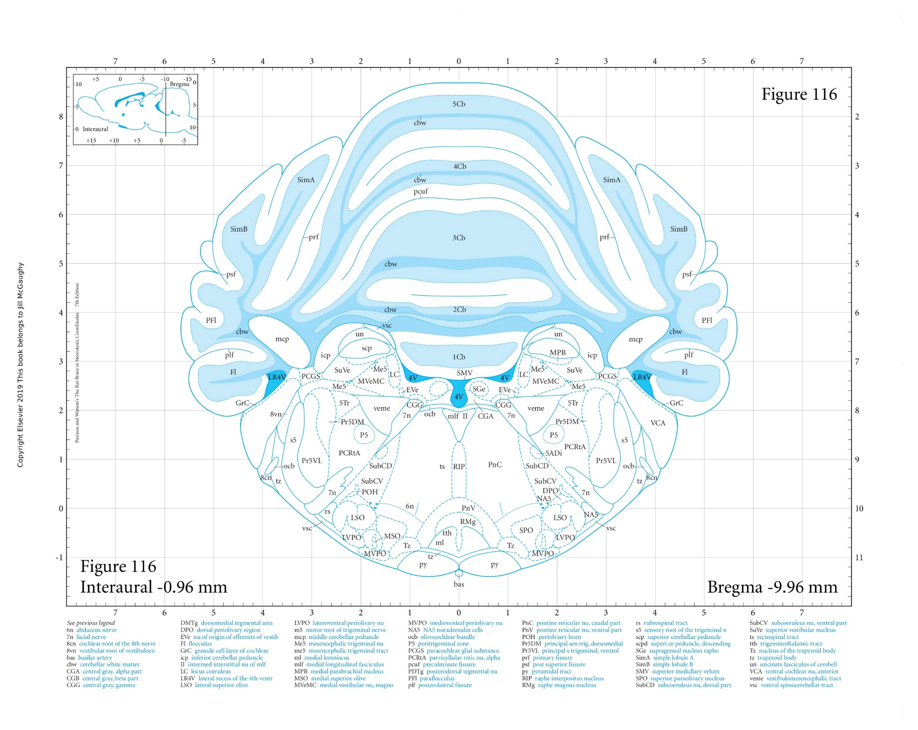
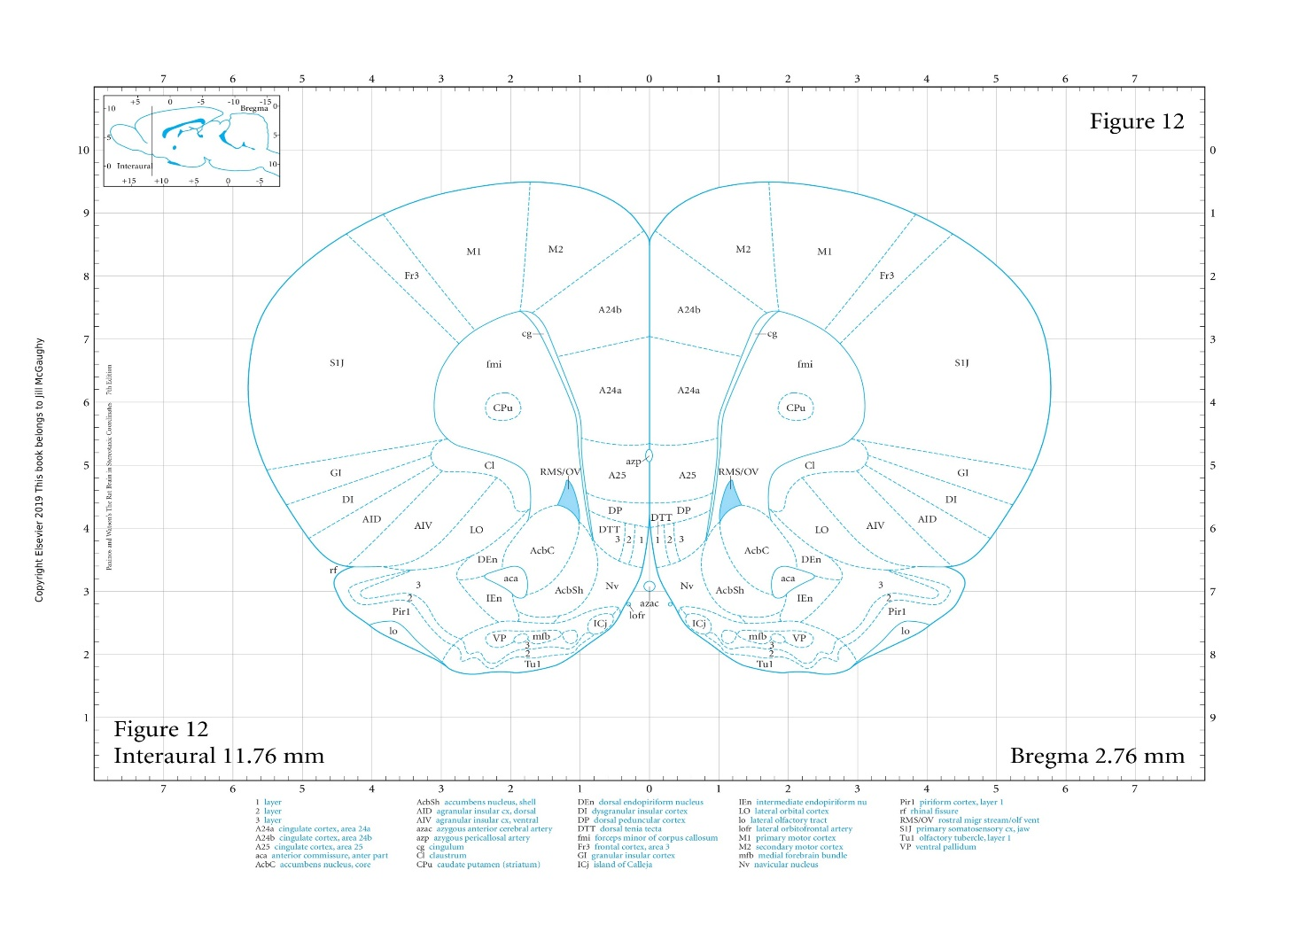
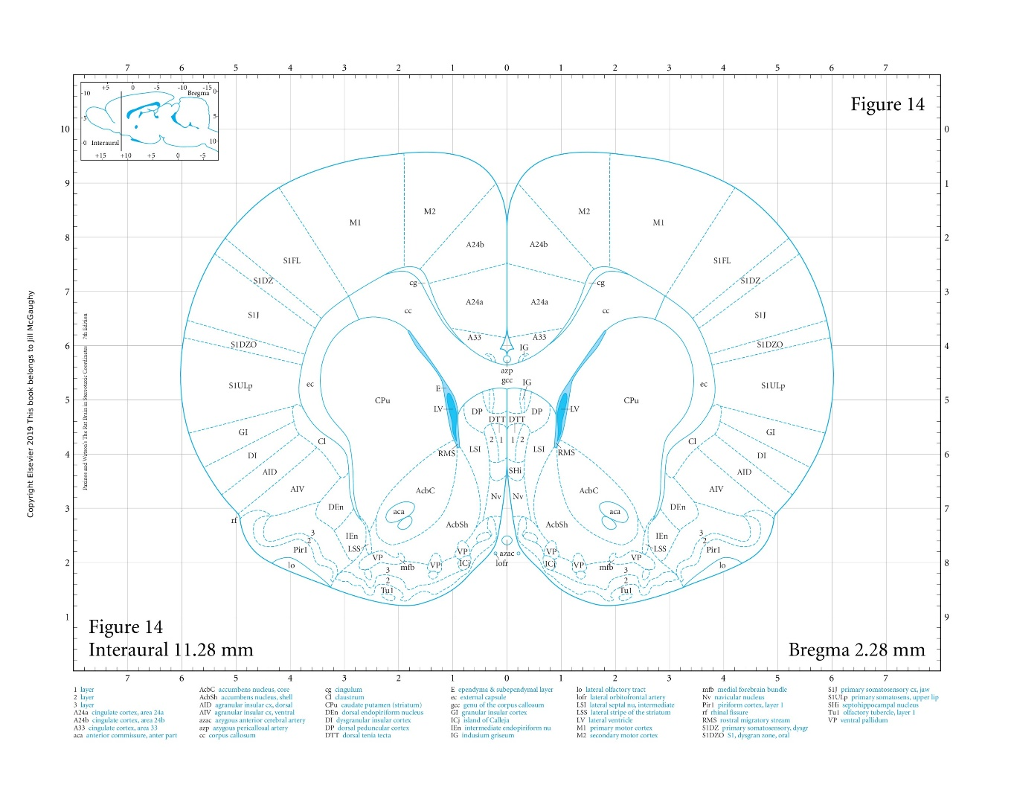
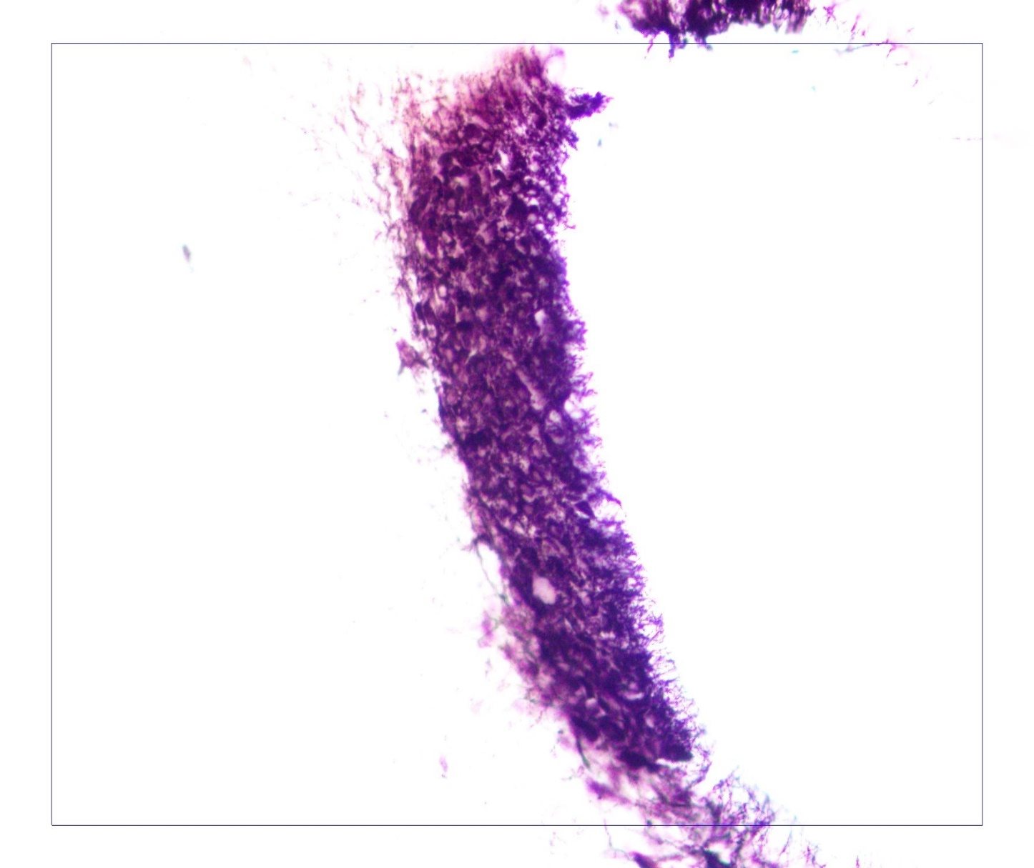
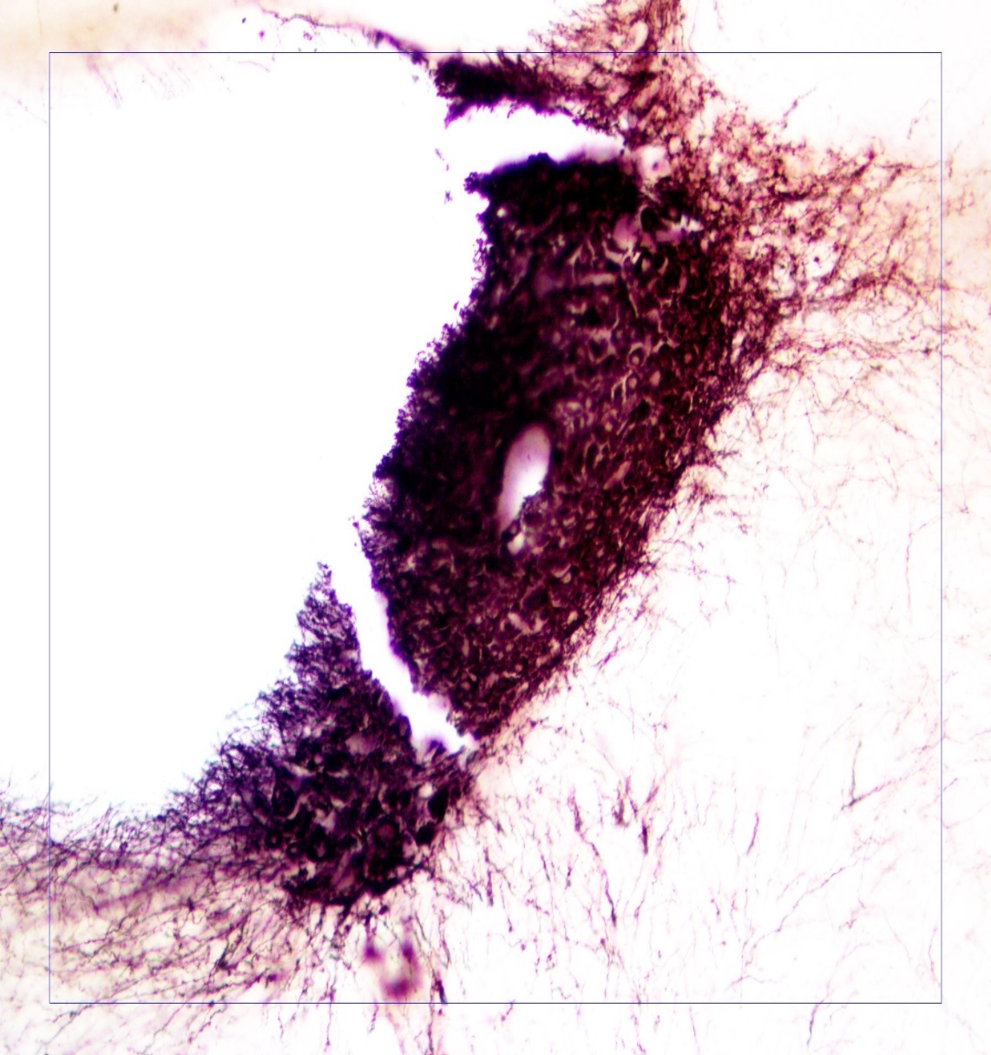
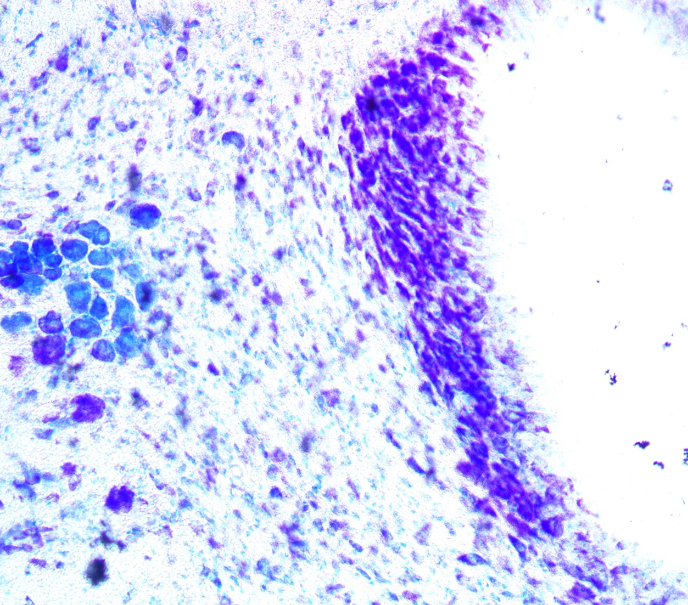
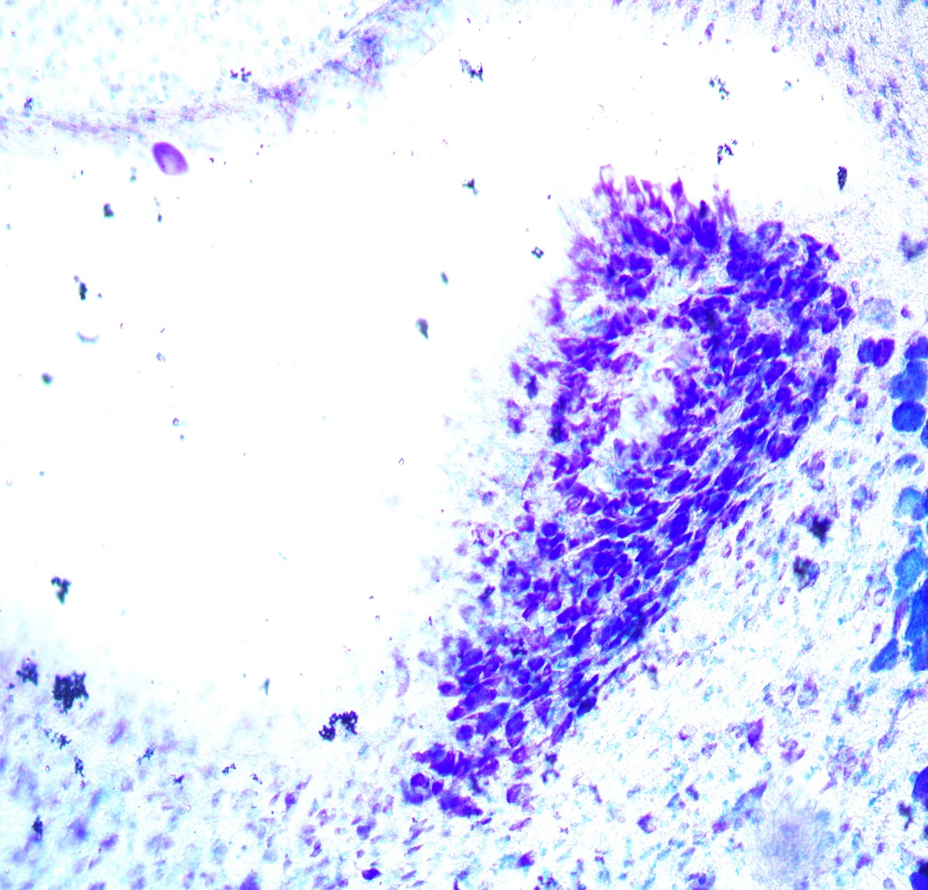

Examining the Connections of the Anterior Cingulate Cortex to the Locus Coeruleus
A.J. Pimentel, M.K. Clement, J.A. McGaughy
Department of Psychology, University of New Hampshire, NH
Introduction
Dysfunction in the anterior cingulate cortex (ACC) has been hypothesized to underlie attentional dysfunction in many neuropsychiatric disorders (Vogt and Paxinos 2014) but the neurochemical bases of this dysfunction has remained unresolved. Norepinephrine is one of the neuromodulatory systems consistently linked to attention (Bradshaw, Agster, Waterhouse and McGaughy 2016). The locus coeruleus (LC) is the primary origin of norepinephrine (NE) throughout the cortex (Swanson, 1976; Aston-Jones & Bloom, 1981) but the precise location of LC cells sending noradrenergic afferents to ACC is unknown. We are interested in understanding thte precise origin and termination of this pathway because future studies will use designer receptors activated by designer drugs (DREADDS) that require infusions at both ends of a pathway. To determine to origin of ACC noradrenergic axons, we injected a conjugated saporin toxin that targeted the synthesizing enzyme for NE, dopamine beta hydroxylase (DBH) into one hemisphere of the ACC of a rat. Because the toxin is retrogradely transported from the ACC to the origin of the pathway, LC, (Blessing, Lappi, &Wiley, 1998; Wiley & Kline, 2000) we can assess damage to both the origin and termination of the pathway. This produced a unilateral depletion of noradrenergic axons in the left hemisphere but spared the right hemisphere. Damage was compared between hemispheres using histological methods described below.
Histological Assessment
Figure 3. Slices of the ACC stained for DBH to elucidate NE axons. The left image shows the lesioned hemisphere of Cg1 (left), while the right image is the unlesioned. Counting was performed by counting the points on the blue square that the DBH axons intersect.
Figure 6. As shown in figure 2, Cg2 sits below Cg1 at the more caudal injection site, and was used as another measure to determine the possible spread of lesion. We found no hemispheric differences in sections of Cg2 showing again that the lesion was restricted to Cg1.
Figure 8. Both NISSL and DBH show hemispheric differences on the same side of the brain as the ACC lesion. The DBH stain shows that there is a connection between ACC/Cg1 and the LC. The results of the DBH counts have a very strong correlation with each other. This would show that the NISSL stain would be a viable method of assessing cell body loss in the LC from NE specific lesion.
Conclusions
We were able to produce area restricted lesions in the Cg1 that did spread to nearby sub-regions of prefrontal cortex, e.g. Cg2 and PL using DBH Saporin.
We are able to show that injection of a noradrenergic toxin into Cg1 produces depletion in the pathway, the LC. However the data collected were from the entire rostro-caudal extent of the LC so future studies will provide a more precise localization of the origin of these afferents.
Unexpectedly, the unilateral lesions did produce a behavioral effect making it more difficult for animals to form an attentional set (data not shown). Future studies will further examine this effect as well as examine the effects of right hemispheric lesions. These data support the hypothesis that rats, like humans, may show lateralization of attentional function improving the utility of rats as models of human cognitive function.
Figure 1. Shows the noradrenergic pathways from the LC travel in the rat brain (Meyer & Quenzer, 2006). The ACC is marked with a red circle to show the general area of the lesion chemical injection.
Surgical Methods
Sham Lesion: Dulbecco’s Saline (0.2μl/infusion)
NE-Lesion: DBH saporin (Dose: 0.02 μg/μl, 0.2 μl/infusion)
Surgical Coordinates
AP: Bregma +2.7; ML: $±$0.6; DV: Skull -2.4
AP: Bregma +2.2; ML: $±$0.6; DV: Skull -2.4
A
Figure 4. The graph shows the mean of DBH axon counts (n=6). The asterisk in the graph denoted a significant difference between left (black bars) and right hemisphere (white bars). Damage between hemispheres in Cg1 is restricted to the sites of injection, 2.7 and 2.28 mm from bregma.
Cg1
Cg1
Cg1
Cg1
PL
PL
Cg2
Cg2
Figure 2. Coronal sections of the rat brain showing the area of injection (Paxinos & Watson, 2014). The brain areas we took counts from are marked in, orange (ACC/Cg1), green (prelimbic cortex/ PL), and black (ACC/Cg2). These three brain areas are functionally distinct and have analogues primate brains including humans (Vogt & Paxinos, 2012). We took samples from these areas to examine possible spread of toxin. The target area is marked with the blue circle and is centered on rostral ACC hypothesized to be critical to attentional function.
B
C
References
Aston-Jones, F., & Bloom, F. E. (1981). Activity of Norepinephrine-Containing Locus Coeruleus Neurons in Behaving Rats Anticipates Fluctuations in the Sleep-Waking Cycle. The Journal of Neuroscience, 876-886.
Birrell, J. M., & Brown, V. J. (2000). Medial Frontal Cortex Mediates Perceptual Attentional Set Shifting in the Rat. Journal of Neuroscience, 4320-4324.
Blessing, W. W., Lappi, D. A., & Wiley, R. G. (1998). Destruction of locus coeruleus neuronal perikarya after injection of anti-dopamine-B-hydroxylase immunotoxin into the olfactory bulb of the rat. Neuroscience Letters, 85-88.
Bradshaw, S. E., Agster, K. L., Waterhouse, B. D., & McGaughy, J. A. (2016). Age-related changes in prefrontal norepinephrine transporter density: The basis for improved cognitive flexibility after low doses of atomoxetine in adolescent rats. Brain Research, 245-257.
McGaughy, J., Dalley, J. W., Morrison, C. H., Everitt, B. J., & Robbins, T. W. (2002). Selective Behavioral and Neurochemical Effects of Cholinergic Lesions Produced by Intrabasalis Infusions of 192 IgG-Saporin on Attentional Performance in a Five-Choice Serial Reaction Time Task. The Journal of Neuroscience, 1905-1913.
Meyer, J. S., & Quenzer, L. (2006). Psychopharmacology: Drugs the brain and behavior. Sunderland: Sinauer Associates.
Paxinos, G., & Watson, C. (2014). The Rat Brain (7th ed.). Boston: Elsevier.
Swanson, L. W. (1976). The Locus Coeruleus: a Cytoarchitectonic, Golgi, and Immunohistochemical Study in the Albino Rat. Brain Research, 39-56.
Vogt, B. A., & Paxinos, G. (2012). Cytoarchitecture of mouse and rat cingulate cortex with human homologies. Brain Structure and Function, 185-192.
Wiley, R. G., & Kline, R. H. (2000). Neuronal lesioning with axonally transported toxins. Journal of Neuroscience, 73-82.
Histological Procedures
D
E
Six adult male Long-Evans rats were used. After behavioral testing was completed, rats were given an overdose of anesthesia. Tissue was exsanguinated and fixed in 4% paraformaldehyde. Brains were then post fixed for a minimum of one hour and placed in a 30% sucrose solution until they sank. 40 μm coronal sections were processed for the presence of DBH positive axons in the cortex, or DBH positive cell bodies in the cerebellum to detect NE presenting cells. Cerebellum sections were also stained for NISSL bodies which in addition to stains for cell bodies indiscriminate of the neurotransmitter they produce. Both were done on cerebellar sections to confirm that the LC is primarily made of NE producing cell bodies. Cortical sections were examined on an Olympus BX51 microscope under 400x magnification Counting was performed using ImagePro software with a 250x250 μm square counting grid, annotating where fibers cross the outer border. LC sections were assessed at 200x magnification and counted using Amscope Software.
Figure 5. As shown in figure 2, PL sits below the Cg1 at the rostral injection site. Axon counts from the PL show that there were no differences in PL DBH counts between hemispheres. This shows that the lesion did not extend outside of Cg1.
Figure 7. Image A shows a schematic diagram of the LC. Images B and C show the LC stained for DBH (Paxinos & Watson, 2014). Image B is from the hemisphere with NE lesions to the Cg1, and Image C is from the unlesioned hemisphere. Images D and E show the same brain, stained for NISSL in the same area. The blue circles that can be seen on the image are cell bodies. NISSL does not stain for any specific neuromodulatory system, but instead shows all cell bodies in the area.
Acknowledgements
We would like to acknowledge the support of the Cole fund, which funded a portion of this study

