Slide 1


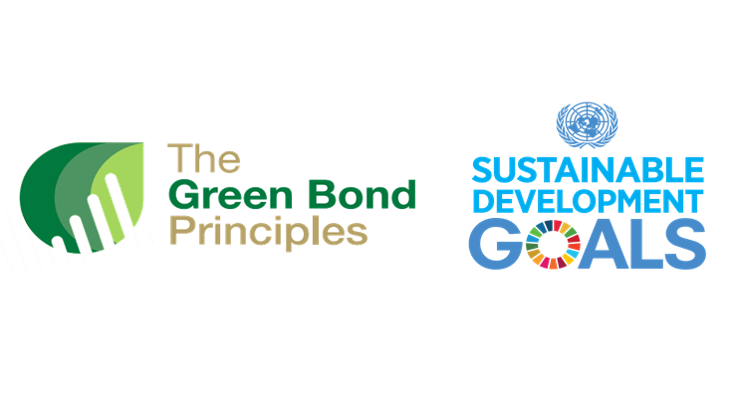

Green Bonds: A Win-Win Cooperative Addressing Climate Change While Creating Corporate Shared Value
Cynthya Gluck
University of New Hampshire
Introduction
Green bonds are issued to finance environmental projects that include, but are not limited to:
  Energy efficiency
  Pollution prevention
  Sustainable agriculture, fishing, forestry
  Ecosystem protection
  Clean transportation
  Water management
  Eco-friendly technological advancement
Green bonds are nontaxable.
The expected issuance of green bonds in 2019 is over $200 billion.
The total issuance of green bonds is currently $442 billion worldwide.
Exemplifying Company Green Bond Issuance:
Apple Inc. & Bank of America
Apple Inc.
Green Bond funds must be allocated to projects that are transforming renewable energy that include, but are not limited to:
  Building development – must be
  LEED-certified or BREEAM-certified
  System upgrades of facilities
  Water reduction
  Material efficiency
  Toxic substance and air
  pollution reduction
In 2016, Apple issued the largest corporate green bond in
history of $1.5 billion.
In 2017, Apple issued another $1 billion
green bond after President Trump removed the U.S. from the
Paris agreement.
Utilization of green bond issuance for internal
environmental projects with mindful investors
Bank of America
BofA’s 2018 green bond was the institution’s fourth and largest green bond of $2.25 billion.
  BofA has the most amount of corporate green bonds of all U.S. financial institutions of $4.35 billion since 2013.
BofA has underwritten green bonds for more than 100 clients at $27 billion total.
BofA’s first green bond financed nine projects including, but not limited to:
  L.A. and Oakland Streetlight Projects
  Anitoch Unified School District project
  SolarCity, Solar PV Power Partnership
  Silicon Ranch, Simon Solar
BofA’s second green bond financed two energy efficiency projects and five renewable energy projects including, but not limited to:
  White Oak Independent School District of Texas
BofA’s third green bond financed eight more projects, three of which were refinanced from the first green bond.
  SunPower, Sunrise 2 project
Utilization of green bond issuance as intermediary between investors and projects
  Profiting off of the maintenance of this transaction while also practicing environmental sustainability
Daisy, Apple’s robot, disassembles nine versions of the iPhone
https://www.apple.com/newsroom/2018/04/apple-adds-earth-day-
donations-to-trade-in-and-recycling-program/
As of 2018, each project eligible under the Green Bond Principles requires a mapping to the Sustainability Development Goals of the United Nations.
https://wealthmanagement.bnpparibas/asia/en/expert-voices/sustainable-development-goals-the-new-framework.html
Limitations and Solutions
Standardization
  Third-party verification – Climate Bonds Initiative’s Climate Bonds Standard and Certification Scheme or Norway’s Center for International Climate Research’s Shades of Green scale
  Green Bond Bank
Pricing
  “California Green Bond Credit Enhancement”
Market Function
  Increasing issuance amount to build eligibility for the market index
  “Regional Municipal Issuer Fund”
Conclusion
Apple’s Shared Value
Each renewable energy project funded by green bond issuances creates productivity in the value chain.
  Closed-loop goal
Bank of America’s Shared Value
The facility upgrades of the White Oak school district and the Californian streetlight projects exemplify productivity in the value chain.
BofAML’s partnership with SunPower exemplifies cluster development.
Green bonds are effective in addressing climate change through the creation of shared value. While taking a “planet” initiative by financing renewable energy projects, corporations that issue these bonds are also profiting off of the investor and innovator relationship. Projects themselves call for productivity in the value chain and cluster development, while green bonds have reconceived an entirely new market to finance the reconceiving of new products.
LEED-Certification Levels: Certified, Silver, Gold, Platinum
https://www.everbluetraining.com/what-is-leed
References
Bank of America has issued four corporate green bonds, raising a total of $4.35 billion for renewable energy projects. (2017, April 6). Bank of America. Retrieved from https:// about.bankofamerica.com/en-us/green-bond-overview.html#fbid=QNQKR7Va3o6
Chen, James. (2019, March 30). Green Bond. Investopedia. Retrieved from https://www.investopedia.com/terms/g/green-bond.asp
Heimer, Mathew. (2018, August 20). How a Big Bank Fueled the Green Energy Boom. Fortune. Retrieved from http://fortune.com/2018/08/20/bank-of-america-wind-solar-energy/
Milken Institute. (2018). Growing The U.S. Green Bond Market (Volume 2). Sacramento, California: Brennan, Maressa & MacLean, Caitlin. Retrieved from https://www.treasurer.ca.gov/growing-the-u.s.-green-bond-mkt-vol2-final.pdf.
Sustainalytics. (2017, June 13). Apple Inc. Green Bond. Taneja, T., Peyraud, C., da Dilva, Catarina. Retrieved from
https://www.sustainalytics.com/wp-content/uploads/2017/06/Green-Bond-Framework-and-Second-Opinion-Apple2017-final.pdf

