Slide 1
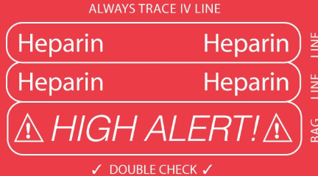
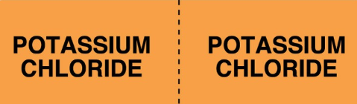
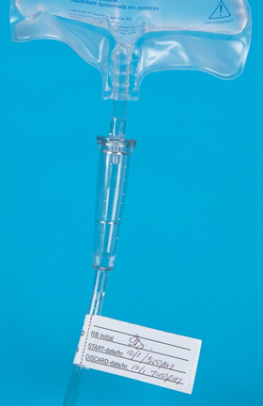
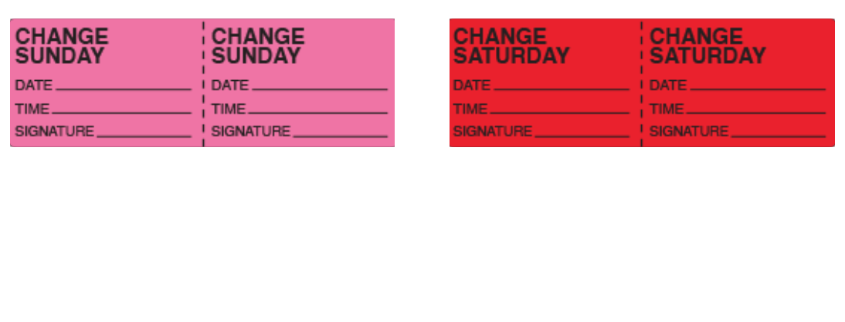
The Importance Of Labeling Intravenous Tubing
Senior Nursing Student Julie Labnon
University of New Hampshire Department of Nursing
Introduction
In hospitalized adult patients, does using intravenous tubing labels compared to not using labels decrease medication errors and decrease waste?
One of the most common reasons of hospital errors occur during the use and administration of intravenous (IV) medications. Proper labeling directly impacts the rate of medication administration errors common across hospital settings (United Ad Label, 2017). Unlabeled tubing increases the risk for unnecessary waste and increases hospital expenses. The goal of proper tubing labeling is to reduce the potential risk for medication errors.
Current Evidence
Clinical And Research Implications
Clinical Recommendations
During a multisite study by Schnock et al. consisting of 10 hospitals and 1164 medication administrations, 60% of infusions contained one or more errors (2017). Violations of IV labeling and tubing change policies (which vary between hospitals) accounted for approximately 65% of the observed mistakes (Schnock et al, 2017).
Unfortunately, there is no current evidence regarding unnecessary waste of IV tubing.
The labeling of all medications, containers, and solutions is a risk-reduction activity consistent with safe medication management and is a 2017 National Patient Safety Goal (The Joint Commission, 2017).
Primary IV tubing is to be changed every 96 hours (4 days) (SMHC, 2018). Without labels, IV tubing could be unnecessarily discarded up to eight times in a 96 hour span. This is a waste management and cost issue.
Future Research Trials Include:
Identify benefits from proper tubing labels
Impact of unlabeled tubing on hospital waste management
Cost-effectiveness of labeling tubing to decrease unnecessary disposal
All IV tubing labels should be easily visible and accessible in the medication room.
Directing staff with signs pointing to the labels could increase the use of labels.
IV LABELS HERE
↓
Risk Reduction Strategies:
  Setting up infusions one at a time
  Label all infusions with type of medication, high alert (if applicable), and date of expiration
  Raising awareness of the risk of IV errors
(Wollitz & Grissinger, 2014)

