Slide 1



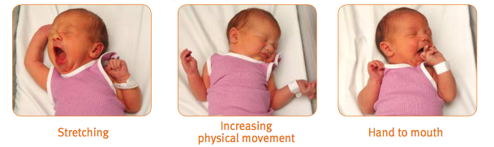
Using Cue-Based Feeding in the Winchester SCN
Rachel Schiff : UNH Senior Nursing Student
Current Evidence
In volume driven cultures, a “successful feeding” is measured by volume intake (Shaker, 2013).
There is a connection to an infant’s ability to feed well and the caregiver’s ability to understand the behavioral communication that an infant is portraying (Shaker, 2013).
Cue-based feeding has lead to increased weight gain, shorter hospitalization, and improved physiological outcomes (Lubbe, 2017)
Introduction
“ Delay in acquired feeding skills is the most frequent cause of prolonged hospitalization in the neonatal intensive care unit” (Shaker, 2013).”
Traditional methods of infant feeding are based on volume and time. Common feedings practices in NICU units involve nurse driven feeds with a goal for infants to finish the designated amount (Flanagan, 2017). Although infants may not demonstrate feeding difficulties at the time of discharge from the NICU, more than 50% of NICU parents report problems with feeding at 18 to 24 months post-discharge (Shaker, 2013). Evidence has suggested that this volume-driven feeding model should be replaced with infant-guided feeding (Whetten, 2016).
Feeding Cues
Early cues
  Stirring
  Mouth opening
  Turning head
Mid Cues
  Stretching
  Physical movement
  Hand to mouth
Later Cues “Feed me”
  Crying
  Agitated
  Turning red
(Floating Hospital for Children, 2019)
Clinical Implications
Feedings will stop after any sign of stress, regardless of the volume taken by the infant
Focus will be catered to the individual needs of each infant
Accurate documentation of infant readiness to feed
Assessment of infant behaviors during each feeding
Recommendations
An assessment needs to be completed prior to beginning each care time
  Is this infant awake before being touched?
  Are they demonstrating feeding cues?
The unit as a whole needs to transition to this feeding style for consistency and culture change
Feeding events, assessments, and behaviors need to be discussed during report
The role of parents and the effect that cue-based feeding has on parent-infant bonding needs to be researched
More research is needed on the challenges nurses have faced when making this change in their units
(Queensland Health, 2010)
Signs of Stress During Feeding
Color change from baseline
Nasal flaring
Respiratory fatigue
Unstable saturations
Bradycardia
Apnea
Change in state of alertness
Gulping
Gurgling sounds
Coughing
Choking
(Shaker, 2013)
(University Health System, 2019)
Research Implications
PICO
For infants hospitalized in the Special Care Nursery, will the implementation of cue-based feeding lead to an earlier achievement of full oral feedings?

