Slide 1

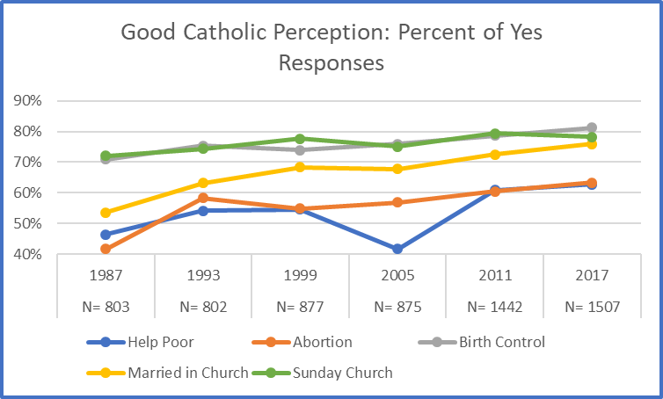
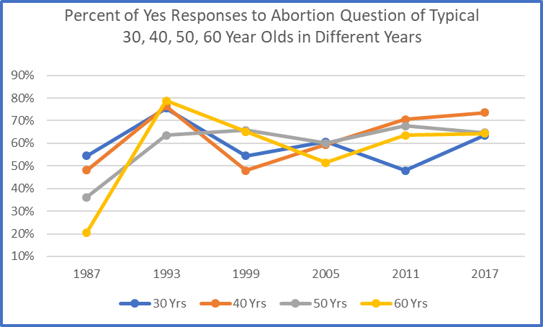
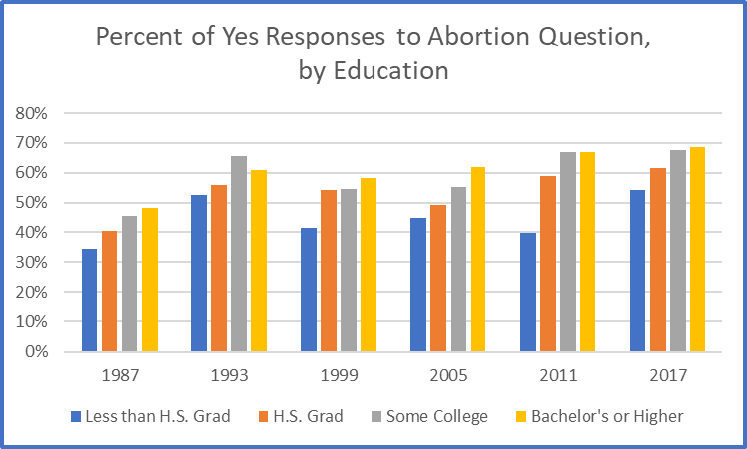
The Changing Perception of what
Constitutes a ‘Good Catholic’
Matthew Cook
Advisor: Michele Dillon, Ph.D.
Introduction
The Data
In 1987 the first of a series of six surveys using a nationally representative sample of American self-identified Catholics was conducted. This was followed up with similar surveys in 1993, 1999, 2005, 2011, and 2017. Among the questions asked on each survey was whether one can be a ‘Good Catholic’ while not adhering to certain Catholic teachings and practices.
The Questions
Please tell me if you think a person can be a good Catholic,
Without obeying the Church’s teaching regarding abortion.
Without obeying the Church’s teaching regarding birth
control.
Without getting married in the Church.
Without going to Church every Sunday.
Without donating time or money to help the poor.
Project Summary
Determine what questions and associated responses were
consistent across all six surveys.
Merge all common questions and responses into a single
database using SPSS (Statistical Package for the Social
Sciences).
Generate additional Birth Year and Cohort (Birth Decade)
variables, to allow for finer analysis.
Analyze the combined database for trends regarding the
‘Good Catholic’ questions.
Results
American Catholics are steadily moving to a more liberal, tolerant view of what it means to be a ‘Good Catholic’.
Intensification of abortion activism in American society more generally may have contributed to attitudinal change observed among Catholics.
Changes in perception regarding abortion are changing at roughly double the rate regarding birth control.
Higher education trends to more open views regarding abortion among American Catholics. However, the gap in acceptance between education levels is consistent.
References
William D’Antonio, Michele Dillon, & Mary Gautier. 2013. American Catholics in Transition. Lanham, MD: Rowman and Littlefield.
Michele Dillon. 2018. Postsecular Catholicism. New York: Oxford University Press.

