Slide 1


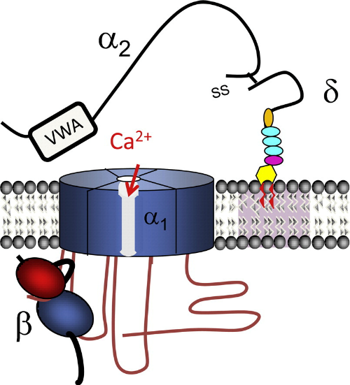
Functional Characterization of CACHD1, a Protein Closely Related to the Gabapentinoid Receptor α₂δ
Julian Brown, Juan Gomez-Rivadeneira, Arturo Andrade
University of New Hampshire
Background
Methodology (Cont.)
Discussion & future directions
Pain:
Chronic pain is a major public health issue. Pain management is estimated to cost $560-$635 billion annually
Mediated by complex pathways in the peripheral and central nervous system
Epilepsy & Seizures
Recurrent episodes of excessive/synchronous neuronal activity
Estimated to affect ~1% of global population
Causes and risk factors are not well understood
The genetic model for knockdown of CG16868 used the insertion of a transgenic transposon known as PBac into the 5’ UTR of CG16868 which should inhibit transcription
The efficacy of the genetic model was tested using reverse transcription quantitative polymerase chain reaction (RT-qPCR) on transgenic D. melanogaster tissue samples
Transgenic CG16868 deficient flies were subjected to behavioral testing using FlyGrAM, where flies are visually tracked and their activity levels quantified to assess differences in activity between transgenic and wild-type flies
PBac system produced an effective knockdown of CG16868 in males but not in females, indicating that PBac mediated genetic ablation is a useful tool, and that there may be potential differences in CG16868 regulation between sexes
Behavioral analysis revealed a visible trend of difference in activity between CG16868 knockdown and wild-type flies, especially in males
To determine whether this difference is statistically significant we will conduct a repeated measures ANOVA to determine whether this behavioral difference is significant
Given the difference in the effectiveness of the knockdown of CG16868 in males and females, and the apparent difference in activity levels, we will use an ANOVA and Bonferroni correction with data from qPCR to determine whether there are differences in expression of CG16868 between male and female wild-type flies
Gabapentinoids
Emerging class of anti epileptic/analgesic
Potent therapy against neuropathic pain, serving as an alternative to opioids
Bind to α₂δ-1 and α₂δ-2 subunits of N-type calcium channels
α₂δ Proteins in Pain & Epilepsy
α₂δ proteins are extracellular regulatory subunits of voltage gated calcium channels (Figure 1)
The family contains 4 members, α₂δ 1-4. α₂δ-1, α₂δ-2, and α₂δ-3 have shown effects on modulating pain signaling and epilepsy in knockout animal models
These effects are conserved evolutionarily from D. melanogaster to humans
results
PBac system produced a 41.6% reduction of CG16868 expression in males (P=0.0012) (Figure 3)
PBac system did not produce a significant reduction in CG16868 expression in females (P>0.1)
Behavioral analysis did not show a significant difference between genotypes (Figure 4)
Acknowledgments
Funded by Hamel Center for Undergraduate Research and the Summer Undergraduate Research Fellowship
Thank you to Dr. Karla Kaun from Brown University for your support of this research
Thank you to Juan Gomez-Rivadineira for your constant help throughout this project
Figure 1: Schematic of a N-type voltage gated calcium channel, showing the α₂ and δ subunits
References
Basbaum, A. I., Bautista, D. M., Scherrer, G., & Julius, D. (2009). Cellular and molecular mechanisms of pain. Cell, 139(2), 267–284.
Cunliffe, V. T., Baines, R. A., Giachello, C. N. G., Lin, W.-H., Morgan, A., Reuber, M., … Williams, R. S. B. (2015). Epilepsy research methods update: understanding the causes of epileptic seizures and identifying new treatments using non-mammalian model organisms. Seizure-European Journal of Epilepsy, 24, 44–51.
Fisher, R. S., Boas, W. van E., Blume, W., Elger, C., Genton, P., Lee, P., & Engel, J. (2005). Epileptic seizures and epilepsy: definitions proposed by the International League Against Epilepsy (ILAE) and the International Bureau for Epilepsy (IBE). Epilepsia, 46(4), 470–472.
Geisler, S., Schöpf, C. L., & Obermair, G. J. (2015). Emerging evidence for specific neuronal functions of auxiliary calcium channel α2δ subunits. General Physiology and Biophysics, 34(2), 105.
Hannon, G. J. (2002). RNA interference. Nature, 418(6894), 244.
Madabattula, S. T., Strautman, J. C., Bysice, A. M., O’Sullivan, J. A., Androschuk, A., Rosenfelt, C., … Bolduc, F. (2015). Quantitative analysis of climbing defects in a Drosophila model of neurodegenerative disorders. JoVE (Journal of Visualized Experiments), (100), e52741.
Neely, G. G., Hess, A., Costigan, M., Keene, A. C., Goulas, S., Langeslag, M., … Smith, S. B. (2010). A genome-wide Drosophila screen for heat nociception identifies α2δ3 as an evolutionarily conserved pain gene. Cell, 143(4), 628–638.
Parker, L., Howlett, I. C., Rusan, Z. M., & Tanouye, M. A. (2011). Seizure and epilepsy: studies of seizure disorders in Drosophila. In International review of neurobiology (Vol. 99, pp. 1–21). Elsevier.
Sills, G. J. (2006). The mechanisms of action of gabapentin and pregabalin. Current Opinion in Pharmacology, 6(1), 108–113.
Zerbino, D. R., Achuthan, P., Akanni, W., Amode, M. R., Barrell, D., Bhai, J., … Girón, C. G. (2017). Ensembl 2018. Nucleic Acids Research, 46(D1), D754–D761.
CACHD1: A novel family member
The protein CACHD1 has been identified as an paralogue of the α₂δ protein family and is currently uncharacterized
CACHD1 has multiple conserved structures including VWA and Cache domains
Like other α₂δ proteins CACHD1 is evolutionarily conserved, with orthologues present in mice and notably in D. melanogaster
It is hypothesized that CACHD1 may have similar effects on pain signaling and epilepsy to other α₂δ proteins
Figure 3: Relative expression of CG16868 in transgenic and wild-type flies from RT-qPCR
objectives
Determine the function of the orthologue CACHD1, CG16868 in Drosophila melanogaster:
  Identify and validate a model for genetic ablation of CG16868
  Assay whether genetic ablation of CG16868 affects behavior
methodology
Drosophila melanogaster was chosen as a model organism for genetic ablation of CACHD1, because of the presence of an orthologue of CACHD1 known as CG16868, the evidence for evolutionary conservation, and the decreased cost and time required for fly-based assays
Figure 4: Activity of male and female CG16868 knockdown and wild-type flies

