Slide 1

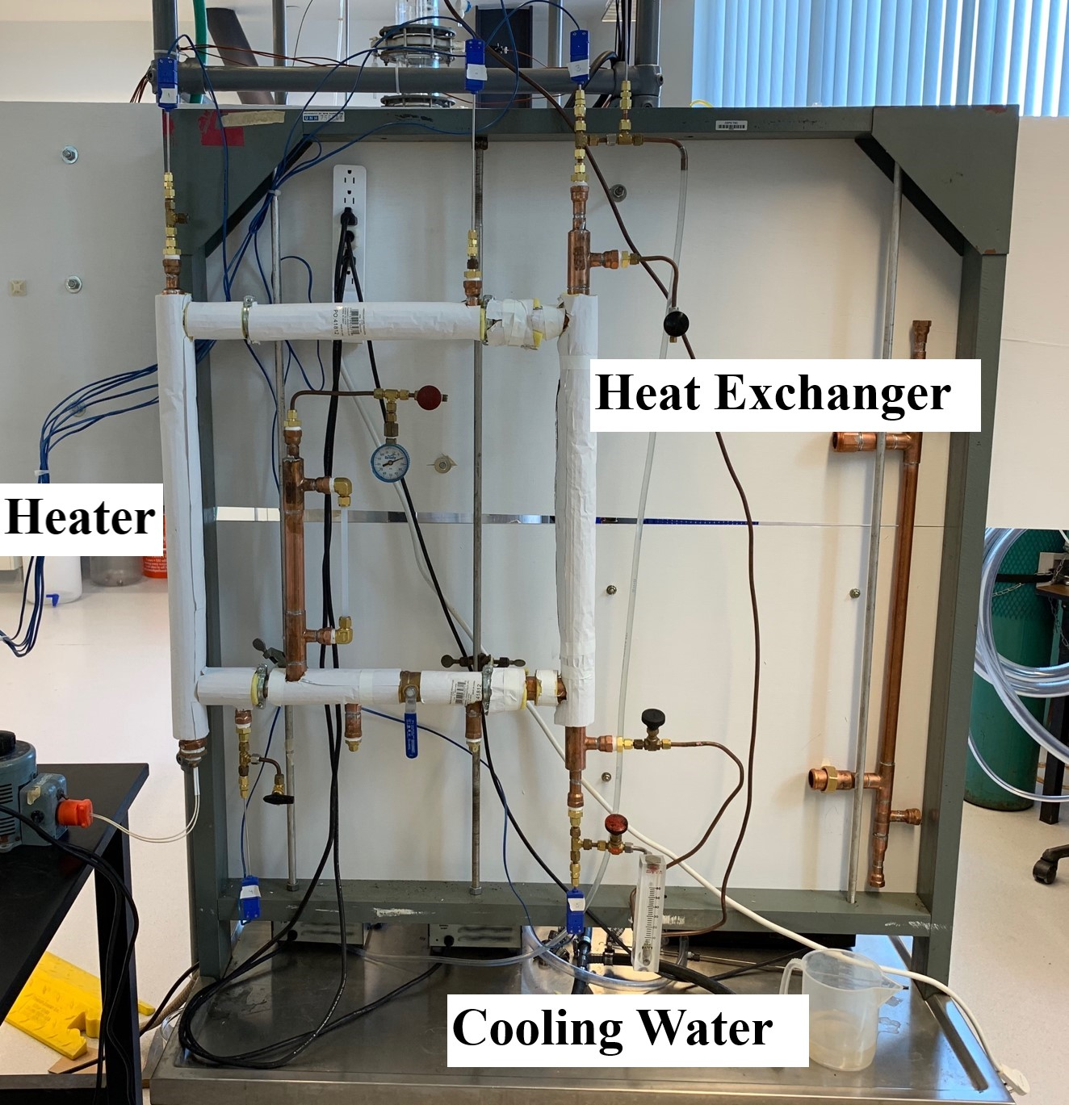
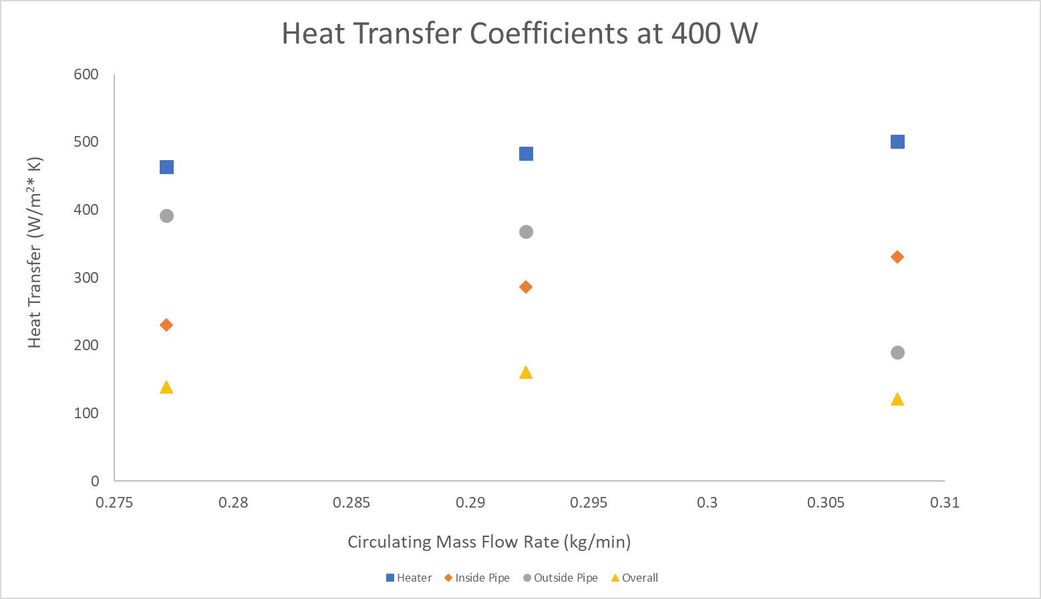
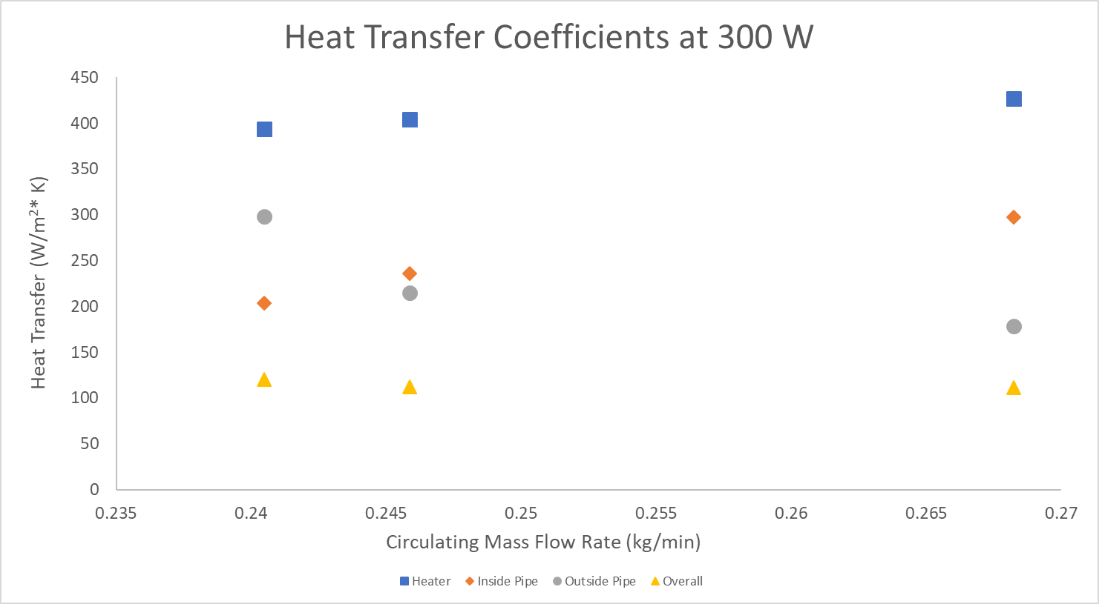
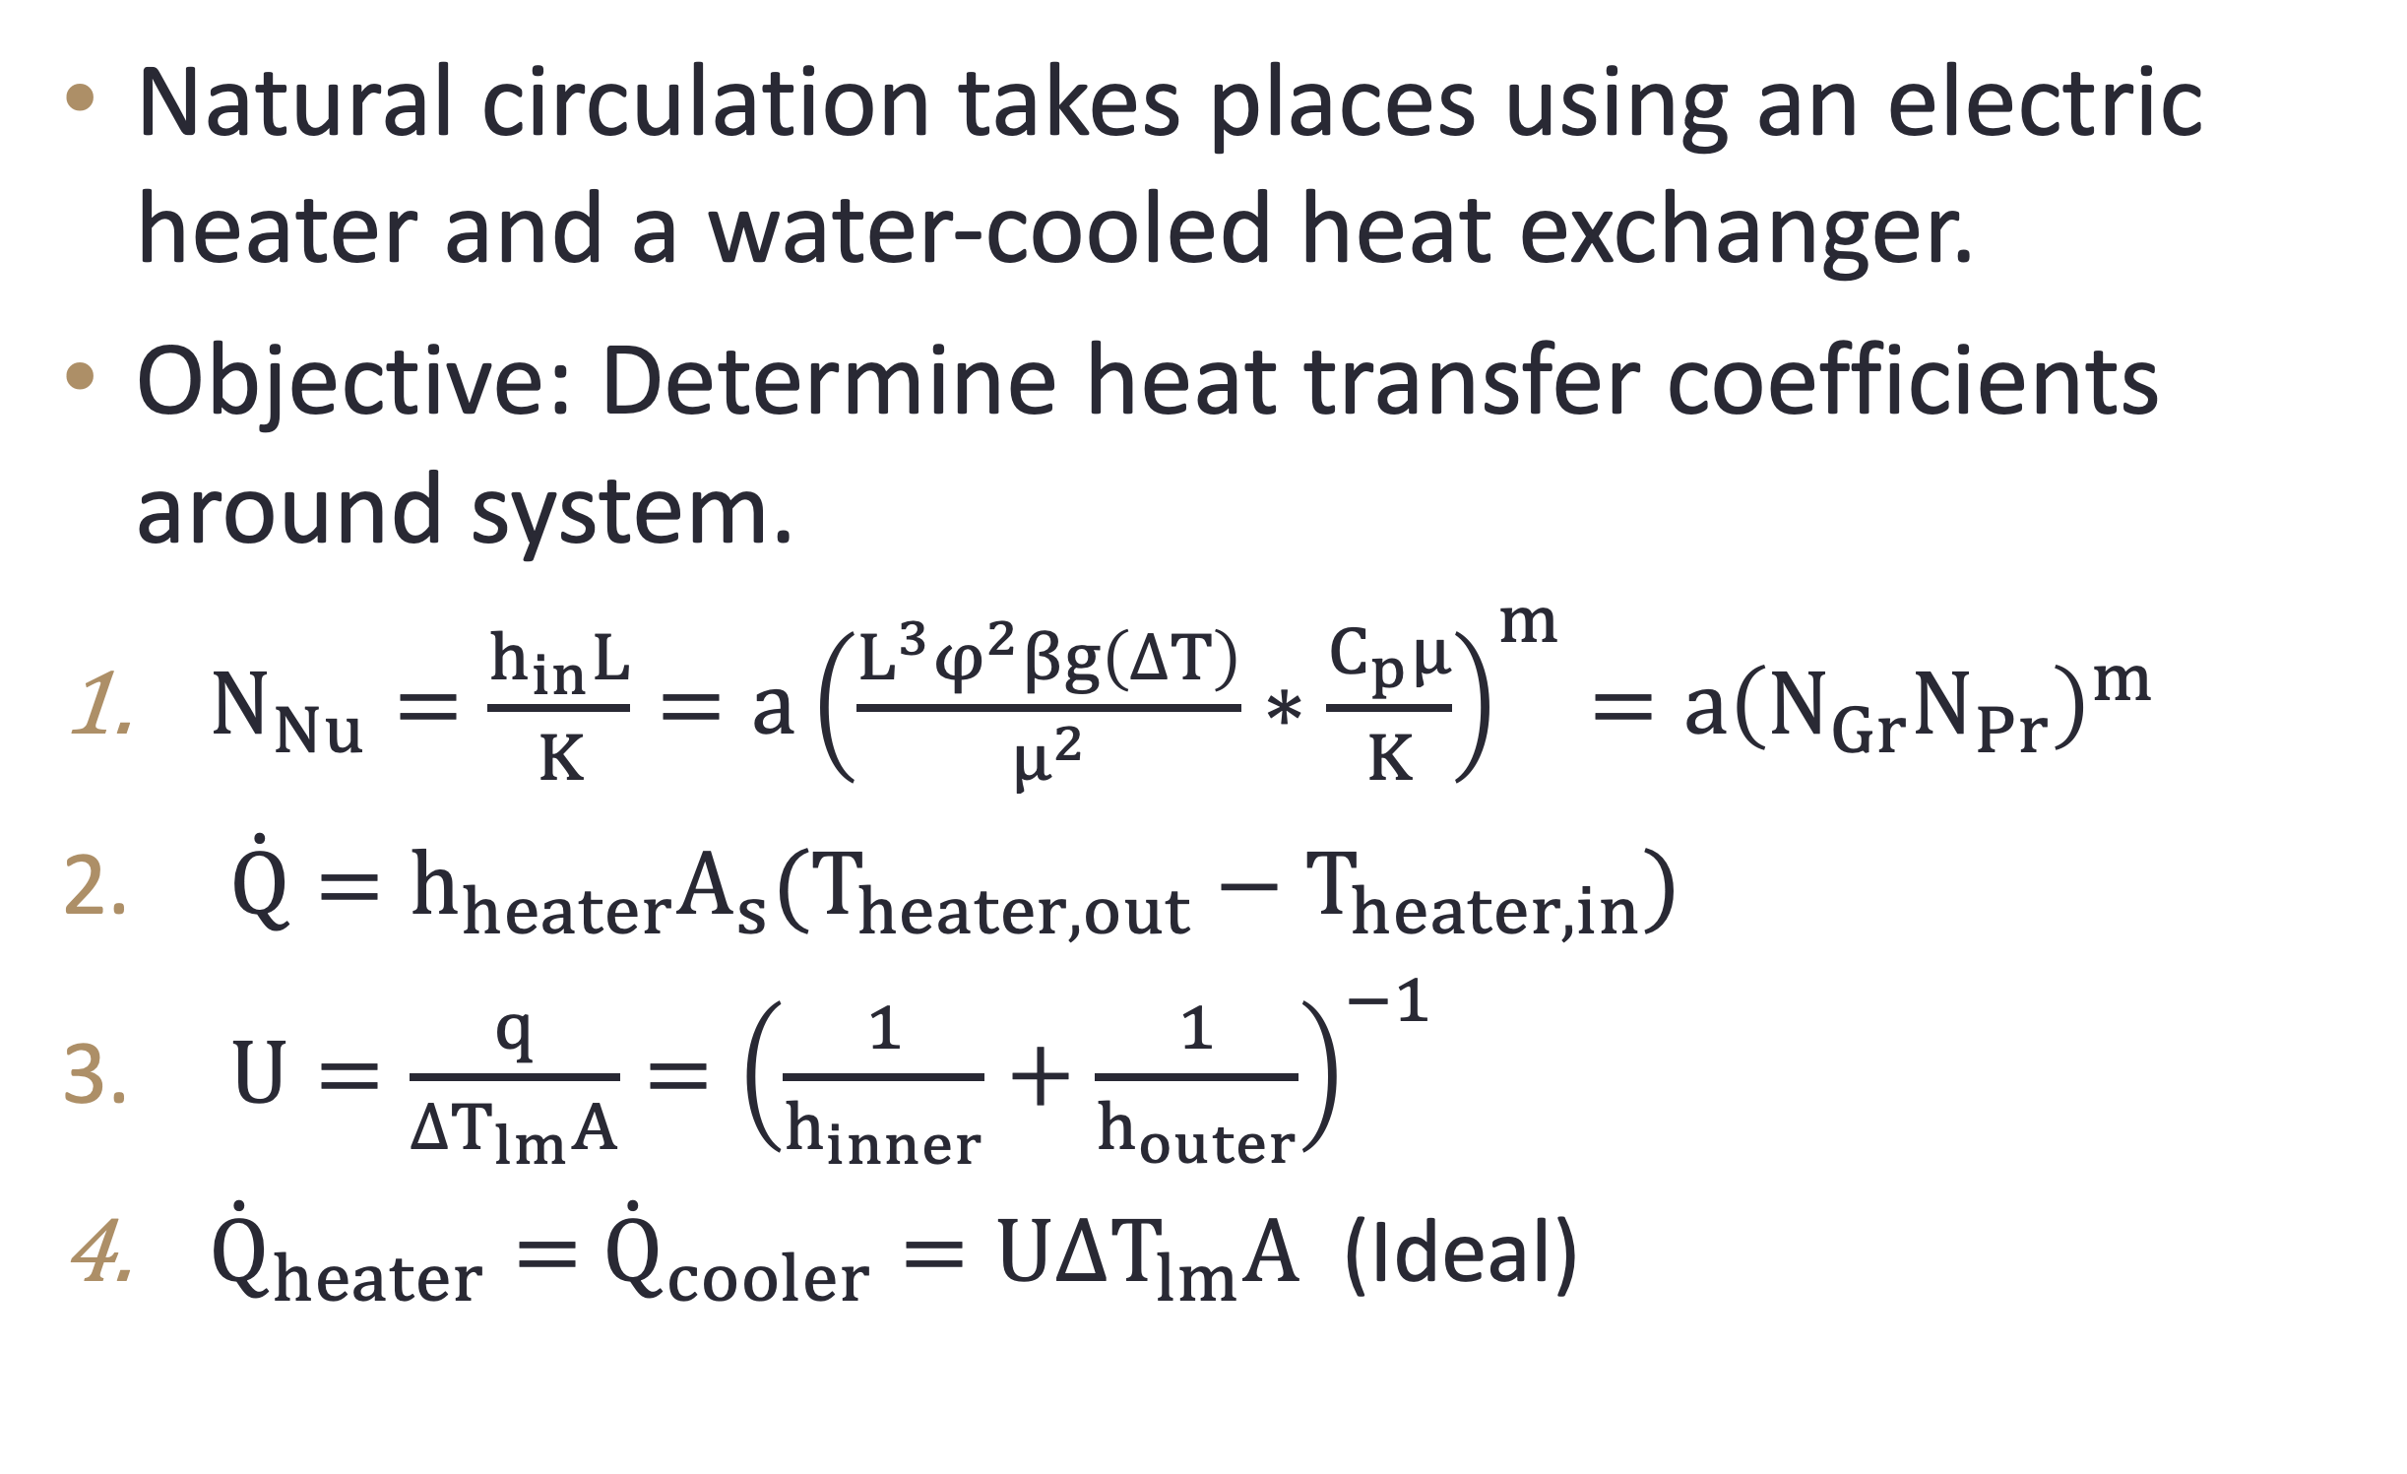
Natural Circulation and Convection
Jacob Andrzejczyk, Matthew Smolag, Department of Chemical Engineering, University of New Hampshire
Introduction
methods
Results (heat exchanger 1)
Natural circulation takes places using an electric heater and a water-cooled heat exchanger.
Objective: Determine heat transfer coefficients around system.
$N_{Nu}=\frac{h_{in}L}{K}=a{\left(\frac{L^{3}φ^{2}βg\left(∆T\right)}{μ^{2}}∗\frac{C_{p}μ}{K}\right)}^{m}=a{\left(N_{Gr}N_{Pr}\right)}^{m}$
$\dot{Q}=h_{heater}A_{s}(T_{heater,out}−T_{heater,in})$
$U=\frac{q}{∆T_{lm}A}={\left(\frac{1}{h_{inner}}+\frac{1}{h_{outer}}\right)}^{−1}$
${\dot{Q}}_{heater}=$ ${\dot{Q}}_{cooler}=U∆T_{lm}A$ (Ideal)
Heat Exchanger 1:
Outside 1-inch diameter insulated type L copper piping
Inside ½- inch diameter type L copper piping
Heat Exchanger 2:
Outside 1-inch diameter insulated type L copper piping
Inside ¾- inch diameter type L copper piping
When running trials on Heat Exchanger 1 (½-inch type L copper piping), several factors caused the data obtained to be unreliable and unusable.
  Cold-water entrance temperature: the temperature of the water being fed to the system was far too high (>25°C)
  Exposed piping: Heat losses due to radiation and convection through non-insulated piping caused significant temperature changes
  Thermocouples: The experiment relied on measuring changes in temperature that were typically less than 1°C, the accuracy on the thermocouples themselves was ±1°C
The temperature differences, which represent the driving potential of the system, were recorded at different cold-water flow rates and used to calculate the heat transfer coefficients of the system.
Results (Heat exchanger 2)
Design Problem
Problem:
A fuel element for cooling nuclear reactor produces heat at a rate of 4000 W/m, and the temperature of the heat element must remain below 120ºC. Cooling water is supplied at 10ºC. Size of the heat exchanger and circulation rate needed to maintain these temperatures must be determined.
Solution:
  Fuel Element: Diameter= 0.067 m and Length = 0.56 m.
  Circulation Rate: Approximately 0.29 kg/min using cooling water at 20 gph (gallons per hour).
conclusions
Heat Exchanger 2: An increase in the circulating mass flow rate led to an increase in the HTC of the heater and the HTC of the cold fluid in the heat exchanger. An increase in power supplied led to an increase in all HTC.
Heat Exchanger 1: Problems in the experimental set-up prevented adequate and reliable data from being collected.
References
Geankoplis CJ. Transport Processes and Separation Process Principles (4th or 5th ed.) New York: Prentice Hall

