Slide 1

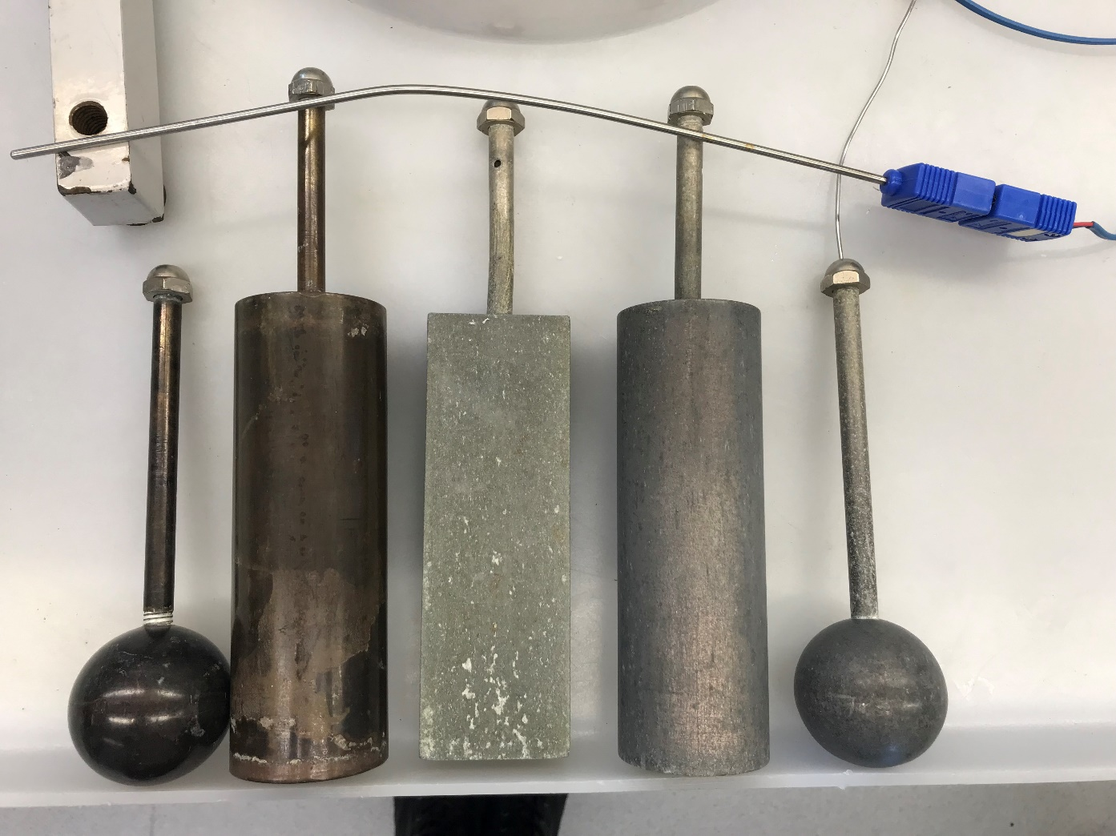
Transient Conduction-Convection
Cody Paquette, Casey Maranto & Michael Thorpe
Department of Chemical Engineering, University of New Hampshire
Introduction
Results
Metal Objects Tested
In the canning industry perishable canned foods are heated by immersion in steam baths or chilled by immersion in cold water. In this experiment, the temperature distribution from approximately 100°C water to approximately 0°C water was measured for aluminum and brass shapes
Design Problem:
Aluminum cans of cooked food must be cooled from 120 to 10. It is achieved by immersing the cans in a cold-water bath of 0.
Determine the time required for each shaped can to reach the desired temperature
 | Rectangle | Cylinder | Sphere
Aluminum | 16.98 | 20.04 | 20.66
Brass | - | 18.87 | 24.97
Dimensions:
Block: 6x2x1 in.
Cylinders: D=2in. H=6in.
Spheres: D=2in.
Heat transfer coefficients (W/m²*K) of Aluminum and Brass objects without agitation.
Conclusion
 | Rectangle | Cylinder | Sphere
Aluminum | 79.76 | 105.84 | 115.63
Brass | - | 106.04 | 134.16
The spherical object had the greatest heat transfer coefficient of the three objects used in the experiment.
The rectangular object had the lowest heat transfer coefficient.
Brass had a higher heat transfer coefficient for both shapes compared to aluminum.
Agitating the system caused a significant increase in the heat transfer coefficient for both materials used.
Heat transfer coefficients (W/m²*K) of Aluminum and Brass objects with agitation.
Methods
Brass and Aluminum shapes heated in hot water baths.
Natural convection studied on each shape from 100°C to 0°C using ice water bath
Forced convection studied for each shape from 100°C to 0°C using ice water bath agitated by Lightning Mixer at 300RPM
Cooling profiles made using LabView computer program and Type T Thermocouples (± 1°C) for water baths, and Type K Thermocouples (± 2°C) for shapes.
Additional cooling profiles made using natural convection from 80°C and 60°C to 0°C, using the aluminum cylinder.
Design Problem Solution
 | Rectangle | Cylinder | Sphere
Time (s) | 271.0 | 328.4 | 241.3
.
Time, in seconds, for each Aluminum shaped container to reach 10 ºC based on each shape’s respective heat transfer coefficient.
Aluminum Cylinder and Rectangle Temperature vs Time and Log Temperature Difference vs Time

