Slide 1

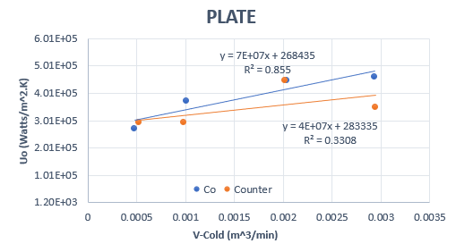
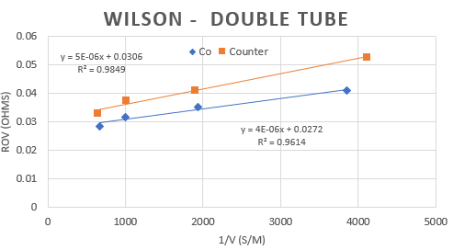
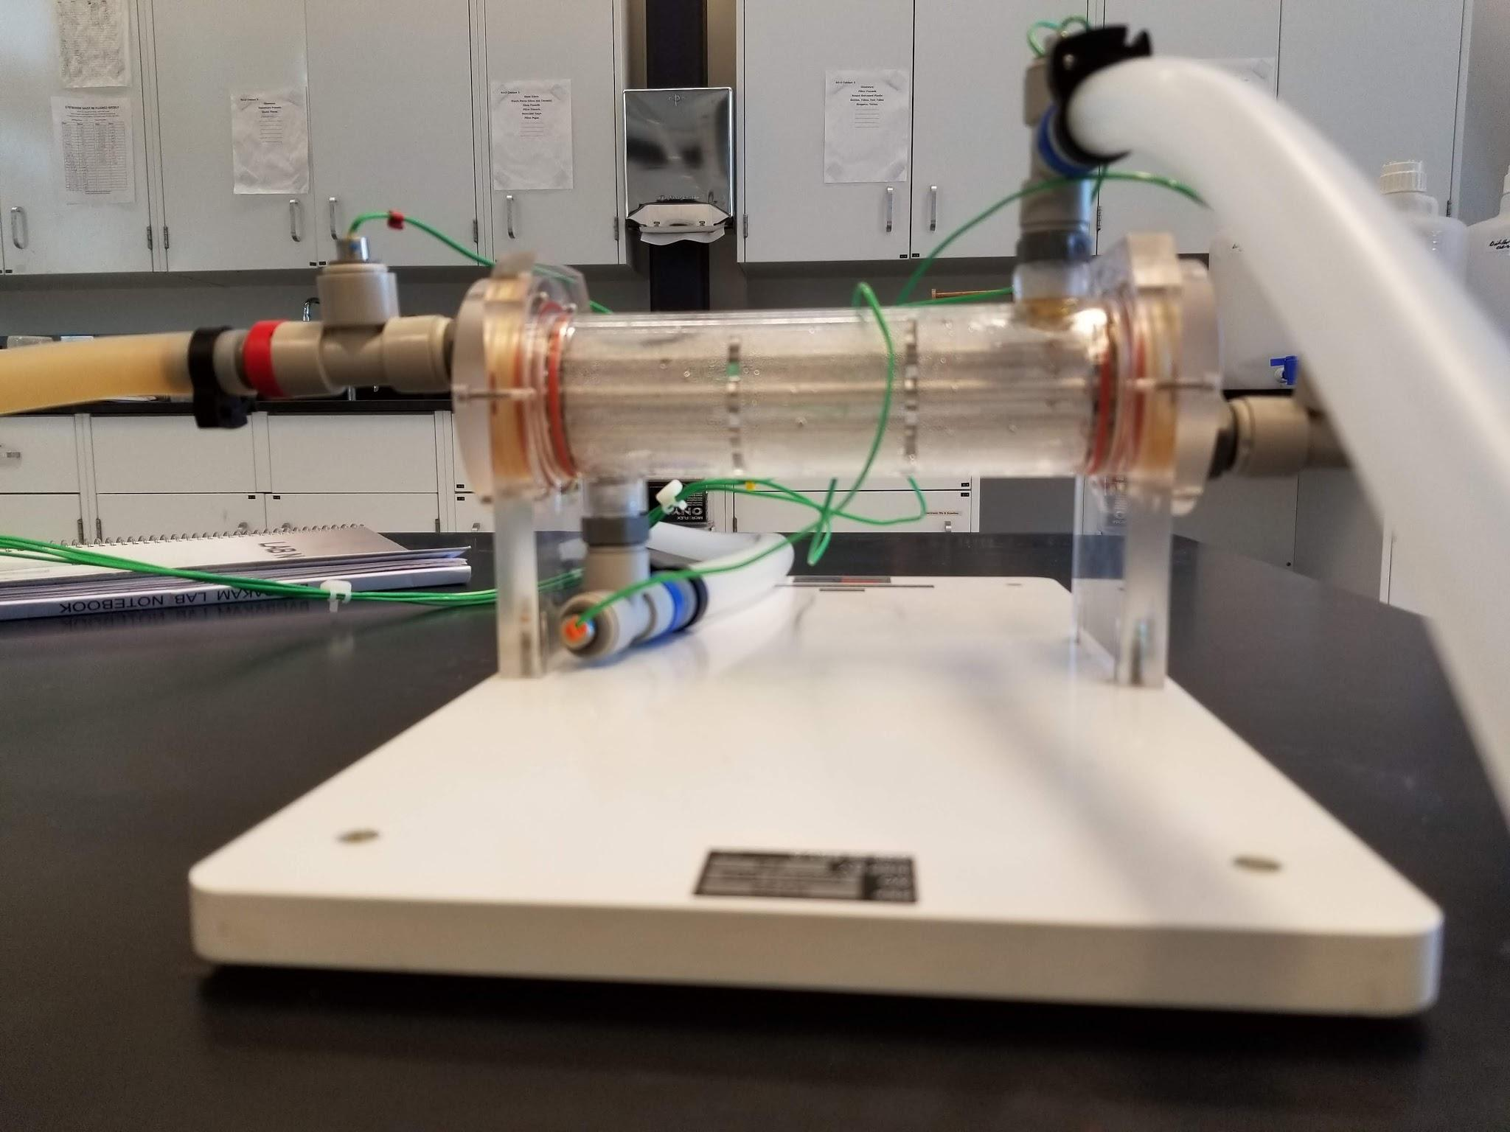
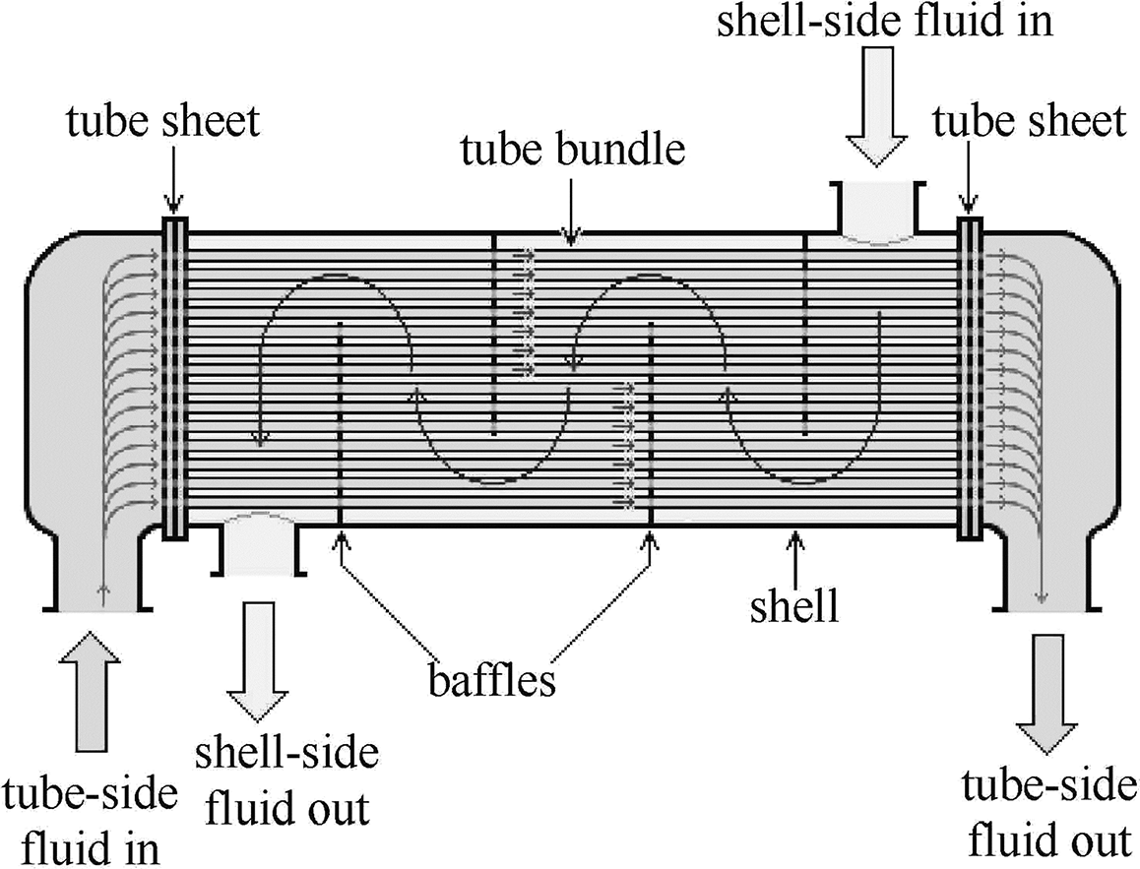
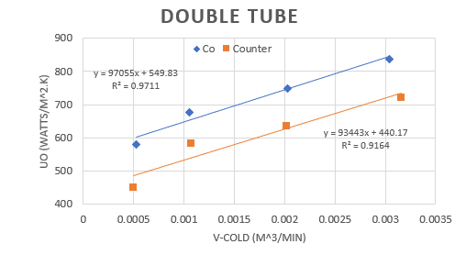
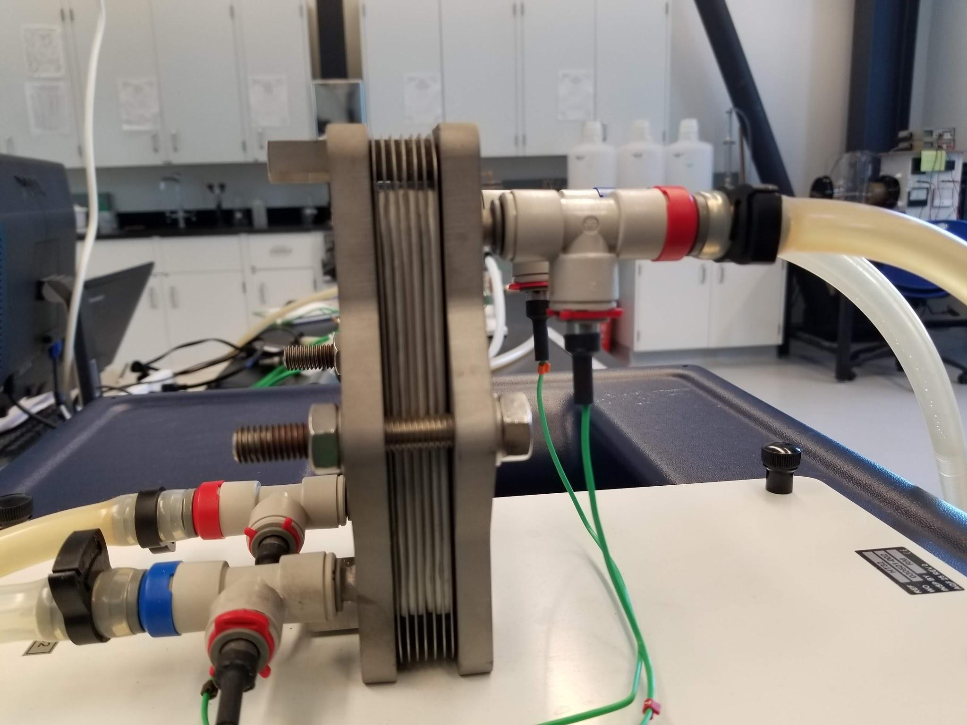
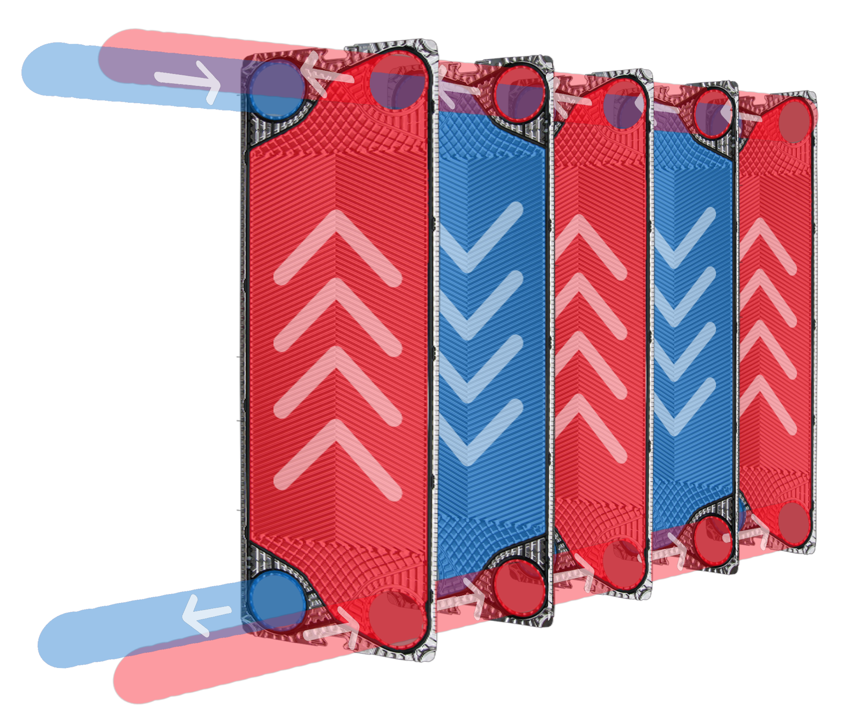
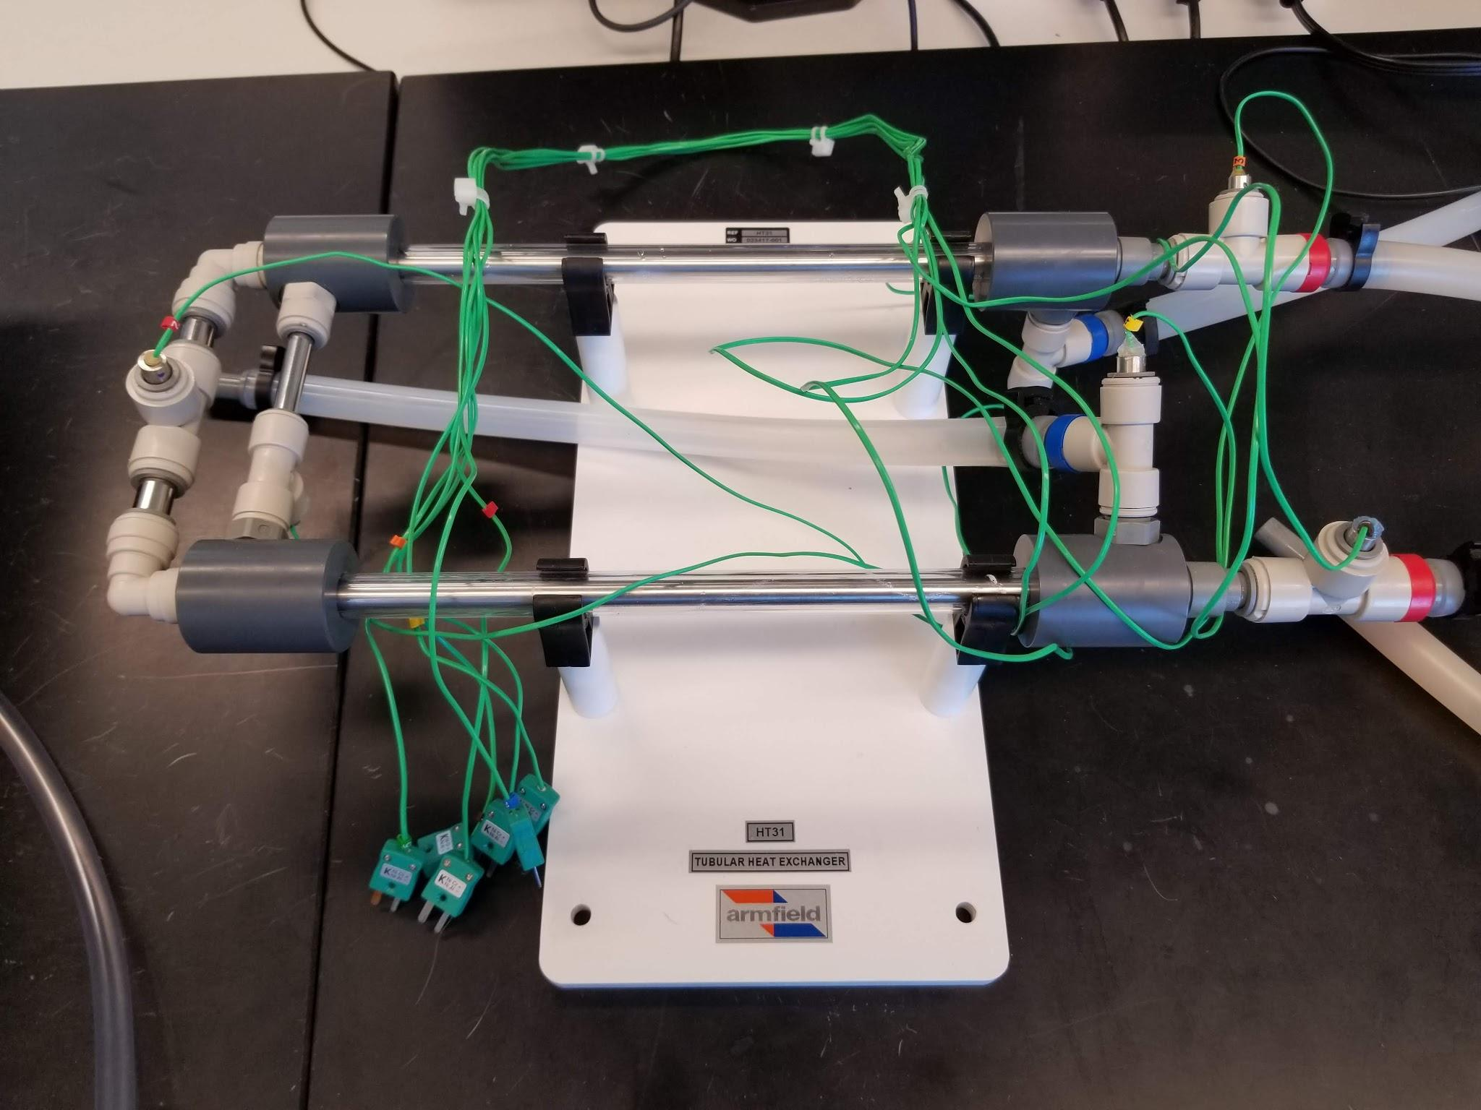
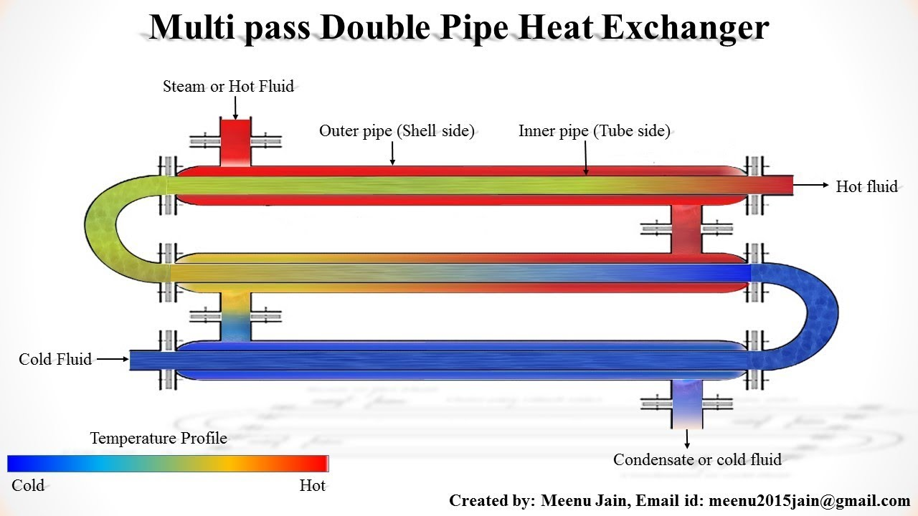
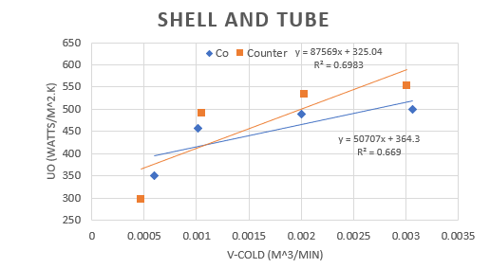
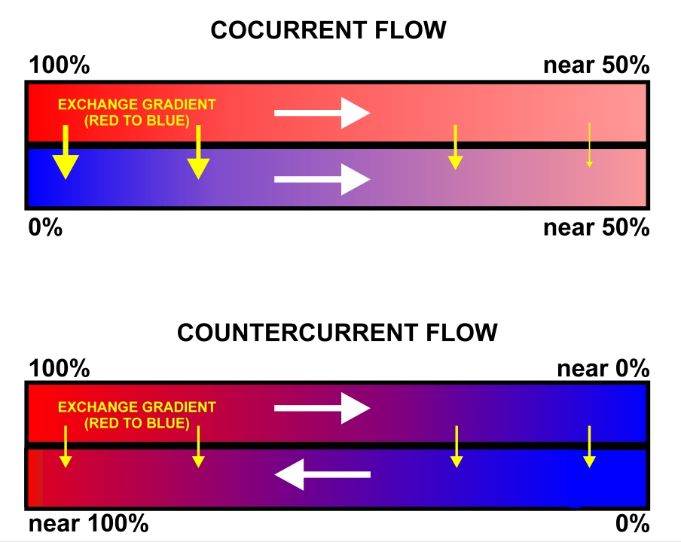
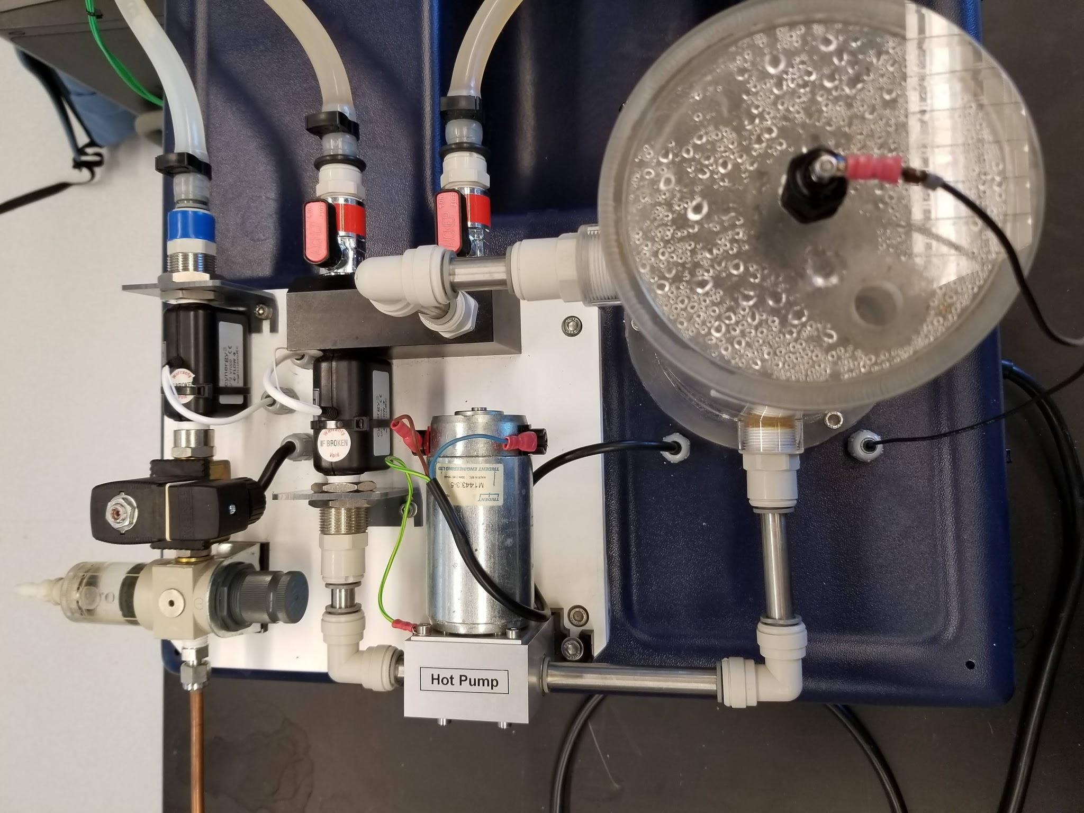
HEAT EXCHANGER COMPARISION
KEVIN ADAIR, KYLE YORK, ALI ASGHAR. University of New Hampshire
Introduction
Methods
Results
Heat exchangers are used to transfer heat between fluids. There are different types of heat exchangers that work in various ways. Each heat exchanger has a different heat transfer coefficient that relates to it and the conditions applied to it.
Hot water flow and temperature kept constant at 2.0 l/min and 40°C
Cold water flow varied at 0.5, 1.0, 2.0 and 3.0 l/min.
3 different heat exchangers were tested
Shell and Tube Exchanger
Heat transfer coefficient for the plate exchanger is larger under countercurrent at smaller flow rates while the opposite is true at higher flow rates.
Objectives
Wilson plot determine the average heat transfer coefficients for the Double Tube heat exchanger
Three heat exchangers were tested (double tube, shell and tube and plate) for:
Different cooling flow rates
Different flow patterns (Co-Current/Counter-Current)
The trend for overall heat cofficents as changes are made
The average heat coefficients using a wilson plot analysis (Fig.5)
Design Problem:
Reactant stream 180 lpm
Heated from 20°C to 50°C
Heating medium is water at 80°C
J. F. Zhou, Y. Li, B. Q. Gu and C. L. Shao, Figure 1, Temperature Field Prediction of Rectangular Shell-and-Tube Heat Exchanger, 10 December 2011
Conclusions
Plate Exchanger
Most efficient design problem solution was determined based on spatial efficacy:
Counter-current plate heat exchanger
  total heat transfer area is 158 m²
  Total width of plates would be 4.5 m
  Can be split up into parallel systems
  Total Length of each plate will be 35.1m
  Can be split between multiple plates
Ex. Split into 2 parallel systems with 5 plates each gives plates of width 2.25m and lengths of 7.2m
The heat transfer coefficient for the double tube exchanger is shown to be larger with co-current occuring, as flow increased the coefficient in both trends increased with similar rates.
Industmarine Engineers, www.industmarine.com/content/essentials/plate-heat-exchanger.php, accessed 30 April 2019
Double Pipe Exchanger
Hot Water inlet
Hot Water Outlet
Water Heater
Meenu Jain Lalitpur, Double Pipe Heat Exchanger Animation, https://www.youtube.com/watch?v=MdDbxktvecg, accessed 30 April 2019
Cold water Inlet
Each test conducted in triplicate for the given cold water flow rates
each heat exchanger was also tested for the different flow patterns (Co-current/Counter-Current
Data was recorded for the cold water flow rates, Temperatures of cold and hot water in and temperatures of cold and hot water out.
Cruithne9 (https://commons.wikimedia.org/wiki/File:Comparison_of_con-_and_counter-current_flow_exchange.jpg), https://creativecommons.org/licenses/by-sa/4.0/legalcode, accessed 26 April 2019
The heat transfer coefficient for the shell and tube is larger under co-current at smaller flow rates while the opposite is true at higher flow rates.
References
Cold Water Flow Control
Hot Water Gear Pump
Geankoplis, C. J. (1978). Transport processes and unit operations. Boston: Allyn and Bacon.

