Slide 1

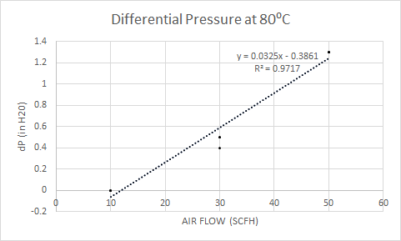
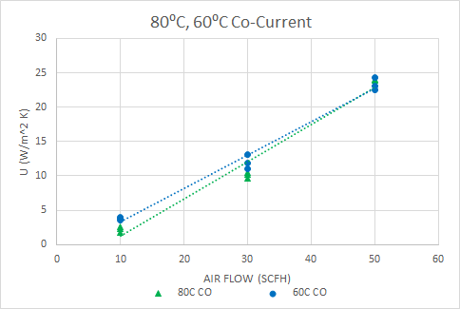
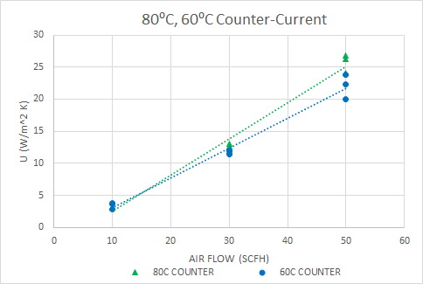
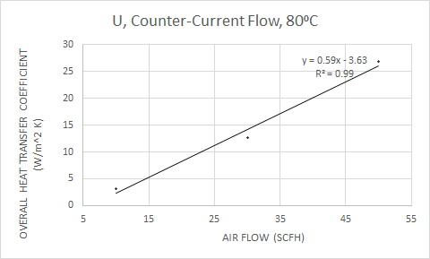
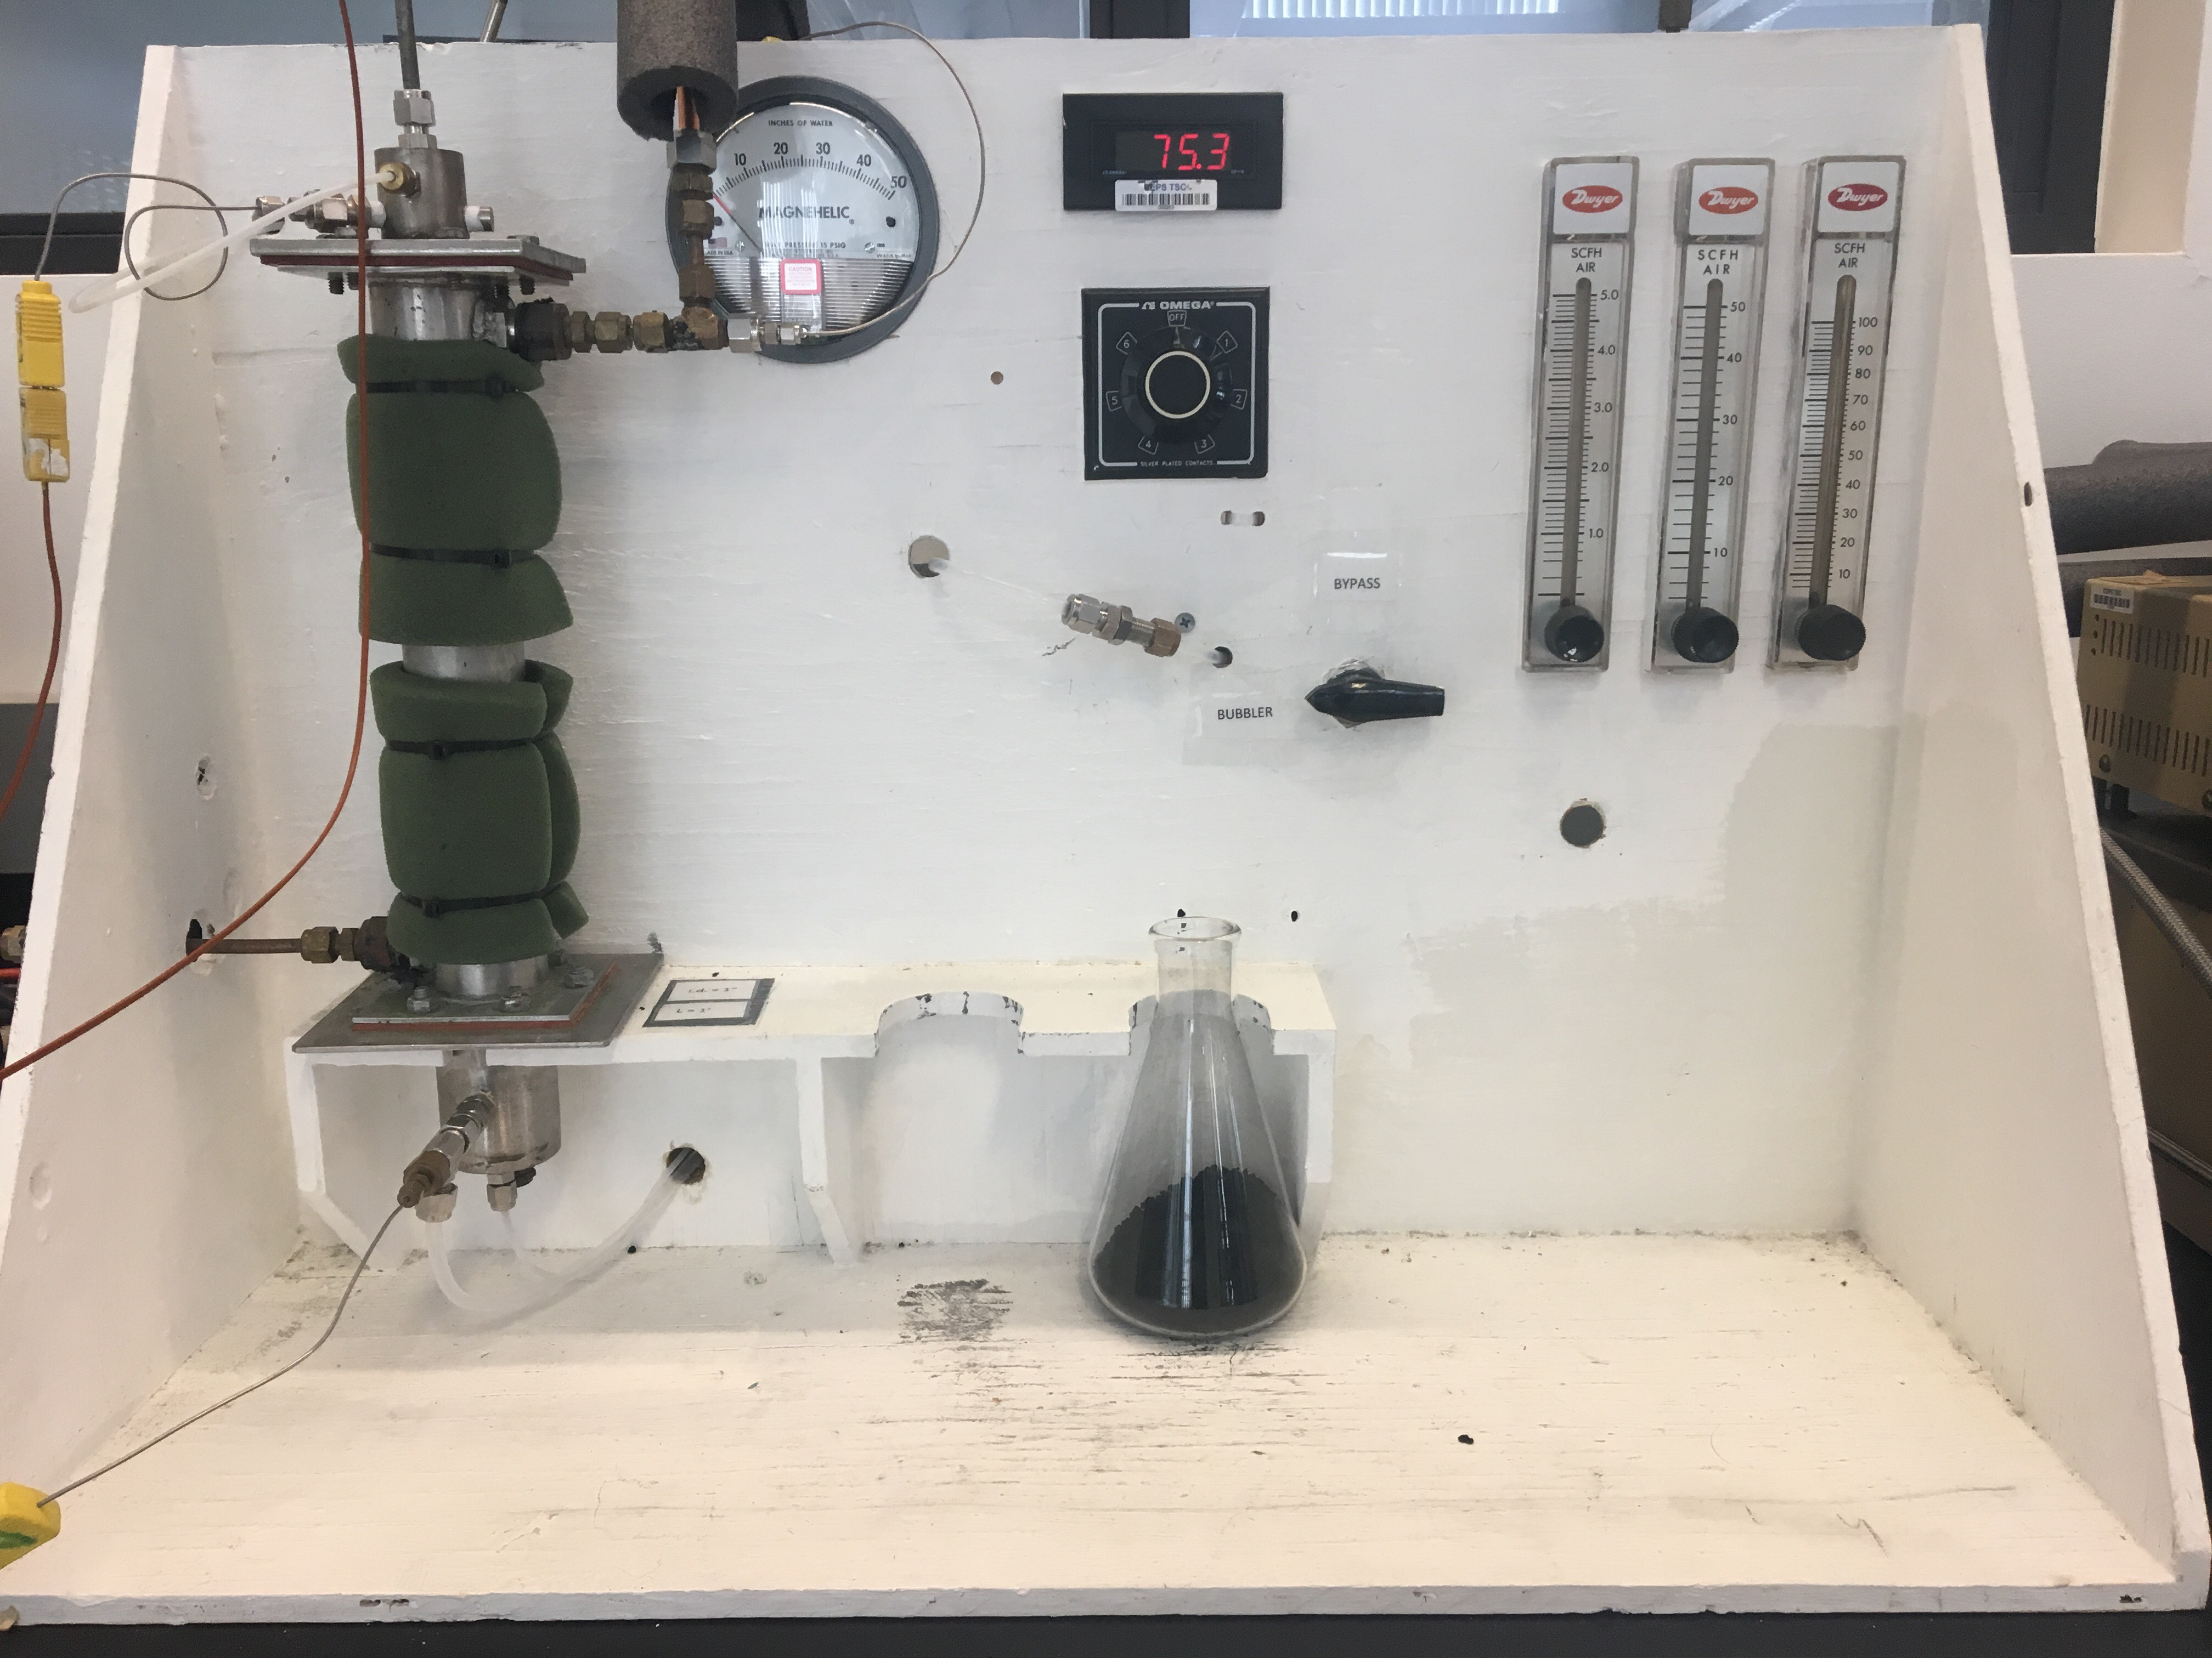
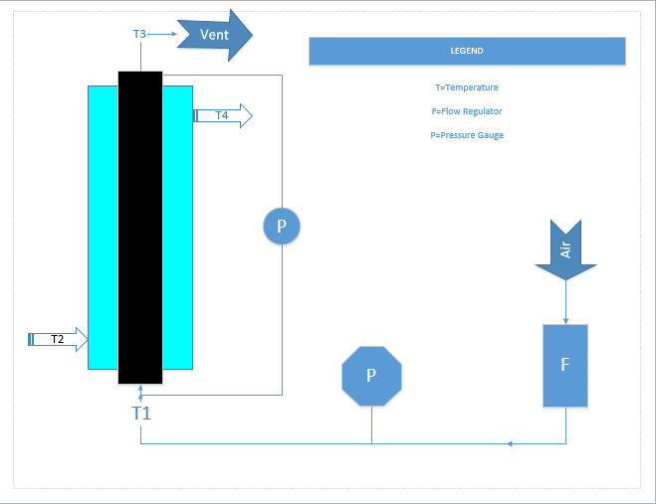
Packed Bed Heat Exchange
Rachel Parr, Alex Corbeil, Amanda Savina
Department of Chemical Engineering, University of New Hampshire
Introduction
Results
Design Problem Cont.
Objectives: Study heat transfer inside a jacketed packed bed reactor; determine factors affecting this transfer. Use results to solve design problem.
Packed Bed Heat Exchangers are extremely useful in chemical processes such as separations, distillation, and catalytic reactions.
  Heat transfer within the reactor is affected by flow rate and area. Rate of heat transfer inside the bed is increased due to the large surface area of packing.
Data at 60°C and 80°C analyzed
Overall heat transfer coefficient U calculated for three trials at each condition
      q= mCp(ΔT)
      U= q /As(ΔTlm)
Trials were averaged to find the overall heat transfer coefficient at each condition
ΔP= 0.0325(Q) - 0.3861
ΔP= 195 in H2O = 4.9 x 10^4 Pa
mwater = q/(Cp ΔT)
mwater = 0.0063 kg/s
Qwater = 6.3 x 10⁻⁶ m³/s
P = Q ΔP
P = 2.5 kW
Methods
Conclusions
Analysis was conducted using t-Tests to determine which conditions have a statistically significant effect on the value of U:
    U is not a function of temperature
    Direction of flow had a significant effect on U
        Counter-current preferred
    U driven by air flow rate in the bed
        As air flow increased, Re increased
        U is a function of Re of air
Conclusion: Overall heat transfer coefficient is a function of the Reynolds number of air flow
Heated water ran through the system's outer tube to heat the airstream
The inner tube was packed with activated carbon
Conditions Varied:
      Temperature of the bath (80°C, 70°C, 60°C), water flow rate ('high', 'low'), direction of flow (counter-current, co-current), air flow rate (10, 30, 50 SCFH).
Temperature measurements locations:
      Air inlet and outlet, water inlet and outlet, at each end of bed
The differential pressure, gauge pressure in the pipe, and air flow rate were measured once the system reached steady state.
Re was calculated for each air flowrate
FLOWRATE (SCFH) | Re
10 | 170
30 | 511
50 | 851
Design Problem
A gas stream with properties of air at ambient conditions (25°C, 1atm) needs to be heated to 50°C. It flows into a packed bed of activated charcoal with a water jacket at 100 SCFM. The water has a maximum operating temperature of 80°C.
Specify jacket temperature, water flowrate, direction of flow, and length and diameter of the column, and power
-Assuming water is at max operating temperature, 80°C and exits at 35°C
-Using counter-current flow
-U is calculated at 100 SCFM using the trendline
U = 0.59(Q) - 3.63
U = 3.5 kW/ m²K
q = mair Cp ΔT
q = 1186 W
References
Geankoplis CJ. Transport Processes and Separation Process Principles (4th or 5th ed.). New York: Prentice Hall.
.
As = q/(U ΔTlm) L = As / 2πr
As = 0.018 m² L = 0.23 m
Lab Set-Up
Schematic

