Slide 1




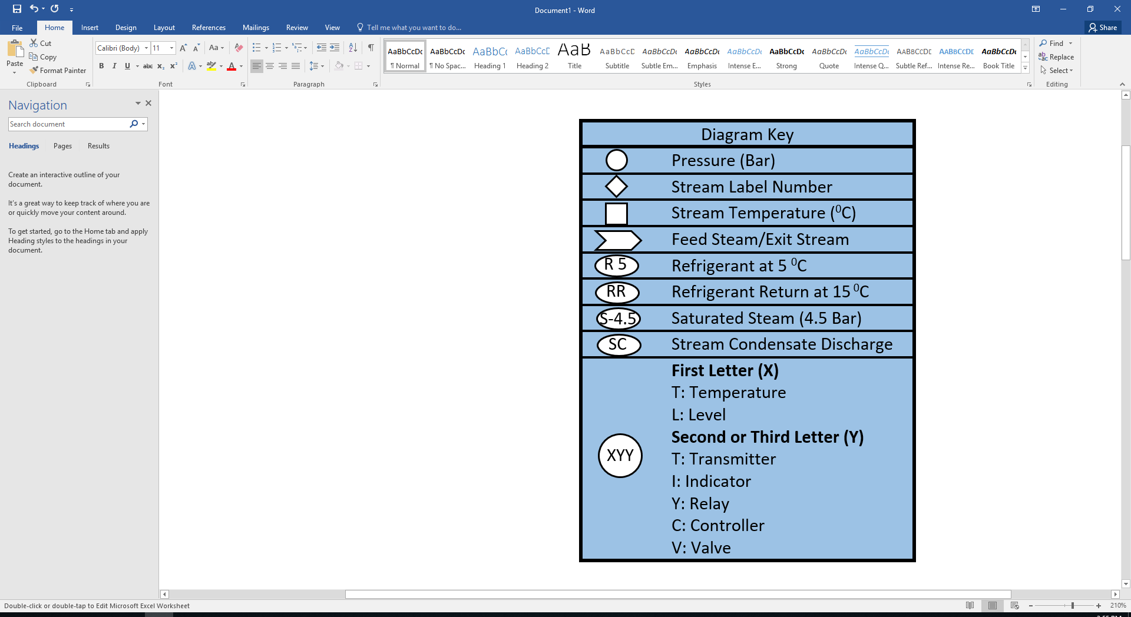
MAb Crazy Production
Confused Screaming – Jarret Askin, Genevieve Frigon, Aaron Spencer, Dean Yost
Objectives:
Produce 1000kg of MAb annually
Introduction
MAb product is designed to treat Colon Cancer, Breast Cancer, Neovascular Glaucoma, Macular Degeneration
Projected Market Share
Critical to Quality Variables:
Oxygen levels, pH, Temperature
Objectives
Equipment Cost Summary
Upstream
The Filters are the largest contributor of equipment cost
The fan is the smallest contributor
Fixed Capital Cost of $5.9 million
Annual operating expense of $37 million
300 - Upstream production | Stream # | 28 | 61 | 62 | 63 | 64 | 65 | 66 | 67 | 68 | 69 | 70 | 71 | 72 | 73 | 74 | 75 | 76 | 77 | 78 | 79 | 80 | 81 | 82 | 83 | 84 | 85 | 86 | 87 | 88 | 89 | 90 | 91 | 92 | 93 | 94 | 95 | 125
 | Flow Rate (kg/batch) | 204 | 0.1 | 10087 | 106 |  |  | 87 |  | 106 | 87 | 106 | 318 | 87 | 3 | 4 | 425 | 3 | 3 | 200 | 9769 | 425 | 84 | 1696 | 18 | 14 | 15 | 2128 | 18 | 182 | 8073 | 2128 | 70 | 10232 | 74 | 92 | 10232 | 92
 | Temperature (°C) | 37 | 37 | 37 | 37 |  |  | 25 |  | 37 | 25 | 37 | 37 | 25 | 25 | 37 | 37 | 37 | 37 | 37 | 37 | 37 | 25 | 37 | 37 | 25 | 37 | 37 | 37 | 37 | 37 | 37 | 25 | 37 | 37 | 37 | 37 | 37
 | Pressure (bar) | 1.2 | 1.0 | 3.0 | 1.0 |  |  | 1.0 |  | 1 | 1.0 | 1 | 3 | 1.0 | 1 | 1.2 | 1 | 1 | 1 | 1.2 | 3 | 1.2 | 1 | 3 | 1.2 | 1 | 1 | 1 | 1 | 1.2 | 3 | 1.2 | 1 | 1 | 1 | 1 | 1.2 | 1
Component | MW (g/mol)
Cells (kg/batch) | - | - | - | - | 5.E-03 |  |  | - |  | 5.E-03 | - | 5.E-03 | - | - | - | - | 2E-02 | - | - | - | - | 2E-02 | - | - | - | - | - | 0.1 | - | - | - | 0.1 | - | 0.6 | - | - | 0.6 | -
Glucose (kg/batch) | 180.156 | 204 | - | - | - |  |  | - |  | - | - | - | - | - | - | 4 | 0.8 | - | - | 200 | - | 0.8 | - | - | 18 | - | - | 4 | - | 182 | - | 4 | - | 20 | - | - | 20 | -
Media (kg/batch) | - | - | - | 10087 | 106 |  |  | - |  | 106 | - | 106 | 318 | - | - | - | 424 | - | - | - | 9769 | 424 | - | 1696 | - | - | - | 2120 | - | - | 8073 | 2120 | - | 10193 | - | - | 10193 | -
Oxygen (kg/batch) | 32 | - | - | - | - |  |  | 21 |  | - | 21 | - | - | 21 | 1 | - | - | 0.4 | 0.4 | - | - | - | 20 | - | - | 3 | 2 | - | 2.04 | - | - | - | 17 | - | 8 | 10 | - | 10
Carbon Dioxide (kg/batch) | 44.01 | - | 0.1 | - | - |  |  | - |  | - | - | - | - | - | - | - | - | 1 | 1 | - | - | - | - | - | - | - | 3 | - | 3 | - | - | - | - | - | 12 | 15 | - | 15
Product (kg/batch) | - | - | - | - | 0.1 |  |  | - |  | 0.1 | - | 0.1 | - | - | - | - | 0.6368 | - | - | - | - | 1 | - | - | - | - | - | 4 | - | - | - | 4 | - | 19 | - | - | 19 | -
Buffer - 6M Urea (kg/batch) | 60.06 | - | - | - | - |  |  | - |  | - | - | - | - | - | - | - | - | - | - | - | - | - | - | - | - | - | - | - | - | - | - | - | - | - | - | - | - | -
Regen - 0.1M NaOH (kg/batch) | 40 | - | - | - | - |  |  | - |  | - | - | - | - | - | - | - | - | - | - | - | - | - | - | - | - | - | - | - | - | - | - | - | - | - | - | - | - | -
Nitrogen (kg/batch) | 28.02 | - | - | - | - |  |  | 66 |  | - | 66 | - | - | 66 | 2 | - | - | 2 | 2 | - | - | - | 64 | - | - | 11 | 11 | - | 13 | - | - | - | 53 | - | 53 | 66 | - | 66
Production Total | - | 204 | 0.1 | 10087 | 106 |  |  | 87 |  | 106 | 87 | 106 | 318 | 87 | 3 | 4 | 425 | 3 | 3 | 200 | 9769 | 425 | 84 | 1696 | 18 | 14 | 15 | 2128 | 18 | 182 | 8073 | 2128 | 70 | 10232 | 74 | 92 | 10232 | 92
Conclusion
1160 kg/yr produced
Sale price $10 million/kg
Annual Revenue of $11.4 billion
Annual Profit of $7.4 billion
Downstream
Economic Analysis
Confused Screaming is giving a GO recommendation on this process
A pilot plant study of the separation process
Recommendations
We would Like to acknowledge Dr. Halpern and the rest of the UNH Chemical Engineering Department for getting us this far
Acknowledgement
400 - downstream production | Stream # | 35 | 42 | 95 | 96 | 97 | 98 | 99 | 100 | 101 | 102 | 103 | 104 | 105 | 106 | 107 | 108 | 109 | 110 | 111 | 112 | 113 | 114 | 115 | 116 | 117 | 118 | 119 | 126
 | Flow Rate (kg/batch) | 272 | 450 | 10232 | 21 | 10212 | 10212 | 10212 | 10212 | 10212 | 91 | 10343 | 150 | 110 | 10364 | 300 | 181 | 110 | 91 | 150 | 241 | 110 | 10604 | 150 | 91 | 241 | 110 | 10845 | 110
 | Temperature (°C) | 25 | 25 | 37 | 37 | 37 | 37 | 37 | 25 | 25 | 25 | 25 | 25 | 25 | 37 | 25 | 25 | 25 | 25 | 25 | 25 | 25 | 37 | 25 | 25 | 25 | 25 | 37 | 25
 | Pressure (bar) | 1.2 | 1.2 | 1.2 | 1.2 | 1.2 | 1.4 | 1.4 | 1 | 1.2 | 1.2 | 1 | 1 | 1.2 | 1 | 1.2 | 1.2 | 1.2 | 1.2 | 1.2 | 1.2 | 1.2 | 1.2 | 1.2 | 1.2 | 1.2 | 1.2 | 1.2 | 1.2
Component | MW (g/mol)
Cells (kg/batch) | - | - | - | 1 | 1 | - | - | - | - | - | - | - | - | - | 1 | - | - | - | - | - | - | - | 1 | - | - | - | - | 1 | -
Glucose (kg/batch) | 180.156 | - | - | 20 | 20 | - | - | - | - | - | - | - | - | - | 20 | - | - | - | - | - | - | - | 20 | - | - | - | - | 20 | -
Media (kg/batch) | - | - | - | 10193 | - | 10193 | 10193 | 10193 | 10193 | 10193 | - | 10193 | - | - | 10193 | - | - | - | - | - | - | - | 10193 | - | - | - | - | 10193 | -
Oxygen (kg/batch) | 32 | - | - | - | - | - | - | - | - | - | - | - | - | - | - | - | - | - | - | - | - | - | - | - | - | - | - | - | -
Carbon Dioxide (kg/batch) | 44.01 | - | - | - | - | - | - | - | - | - | - | - | - | - | - | - | - | - | - | - | - | - | - | - | - | - | - | - | -
Product (kg/batch) | - | - | - | 19 | - | 19 | 19 | 19 | 19 | 19 | - | - | - | 19 | - | - | - | 19 | - | - | - | 19 | - | - | - | - | 19 | - | 19
Buffer - 6M Urea (kg/batch) | 60.06 | 272 | - | - | - | - | - | - | - | - | 91 | - | - | 91 | - | - | 181 | 91 | 91 | - | 91 | 91 | 91 | - | 91 | 91 | 91 | 181 | 91
Regen - 0.1M NaOH (kg/batch) | 40 | - | 450 | - | - | - | - | - | - | - | - | 150 | 150 | - | 150 | 300 | - | - | - | 150 | 150 | - | 300 | 150 | - | 150 | - | 450 | -
Nitrogen (kg/batch) | 28.02 | - | - | - | - | - | - | - | - | - | - | - | - | - | - | - | - | - | - | - | - | - | - | - | - | - | - | - | -
Production Total |  | 272 | 450 | 10232 | 21 | 10212 | 10212 | 10212 | 10212 | 10212 | 91 | 10343 | 150 | 110 | 10364 | 300 | 181 | 110 | 91 | 150 | 241 | 110 | 10604 | 150 | 91 | 241 | 110 | 10845 | 110
Notes:
This is only a template. You may chose to use or not use this format. I highly recommend you use a format that works for your group.

