Slide 1


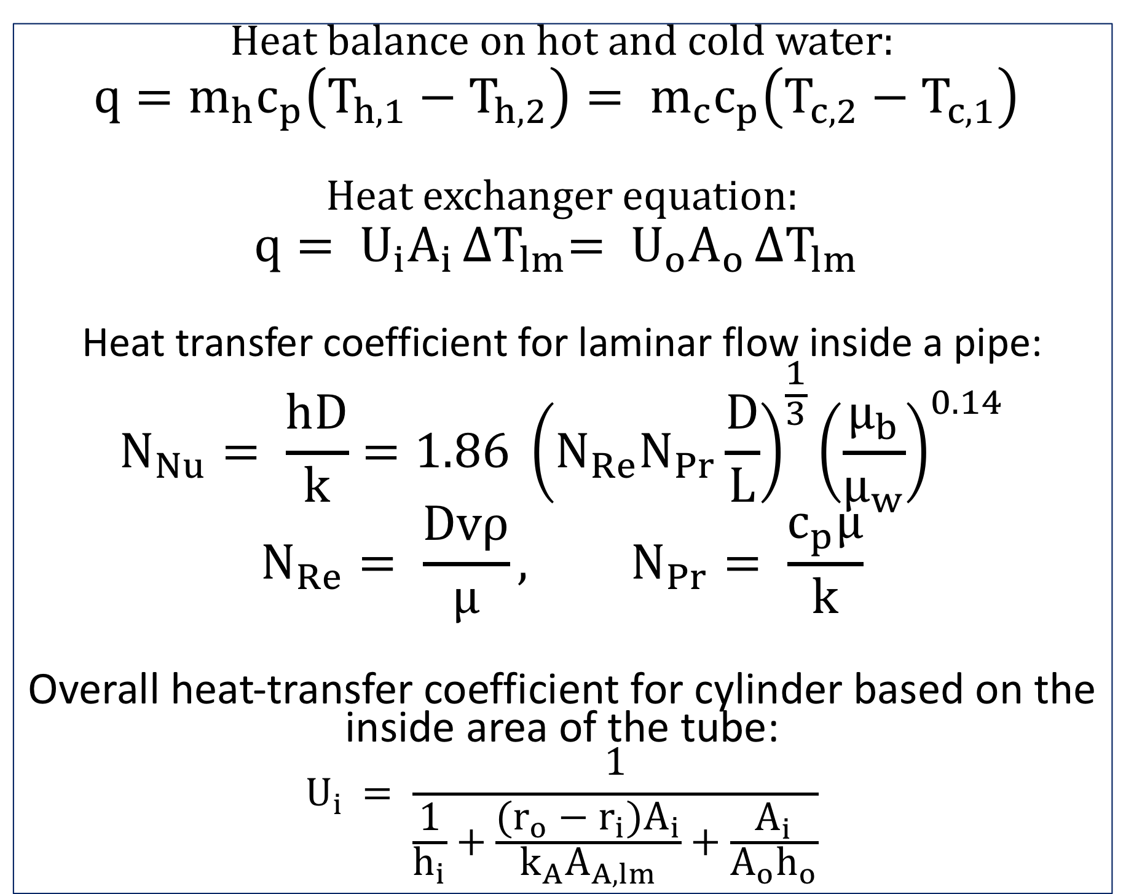
Natural Circulation in Heat Exchangers
Chit Eaindray Thant, Jonathan Thomas, & Shadi Zamani
Chemical Engineering Department, University of New Hampshire, Durham, NH 03824
Place your Project Logo Here
Introduction
Schematic
Design Solution
In the event of a loss of power at a nuclear plant, waste heat must be diffused from the fuel rods to avoid a catastrophic meltdown. Waste heat can be utilized to develop natural convection of working fluid through a cooling loop which undergoes heat exchange with a natural stream of flowing water at 10°C. Laboratory testing was carried out to determine optimal heat exchanger sizing and cold stream flow rates for the design problem solution. The goal was extrapolate heat transfer coefficients to use on a larger scale.
1
4
1: Hot water in
2: Hot water out
3: Cold water in
4: Cold water out
5: Rotameter
6: Variable Heat Source
7: Bubble check
Type L copper tube
Heat Exchanger 1 dimensions
L = 0.547 m
D1 = 0.0138 m
D2 = 0.0260 m
Heat Exchanger 2 dimensions
L = 0.547 m
D1 = 0.0199 m
D2 = 0.0260 m
To dissipate 4000 W/m, the double pipe heat exchanger must meet or exceed a diameter of 30m at a cold stream flow rate of 28.35 L/s.
As the overall and convective heat transfer rates are strongly related to the contact surface area, enormous pipes are needed to achieve appropriate heat transfer, given a double-pipe heat exchange mechanism.
Hot water flow
Cold water flow
7
2
6
5
3
Methodology
Results
Recommendations
Assembly of copper heat exchangers of two sizes
Collection of temperature data at 200W, 300W, 400 W heat input with cold stream flowrate 10-30 gph for Heat exchanger 1 and 300W and 400W heat input for Heat exchanger 2, performed in triplicate
Derivation of energy balances, natural convection flow rates, and thermal convection coefficients
Extrapolation to design problem system
In order to decrease the pipe size necessary for heat dispersion, alternative mechanisms of heat exchange, such as plate or shell and tube heat exchangers, are worth exploring. Double pipe heat exchange necessitates on overly large design setup.
Equations
References
Results Summary
Overall heat transfer coefficients in the test system were derived under all conditions other than low power input (200W), as temperature differentials were too small to allow for accurate extrapolation of hot loop flow rates. Calculation of hot water loop velocity was achieved by utilizing energy balance equations. Heat transfer resistance values for copper tubing double pipe heat exchangers as a function of contact surface area were extrapolated.
Geankoplis, CJ. Transport Processes and Separation Process Principles, 4th Ed. 2015. Pearson. New York, NY.
Engineer’s Edge. Accessed via web at 20:43, 25 April, 2019. URL:https://www.engineersedge.com/fluid_flow/copper_tubing_size_chart_astm_b88_13181.htm
UCSUSA. Accessed via web at 20:40, 25 April, 2019. URL: https://www.ucsusa.org/clean-energy/energy-and-water-use/water-energy-electricity-cooling-power-plant
Atomic Energy Resource Board. Government of the United Kingdom. Accessed via web at 20:10, 25 April, 2019. URL: https://www.aerb.gov.in/english/radiation-symbol
ECMAG. Accessed via we at 20:05, 25 April, 2019. URL: https://www.ecmag.com/media/15875
Heat balance on hot and cold water:
$$q=m_{h}c_{p}\left(T_{h,1}−T_{h,2}\right)= m_{c}c_{p}\left(T_{c,2}−T_{c,1}\right)$$
Heat exchanger equation:
$$q= U_{i}A_{i }{∆T}_{lm}= U_{o}A_{o }{∆T}_{lm}$$
Heat transfer coefficient for laminar flow inside a pipe:
$$N_{Nu}= \frac{hD}{k}=1.86 {\left(N_{Re}N_{Pr}\frac{D}{L}\right)}^{\frac{1}{3}}{\left(\frac{μ_{b}}{μ_{w}}\right)}^{0.14}$$
$$N_{Re}= \frac{Dvρ}{μ}, N_{Pr}= \frac{c_{p}μ}{k}$$
Overall heat-transfer coefficient for cylinder based on the inside area of the tube:
$$U_{i }= \frac{1}{\frac{1}{h_{i}}+\frac{(r_{o}−r_{i})A_{i}}{k_{A}A_{A,lm}}+\frac{A_{i}}{A_{o}h_{o}}}$$

