Slide 1

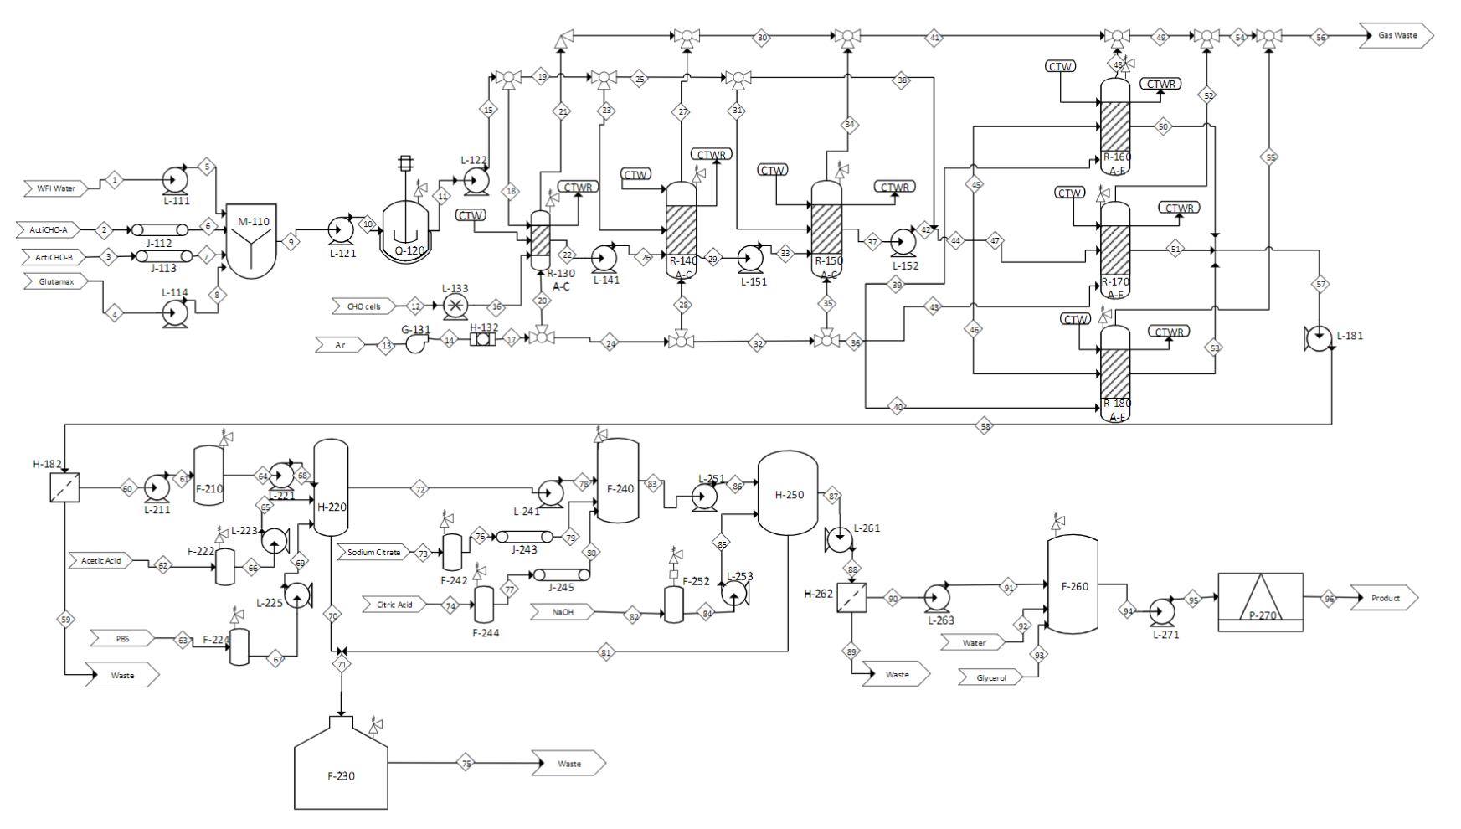
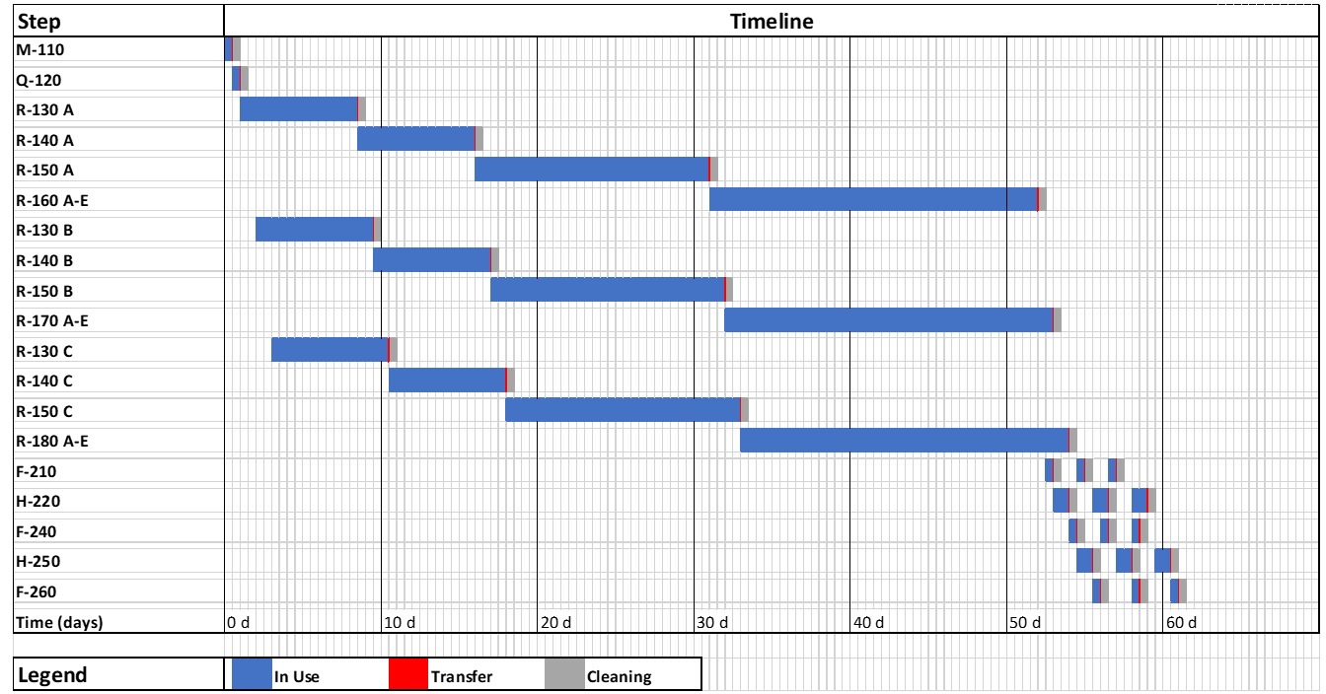
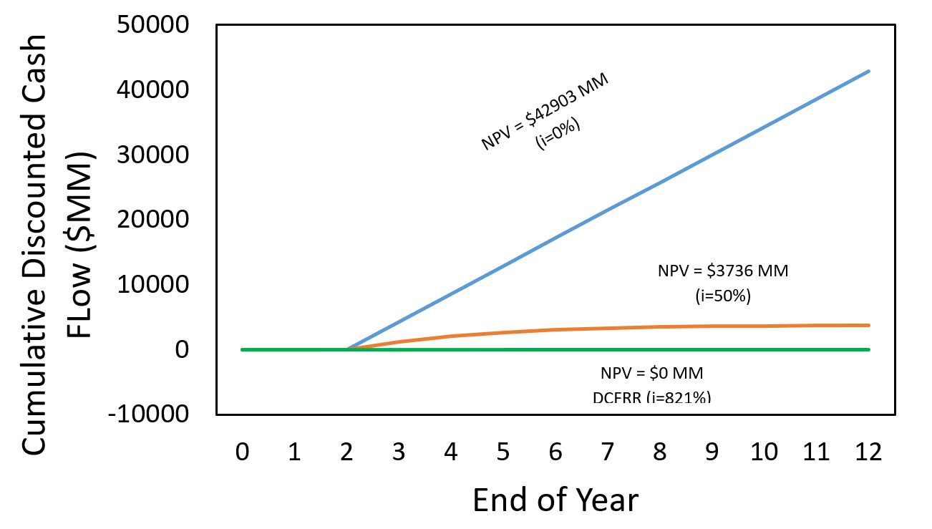
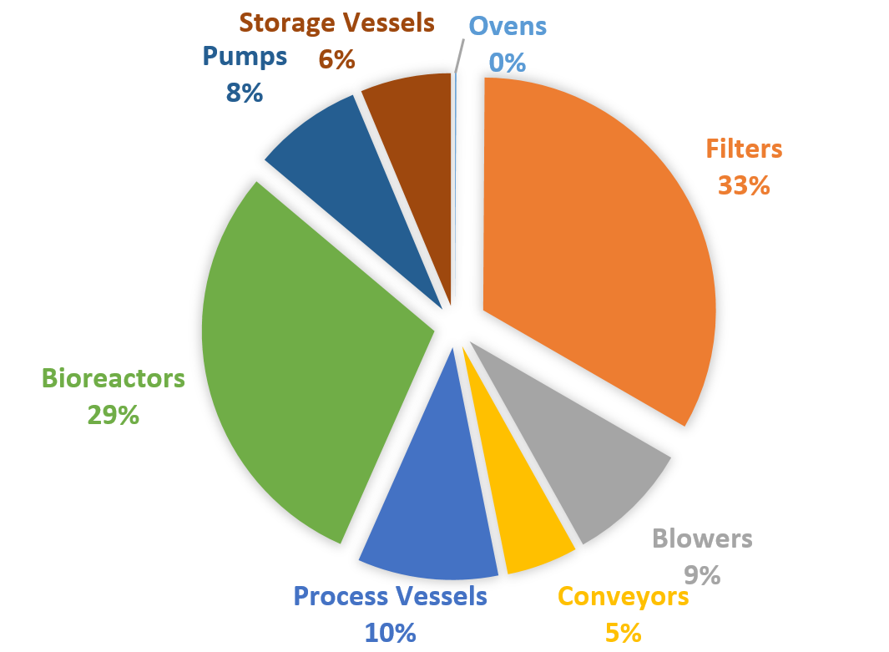
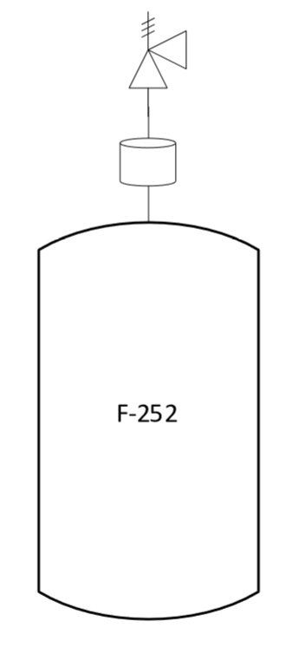
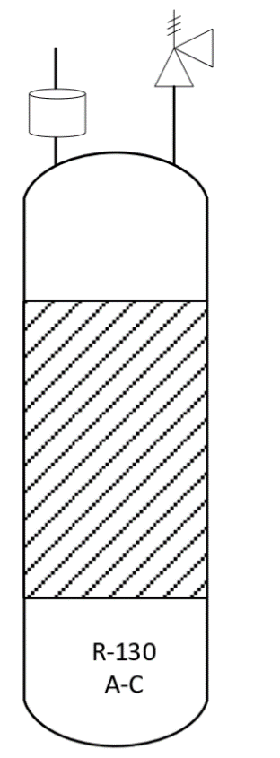
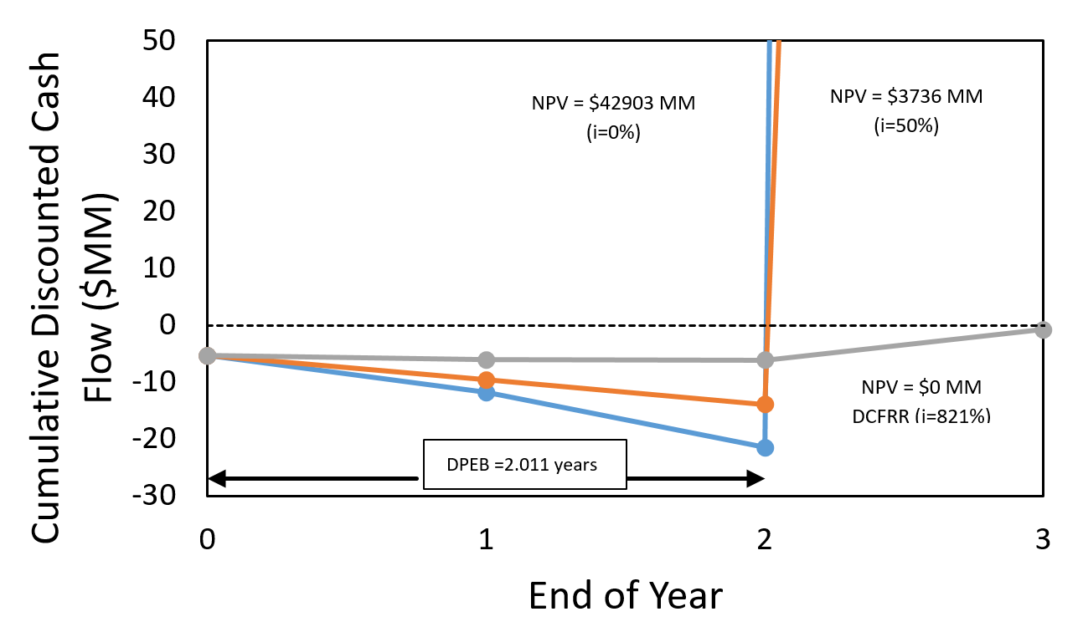
Batch Production of Monoclonal Antibodies
Ion the Prize: Caitlin Considine, Julie Delano, Lucas Hefler, and Evan Redfearn
Objectives:​
Design a facility to produce a variety of monoclonal antibody (mAb) products. Specifically, mAbs to be used in research for the treatment of colon and breast cancer along with neovascular glaucoma and macular degeneration.​
Introduction:​
Market​
Expected to grow $85.4B to $138.6B ​
Customer Requirements ​
99.5% humanized mAbs​
Titer of 1-2g/L with capabilities to increase to 5-10g/L​
Critical to Quality Variables:​
Temperature, dissolved oxygen, pH​
Stored for a year In 50% glycerol at -20 degrees C. ​
Process Flow Diagrams and Material Balances
Equipment | Description
L-111 | Centrifugal Radial Flow Pump
L-114 | Centrifugal Radial Flow Pump
L-121 | Centrifugal Radial Flow Pump
L-122 | Centrifugal Radial Flow Pump
L-133 | Positive Displacement Pump
L-141 | Centrifugal Radial Flow Pump
L-152 | Centrifugal Radial Flow Pump
L-181 | Centrifugal Radial Flow Pump
L-211 | Centrifugal Radial Flow Pump
L-221 | Centrifugal Radial Flow Pump
L-223 | Centrifugal Radial Flow Pump
L-241 | Centrifugal Radial Flow Pump
L-251 | Centrifugal Radial Flow Pump
L-253 | Centrifugal Radial Flow Pump
L-261 | Centrifugal Radial Flow Pump
L-271 | Centrifugal Radial Flow Pump
G-131 | Air Blower
H-132 | HEPA Filter
H-182 | NANO Filter
H-262 | Filter
R-130 | 1 Liter Bioreactor
R-140 | 1,000 Liter Bioreactor
R-150A-C | 5,000 Liter Bioreactor
R-160A-E | 6,000 Liter Bioreactor
R-170A-E | 6,000 Liter Bioreactor
R-180A-E | 6,000 Liter Bioreactor
J-112 | Vibrating Conveyor
J-113 | Vibrating Conveyor
J-243 | Vibrating Conveyor
J-245 | Vibrating Conveyor
H-220 | Ion-Exchange Column
H-250 | Ion-Exchange Column
Q-120 | Oven
F-210 | Storage Tank
F-222 | Acetic Acid Storage Tank
F-224 | PBS Storage Tank
F-230 | Kill Tank
F-240 | Storage Tank
F-242 | Sodium Citrate Storage Tank
F-244 | Citric Acid Storage Tank
F-252 | Sodium Hydroxide Storage Tank
P-270 | Refrigerator
M-110 | Mixer
 | 1 | 2 | 3 | 4 | 5 | 6 | 7 | 8 | 9 | 10 | 11 | 12 | 13 | 14 | 15 | 16 | 17 | 18 | 19 | 20 | 21 | 22 | 23 | 24 | 25 | 26 | 27 | 28 | 29 | 30 | 31 | 32 | 33 | 34 | 35 | 36 | 37 | 38 | 39 | 40 | 41 | 42 | 43 | 44 | 45 | 46 | 47 | 48 | 49 | 50 | 51 | 52 | 53 | 54 | 55 | 56 | 57
WFI | 71784.00 |  |  |  | 71784.00 |  |  |  | 71784.00 | 71784.00 | 71784.00 | 0.001 |  |  | 71784.00 | 0.001 |  | 2.39 | 71781.61 |  |  | 2.39 | 2390.41 | 0.00 | 69391.20 | 2.39 |  |  | 2392.80 |  | 9571.20 |  | 2392.80 |  |  |  | 11964.00 | 59820.00 |  |  |  | 11964.00 |  | 71784.00 | 23928.00 | 7976.00 | 23928.00 |  |  | 23928.00 | 23928.00 |  | 23928.00 |  |  |  | 71784.00
MAB |  |  |  |  |  |  |  |  |  |  |  |  |  |  |  |  |  |  | 0.00 |  |  | 0.00 |  | 0.00 |  |  |  |  | 0.00023 | 0.00 |  |  | 0.00023 |  |  |  | 0.24 |  |  |  |  | 0.24 |  | 0.24 | 0.08 | 0.03 | 0.08 |  |  | 77.08 | 77.08 |  | 77.08 |  |  |  | 231.24
Oxygen |  |  |  |  |  |  |  |  |  |  |  |  | 2261.15 | 2261.15 |  |  | 2261.15 |  |  | 0.00008 | 0.000016 | 0.000016 |  | 2261.15 |  |  | 0.01 | 0.03 | 0.02 | 0.01 |  | 2261.12 | 0.02 | 0.31 | 2.00 | 2259.12 | 0.08 |  | 753.04 | 753.04 | 0.31 | 0.08 | 753.04 |  |  |  |  | 150.47 | 150.78 | 0.16 | 0.16 | 150.47 | 0.16 | 301.26 | 150.47 | 451.73 | 0.49
Nitrogen |  |  |  |  |  |  |  |  |  |  |  |  | 7442.94 | 7442.94 |  |  | 7442.94 |  |  | 0.00026 | 0.00026 | 0.000054 |  | 7442.94 |  |  | 0.08 | 0.08 | 0.05 | 0.08 | 0.00 | 7442.85 | 0.05 | 6.58 | 6.58 | 7436.27 | 0.27 | 0.00 | 2478.76 | 2478.76 | 6.67 | 0.27 | 2478.76 |  |  |  |  | 2478.76 | 2485.42 | 0.54 | 0.54 | 2478.76 | 0.54 | 4964.18 | 2478.76 | 7442.94 | 1.61
Carbon Dioxide |  |  |  |  |  |  |  |  |  |  |  |  |  |  |  |  |  |  |  |  | 0.000069 |  |  |  |  |  | 0.02 |  |  | 0.02 |  |  |  | 5.23 |  |  |  |  |  |  | 5.25 |  |  |  |  |  |  | 1542.55 | 1547.80 |  |  | 1542.55 |  | 3090.35 | 1542.55 | 4632.89
CHO cells |  |  |  |  |  |  |  |  |  |  |  | 0.000001 |  |  |  | 0.000001 |  |  |  |  |  | 0.000032 |  |  |  |  |  |  | 0.001 |  |  |  | 0.0010 |  |  |  | 1.05 |  |  |  |  | 1.05 |  | 1.05 | 0.35 | 0.12 | 0.35 |  |  | 21.33 | 21.33 |  | 21.33 |  |  |  | 64.00
Lactate |  |  |  |  |  |  |  |  |  |  |  |  |  |  |  |  |  |  |  |  |  | 0.00 |  |  |  |  |  |  | 0.00028 |  |  |  | 0.00028 |  |  |  | 0.28 |  |  |  |  | 0.28 |  | 0.28 | 0.09 | 0.03 | 0.09 |  |  | 762.53 | 762.53 |  | 762.53 |  |  |  | 2287.60
Glucose |  | 5137.00 | 7.94 |  |  | 5137.00 | 7.94 | 0.00 | 5144.94 | 5144.94 | 5144.94 |  |  |  | 5144.94 |  |  | 0.17 | 5144.77 |  |  | 0.17 | 171.33 |  | 4973.44 | 0.17 |  |  | 171.49 |  | 685.99 |  | 171.49 |  |  |  | 853.06 | 4287.45 |  |  |  | 853.06 |  | 5140.51 | 1713.50 | 571.17 | 1713.50 |  |  | 75.54 | 75.54 |  | 75.54 |  |  |  | 226.61
Amino Acids |  | 5956.00 | 646.80 |  |  | 5956.00 | 646.80 | 0.00 | 6602.80 | 6602.80 | 6602.80 |  |  |  | 6602.80 |  |  | 0.22 | 6602.58 |  |  | 0.22 | 219.87 |  | 6382.71 | 0.22 |  |  | 220.09 |  | 880.37 |  | 220.09 |  |  |  | 1099.27 | 5502.33 |  |  |  | 1099.27 |  | 6601.60 | 2200.53 | 733.51 | 2200.53 |  |  | 2037.57 | 2037.57 |  | 2037.57 |  |  |  | 6112.72
glutamine |  |  |  | 0.47 |  |  |  | 0.47 | 0.47 | 0.47 | 0.47 |  |  |  | 0.47 |  |  |  | 0.47 |  |  |  | 0.02 |  | 0.45 | 0.00 |  |  | 0.01 |  | 0.06 |  | 0.01 |  |  |  | 0.07 | 0.39 |  |  |  | 0.07 |  | 0.46 | 0.15 | 0.05 | 0.15 |  |  | 0.05 | 0.05 |  | 0.05 |  |  |  | 0.16
Total (kg/batch) | 71784.00 | 11093.00 | 654.74 | 0.47 | 71784.00 | 11093.00 | 654.74 | 0.47 | 83532.21 | 83532.21 | 83532.21 | 0.001001 | 9704.08 | 9704.08 | 83532.21 | 0.001001 | 9704.08 | 2.78 | 83529.42 | 0.00 | 0.00 | 2.78 | 2781.62 | 9704.08 | 80747.80 | 2.78 | 0.11 | 0.11 | 2784.47 | 0.11 | 11137.63 | 9703.98 | 2784.47 | 12.12 | 8.58 | 9695.39 | 13918.31 | 69610.17 | 3231.80 | 3231.80 | 12.23 | 13918.31 | 3231.80 | 83528.13 | 27842.71 | 9280.90 | 27842.71 | 4171.78 | 4184.01 | 26902.81 | 26902.81 | 4171.78 | 26902.81 | 8355.78 | 4171.78 | 12527.56 | 80708.43
Temperature (°C) | 25.00 | 25.00 | 25.00 | 25.00 | 25.00 | 25.00 | 25.00 | 25.00 | 25.00 | 25.00 | 37.00 | 37.00 | 25.00 | 25.00 | 37.00 | 37.00 | 25.00 | 37.00 | 37.00 | 25.00 | 37.00 | 37.00 | 37.00 | 25.00 | 37.00 | 37.00 | 37.00 | 25.00 | 37.00 | 37.00 | 37.00 | 25.00 | 37.00 | 37.00 | 25.00 | 25.00 | 37.00 | 37.00 | 25.00 | 25.00 | 37.00 | 37.00 | 25.00 | 37.00 | 37.00 | 37.00 | 37.00 | 37.00 | 37.00 | 37.00 | 37.00 | 37.00 | 37.00 | 37.00 | 37.00 | 37.00 | 37.00
Pressure (Bar) | 1.00 | 1.00 | 1.00 | 1.00 | 2.00 | 1.00 | 1.00 | 2.00 | 1.00 | 2.00 | 1.00 | 1.00 | 1.00 | 3.00 | 2.00 | 2.00 | 2.00 | 2.00 | 2.00 | 1.90 | 1.00 | 1.00 | 2.00 | 1.90 | 2.00 | 2.00 | 1.00 | 1.80 | 1.00 | 1.00 | 2.00 | 1.80 | 2.00 | 1.00 | 1.70 | 1.70 | 1.00 | 2.00 | 1.50 | 1.50 | 1.00 | 2.00 | 1.50 | 2.00 | 2.00 | 2.00 | 2.00 | 1.00 | 1.00 | 1.00 | 1.00 | 1.00 | 1.00 | 1.00 | 1.00 | 1.00 | 1.00
 | 58 | 59 | 60 | 61 | 62 | 63 | 64 | 65 | 66 | 67 | 68 | 69 | 70 | 71 | 72 | 73 | 74 | 75 | 76 | 77 | 78 | 79 | 80 | 81 | 82 | 83 | 84 | 85 | 86 | 87 | 88 | 89 | 90 | 91 | 92 | 93 | 94 | 95 | 96
WFI | 71784.00 | 3589.20 | 68194.80 | 68194.80 | 67796.00 | 67796.00 | 68194.80 | 67796.00 | 67796.00 | 67796.00 | 68194.80 | 67796.00 | 135990.80 | 203786.80 | 67796.00 |  |  | 203786.80 |  |  | 67796.00 |  |  | 67796.00 | 67796.00 | 67796.00 | 67796.00 | 67796.00 | 67796.00 | 67796.00 | 67796.00 | 61016.40 | 6779.60 | 6779.60 | 13255.40 |  | 20035.00 | 20035.00 | 20035.00
MAB | 231.24 | 11.56 | 219.68 | 219.68 |  |  | 219.68 |  |  |  | 219.68 |  | 9.89 | 19.33 | 209.79 |  |  | 19.33 |  |  | 209.79 |  |  | 9.44 |  | 209.79 |  |  | 209.79 | 200.35 | 200.35 |  | 200.35 | 200.35 |  |  | 200.35 | 200.35 | 200.35
Oxygen | 0.49 | 0.02 | 0.47 | 0.47 |  |  | 0.47 |  |  |  | 0.47 |  | 0.44 | 0.47 | 0.02 |  |  | 0.47 |  |  | 0.02 |  |  | 0.02 |  | 0.02 |  |  | 0.02
Nitrogen | 1.61 | 0.08 | 1.53 | 1.53 |  |  | 1.53 |  |  |  | 1.53 |  | 1.45 | 1.53 | 0.08 |  |  | 1.53 |  |  | 0.08 |  |  | 0.08 |  | 0.08 |  |  | 0.08
Carbon Dioxide |  |  |  |  |  |  |  |  |  |  | 0.00
CHO cells | 64.00 | 60.80 | 3.20 | 3.20 |  |  | 3.20 |  |  |  | 3.20 |  | 3.04 | 3.20 | 0.16 |  |  | 3.20 |  |  | 0.16 |  |  | 0.16 |  | 0.16 |  |  | 0.16
Lactate | 2287.60 | 114.38 | 2173.22 | 2173.22 |  |  | 2173.22 |  |  |  | 2173.22 |  | 2064.56 | 2173.22 | 108.66 |  |  | 2173.22 |  |  | 108.66 |  |  | 108.66 |  | 108.66 |  |  | 108.66
Glucose | 226.61 | 11.33 | 215.28 | 215.28 |  |  | 215.28 |  |  |  | 215.28 |  | 204.52 | 215.28 | 10.76 |  |  | 215.28 |  |  | 10.76 |  |  | 10.76 |  | 10.76 |  |  | 10.76
Amino Acids | 6112.72 | 305.64 | 5807.08 | 5807.08 |  |  | 5807.08 |  |  |  | 5807.08 |  | 5516.73 | 5807.08 | 290.35 |  |  | 5807.08 |  |  | 290.35 |  |  | 290.35 |  | 290.35 |  |  | 290.35
glutamine | 0.16 | 0.01 | 0.15 | 0.15 |  |  | 0.15 |  |  |  | 0.15 |  | 0.14 | 0.15 | 0.01 |  |  | 0.15 |  |  | 0.01 |  |  | 0.01 |  | 0.01 |  |  | 0.01
Acetic Acid |  |  |  |  | 8167.07 |  |  | 8167.07 | 8167.07 |  |  |  |  | 8167.07 | 8167.07 |  |  | 8167.07 |  |  | 8167.07 |  |  | 8167.07 |  | 8167.07 |  |  | 8167.07
PBS |  |  |  |  |  | 2795.00 |  |  |  | 2795.00 |  | 2795.00 | 2795.00 | 2795.00 |  |  |  | 2795.00
Sodium Citrate |  |  |  |  |  |  |  |  |  |  |  |  |  | 189.91 |  | 189.91 |  | 189.91 | 189.91 |  |  | 189.91 |  | 189.91 |  | 189.91 |  |  | 189.91
Citric Acid |  |  |  |  |  |  |  |  |  |  |  |  |  | 1220.59 |  |  | 1220.59 | 1220.59 |  | 1220.59 |  |  | 1220.59 | 1220.59 |  | 1220.59 |  |  | 1220.59
NaOH |  |  |  |  |  |  |  |  |  |  |  |  |  |  |  |  |  |  |  |  |  |  |  |  | 2719.80 |  | 2719.80 | 2719.80 |  | 2719.80 | 2719.80 | 2719.80
Glycerol |  |  |  |  |  |  |  |  |  |  |  |  |  |  |  |  |  |  |  |  |  |  |  |  |  |  |  |  |  |  |  |  |  |  |  | 25244.10 | 25244.10 | 25244.10 | 25244.10
Total (kg/batch) | 80708.43 | 4093.02 | 76615.41 | 76615.41 | 75963.07 | 70591.00 | 76615.41 | 75963.07 | 75963.07 | 70591.00 | 76615.41 | 70591.00 | 146586.57 | 224379.63 | 76582.91 | 189.91 | 1220.59 | 224379.63 | 189.91 | 1220.59 | 76582.91 | 189.91 | 1220.59 | 77793.06 | 70515.80 | 77993.41 | 70515.80 | 70515.80 | 77993.41 | 70716.15 | 70716.15 | 63736.20 | 6979.95 | 6979.95 | 13255.40 | 25244.10 | 45479.45 | 45479.45 | 45479.45
Temperature (°C) | 25.00 | 25.00 | 25.00 | 25.00 | 25.00 | 25.00 | 25.00 | 25.00 | 25.00 | 25.00 | 25.00 | 25.00 | 25.00 | 25.00 | 25.00 | 25.00 | 25.00 | 25.00 | 25.00 | 25.00 | 25.00 | 25.00 | 25.00 | 25.00 | 25.00 | 25.00 | 25.00 | 25.00 | 25.00 | 25.00 | 25.00 | 25.00 | 25.00 | 25.00 | 25.00 | 25.00 | 25.00 | 25.00 | -20.00
Pressure (Bar) | 2.00 | 1.00 | 1.00 | 2.00 | 1.00 | 1.00 | 1.00 | 2.00 | 1.00 | 1.00 | 2.00 | 2.00 | 1.00 | 1.00 | 1.00 | 1.00 | 1.00 | 1.00 | 1.00 | 1.00 | 2.00 | 1.00 | 1.00 | 1.00 | 1.00 | 1.00 | 1.00 | 2.00 | 2.00 | 1.00 | 2.00 | 1.00 | 1.00 | 2.00 | 1.00 | 1.00 | 1.00 | 2.00 | 1.00
Gantt Chart
Relief Valves
Corrosive Non-Corrosive
Economic Analysis
Fixed Capital Investment
$9.47 MM
Internal Rate of Return 50 %
NPV = $3,736 MM for 10 years production
Conclusions​
Process is lucrative and inherently safe by design​
DCFRR of 821% indicates good profitability of the process​
Recommendations​
The design team gives this process a “GO” ​
Recommend obtaining pilot and operational-scale fermentation data​
Acknowledgments​
Dr. Jeffrey Halpern and the UNH Department of Chemical Engineering for giving us the tools to design this facility.
Notes:
This is only a template. You may chose to use or not use this format. I highly recommend you use a format that works for your group.

