Slide 1
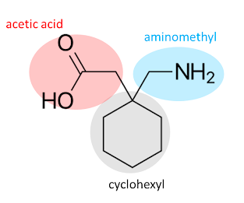
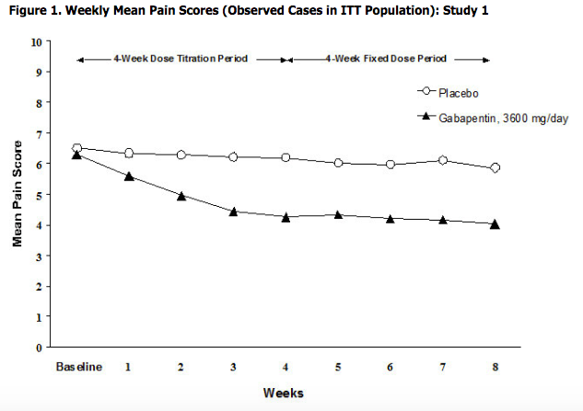
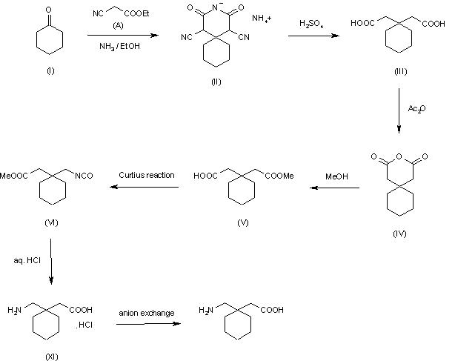
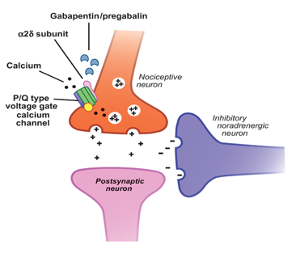
Neurontin
Alexis Little
University of New Hampshire
Department of Chemistry
Results
(2-[1-(aminomethyl) cyclohexyl] acetic acid
Introduction
Production Method of 2-[1-(aminomethyl) cyclohexyl] acetic acid
The chemical structure of gabapentin is derived by addition the backbone of gamma-aminobutyric acid to a cyclohexyl group in a series of reactions.
Brand name = Neurontin
Generic name = Gabapentin
Drug Class = Anticonvulsant
Gabapentin is an FDA approved drug in which a VALID prescription must be obtained by a practicing physician; and it is most commonly associated with the diagnosis:
  - Diabetes
  - Nerve pain after Herpes outbreak
  - Seizure conditions
  - Neuropathic pain
  - Restless leg syndrome
  - Alcohol and Drug Dependencies
  - Fibromyalgia
  - ** Tremors
  - ** Post Operative Pain
  - **Bipolar/Anxiety
NEURONTIN® (gabapentin) Clinical Studies. https://www.pfizermedicalinformation.com/en-us/Neurontin/clinical-studies
Future Work: Rising problems for pharmaceutical and medical industries
Gabapentin is not currently classified as a controlled substance in every state; therefore it is relatively “easy” to obtain a prescription
Overdoses and illicit uses are exponentially increasing
  25,000 more overdoses recorded in 2014 than 2013
Research has found that moderate or high doses of gabapentin increased the odds of a fatal opioid overdose by 60 percent compared to those without concomitant gabapentin and opioid use
(Production Method of Gabapentin - Chempedia. https://www.lookchem.com/Chempedia/Chemical-Technology/Organic-Chemical-Technology/18081.html (accessed Apr 1, 2019).
Mode Of Action
Acknowledgements
Dr. Meg Greenslade
University of New Hampshire Chemistry Department
(GABA: The Brain's Downer. https://www.naturalstacks.com/blogs/news/gaba-the-inhibitory-neurotransmitter )
References
Gamma-aminobutyric acid (GABA) is an inhibitory neurotransmitter that is widely distributed throughout an individuals nervous system via neurons, contributing to motor control, vision, and other cortical functions.
What is Gabapentin? How is It Abused? https://lagunatreatment.com/gabapentin/ (accessed Apr 8, 2019).
GABA: The Brain's Downer. https://www.naturalstacks.com/blogs/news/gaba-the-inhibitory-neurotransmitter (accessed Apr 1, 2019).
Mechanism Gabapentin Action. https://airfreshener.club/mechanism-gabapentin-action.html (accessed April, 2019).
NEURONTIN® (gabapentin) Clinical Studies. https://www.pfizermedicalinformation.com/en-us/Neurontin/clinical-studies (accessed Apr 8, 2019
*** not as common
(Mechanism Gabapentin Action. https://airfreshener.club/mechanism-gabapentin-action.html (accessed April, 2019).

