Slide 1


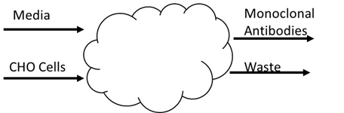


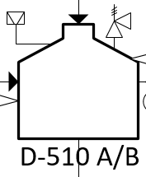
Fed-Batch Production of Humanized Monoclonal Antibodies
Test Tube Babiez Inc.
George Moskos, Kayla Lawlor, John Gwozdz, Liam Corless
Department of Chemical Engineering, University of New Hampshire
Background
Process Flow Diagram and
Material Balances
Objectives
  Produce humanized monoclonal antibodies to treat colon and breast cancer
Customer Requirements
  Produce titers from 5-10 g/L
  Produce ~1,000 kg/yr
Business Case
  Selling for $2,000/g
  Contracting option
Seed Train
Fermentation
Protein A
Chromatography
Virus Inactivation
Polishing
Ultrafiltration
Diafiltration
Economic Analysis
Safety and Other Considerations
Conclusions
Complies to GMP and European regulations
Inherent safe design methods were implemented
All process vessels were equipped with relief valves
Clean-in-Place and Steam-in-Place protocol were used for cleaning
50 kg/batch of MAbs, 20 batches/year
DCFRR is 737% with $726 MM after tax net profit
Inherent safe design for all equipment and HAZOP analysis
Process vessels and piping cleaned with CIP and SIP procedures
Kill Tank Q-710
Relief Valve
Guide Word | Deviation | Cause | Consequences | Action
No | No steam flow | Utility malfunction | Biological waste not killed, sent to sewer while active | Shut down kill tank, assess the steam utility control system
No | No cooling tower water | Utility malfunction | Tank overheats, potential risk of explosion | Shut down tank, fix cooling water. Install temperature monitor
No | No flow out via Stream 90 | Blockage | Tank becomes over pressurized, risk of explosion | Shut down kill tank, clear the blockage
More | More material in inlet streams | Pump malfunction | Rupture disc breaks due to pressurized system | Shut down kill tank, fix pump. Install PAH.
Less | Less flow into the tank | Pump malfunction/less production | Tank overheats due to less material inside | Lessen steam flow
Rupture Disc
Recommendations
Acknowledgements
We would like to thank the Department of Chemical Engineering, Dr. Jeffrey Halpern, and Greg Williams from Thermo Fisher for the continued support and resources throughout this project.
TTB Inc. currently recommends a GO for this process

