Slide 1

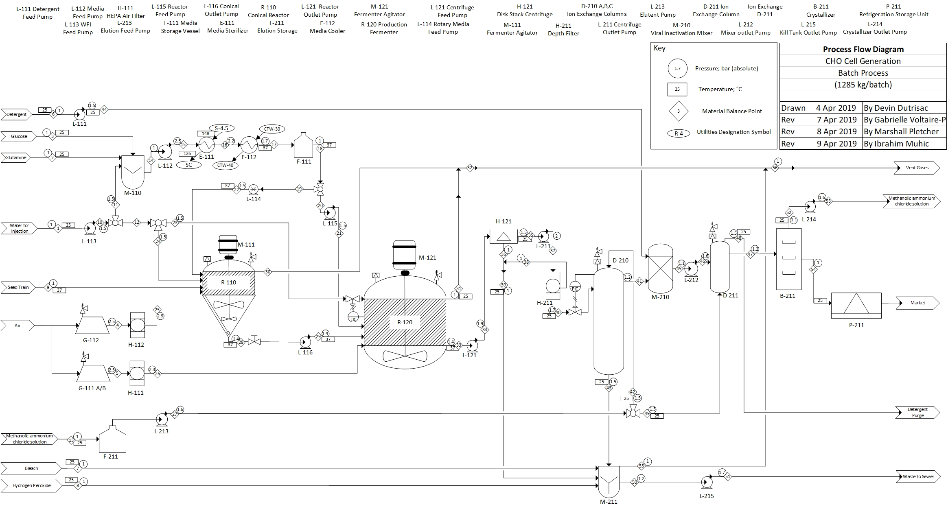
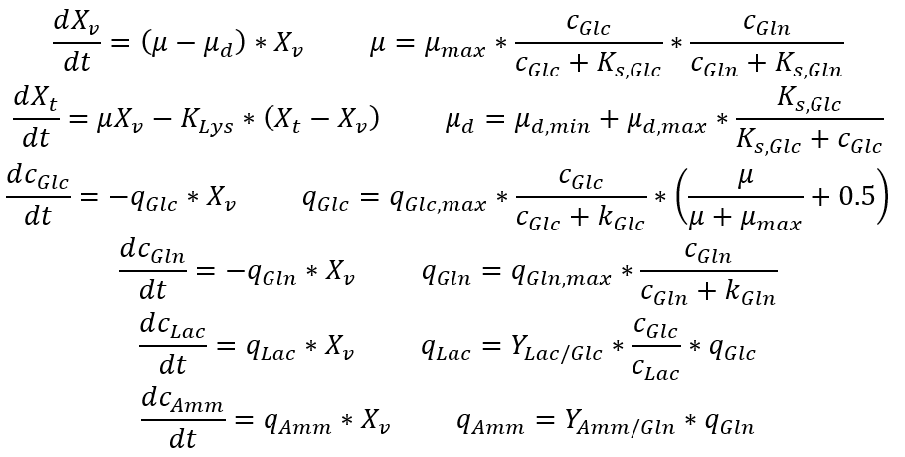
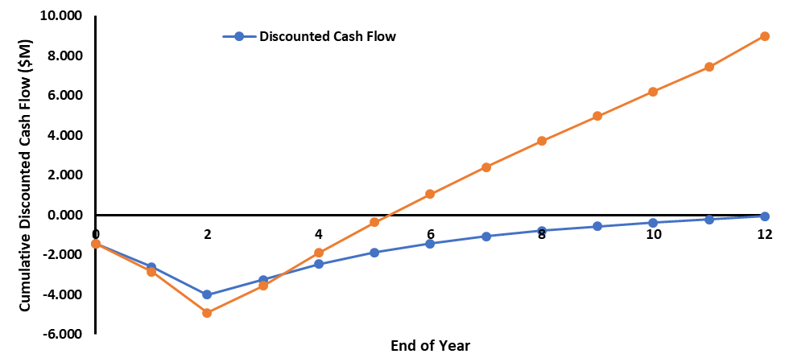
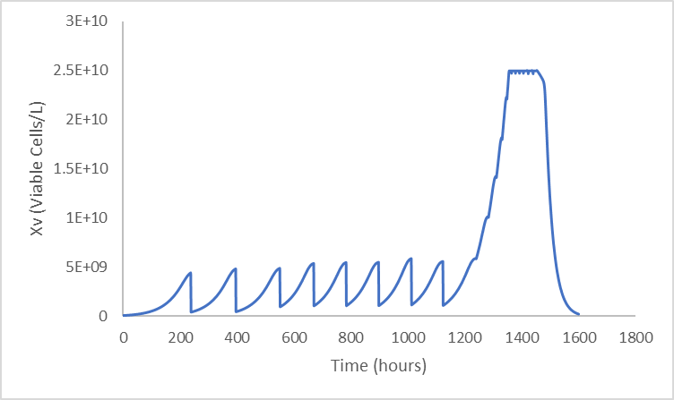
Production of Monoclonal Antibodies
Subject to Change: Ibrahim Muhic, Devin Dutrisac, Gabrielle Voltaire-Polche, Marshall Pletcher
Objectives
Design CHO mAb production facility
1000 kg mAb/year
GMP regulations
Market
$75 B USD in 2013
Expected to reach $125 B in 2020
Average $6 M per kg
Customer Requirements
95% Human Sequence mAb
Critical to Quality Variables
Produce titers of 5-10 g/L
37°C Reactor
Stored for 1 year at -80°C
Other Relevant Items
Replace Triton X-100 with Tween 80 detergent
Relief valves installed on high pressure equipment
Temperatures throughout process will not exceed
CHO Cell Kinetics
Economic Analysis
DCFRR = 21%, Undiscounted NPV = $8.896 M
PBP = 3 years NPT = 5 years DBEP= 7 years
Conclusions
1285 kg mAb product/year
Selling Price of $3,000/kg
Net annual profit after tax = $1.16 M
Project is a GO
Recommendations
Test effectiveness of conical reactor in pilot plant
Determine efficiency of viral inactivation of Tween-80 vs Triton X-100
Acknowledgments
We would like to thank Dr. Halpern and Greg Williams for being resources to help us with this project.
Notes:
This is only a template. You may chose to use or not use this format. I highly recommend you use a format that works for your group.

