Slide 1

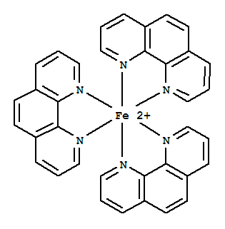
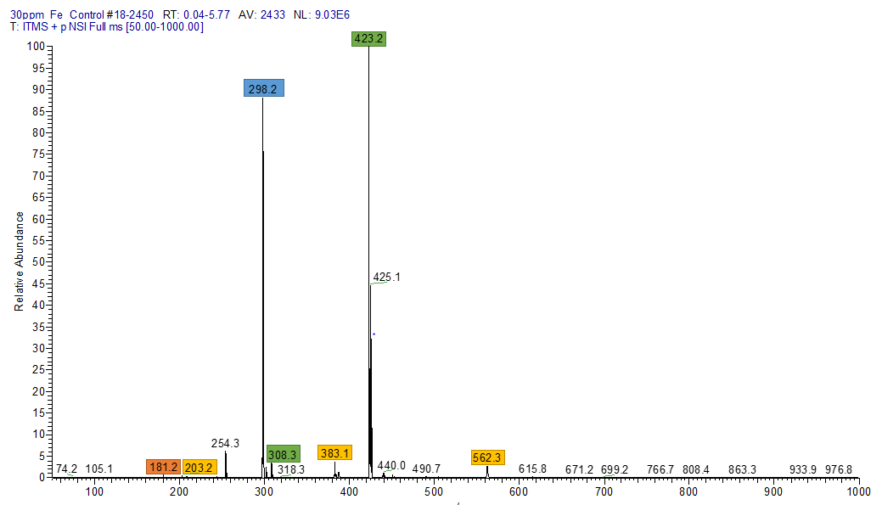
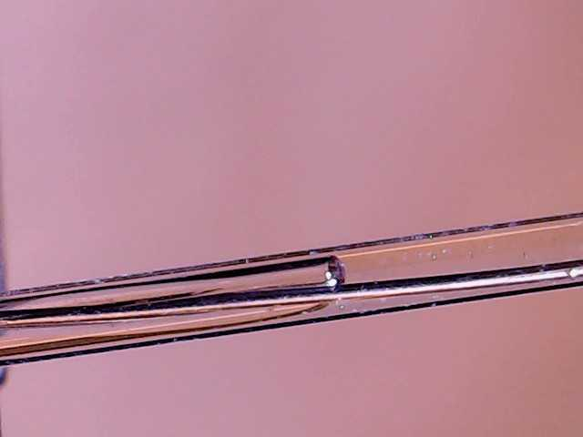
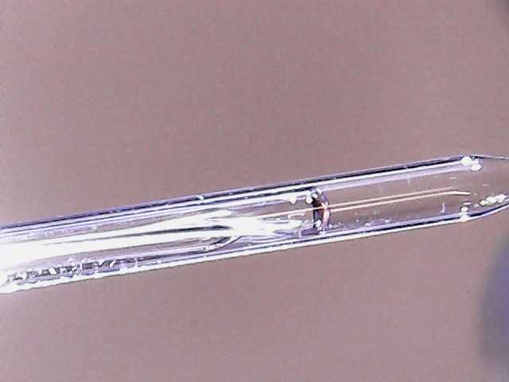
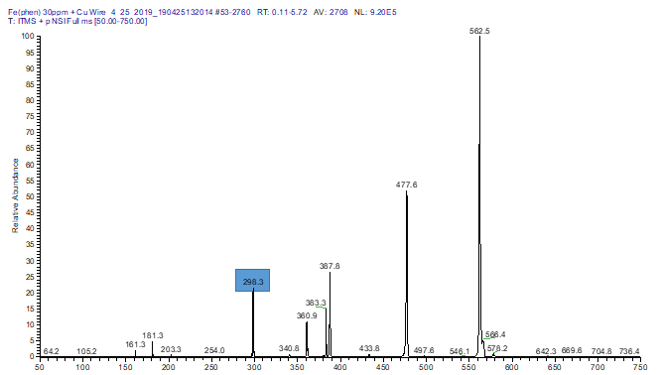
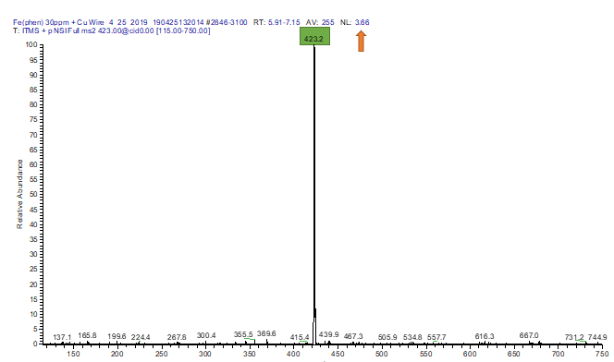
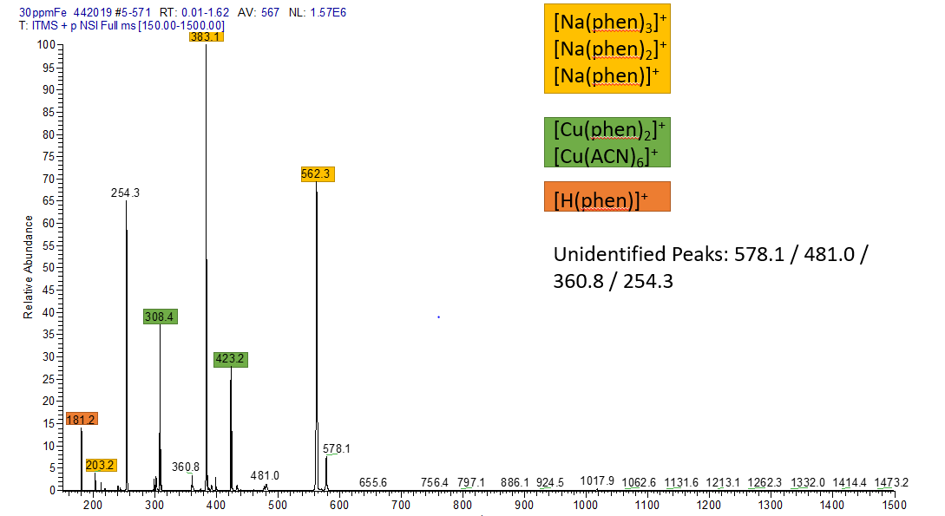
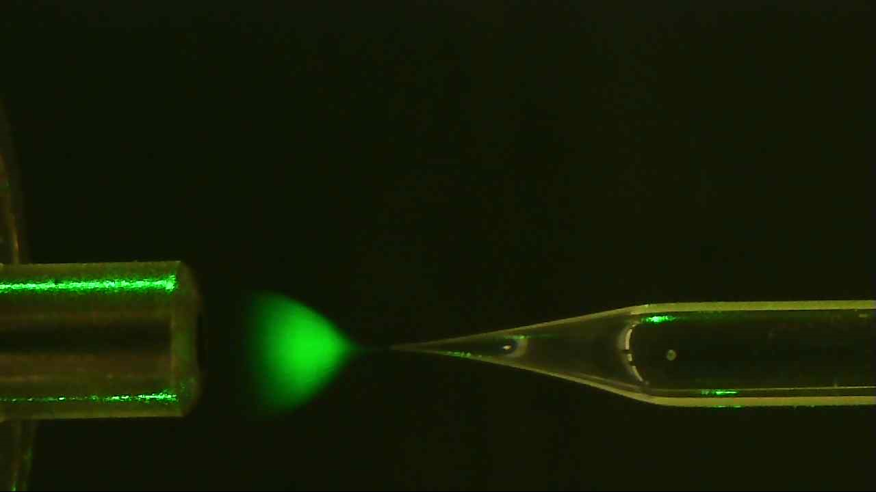

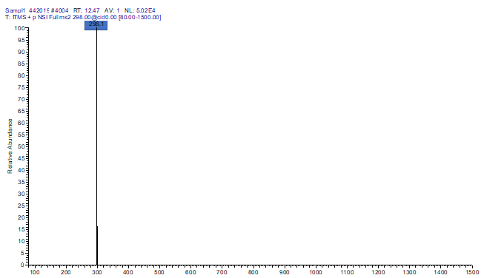
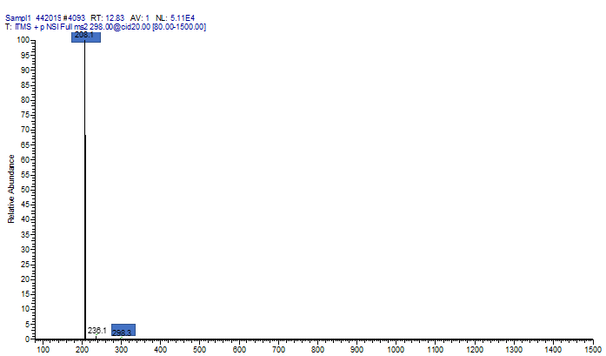
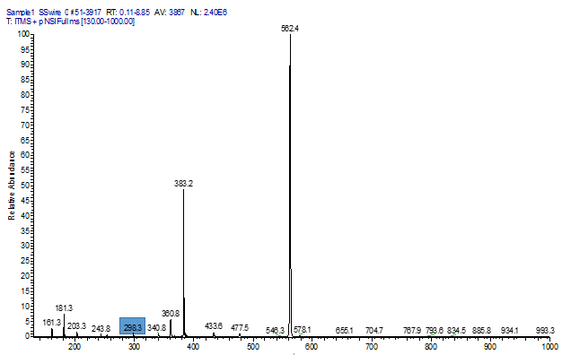
Oxidative Properties of Wire-In Electrodes for nano-ESI-MS
Alexander Tognazzi, Mengtian Li, Anyin Li
University of New Hampshire, Durham
May 2, 2019
Introduction:
This study explores the electrochemistry that is occurring during the process of electrospray ionization – mass spectrometry. Electrospray ionization or ESI is a process that is commonly used coupled with mass spectrometry as an ionization technique for analytes contained within a liquid matrix.. This process is possible through the addition of a metal electrode into the capillary with a large applied voltage. The processes that occur within the capillary during ionization is not widely understood, although, it can be easily surmised that there is electrochemistry occurring. This poses potential problems when utilizing ESI-MS for quantitative studies as there is potential for any generated metal ion to interact with an analyte and metal-solvent interactions.
Results:
Results:
Fe²⁺ + 2e⁻ → Fe(s) Eº = -0.44V
Cu²⁺ + 2e⁻ → Cu(s) Eº = 0.34V
Fe²⁺ + 3(1,10-phenanthroline) → [Fe(phen)₃]²⁺
[Fe(phen)₃]²⁺ + Cu²⁺ ↔ [Cu(phen)₂]⁺ + Fe²⁺
Conclusion:
From the acquired data it can be concluded that from the offline analysis of the stainless-steel electrode that minimal amounts of iron had been oxidized from the electrode.. The iron still being present means that the interactions between the metal cation and any analyte can still be possible posing threats for quantitation. When using the copper electrode and an added amount of iron chloride (30ppm) it can easily be shown that there is potential for secondary reactions occurring during the ionization process. The complexity of the oxidation can be seen when compared to that of the plasma-driven ionization technique which does not utilize an electrode.
Fragmentation
Experimental Methods:
In this study, both online and offline ionization was performed on samples of 1,10-phenanthroline (1mM, 180.21gmol⁻¹) for both copper and stainless-steel wire functioning as the electrodes. Standards of iron(II) were created with iron chloride (3000ppm, 55.845gmol⁻¹) to make peak identifications and for determination of any reactions occurring as a result of electrochemistry. The capillaries that were utilized had an outer-diameter of 1.5mm, inner-diameter of 0.86mm, and a tip-diameter of 3µm. The in-wire ESI-MS was compared to a PDA-ESI-MS set up.
References:
G. J. Van Berkel; K. G. Asano; P. D. Schnier: Electrochemical Processes in a Wire-in-a-Capillary Bulk Loaded, nano-Electrospray Emitter; Oak Ridge National Laboratory, April 2000.
X. Liu; Y. Hu; B. Wang; Z. Su: Synthesis and fluorescent properties of europium-polymer complexes containing 1,10-phenanthroline; Synthetic Metals, 159, 15-16; Aug 2009.
C. J. Hensler; An ultraviolet absorption and fluorescence study of 1,10-phenanthroline and related compounds in aqueous solution; Iwoa State University, Thesis; 1970.
E. Hoffamnn; V. Stroobant; Mass Spectrometry Principles and Applications, third edition; John Wiley & Sons, Ltd; 2007.
G. L. Miessler; P. J. Fischer; D. A. Tarr; Inorganic Chemistry, fifth edition; Pearson; 2014.
Predicted Ions | Molecular Weight | Predicted m/z
[Fe(phen)₃]²⁺ | 596.27gmol⁻¹ | 298.14
[Fe(phen)₂]²⁺ | 416.26gmol⁻¹ | 208.13
[Cu(phen)₂]⁺ | 423.87gmol⁻¹ | 423.87
[H(phen)]⁺ | 181.21gmol⁻¹ | 181.21
Acknowledgments:
I would like to thank the Planalp and Seitz research groups for access to chemicals along with all of the members of the Li research group.

