Slide 1

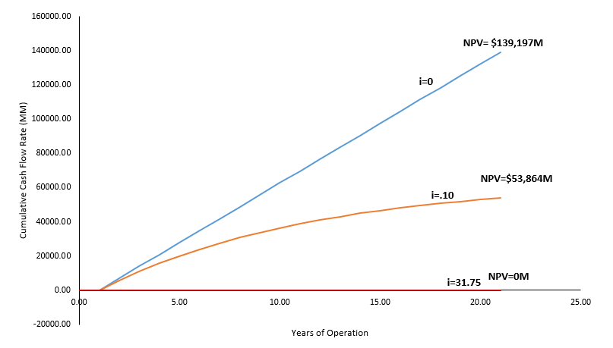
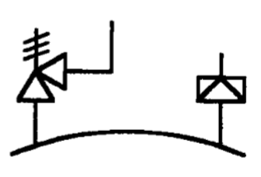
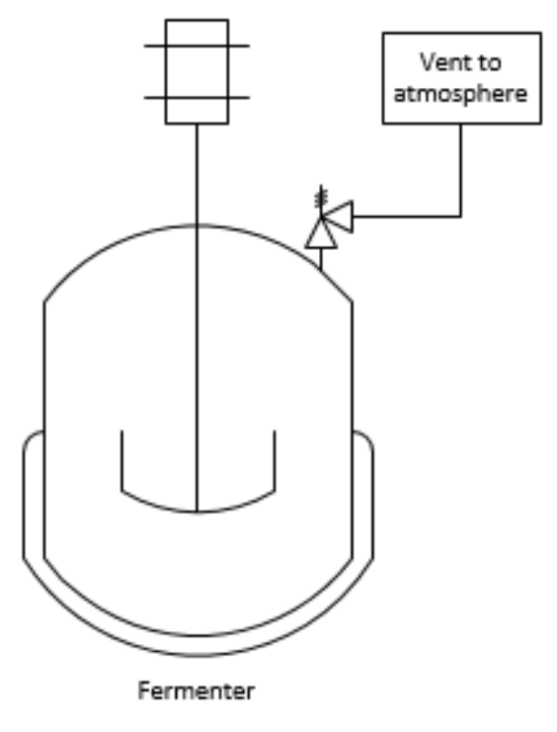
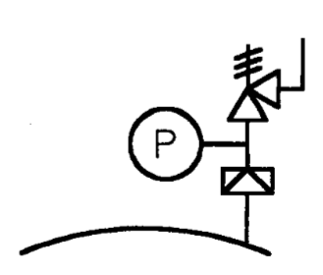
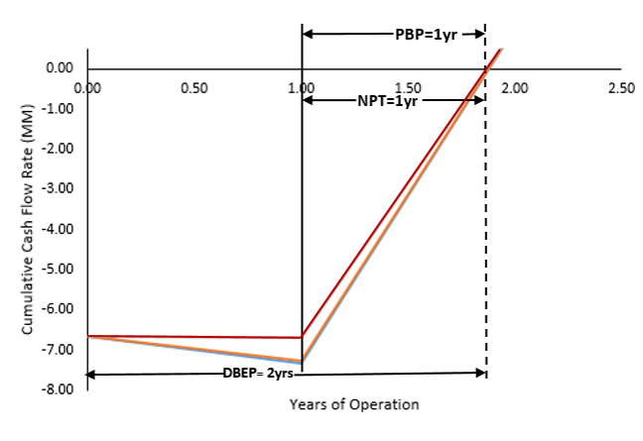
Monoclonal Antibody Production via CHO Cells
Team F.S.G.: Brian Nunnelley, Alex Rioux, Garrett St. Laurent, Jonathan Zywusko
Department of Chemical Engineering, University of New Hampshire
Introduction and Background
Background:
Demand for monoclonal antibodies (MAbs) has risen dramatically
MAbs are used in cancer research
Most pharmaceutical plants are designed to be versatile
VEGF-A is the targeted MAb
Concept:
Single use bioreactor (biobag)
Fed Batch chosen for higher yield
Minimum of 1,000 kg MAb produced annually
1 year of product is storable
Plant to be designed for versatility/contracting
2 Batches completed every 33 days
Safety:
Single use bioreactor bags reduces the cross contamination risk
A HAZOP analysis was done on R-180 A-D
Economic Analysis
Conclusions
We recommend that this plant is a GO
Economic Analysis produced the following results:
      NPV at 10% interest: 53,864,000,000
1,570 kg of MAb intended produced annually, with 2,159 at maximum capacity
Recommendations
We recommend a pilot scale plant to further study the kinetic and thermodynamic properties of CHO cells and to optimize this process
Acknowledgments
We would like to thank the faculty of the Chemical Engineering Department at the University of New Hampshire. We would also like to Dr. Jeffrey Halpern for his support on this project
Total Capital Investment: $8.368 Million
Annual Expenses:
$543 Million
Annual Revenue:
$23.5 Billion
Net Annual Profit:
$12.7 Billion
After Tax Rate of Return:
2,268%
DCFRR: 3,179%
NPV (i=10%): $53,864,000,000
.

