Slide 1



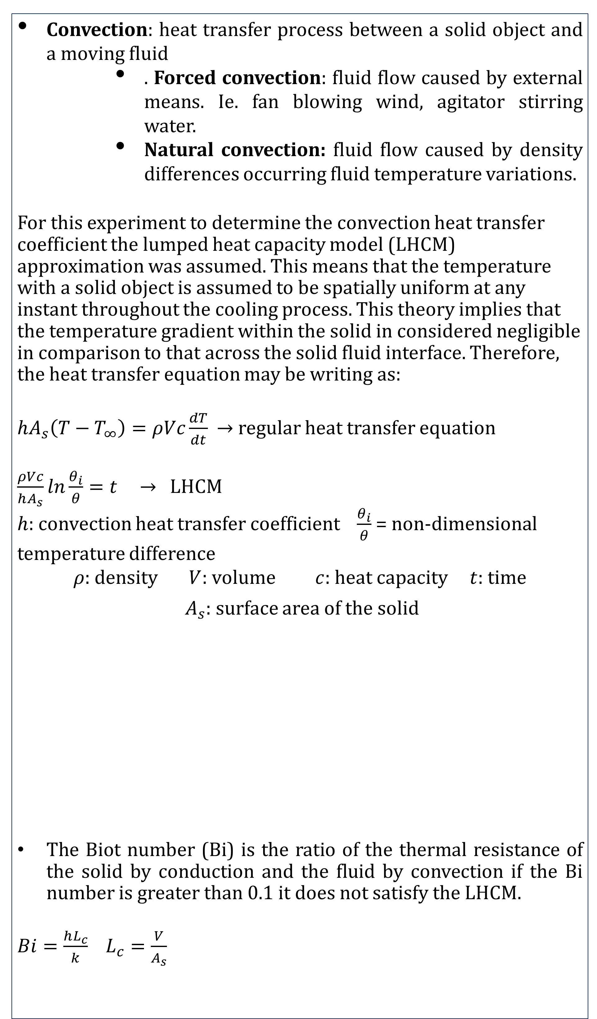
Transient Conduction-Convection
Valerie Mores, Dean Ly, Owen Trindade, JT Couch
Chemical Engineering, University of New Hampshire, Durham, NH 03824
Heat Transfer
About the Experiment
Schematic and Procedural Information
This experiment studies natural and forced convection methods of heat transfer via a water bath respectively.
The heat transfer coefficient of the various shapes of metals at specific conditions was obtained. The Biot number was used to prove which geometric shape satisfies the lump heat capacity model.
This simulation was to understand and solve the design problem, relating to canned foods of varying geometries, which are heated and cooled to temperatures of 120ºC and 0ºC respectively
Agitator
Dimensions for the solid were measured with a caliper The temperatures for the two hot water baths were maintained using hot plates.
Thermocouples were imbedded in all the solids.
Temperature was recorded via LabVIEW , dt=0.2s
The forced convection trials were done in triplicate for the solids at three initial temperatures: ~100 °C, ~80 °C , and ~60 °C . The time it to reach a temperature difference of ~5°C was recorded.
For the forced convection trials, the agitator was set to 400 RPM.
Brass Dimensions
Object | Diameter(mm) | Height (mm)
Cylinder | 50.76 | 152.59
Sphere | 50.6 | - -
“Cans”
Hot Bath
Hot Bath
Aluminum Dimensions
Object | Diameter or Length (mm) | Height (mm) | Width (mm)
Cylinder | 50.81 | 153.55 | - -
Sphere | 50.74 | - - | - -
Rectangle | 152.21 | 51.15 | 25.52
Ice Bath
Hot Plate
Hot Plate
Introduction
Raw data sample
Tabulated Data
Design Problem solution
Convection: heat transfer process between a solid object and a moving fluid
  . Forced convection: fluid flow caused by external means. Ie. fan blowing wind, agitator stirring water.
  Natural convection: fluid flow caused by density differences occurring fluid temperature variations.
For this experiment to determine the convection heat transfer coefficient the lumped heat capacity model (LHCM) approximation was assumed. This means that the temperature with a solid object is assumed to be spatially uniform at any instant throughout the cooling process. This theory implies that the temperature gradient within the solid in considered negligible in comparison to that across the solid fluid interface. Therefore, the heat transfer equation may be writing as:
$hA_{s}\left(T−T_{∞}\right)=ρVc\frac{dT}{dt}$ $→$ regular heat transfer equation
$\frac{ρVc}{hA_{s}}ln\frac{θ_{i}}{θ}=t$ $→$ LHCM
$h$: convection heat transfer coefficient $\frac{θ_{i}}{θ}$ = non-dimensional temperature difference
$ρ$: density $V$: volume $c$: heat capacity $t$: time
$A_{s}$: surface area of the solid
The Biot number (Bi) is the ratio of the thermal resistance of the solid by conduction and the fluid by convection if the Bi number is greater than 0.1 it does not satisfy the LHCM.
$Bi=\frac{hL_{c}}{k}$ $L_{c}=\frac{V}{A_{s}}$
Forced Convection Trials at 100°C
Object | T_{I.B.} (°C) ± 1 | T_{i} (°C) ± 1 | T_{f} (°C) ± 1 | Time (sec) ± 1 S
Al Rect. | 1 | 102 | 6 | 34
Al Rect. | 1 | 102 | 6 | 33
Al Rect. | 1 | 99 | 5 | 33
Al Cylin. | 1 | 99 | 4 | 43
Al Cylin. | 1 | 98 | 6 | 45
Al Cylin. | 1 | 97 | 6 | 42
Al Sphere | 1 | 99 | 5 | 25
Al Sphere | 1 | 97 | 6 | 27
Al Sphere | 1 | 95 | 6 | 26
Forced Convection Trials at 100°C
Object | Mean h (W/m²K) | Mean Bi
Al Rect | 1744 | 0.06922
Al Cylin | 1955 | 0.01034
Al Sphere | 2210 | 0.09071
B Cylin | 496 | 0.00519
B Sphere | 875 | 0.068
Ti=120°C, T=10°C, Tamb=0°C
Shape | Time (sec)
Cylinder | 310.6
Sphere | 243.6
Rectangular | 511.3
Natural Convection Trials at 100°C
Object | Mean h (W/m²K) | Mean Bi
Al Rect | 92.8 | 0.00345
Al Cylin | 217.2 | 0.00093
Al Sphere | 214.9 | 0.00882
B Cylin | 57.9 | 0.00061
B Sphere | 105.4 | 0.00321
Results and Conclusions
The design problem and experimental results, follow a similar trend.
As the surface area decreases, Lc increases, therefore h increases.
The time taken for the solid to reach the desired temperature increases as the value of h decreases.
Decreasing the total thermal resistance of the solid, allowing for maximum heat transfer.
h for laminar flow, normally seen in natural convection is lower than h in turbulent flow, which was observed during forced convection processes.
Turbulent flow has a thin stagnant fluid film layer on the heat transfer surface.
Natural convection
Forced convection
Y
T_{amb}
Find→ h
T_{gradient}
Acknowledgements
X
Dr. McLarnon, and the Chemical Engineering department for guidance and assistance
Prof. Kim, for guidance and assistance on all things heat transfer.
References
Incropera, F. P., & Incropera, F. P. (2013). Principles of heat and mass transfer. Hoboken, NJ: John Wiley.

