Slide 1

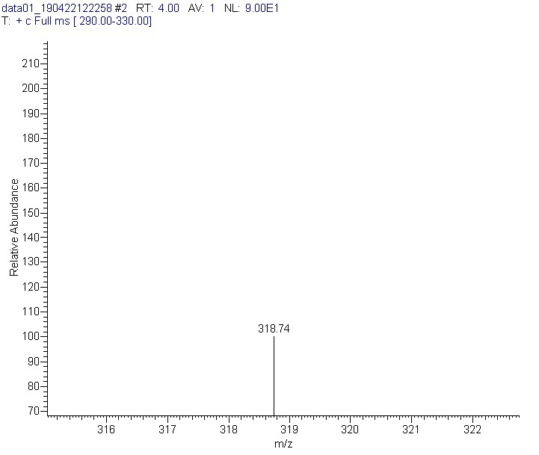
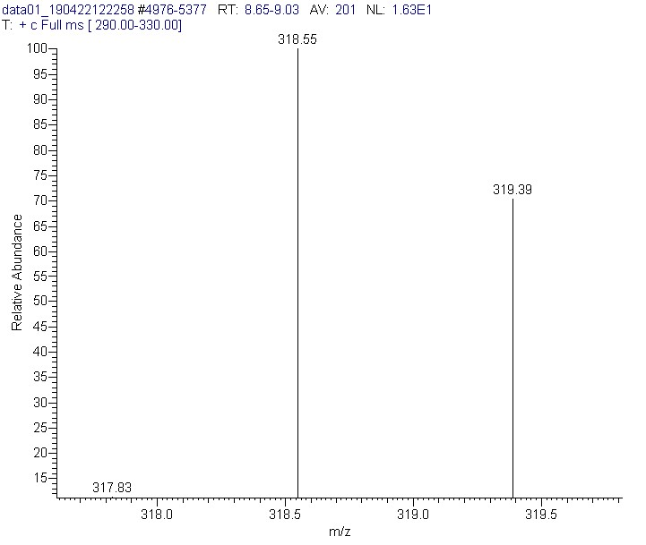
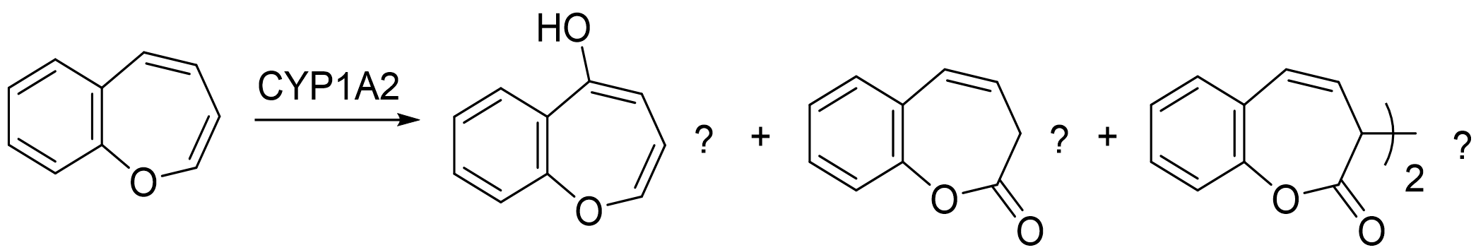
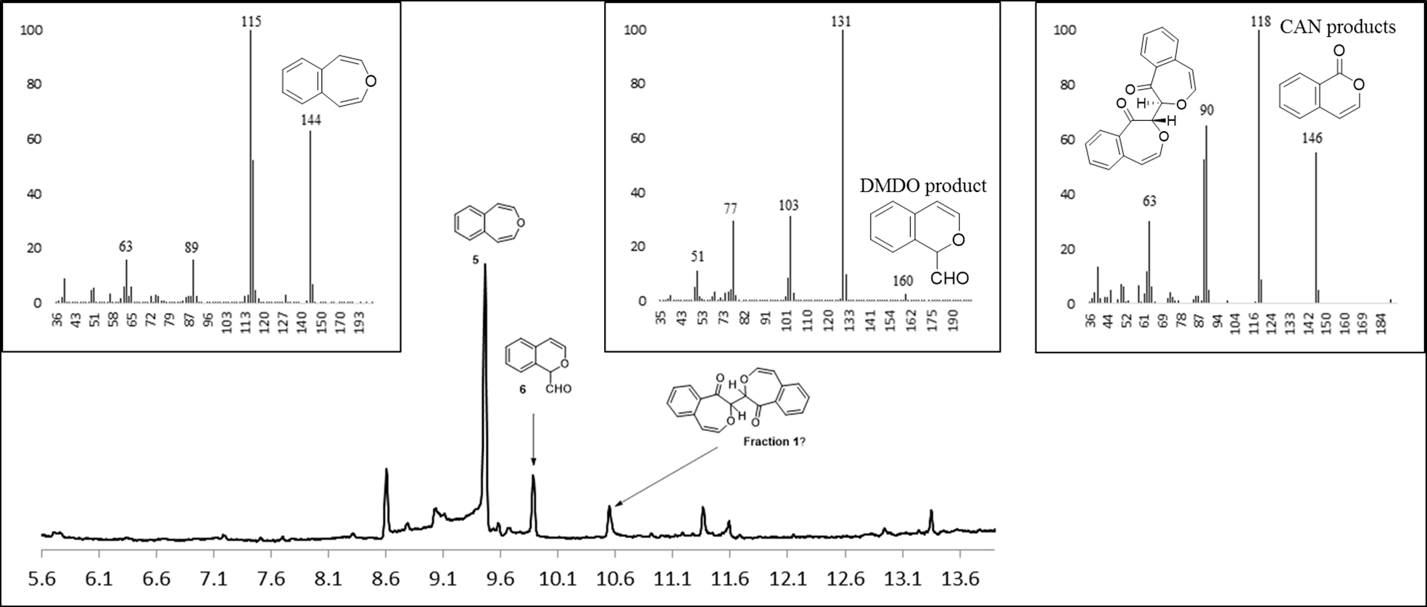
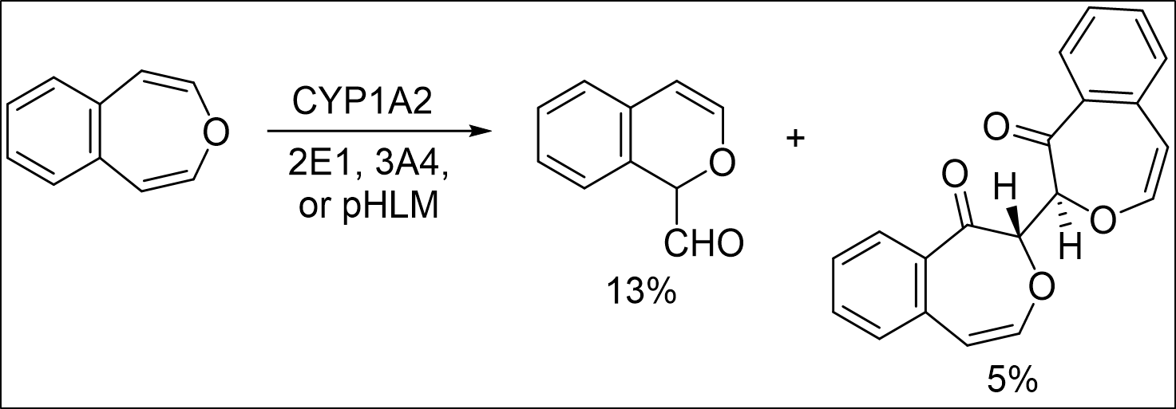
Investigations into Benzene Carcinogen Metabolism: Unveiling the Cytochrome P450 Epoxidation of Oxepin in the mechanism of cancer causing metabolite E,E-muconaldehyde formation
Tristan J. Hart-Bonville^{2b}, Ryan W. Fitzgerald¹, Noah A. Cote^{2a}, Arthur Greenberg^{3*}
tjw1012@wildcats.unh.edu, Department of Chemistry, University of New Hampshire, Durham, NH
Benzene is a known human carcinogen; exposure to benzene has been linked to acute myeloid leukemia, non-Hodgkin lymphoma, and other cancers via cross-linking of DNA. The initial interaction of benzene and cytochrome P450 is well understood to produce the rapid equilibrium of valence tautomers, benzene oxide and oxepin. Though the benzene oxide pathway is highly favored, and produces most benzene metabolites, some ring-opened metabolites, including muconaldehyde, result from the oxidation of oxepin. The mechanism behind the formation of muconaldehyde is unclear. This study proposes that cytochrome P450 can convert oxepin to Z,Z-muconaldehyde through either an epoxidation, or two consecutive single electron oxidations. Z,Z-muconaldehyde then isomerizes to E,E-muconaldehyde. 4,5-benzoxepin and 2,3-benzoxepin were used as model substrates in place of oxepin due to their high barriers for valence tautomerization.
Scheme 1. Metabolic routes of benzene in vivo.^{1,2,3}
Introduction:
Enzymatic studies on 2,3-benzoxepine using 2E1, and 3A4 isoforms of monooxygenase enzyme cytochrome P450, as well as pooled human liver microsomes(pHLM).
The organic synthesis of 2,3-benzoxepin was completed and improved. Enzymatic studies using 2,3-benzoxepin were investigated. Preliminary results indicate that benzene can go through both epoxidation and two consecutive one electron oxidation mechanisms. Hydroxylation of 4,5-positions of the oxepin ring seem to be consistent with either epoxidation or consecutive one electron oxidation of 2,3-benzoxepin.
Results and Discussion:
Future Work:
CYP2E1
CYP3A4
pHLM
Figure 1. Enzymatic reactions with 2,3-benzoxepin model.
Figure 2. Enzymatic reactions with 4,5-benzoxepin model.
Conclusions:
Acknowledgements:
The Elsawa research group and UNH chemistry department are gratefully acknowledged. My co-workers on the oxepin team, Ryan and Noah, are also acknowledged for all their constant support and contributions to the project and 2,3-benzoxepin synthesis.
Experimental Work:
References:
Vogel, E., Gunther, H., Angew. Chem. Int. Ed. 1967, 6, 385-476
Davies, S. G., Whitham, G. H., J. Chem. Soc. Perkin Trans. I, 1977, 1346-1347
Morgan, J., Greenberg, A., J. Org. Chem. 2010, 75, 4761-4768
Greenberg, A., et. al., Structural Chemistry, 1998, 9(3), 223-236
Nauduri, D., Greenberg, A., Tetrahedron Letters, 2004, 45, 4789-4793
Paquette, L. A., Barrett, J. H., Org. Synth. 1969, 49, 62.
Rabideau, Peter W., Burkholder, E., J. Org Chem. 1978, 43, 4283-4288
Enzyme | Substrate | [Substrate] | [Enzyme] | [NADPH] | [MgCl₂]
1A2 | 2,3-benzoxepin | 300 μM | 35 pmol/mL | 1.0 mM | 4.4 mM
1A2 | 2,3-benzoxepin | 300 μM | 35 pmol/mL | 1.0 mM | 4.4 mM
1A2 | 2,3-benzoxepin | 300 μM | 35 pmol/mL | 1.0 mM | 4.4 mM
Control | 2,3-benzoxepin | 0 μM | 35 pmol/mL | 1.0 mM | 4.4 mM
Enzyme | Substrate | [Substrate] | [Enzyme] | [NADPH] | [MgCl₂]
2E1 | 4,5-benzoxepin | 300 μM | 50 pmol/mL | 1.0 mM | 3.3 mM
1A2 | 4,5-benzoxepin | 300 μM | 35 pmol/mL | 1.0 mM | 4.4 mM
3A4 | 4,5-benzoxepin | 300 μM | 35 pmol/mL | 1.0 mM | 3.3 mM
pHLM | 4,5-benzoxepin | 300 μM | 0.5 mg/mL | 1.0 mM | 3.3 mM

