Slide 1

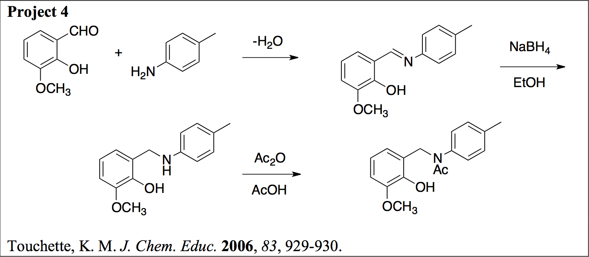
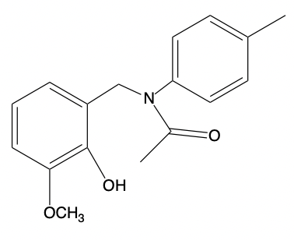
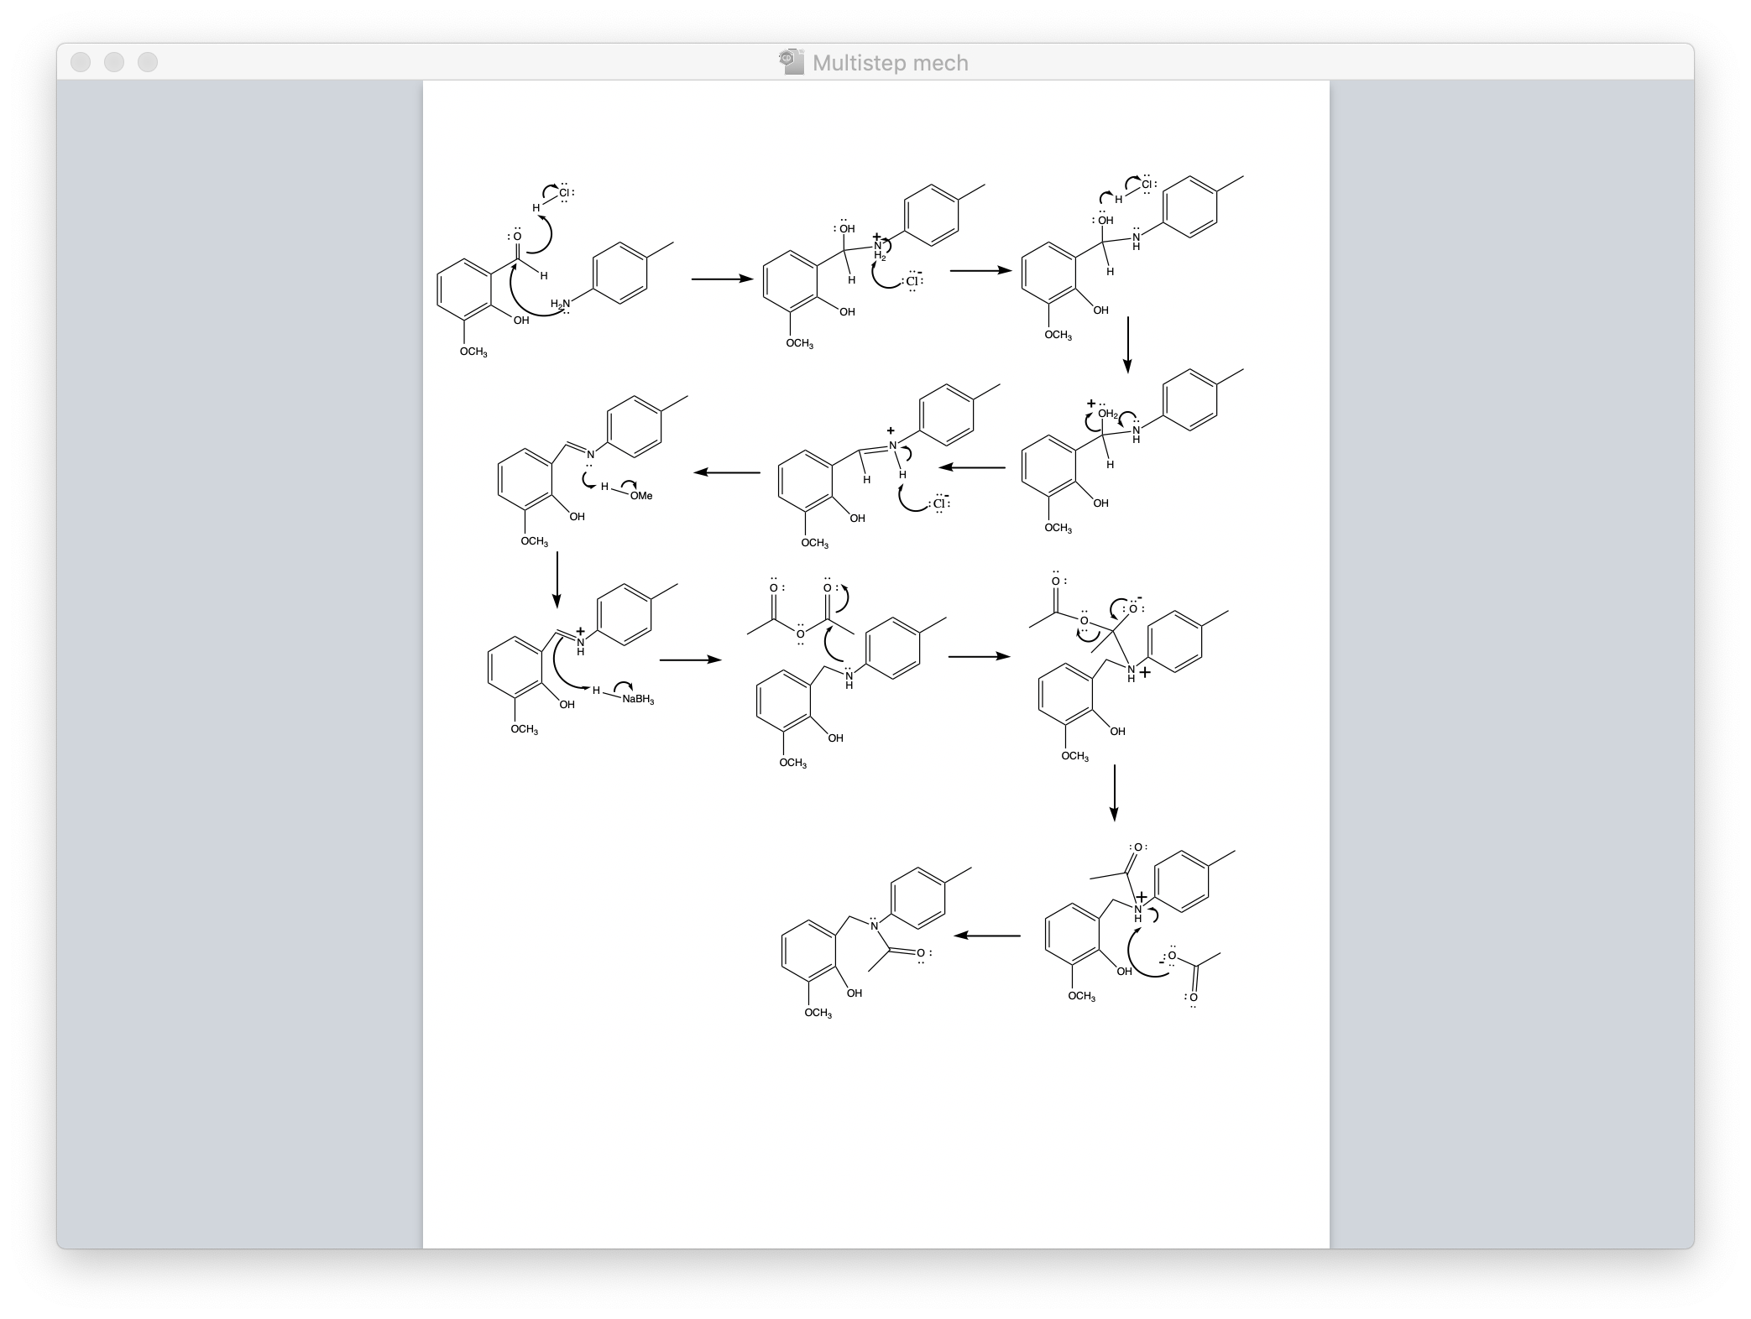
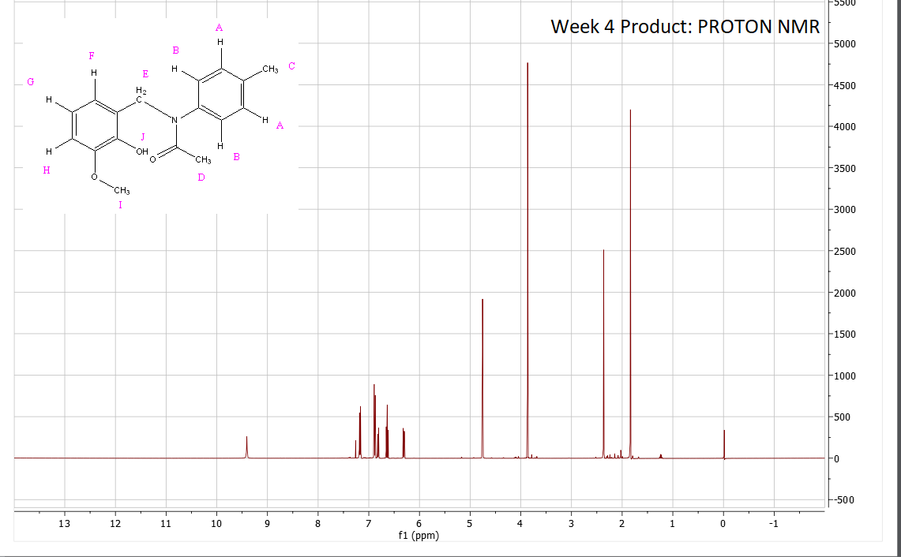
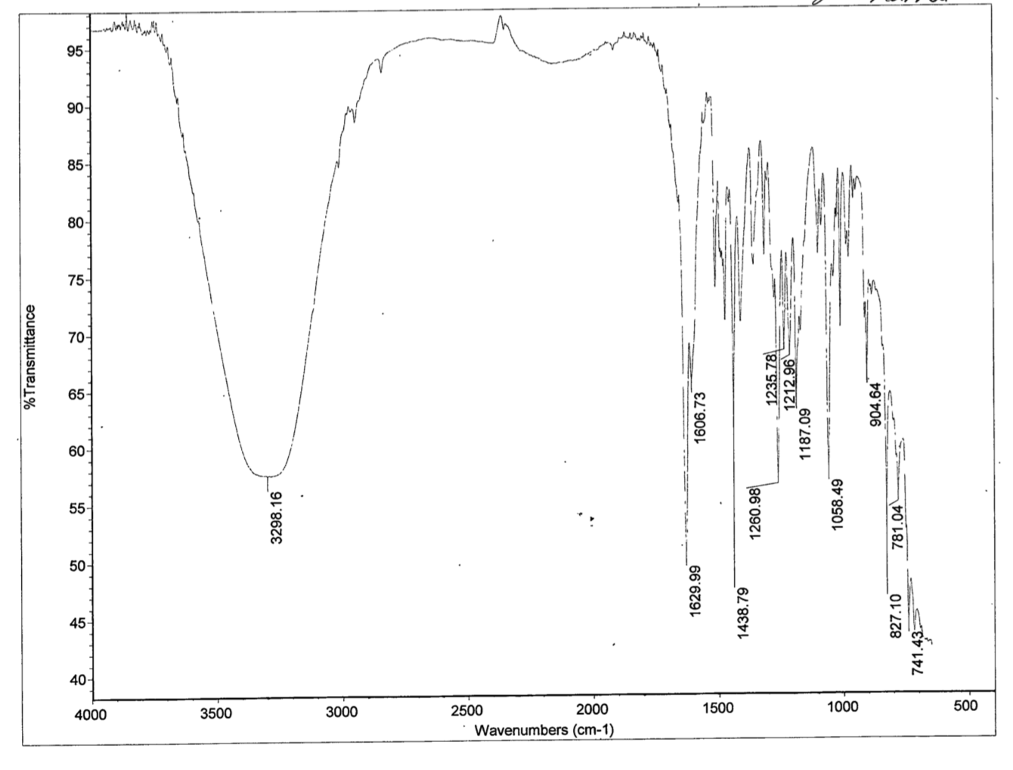
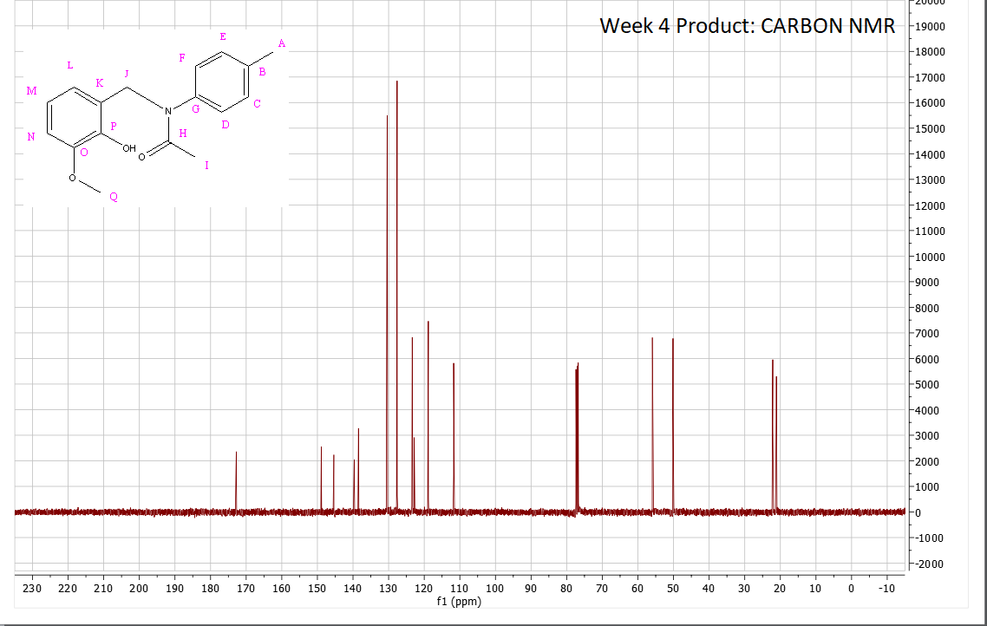

Synthesis of N-(2-hydroxy-3-methoxybenzyl)-N-p-tolylacetamide Through Reductive Amination
Matilda M Delgado, Angela M Martell, Michael P Miller, Fern E Schrader. Brian Patenaude, Nick Arnista and Erik B. Berda. Chemistry 550, Department of Chemistry, University of New Hampshire.
Introduction
Results
Discussion
  The synthesis of amines is a widely used reaction in synthetic chemistry that can be applied to uses with biological molecules and the drug industry. The process of reductive animation itself is a form of animation that converts a carboxyl group to an amine via an intermediate imine (Reusch, 2019). Their pharmaceutical development has led to the creation of analgesics like Morphine and Demerol to relieve pain (Lawrence 2004). Many amines are used in industry for pest control and tanning of leather. Due to the various industrial applications of amines, it is essential to explore faster and more quantitative methods of synthesizing them
Running the reaction steps with an acid catalyst for the initial imine formation reaction, with methanol as the solvent for the reduction step, and with the recrystallization steps removed from the procedure all improved yield when done separately
Any combination of methanol with the acid catalyst showed reduced yield, so it was concluded that the combination of these optimizations were not a valid improvement
Addition of the acid catalyst showed a qualitative improvement of imine formation speed without the normal byproduct of a watery intermediate state
Conditions | Average percent Yield (%)
Original | 57.63%
Acid Catalyst | 75.65%
Methanol | 75.00%
Removal of Recrystallization | 83.12%
All optimizations | 73.56%
Yields from Varying Lab Sections
Optimization | Yield (%) | Yield (%) | Yield (%) | Yield (%) | Average Yield (%)
Original | - | 90.20 | 22.60 | 60.10 | 57.63
Acid Catalyst (1) | - | - | 70.3 | 81.00 | 75.65
Methanol (2) | - | - | - | 75.00 | 75.00
Removal of Recrystallization (3) | 66.00 | 87.30 | 64.00 | 96.07 | 83.12
(1) & (2) | 64.00* | 47.80 | - | - | -
(2) & (3) |  | 99.40* | - | - | -
All optimizations | 60.7 | 79.34 | 90.10 | 85.1 | 73.56
  Figure 5: Summary chart of the optimizations and corresponding experimental yields.
HCl
MeOH
  Overall, the three optimizations combined resulted in an improved yield from the original reaction.
  The removal of the recrystallization step increased the yield the most of the individual optimizations (83.12%) and maintained a pure product (Figure 3,4)
  Methanol individually was the least effective optimization and resulted in impurities in some reaction runs.
Scheme 1: Synthesis of N-(2-hydroxy-3-methoxybenzyl)-N-p-tolylacetamide from o-vanillin and p-toluidine
Methods
The procedure built on Touchette’s design (2006) by adding an acid
catalyst, replacing ethanol with methanol and foregoing the
recrystallization.
Scheme 2: The yields of experiments featuring each individual optimization step and experiments that combined optimizations (Impure products indicated by *)
Summary and Conclusions
DATA
DATA
An acid catalyst improves the average yield of the reductive amination through the optimization of the imine production.
The removal of the recrystallization steps optimized the yield and did not impact the purity of the synthesized product.
Future work could explore the use of NaCNBH3 or decaborane as a milder reducing agent. (Yoon et. Al, 2000)
Figure 1: Proposed mechanism for the synthesis of N-(2-hydroxy-3-methoxybenzyl)-N-p-tolylacetamide
Compound | Cost/unit | Total Amount used (14 runs) | Cost/Total amount used | Amount for one run | Cost/one run
O-vanillin | $40.5/100 g | 10.640 g | $4.31 | 0.760 g | $0.31
p-toluidine | $186/100 g | 7.560 g | $14.06 | 0.54 g | $1.00
Methanol | $60.30/1000 mL | 280 mL | $16.88 | 20 mL | $1.21
NaBH4 | $24.30/10 g | 1.400 g | $3.40 | 0.100 g | $0.24
Acetic Acid | $9.67/950 mL | 28 mL | $0.29 | 2 mL | $0.02
Acetic anhydride | $53.25/500 mL | 28 mL | $ 2.98 | 2 mL | $0.21
HCl | $13.47/500 mL | 0.7 mL | $0.02 | 0.05 mL | $0.01
NMR | $15/hr | 8 hrs | $120 | 1 hr | $15
 |  | Total Cost | $161.94 | Cost ~1 g product | $18.00
Figure 3: Proton and Carbon NMR data from the
week 4 product (all optimizations)
Acknowledgements
Figure 4: The IR data of the final product which featured key peaks at 1629.99 cm⁻¹ and 3298.16 cm⁻¹
This research was supported by Brian Patenaude, Nick Arnista and Erik B. Berda of the Chemistry Department at the University of New Hampshire.
Supporting data from Proton and Carbon NMRs showed that the product from the original reaction was consistently retained in the optimizations; NMR data differed very little as the experimental changes were made
Additional IR data further supported the consistency of the product by indicating key peaks found in the product and excluding peaks that were typical of any reactant structures that could have been impurities (amine peaks)
References
Reusch, William.Preparation of Amines. Michigan State University. 2019.
Lawrence, Stephen A. Amines: synthesis, properties and applications. Cambridge University Press, 2004.
Touchette, K. M. Reductive Amination: A Remarkable Experiment for the Organic Laboratory. Journal of Chemical Education. 2006, 83 (6), 929-930, Hudson, NY.
Bae J. W., Lee S. H., Cho Y. J., Yoon C. M., J. Chem. Soc., Perkin Trans. 1, 2000, 145.
Zhu G., Zhang X. Tetrahedron Asym., 1998, 9, 2415
Figure 2: Cost analysis for the synthesis of N-(2-hydroxy-3-methoxybenzyl)-N-p-tolylacetamide

