Slide 1

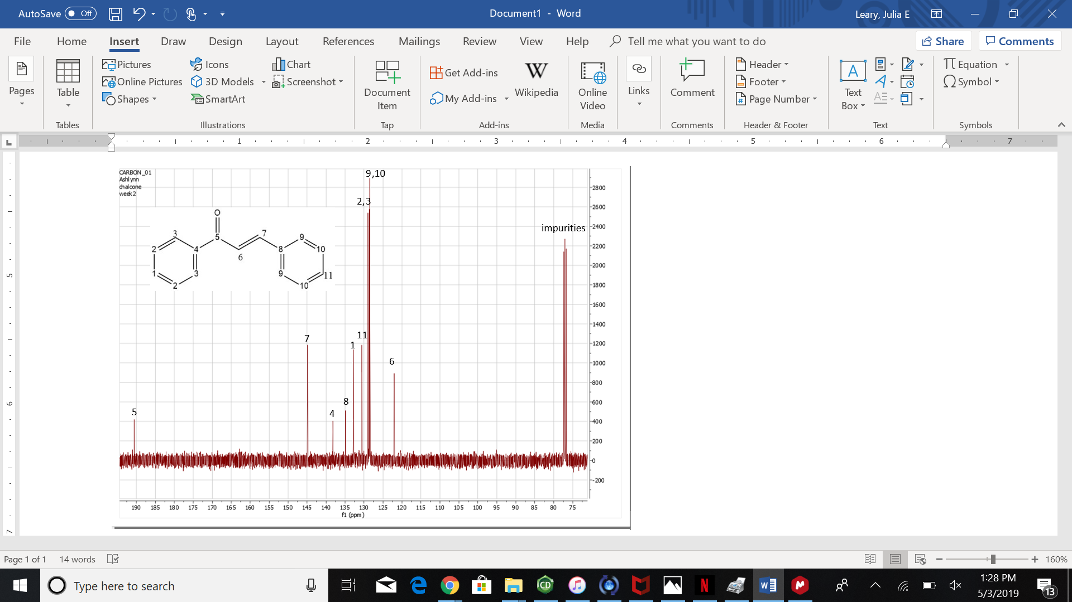
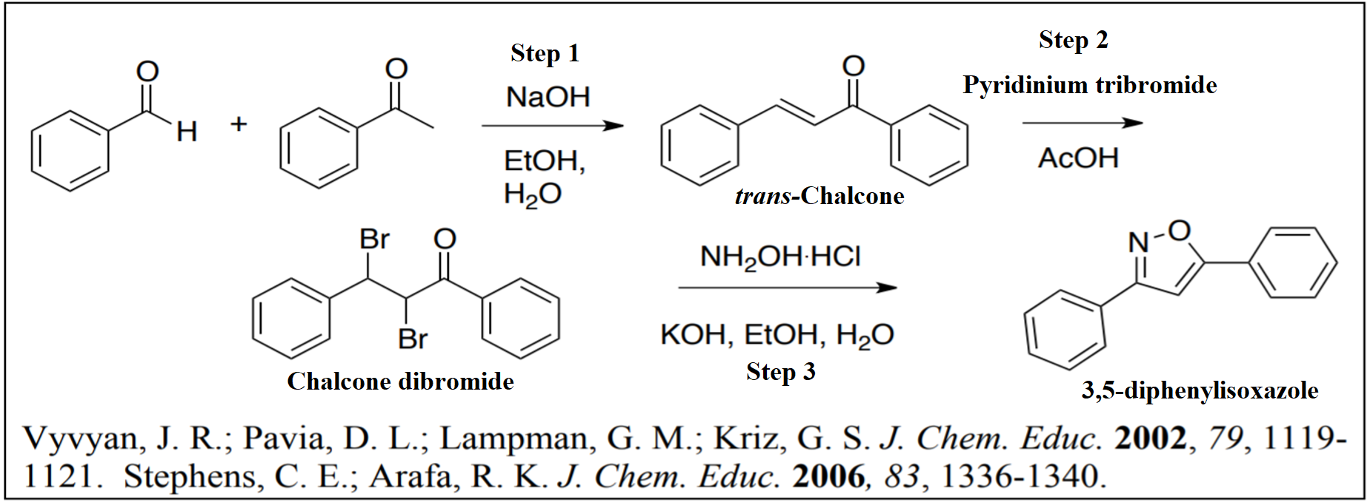
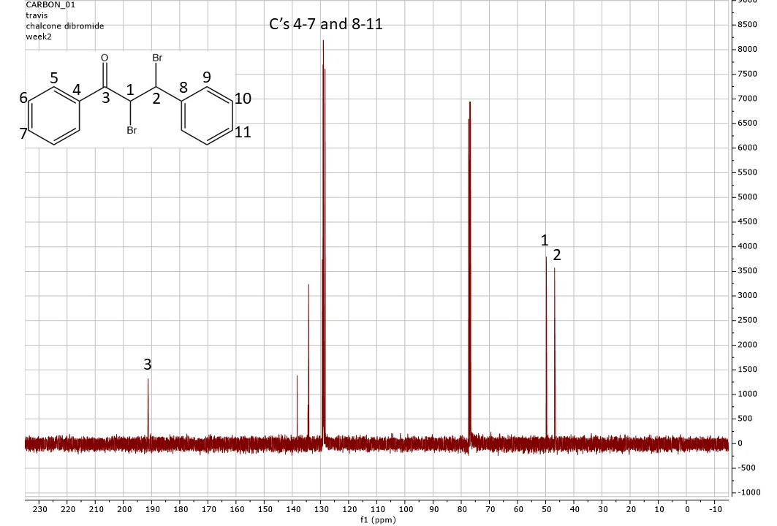
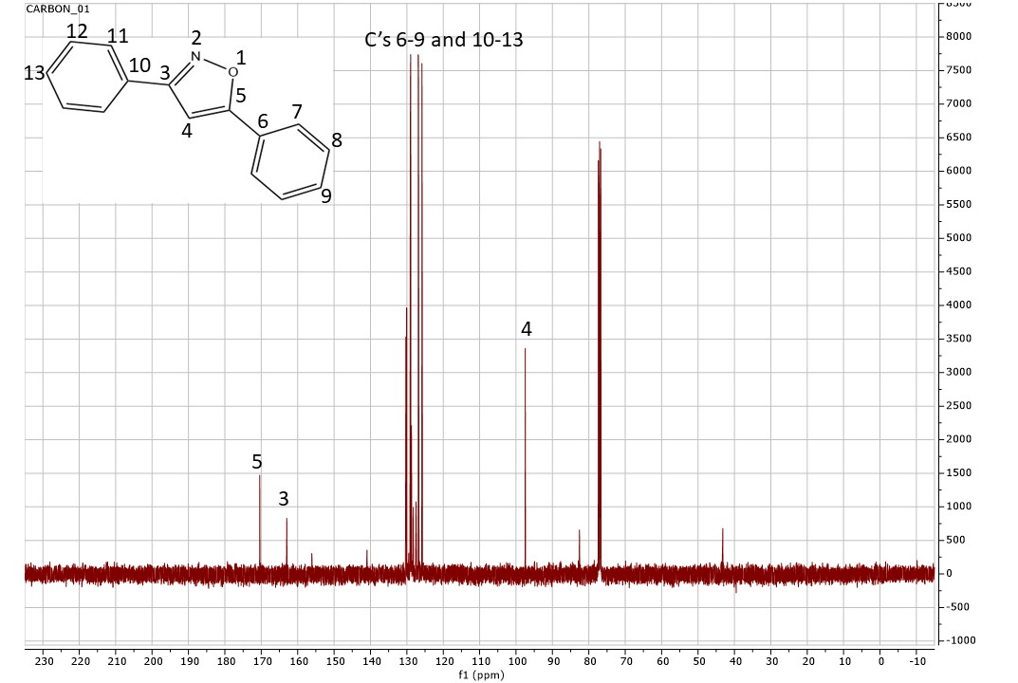
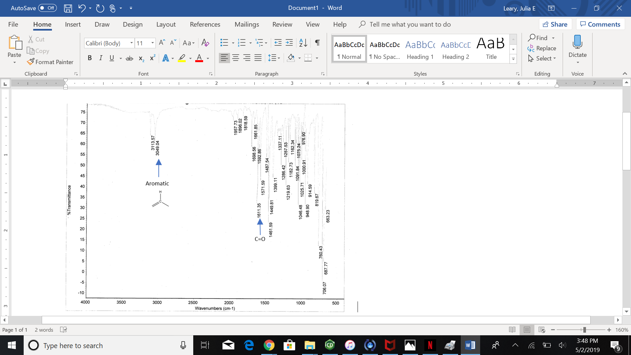
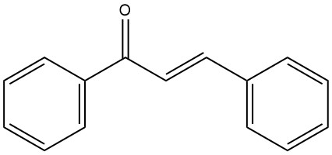
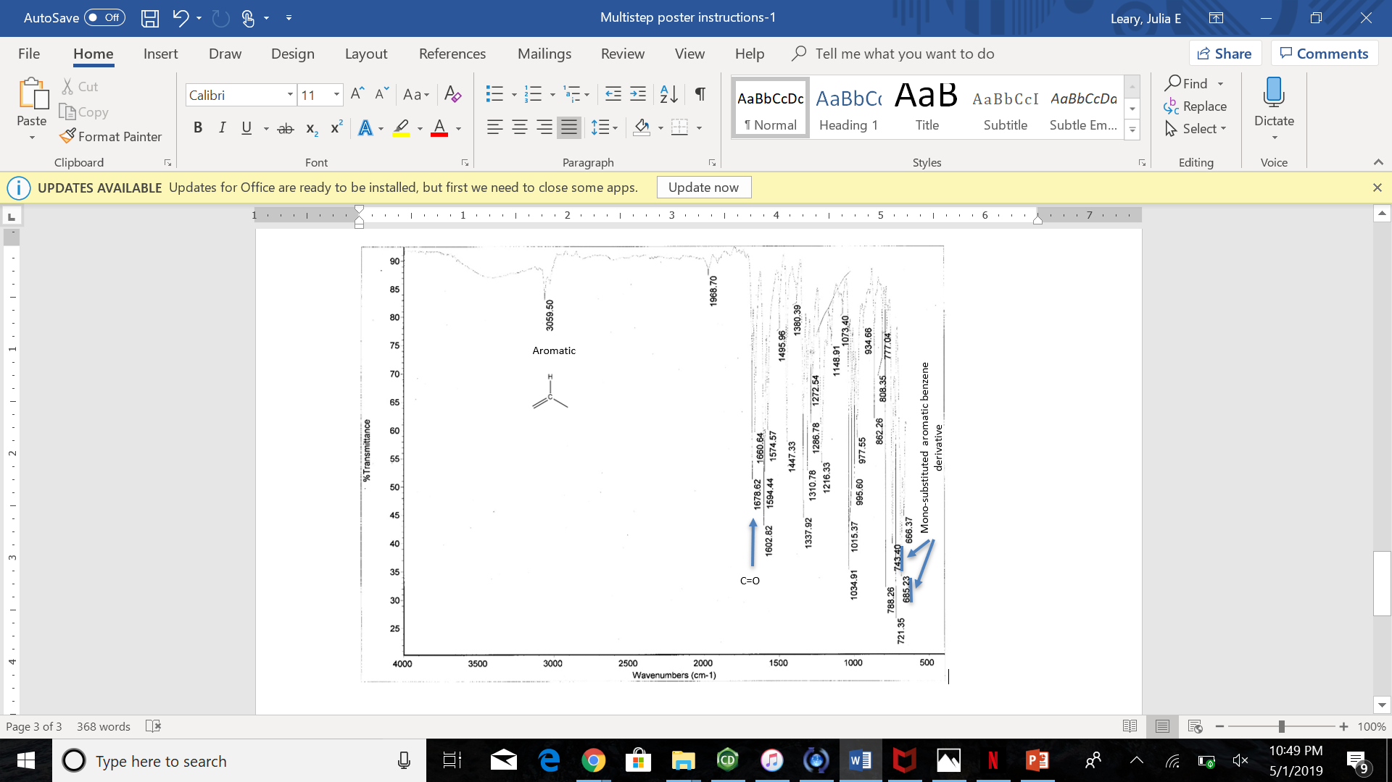
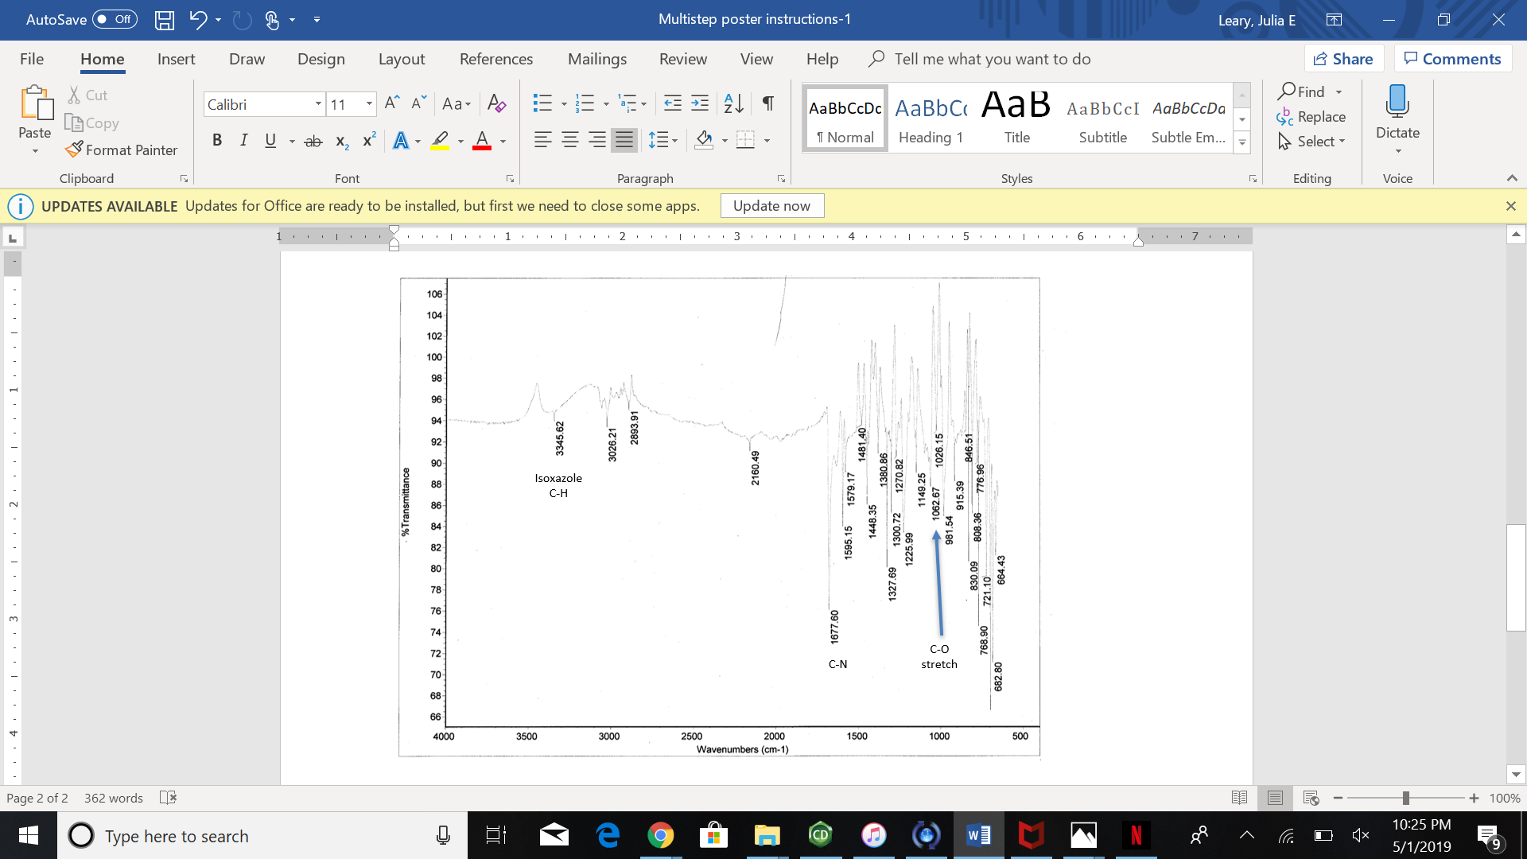

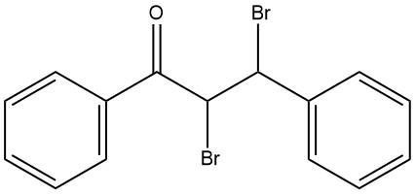
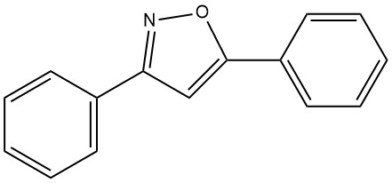
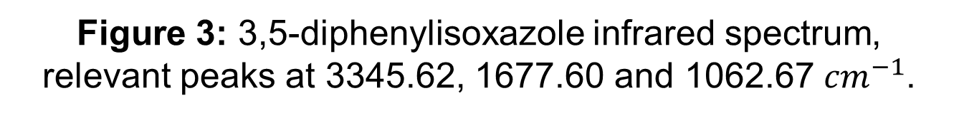
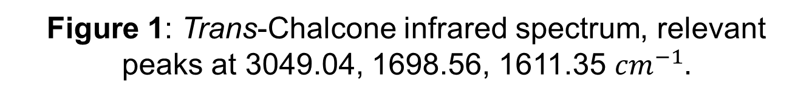
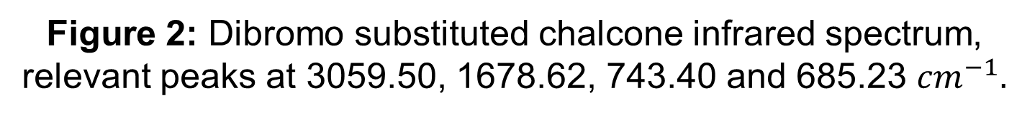
Just a Bunch of Azoles: Analysis of and Optimization Options for the Three-Step Synthesis of 3,5-Diarylisoxazole
Andrea L. Cote, Travis D. Fischer, Julia E. Leary, Kelsey C. Mercurio, Brian Patenaude, Nick Arnista, and Erik B. Berda. Chemistry 550, Department of Chemistry, University of New Hampshire.
Introduction
Results
Discussion
  This experiment focused on the synthesis of 3,5-diphenylisoxazole and the three subsequent optimizations of the reactions. Isoxazole structures are found very commonly in the structures of drugs, including potential chemotherapeutics^{1,} anti-diabetic compounds² and anti-inflammatory analgesics.³ The beginning steps of the synthesis involved the creation of a chalcone followed by bromination. Chalcones are aromatic ketones, which are useful precursors for the production of isoxazoles. They have been widely studied for their role as primary scaffolds in many natural products, and as fluorescent chemical probes. ⁴
To determine the purity of the compounds produced after each step and to confirm that the final product was the desired product, a ¹³C-NMR was performed after each step.
A ¹H-NMR was also obtained after each step in the synthesis. However, the results were unclear and the graphs were not able to be interpreted correctly due to excessive amounts of background and other impurities in the samples. Therefore, analysis and characterization of final products relied on data from the ¹³C-NMR
Step | % Yield | Optimization | % Yield
1: Chalcone Synthesis | 97.5% | Mortar and pestle | 91.7%
2: Bromination of Chalcone | 69.4% | Brominating Reflux | 66.9%
3: Diaryloxazole Synthesis | 52.2% 103.8% | Workup | 17.8%
Figure 5: Percent yields for the steps involved in the synthesis of 3.5-diphenylisoxazole, along with the yields percent yields for the optimizations performed
  The chalcone synthesis had a yield of 97.5%. When the solution-based synthesis was changed to use a solid-state approach, the yield was lowered to 91.7%.
  The bromination step of the synthesis resulted in a yield of 69.4%. After the solution was heated and refluxed to increase the solubility of the reactants and promote further completion of the reaction, the yield was 66.9%.
  For the third part of the synthesis, 103.8% yield was obtained; which indicates that the substance was impure. However, the best earlier attempt resulted in a 23.9% yield (52.2% crude). This optimization altered the extraction method in an attempt to recrystallize more of the product out of solution. This optimization resulted in a 17.8% yield, which was significantly less than the original method.
Figure 4: Carbon NMR of trans-chalcone provided by A. Gatto, R. Zhong, R. Puterbaugh, M. E. MacMillan
Scheme 1: Synthesis of compound 3,5-diphenylisoxazole.
Methods
The optimization of the chalcone synthesis employed the use of a mortar and pestle to perform the reaction with solid-state chemistry. This method was employed to preserve solvent and transform the reaction to consider greener chemistry as well as creating a more direct interaction between reactants possibly resulting in higher yield.
The original synthesis of the chalcone dibromide consisted of the reaction occurring while the pyridinium tribromide was still being dissolved. To decrease the required amount of acetic acid and increase the amount of bromine able to react with the chalcone, a reflux was run. Refluxing allows for the system to be heated without losing product. The optimization utilized the increased solubility of the pyridinium tribromide when exposed to heat and provided minimal loss of product that usually occurs when heating a reaction.
The 3,5-diphenylisoxazole optimization involved a modified workup procedure. In this, precipitated salts were removed by gravity filtration before extracting with diethyl ether and washing with brine. The organic extract was subsequently rotary evaporated to remove excess solvent before water was added to induce crystallization of the product.
Summary and Conclusions
Figure 5: Carbon NMR of chalcone dibromide
Figure 6: Carbon NMR of 3,5-diphenylisoxazole.
None of the optimizations improved the yield of the individual steps. The solid-state synthesis using a mortar and pestle however, only saw a slight decrease in yield, and could be improved with practice and/or the use of a ball mill.
The addition of the reflux step to the chalcone dibromide synthesis slightly reduced the percent yield. In future attempts, adding more water to further precipitate out the product may be a plausible and helpful modification.
The added extraction and workup for the final step resulted in a yield which was significantly less than the original procedure. To better isolate the desired product in the future, longer rotary evaporation may be more effective.
Infrared spectroscopy analysis was utilized to confirm the identity of each product and to test the purity of each sample. For example, IR analysis was used to determine the completion of the chalcone synthesis by confirming the lack of sp³ or aldehyde C-H peaks in the range of 2850-2980. IR analysis for the second and third steps were additionally compared to the expected spectra in the report by Stephens and Arafa (2006) to confirm proper product synthesis and purity status.
Figure 1: Trans-Chalcone infrared spectrum, relevant peaks at 3049.04, 1698.56, 1611.35 ${cm}^{−1}.$
Acknowledgements
Cost Analysis
We would like to thank the UNH Department of Chemistry for funding this research with our $90 lab fee that we pay each semester.
Water: free Ethanol (212 mL): $1.60 0.03 mole (3.183 g) Benzaldehyde: $0.07 0.03 mole (3.604 g) Acetophenone: $0.20 100 mL Glacial Acetic Acid: $1.14 | 0.015 moles (4.797 g) Pyridinium Hydrobromide Perbromide: $3.32 1.4 g Hydroxylamine hydrochloride: $0.13 3.4 g KOH: $0.20
References
1. Brough, P. A.; Aherne, W.; Barril, X. et al. 4,5-Diarylisoxazole Hsp90 Chaperone Inhibitors: Potential Therapeutic Agents for the Treatment of Cancer. J. Med. Chem. 2008. 51 (2), pp 196–218
2. Kumar, A.; Maurya, R. A.; Sharma, S.; Ahmad, P.; Singh, A. B.; Tamrakar, A. K.; Srivastava, A. K. Design and synthesis of 3,5-diarylisoxazole derivatives as novel class of anti-hyperglycemic and lipid lowering agents. Bioorg. Med. Chem. 2009. 17 (14), pp 5285-5292.
3. Habeeb, A. G.; Rao, P. N. P.; Knaus, E. E. Design and syntheses of diarylisoxazoles: Novel inhibitors of cyclooxygenase‐2 (COX‐2) with analgesic‐antiinflammatory activity. J. Drug. Dev. Res. 2000. 51:273–286.
4. Zhuang C.; Zhang, W.; Sheng, C; Zhang, W.; Xing, C.; Miao, Z. Chalcone: A Privileged Structure in Medicinal Chemistry. Chem. Rev. 2017. 117 (12).
5. Vyvyan, J. R.; Pavia, D. L.; Lampman, G. M.; Kriz, G. S. Preparing Students for Research: Synthesis of Substituted Chalcones as a Comprehensive Guided-Inquiry Experience. J. Chem Educ. 2002, 79 (9), p 1119.
6. Stephens, C. E.; Arafa, R. K. 3,5-Diarylisoxazoles: Individualized Three-Step Synthesis and Isomer Determination Using 13C NMR or Mass Spectroscopy. J. Chem Educ. 2006. 83 (9), p 1336.
Total: $6.66/6.638 g = $1.00 per gram
Figure 2: Dibromo substituted chalcone infrared spectrum, relevant peaks at 3059.50, 1678.62, 743.40 and 685.23 ${cm}^{−1}.$
Figure 3: 3,5-diphenylisoxazole infrared spectrum, relevant peaks at 3345.62, 1677.60 and 1062.67 ${cm}^{−1}$.

