Slide 1

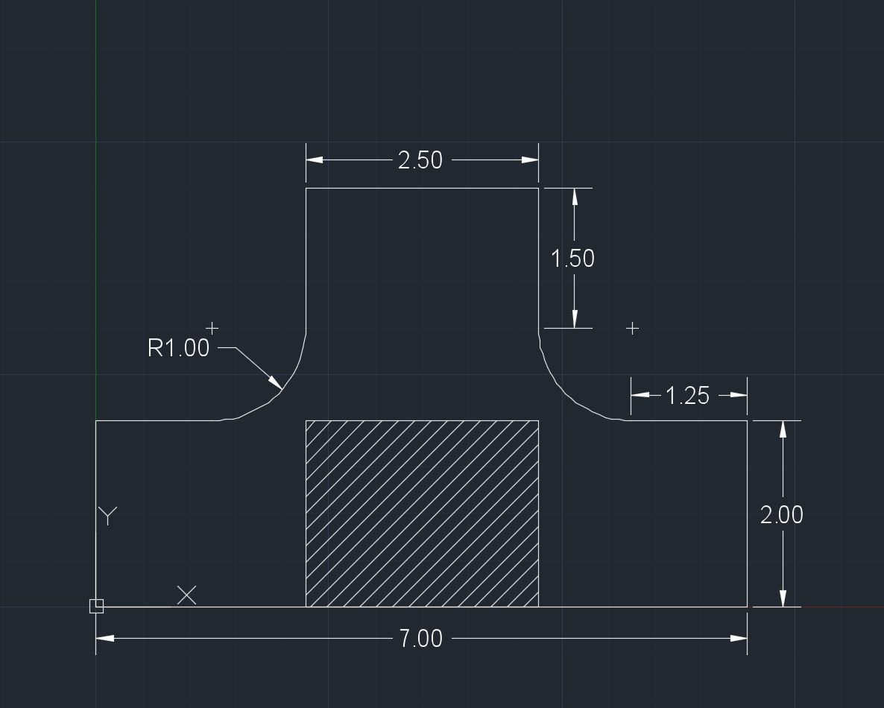
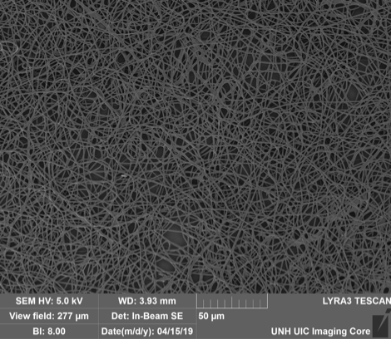
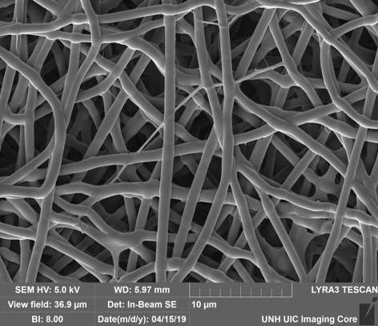
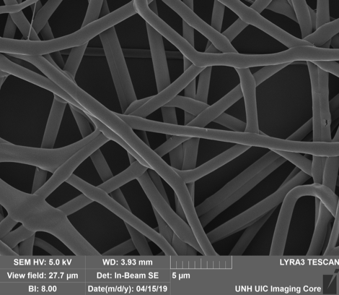
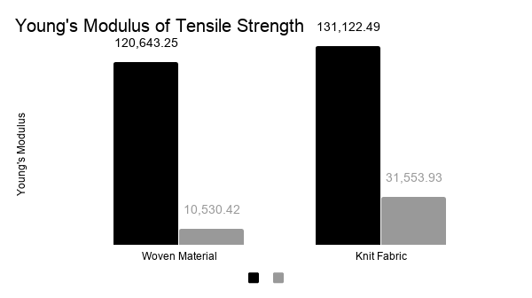
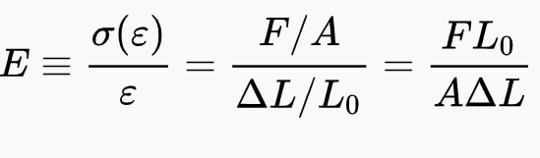
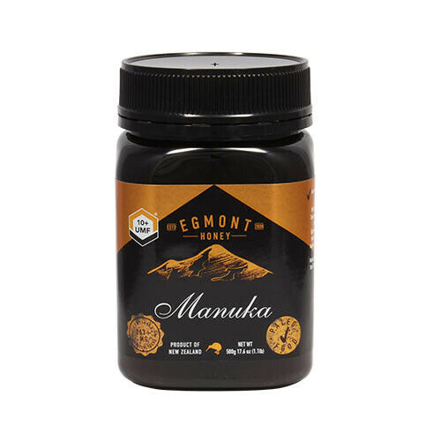
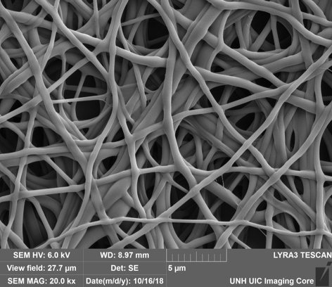
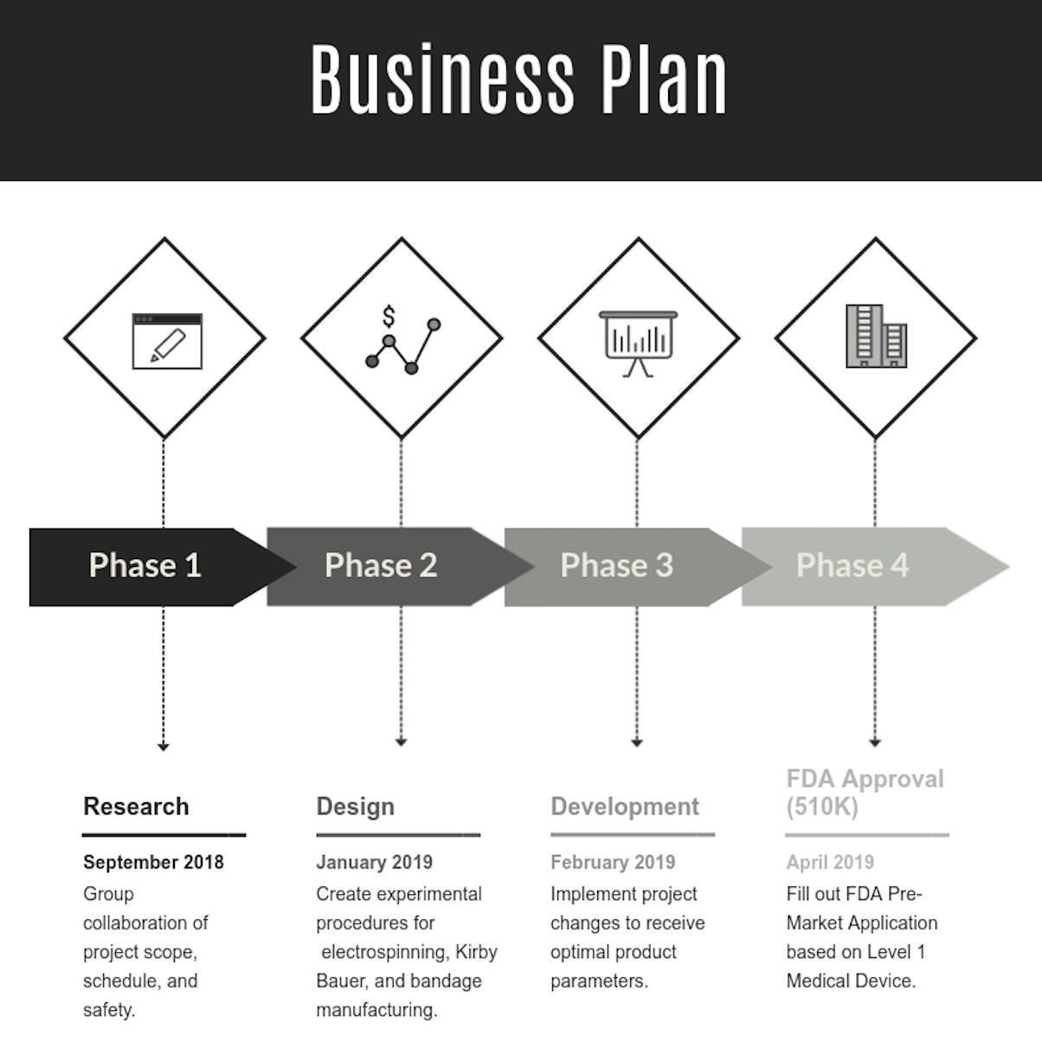

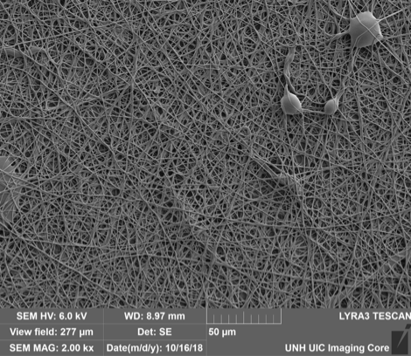
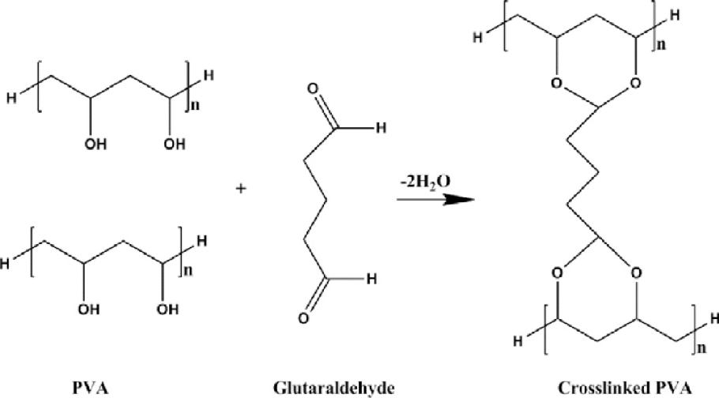
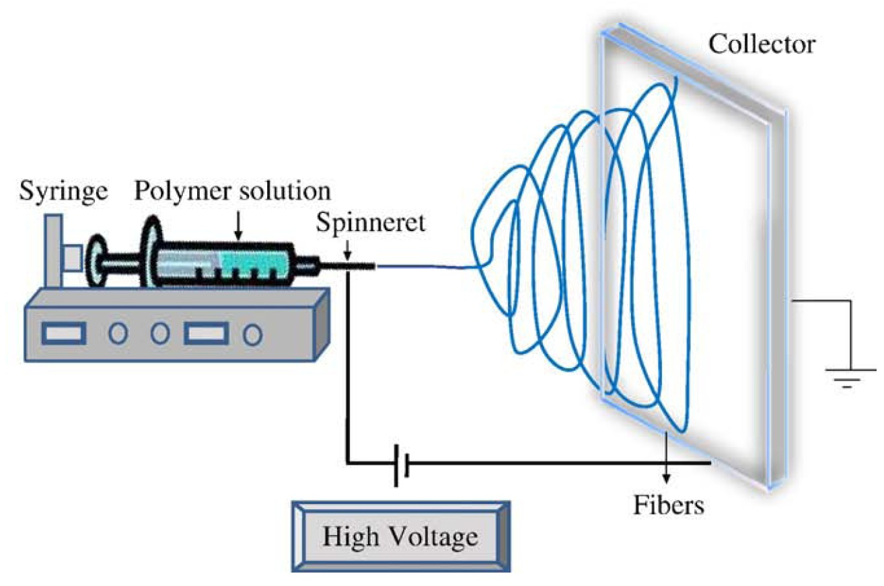
Manuka Honey Anti-bacterial Fingertip Bandage
Department of Bioengineering |University of New Hampshire, Durham, NH
Krystal Burbank, Tyler Janko, Brian Piekutowski, Christine Spaulding, Tingman Zhu
Project Scope
Bandage Shape
Step 1
Step 3
Step 4
Step 2
Electrospinning of Nanofibers
The Manuka Honey bandage is designed to provide users a newly improved fingertip fit to ensure customer comfort. Manuka Honey is electrospun into fibers and incorporated into the bandage gauze to promote anti-bacterial properties throughout the healing process.
User Application
1kX
7.5kX
10kX
Capturing the Market
AutoCAD Layout
Young’s Modulus is a measurement used to determine the tensile strength of an object or material. It is determined by the ratio of stress over strain.
Using a spring scale, the “force until material breakage” was measured and compared with the associating length displacement of the material, which was measured with a caliper.
The Knit Fabric bandage showed greater tensile strength, and seemed to be a more durable and suitable choice for material.
Expedited Recovery
Industry Manufacturers
Maintaining Sterility
Chefs
Minimize Risk of Infection
Commercial Fishers
Pictures of the nanofibers were taken using a scanning electron microscope (SEM). A sample from a nanofiber mat was viewed at multiple regions and fibers were randomly selected to measure diameter.
The images above illustrate the magnification of a random region within the nanofiber sample: 1000X, 7500X, to 10,000X.
Why Manuka Honey?
Manuka Honey is specifically unique for containing hydrogen
peroxide and methylglyoxal, both of which kill bacteria
High viscosity acts as a protective barrier to prevent wound infections
High sugar content correlates to high osmolarity and stunts the growth of microbes
Stimulates macrophages that secrete TNF to expedite wound healing process
Electrospinning and Crosslinking
Honey/ PVA
Nanofibers were created using the electrospinning process; electrospinning requires a solution viscous enough to maintain a fibrous structure, yet fluid enough to flow through a syringe. Polyvinyl alcohol, a biocompatible polymer, was added to Manuka honey to create a solution that maximized the concentration of honey while maintaining the requirements needed for electrospinning.
Successful solution: 20 wt% Manuka honey and 8 wt% polyvinyl alcohol using the following parameters: 27 gauge needle, 18kV, 0.04mL/h, and 5 inches from plate.
PVA
Safety
10kX
Biosafety Level 2 (BSL-2) Certification
Non-pathogenic bacteria: Escherichia coli and Staphylococcus
Polyvinyl alcohol(PVA), glutaraldehyde, and acetic acid
Electrospinning needle sharps
Solutions formulated in Biological Safety Cabinet with PPE
Polyvinyl alcohol is a water soluble polymer, therefore crosslinking of the polymer is necessary to avoid dissolution. Chemical crosslinking of the fiber was done using glutaraldehyde in a desiccator; once with a vacuum, once without.
In both trials, the nanofibers dissolved after attempted crosslinking. This is possibly due to too much water in the glutaraldehyde solution or the fact that an acid catalyst was not used.
1kX
Average diameter: 0.62µm
Average diameter: 1.02µm
Escherichia coli
Staphylococcus aureus
Conclusion
Antimicrobial Testing: Kirby Bauer
Solution Index
A : Autoclaved Water
B : Neosporin
C: Manuka Honey
Optimal Electrospinning fibers designed using syringe solution of 20 wt% Manuka Honey, 8 wt% polyvinyl alcohol
27 gauge needle allowed solution to spin to effective nanofibers using a consistent voltage of 18kV
Manuka Honey is effective against killing Escherichia coli strands per Kirby Bauer Zone of Inhibition test
Electrospinning Technology
A method of fiber production that uses high voltage to draw a charged thread of polymer onto a collection plate.
Adjustable Parameters:
Voltage
Flow rate of solution
Solution in syringe
Distance from collector plate
Size of syringe
Future Work
Research and experiment alternative crosslinking techniques to prevent dissolving of fibers
Test anti-microbial properties using additional various strands of bacteria found in wounds
IRB review to tests on human subjects
The antibacterial ability of the Manuka honey bandage tested against Gram-positive bacterium Staphylococcus aureus and Gram-negative bacterium Escherichia coli with a Kirby Bauer test using autoclaved deionized water as the negative control and antimicrobial ointment, Neosporin, as the positive control.
Zone of Inhibition was measured with a caliper, diameters of zone were compared
Anti-microbial property of Manuka Honey is superior to the positive control, Neosporin.
Awknowledgments
We would like to thank our Senior Advisor Dr. Russell Carr, Dr. Kang Wu, Dr. Kyung Jae Jeong, and Nancy Cherim for assistance with SEM.

