Slide 1

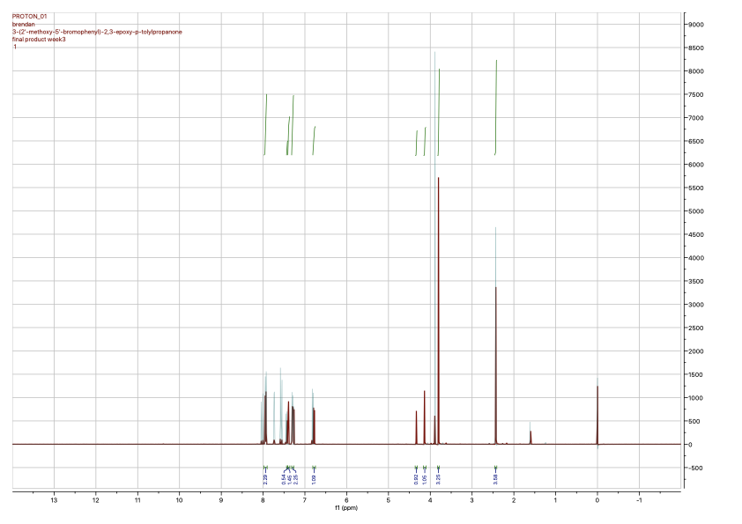
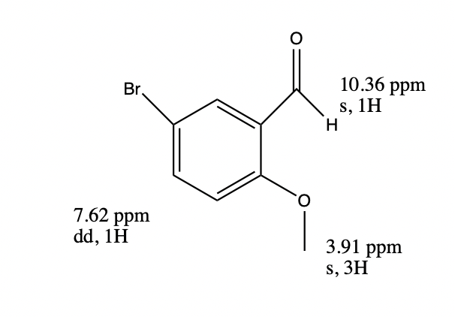
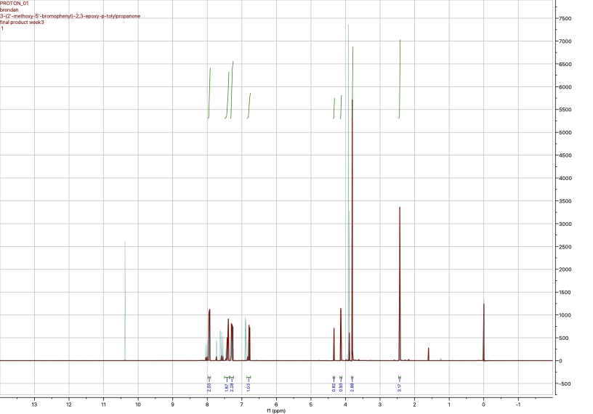
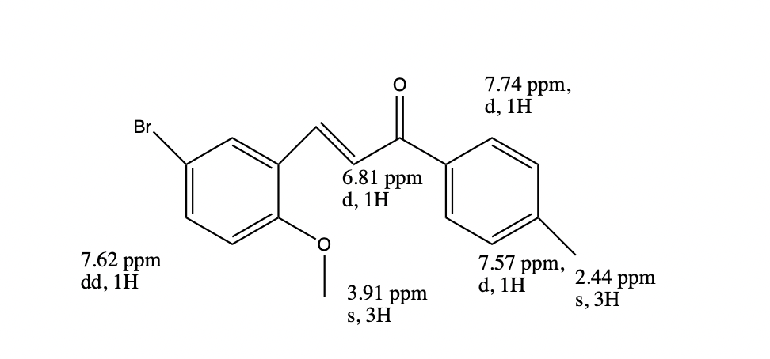
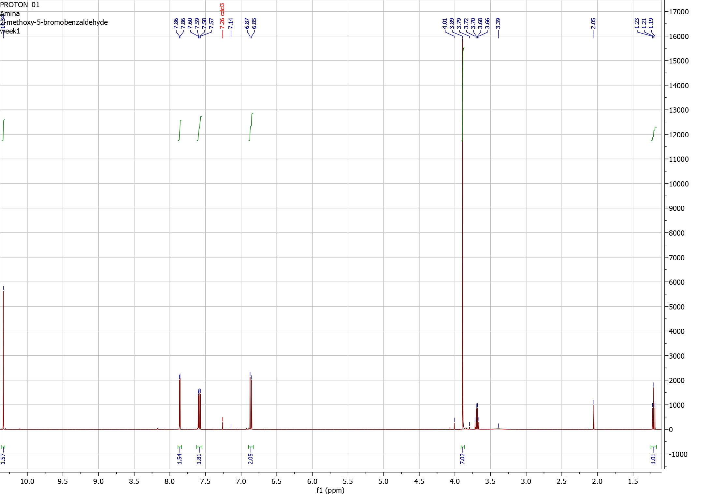
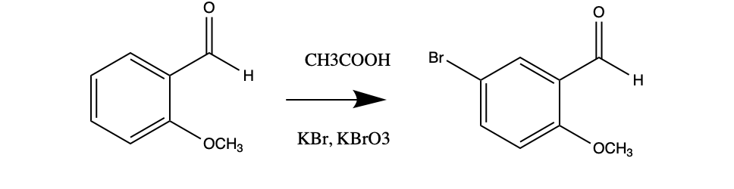
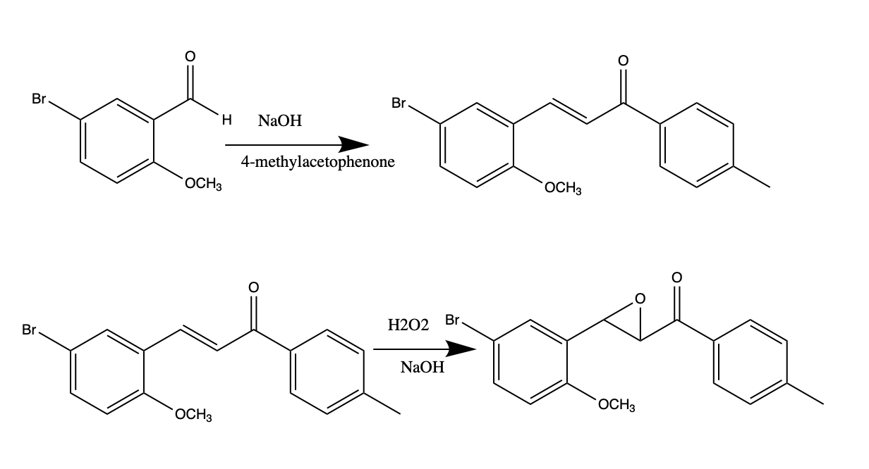
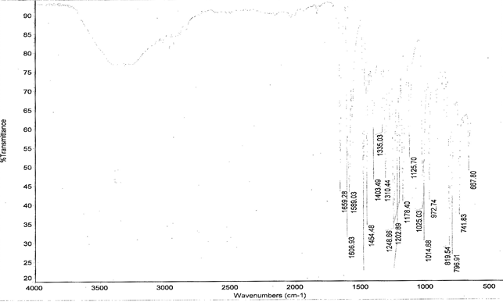
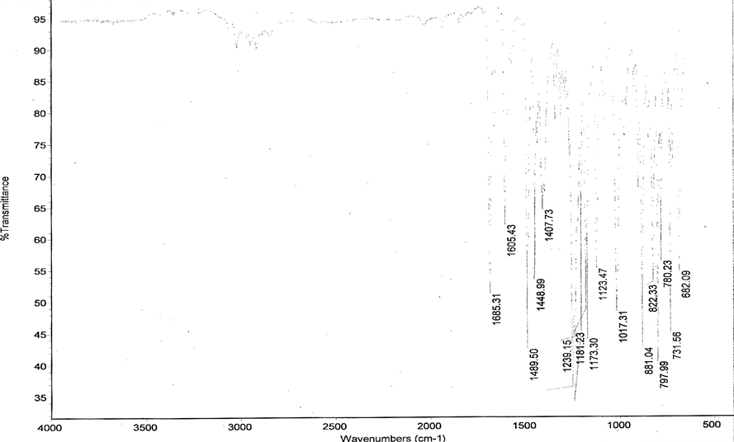
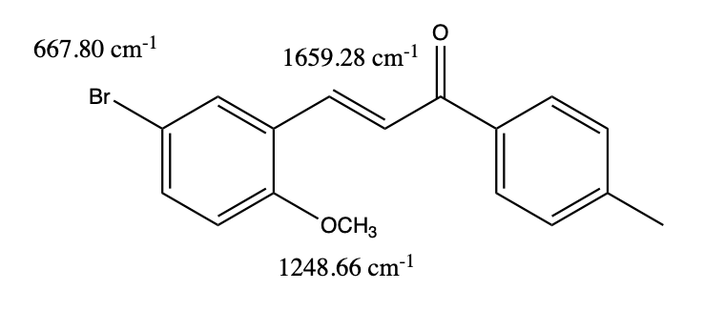
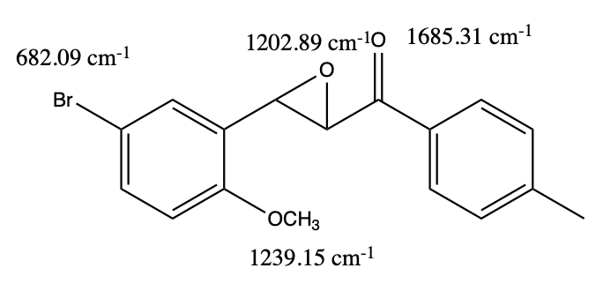

Optimization of the Synthesis of 3-(2’-methoxy-5’-bromo-phenyl)-2,3-epoxy-p-tolylpropanone
Amina Gusic, Jessica A. Douillette, Brendan L. Murphy, Jayce K. Knapik; Nick Arnista, Brian Patenaude, and Erik B. Berda. Chemistry 550, Department of Chemistry, University of New Hampshire.
Introduction
Results
Discussion
The objective of this experiment was to optimize all three steps in the synthesis of an epoxidized chalcone derivative. Optimizations were made to the reflux of step 1, recrystallization of step 2, and molar ratios of step 3.
Modification of step one yielded 41.1% when refluxed for 45 minutes and 73.0% after reflux of one hour. The second step optimization yielded 48.3% showing little improvement. However, the optimization of the final step increased the yield from 34.1% to 73.7%. ¹H NMR, ¹³C NMR, IR and TLC were used in the analysis to identify the compounds, monitor the reaction, and determine purity of the final product.
  The first optimization of refluxing longer, for 45 and 60 minutes, was justified based on the idea that longer reflux would allow the reaction to go to completion. The second optimization was supported by the original article because it was hypothesized that hot acetone and methanol (4 to 1 respectively) would act as a better solvent for recrystallization.
  The optimization for the third step of the synthesis was based off of research found on the epoxidation of chalcones.
  The stacked ¹H NMR spectra in Figure 1 of the of the chalcone and epoxidized chalcone confirm the epoxidation of the chalcone derivative into the final product. The absence of a peak at 10.36 ppm confirmed that the aldehyde of step 1 product reacted completely. The epoxidation of the chalcone was confirmed by ¹H NMR because of the appearance of two new singlets at 4.34 and 4.13 ppm which is representative of hydrogens.
Figure 1. Stacked H¹ NMR for chalcone and epoxidized chalcone products
Figure 4. H¹ NMR for brominated product, first step of the synthesis.
Optimized Step | Product Name | Product Yield | Melting Point
1 (45 minutes) | 2-methoxy-5-bromobenzaldehyde | 2.317g | 111.4-113.7 ֯C
1 (60 minutes) | 2-methoxy-5-bromobenzaldehyde | 3.944g | 111.5-112.6 ֯C
2 | 3-(2’-methoxy-5’-bromo-phenyl)-p-tolylprop-2-eno | 1.077g | 126.128.7 ֯C
3 | 3-(2’-methoxy-5’-bromo-phenyl)-2,3-epoxy-p-tolylpropanone | 0.417g | 121.1-123.8 ֯C
Methods
Summary and Conclusions
Scheme 1: Synthesis of 2-bromo-5-methoxybenzaldehyde
The results from this data illustrate that the first and last optimized steps showed an increase in the amount of product yielded. Carbon and proton NMRs were analyzed and interpreted to determine the structure of the products made in each step of the synthesis.
Acknowledgements
We would like to thank Professor Berda, Brian Patenaude, and Nick Arnista for all of their help.
References
Scheme 2: Synthesis and epoxidation of chalcone derivative
3-(2'-methoxy-5'-bromophenyl)-p-tolyl prop-2-enone
Figure 2. IR spectrum of step 2 product
Figure 3: IR Spectrum of step 3 product.
1. Dixon, C. E.; Pyne, S. G. Journal of Chemical Education 1992, 69 (12), 1032.
2. Moloney, G. P. Journal of Chemical Education 1990, 67 (7), 617.

