Slide 1


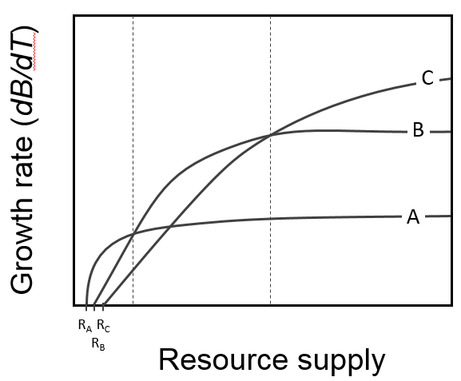
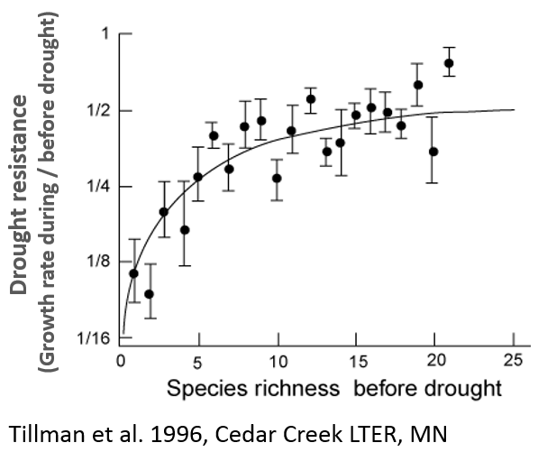
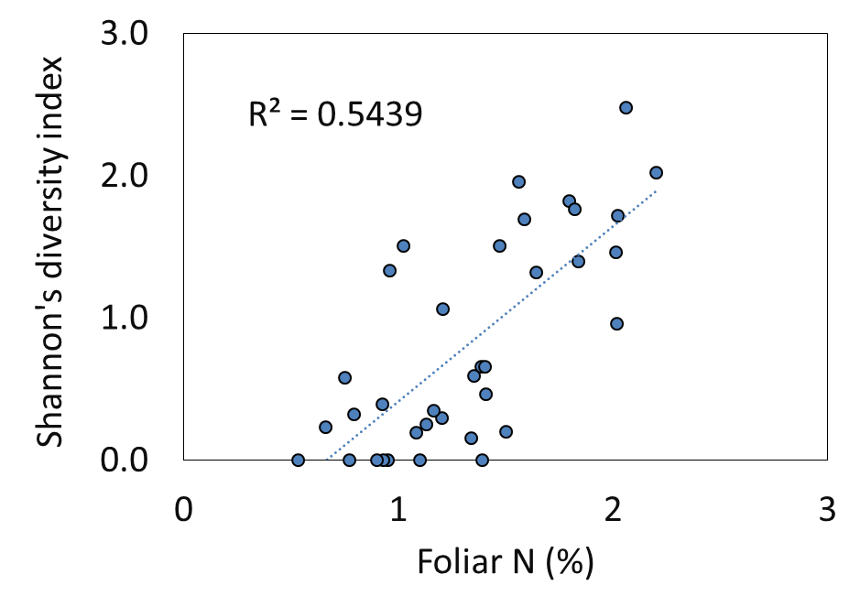
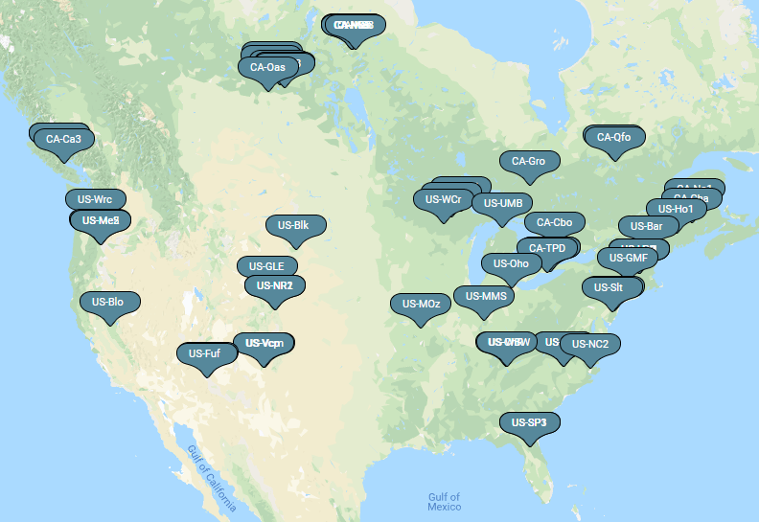
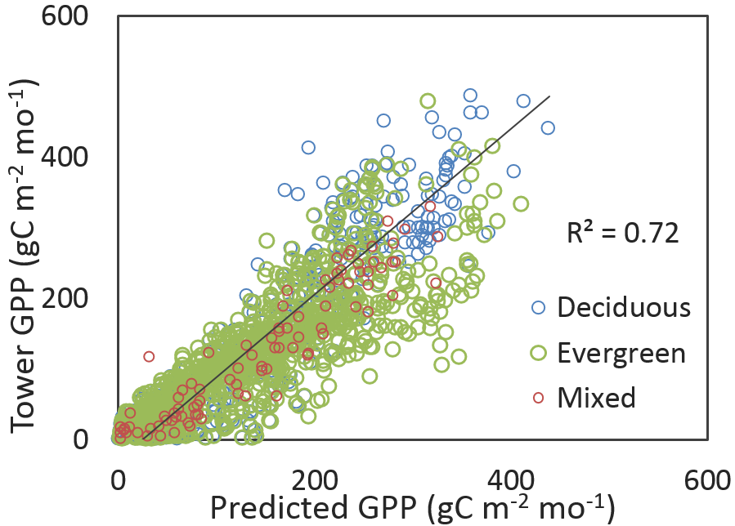
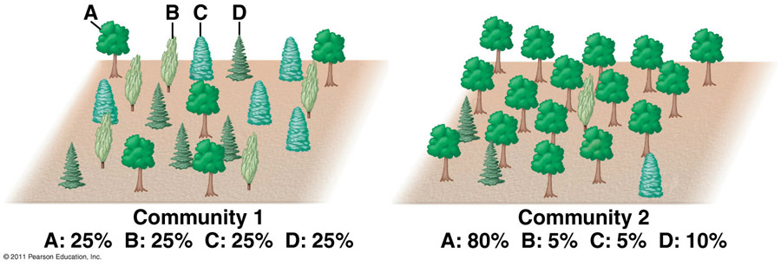
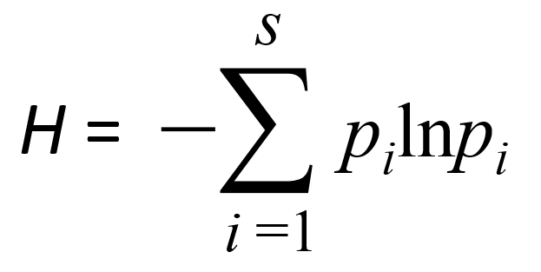
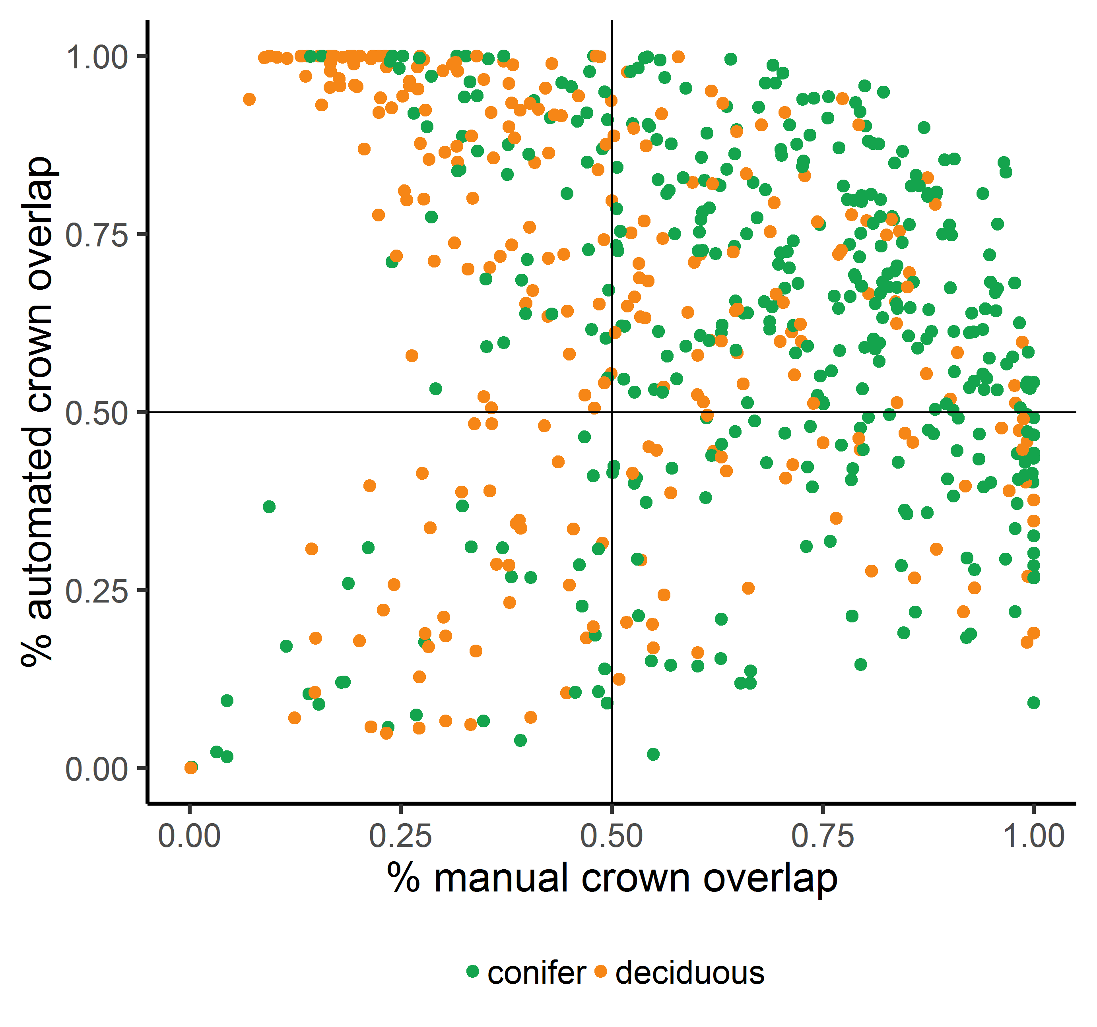
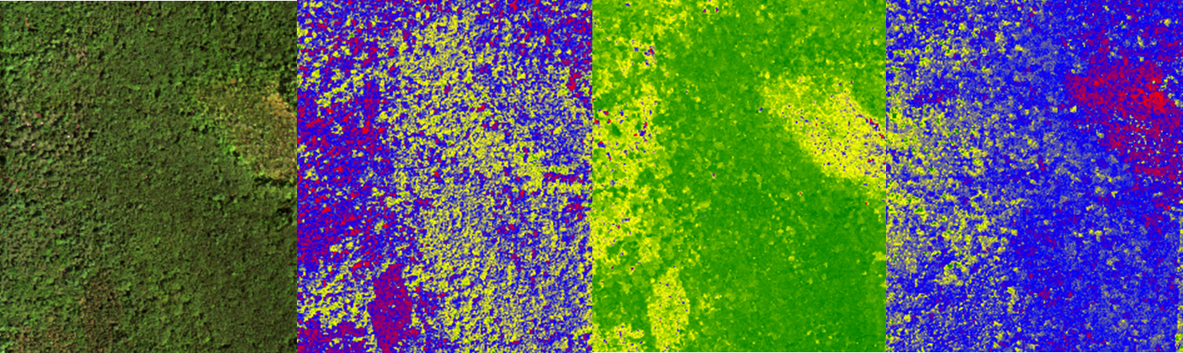
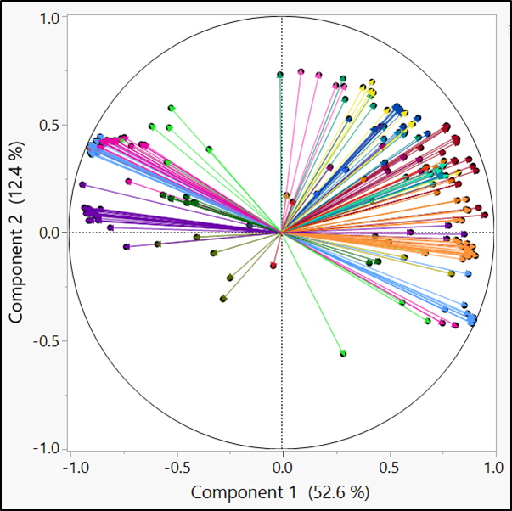
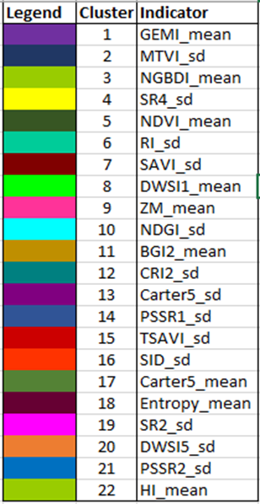
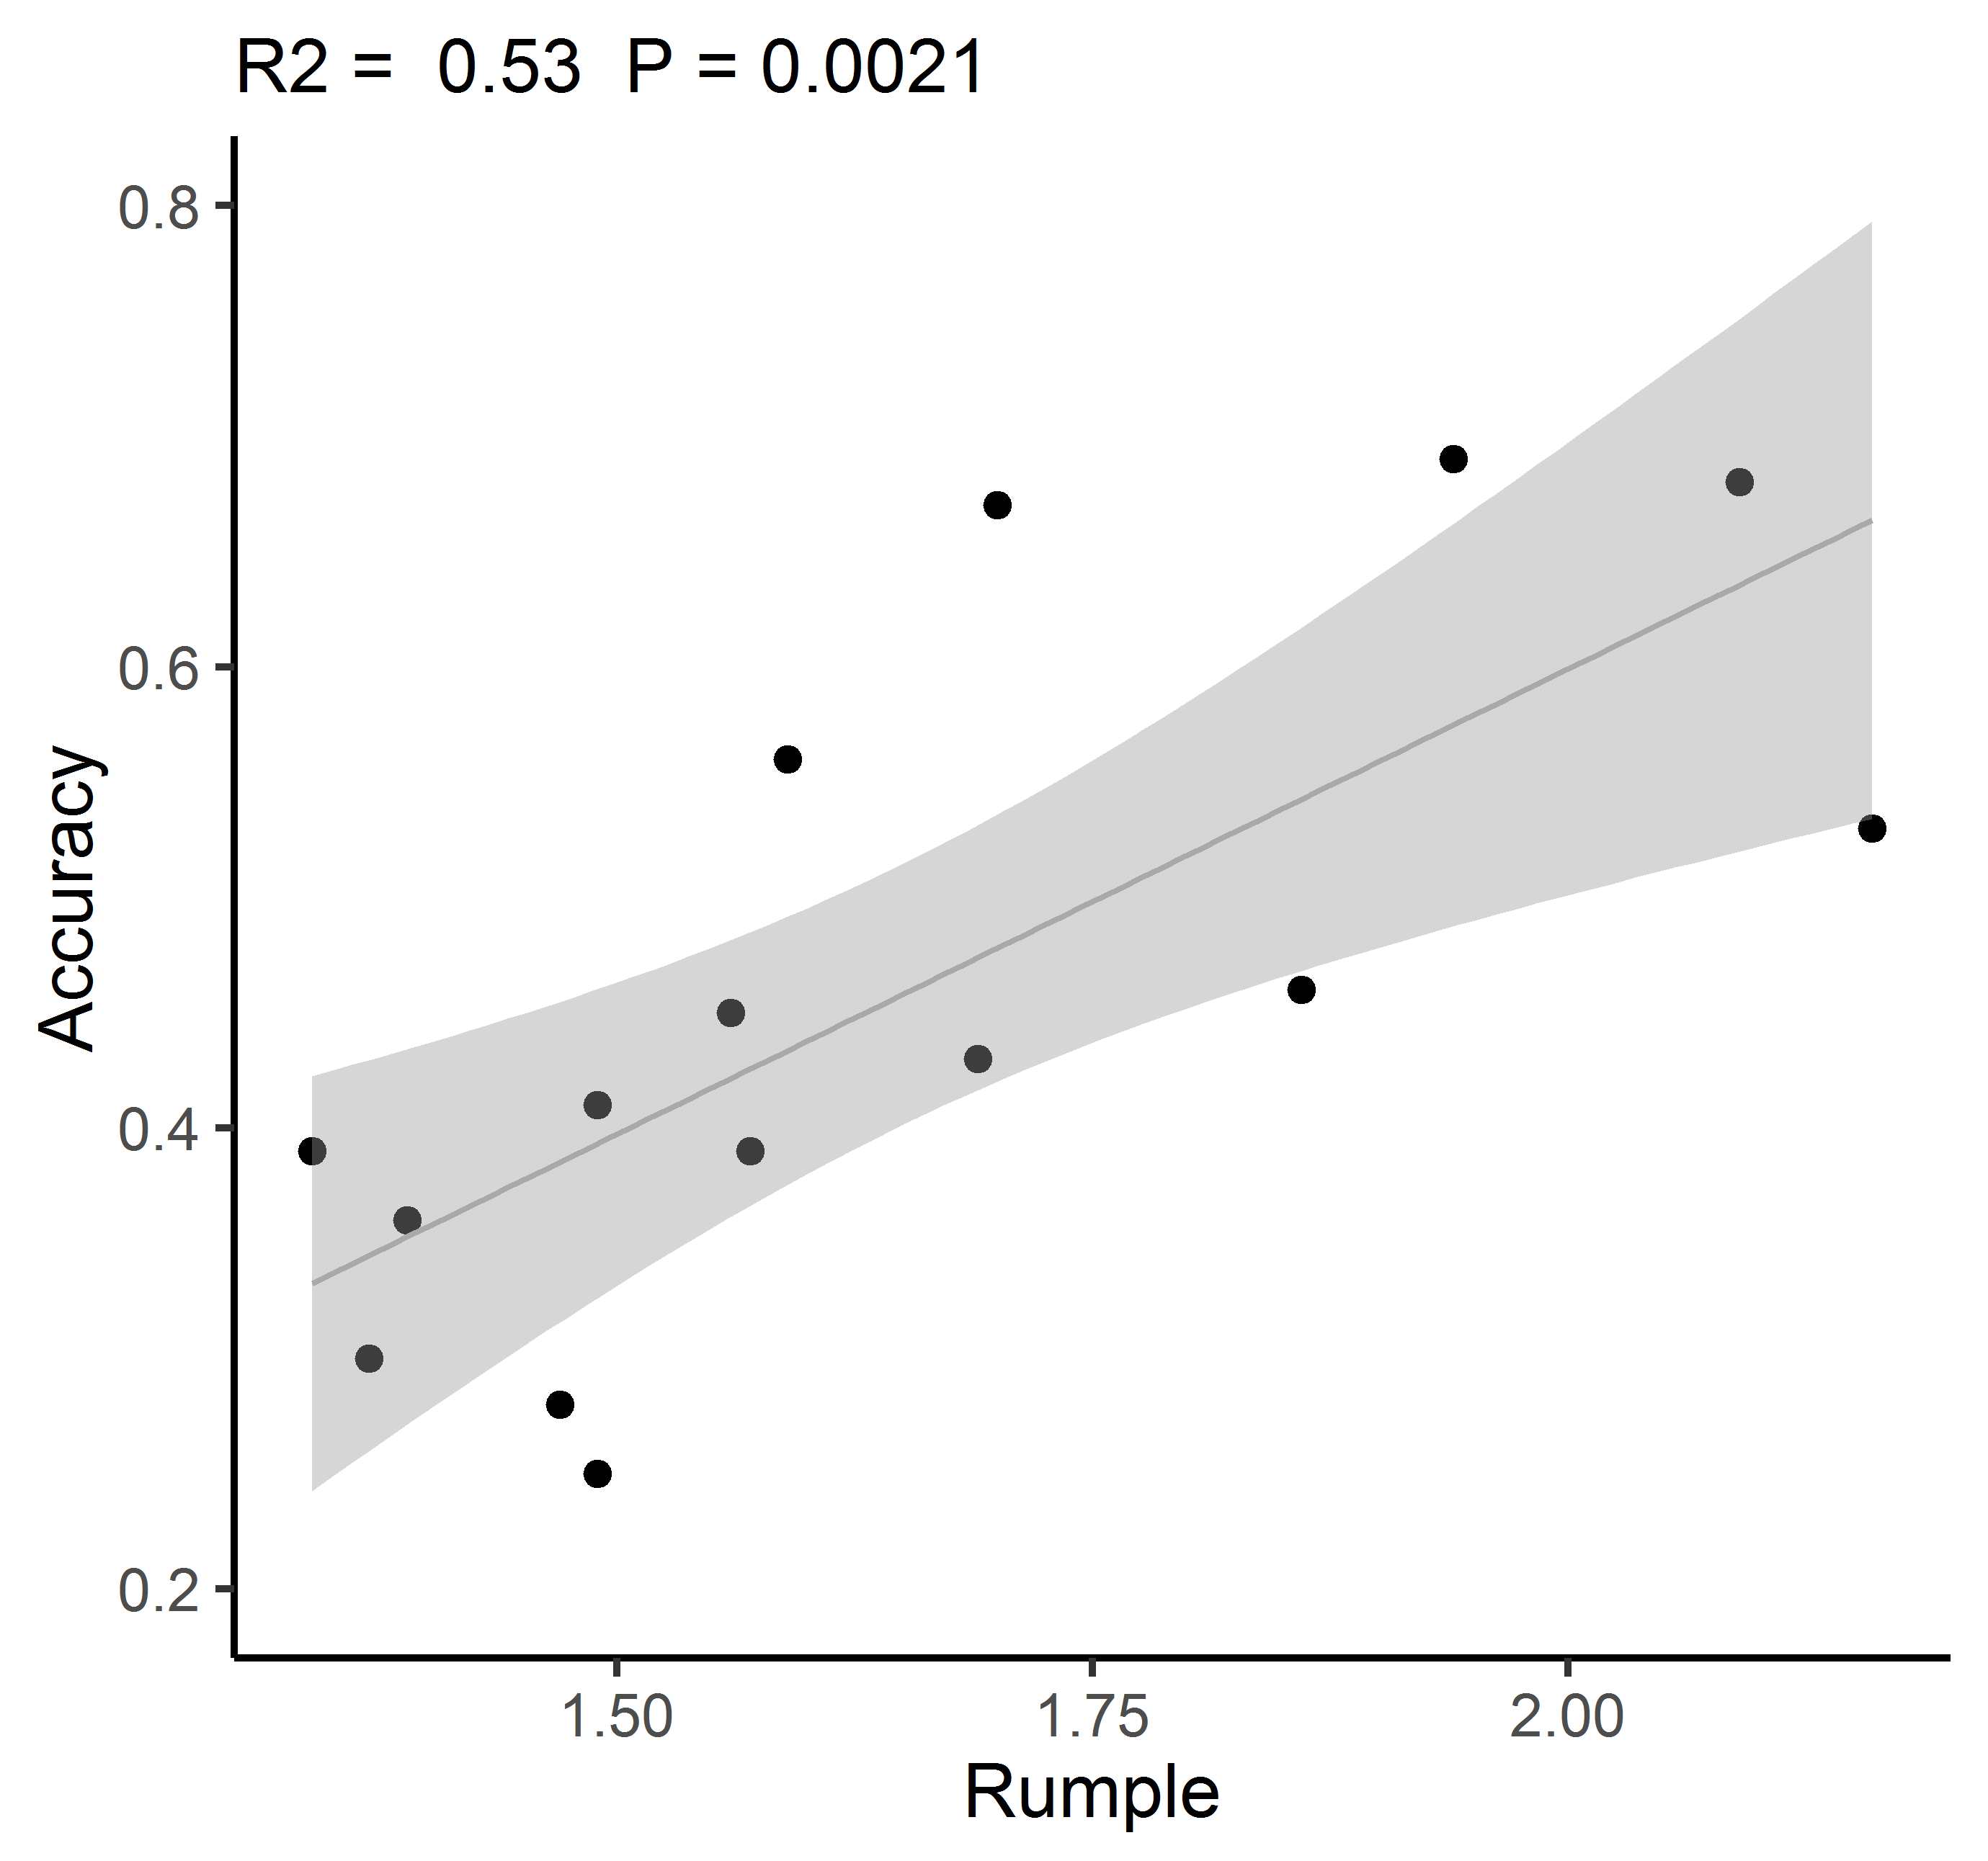
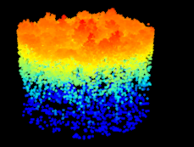
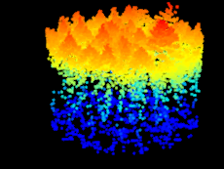
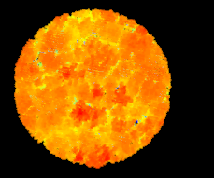
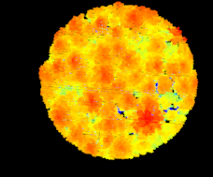
Patterns and processes of biodiversity and ecosystem function in forests
S. Ollinger, K. Baillargeon, J. Hastings, A. Ouimette, R. Sanders-DeMott, F. Sullivan, M. Palace, J. Xiao
Earth Systems Research Center, University of New Hampshire, Durham, NH 03824
Support from NSF’s Macrosystems Biology Program (grant # 1638688)
Introduction and rationale
Why should diversity matter?
The question of how biological diversity influences ecosystem function has been an active topic for decades, but relatively few studies have been conducted in forests and even fewer have addressed broad-scale land-atmosphere exchange.
We are addressing this need by pursuing the following questions:
1. Does biodiversity in forests influence broad-scale patterns of land-atmosphere exchange of carbon, water and energy?
  Here, we examined the influence of tree diversity on fluxes of carbon and water and resistance to environmental change at 61 forested sites across the U.S. and Canada using data from FLUXNET2015 and the AmeriFlux network
2. To what extent can spatial patterns of tree diversity in forests be mapped using remote sensing?
  On an individual tree basis; we test the ability to delineate individual tree crowns at the Harvard Forest, MA using LiDAR-baser approaches, and classify species using airborne hyperspectral and LiDAR remote sensing
3. What information do various metrics of tree diversity convey and what remote sensing measurements are relevant to each?
  Through general reflectance properties; we test the ability to estimate different metrics of biodiversity (e.g. species, structural, functional, phylogenetic) from hyperspectral remote sensing and LiDAR and examine how different metrics relate to one another.
Figure 2. Diversity-stability hypothesis: During times of stress, diverse ecosystems are more likely to contain at least some species that are suited to withstand or exploit a given set of conditions.
Figure 1. Resource acquisition hypothesis: All plant growth strategies involve tradeoffs among resource acquisition and/or stress tolerance. In theory, diverse plant communities should exploit resources more thoroughly.
Q1. Tree diversity and land-atmosphere exchange
Figure 6. Foliar nitrogen (percent by leaf mass) in relation to Shannon’s diversity index. If the analysis shown in Fig. 5 is conducted without foliar N data included, species diversity emerges as a consistent predictor of GPP. With foliar N data included, the diversity effect was weaker and limited to summer months.
We examined the influence of tree diversity on fluxes of carbon (C) and water (H₂O) and at 61 AmeriFlux sites across the U.S. and Canada where eddy flux data could be combined with a unique assemblage of stand-level measurements, ecophysiological variables and micrometeorology.
We constructed a data set of carbon and water fluxes using standardized partitioning methods for gap filling missing time periods.
Shannon’s diversity index (H) was calculated from canopy point quadrat sampling or inventory data.
Other data included micrometeorology, canopy %N, biomass & stand age.
Resulting data set included 61 sites and 4825 months of data from 1991 to 2018.
Diversity effect on daily and monthly GPP and ET was assessed through stepwise regression with all other driving variables included.
Sites with 5 or more years of data were also used to test the hypothesis that more diverse sites should experience less interannual variability.
Figure 7. The best-fit models from figure 5 fluxes explained 72% of the variation in monthly GPP and 65% of the variation in monthly ET. Contrary to expectations, diversity did not dampen interannual variability in GPP or ET, but was weakly and positively correlated to both variables.
Figure 3. Location of AmeriFlux sites that met data quality standards and where sufficient ancillary biological data were available.
R² = 0.72
H = 1.39
H = 0.71
Conclusions to date:
The absence of a consistent diversity effect on GPP or ET was due to a strong influence of foliar nitrogen on and a positive underlying relationship between foliar N and species diversity.
This suggest that studies of diversity effects on productivity in forests should consider the potential underlying influence of foliar N and other variables related to photosynthesis and site fertility, variables that have not been well characterized in previous studies involving forests.
s = number of species present
Figure 5. Models of monthly GPP and ET, aggregated seasonally and annually. Earlier findings showing a strong diversity effect were not observed here, largely due to the inclusion of data for foliar nitrogen and a strong positive correlation between foliar N and diversity (Fig 6.)
p_{i} = prop. of s made up of the ith species
Figure 4. Calculation of Shannon’s diversity index (H), which combines species richness and abundance.
Q2. Individual Tree Crown Mapping and Identification
Q3. Estimating Biodiversity with Hyperspectral Imagery
Here, we assessed the degree to which individual-based tree identification is possible. We use detailed tree data from the Harvard Forest in Central Massachusetts, and high resolution hyperspectral and LiDAR airborne remote sensing collected by the NEON Airborne Observation Platform (AOP) and NASA Goddard’s LiDAR, Hyperspectral and Thermal Imager (G-LiHT).
In addition to assessing the feasibility of performing tree-level identification, we examined an indirect approach to estimate diversity from high resolution data collected by the NEON AOP. Here, we tested the degree to which three metrics of diversity (species, functional, structural) can be predicted from hyperspectral imagery by comparing inventory-based calculations of diversity to remote sensing indices.
1.
2.
A.
a
B.
b
C.
c
D.
d
Figure 11: We calculated multiple common remote sensing indices. This figure shows Harvard Forest displayed in a) true color, b) shortwave- infrared (SWIR-VI),
c) normalized difference vegetation index (NDVI), and d) blue green pigment index (BGI).
3.
4.
A.
B.
Figure 12. (right) We clustered similar remote sensing indices together using a Principal Component Analysis. Clusters are based on the strength of the correlations between variables. Indicators are the most representative index of each cluster.
Figure 8. (A) We evaluated five automated crown delineation routines by comparing them against manual delineations. Crowns were categorized based on overlap: 1) over-segmentation 2) correct delineation 3) missed delineation 4) under-segmentation. (B) Example categorization of one automated delineation method showing that deciduous trees were often less accurately delineated.
1
2
Figure 13. (below) A Partial Least Squares Regression was performed to explore the predictability of the three biodiversity metrics from hyperspectral imagery.
Biodiversity Metrics | Predictors | Number of Factors | % Variation Predicted | Number of VIPS >0.8 | Greatest VIP’s
Species Diversity | All | 9 | 57.77 | 193 | SWIR-VI_mean; NDI3_sd
 | Indicators | 15 | 46.96 | 15 | NDVI_mean; DWSI1_mean
 | Clusters | 7 | 46.51 | 14 | Cluster 8; Cluster 5
Functional Diversity | All | 10 | 58.53 | 176 | SWIR-VI_mean; NDVI_mean
 | Indicators | 13 | 49.88 | 14 | NDVI_mean; GEMI_mean
 | Clusters | 13 | 49.35 | 15 | Cluster 5; Cluster 1
Structural Diversity | All | 11 | 52.12 | 144 | PRI_mean; BGI1_mean
 | Indicators | 15 | 36.59 | 16 | BGI2_mean; HI_mean
 | Clusters | 14 | 35.07 | 17 | Cluster 11; Cluster 22
A.
B.
Figure 9. (A) Plot-level accuracy is related to canopy structure, as estimated by rumple index (canopy surface area: ground area) (B) LiDAR point clouds showing (1) a typical deciduous dominated stand with low canopy rumple, and (2) a typical conifer dominated stand with high canopy rumple.
 | black birch | hemlock | red maple | red oak | red pine | spruce | white pine
black birch | 12 | 1 | 0 | 0 | 0 | 0 | 0
hemlock | 0 | 53 | 0 | 0 | 0 | 3 | 1
red maple | 2 | 0 | 40 | 1 | 0 | 0 | 0
red oak | 1 | 0 | 3 | 29 | 0 | 0 | 0
red pine | 0 | 0 | 0 | 0 | 29 | 0 | 1
spruce | 0 | 0 | 0 | 0 | 3 | 20 | 0
white pine | 0 | 1 | 1 | 0 | 1 | 1 | 30
Conclusions to Date:
Our results show that combining remotely sensed spectral and LiDAR metrics improves the classification (>90%) of species due to distinct species-specific structural characteristics. Despite our success in classifying the identity of pre-delineated tree crowns, automated detection of individual tree crowns using standard LiDAR-based approaches remains difficult and unreliable (<50% overall accuracy).
Conclusions to Date:
Results show that ~47% of the variation in species and functional diversity can be predicted using the Normalized Vegetation Index (NDVI) while ~37% of the variation in structural diversity can be predicted with BGI. The presence of common predictors for both species and functional diversity suggest the possibility of using one indicator to represent several forms of similar diversity metrics. Further research needs to be conducted to explore the specifics of the indices that make them the best predictors for these diversity metrics.
Figure 10. We classified manually delineated crowns using hyperspectral and LiDAR data. The combined data approach achieved an overall accuracy of 91.5%.
Acknowledgements: We gratefully acknowledge AmeriFlux data contributors for flux data, David Orwig at the Harvard Forest for georeferenced tree inventory data, David Basler for drone imagery, the staff at NEON for help with NEON AOP data, and the staff at NASA for help with G-LiHT data.

